Slide 1
Culture and Diffusion

Slide 2
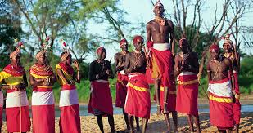
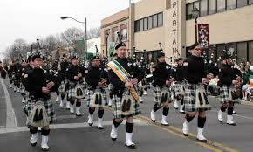
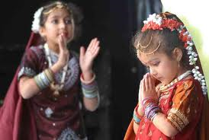
WHAT IS CULTURE??

Slide 3
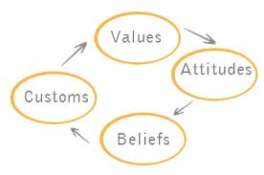
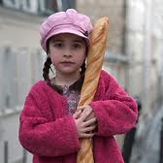
Culture
All-encompassing term that identifies not only the whole tangible lifestyle of peoples, but also their prevailing values and beliefs
Cultural trait – a defining characteristic that is shared by most,
if not all, members

Slide 4
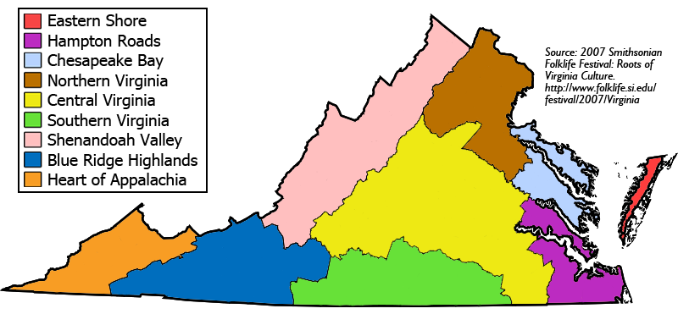
Culture cont.
Culture Region – A region defined by key recognizable culture traits in which the people are aware of their heritage

Slide 5
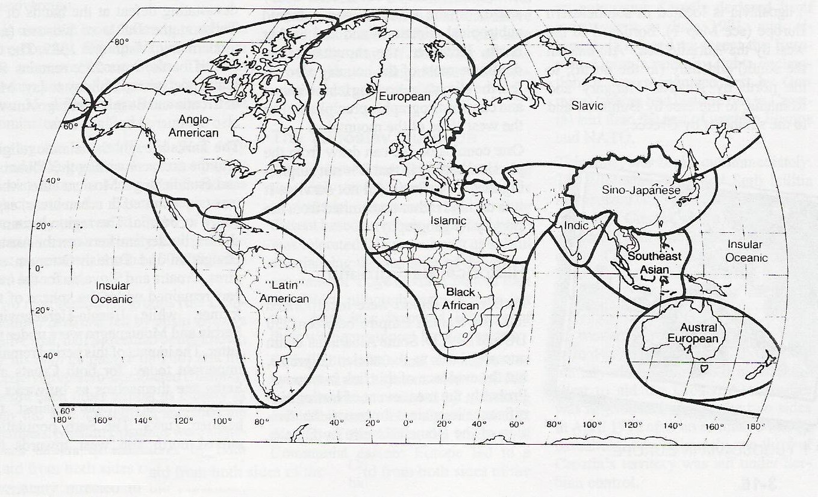
Culture Realm – A grouping of culture regions

Slide 6
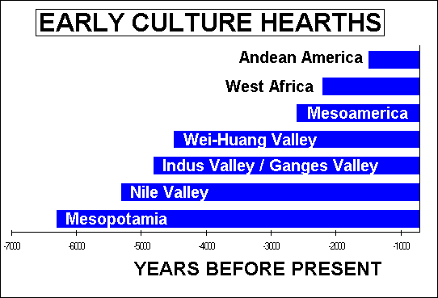
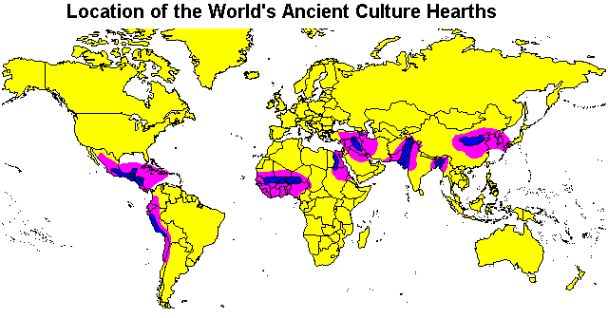
Culture Hearths
Earliest sources of civilization
Radiated ideas, innovations,
and ideologies that would
change the world & continue to influence it today
Developed in Eurasia, Africa & Americas

Slide 7
Connectedness
Diffusion: process of dissemination, the spread of an idea or innovation from its hearth to other areas

Slide 8
Types of Diffusion
Expansion Diffusion: idea/innovation spreads outward from hearth
~Contagious Diffusion: spreads adjacently (like the flu)
~Hierarchical Diffusion: spreads to most linked people or places first

Slide 9
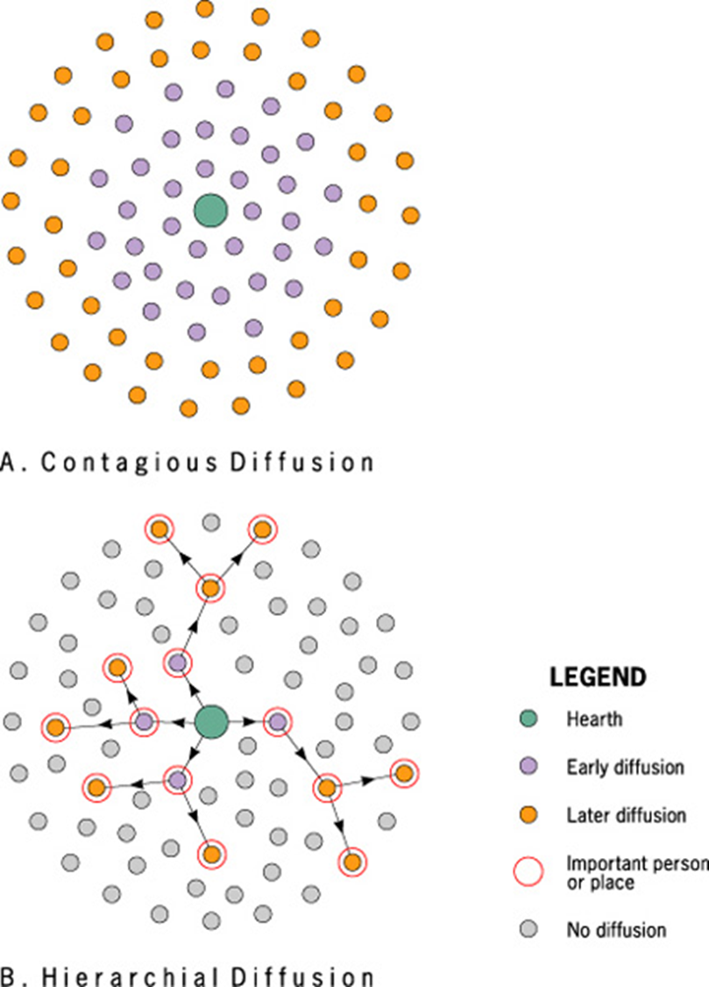

Slide 10
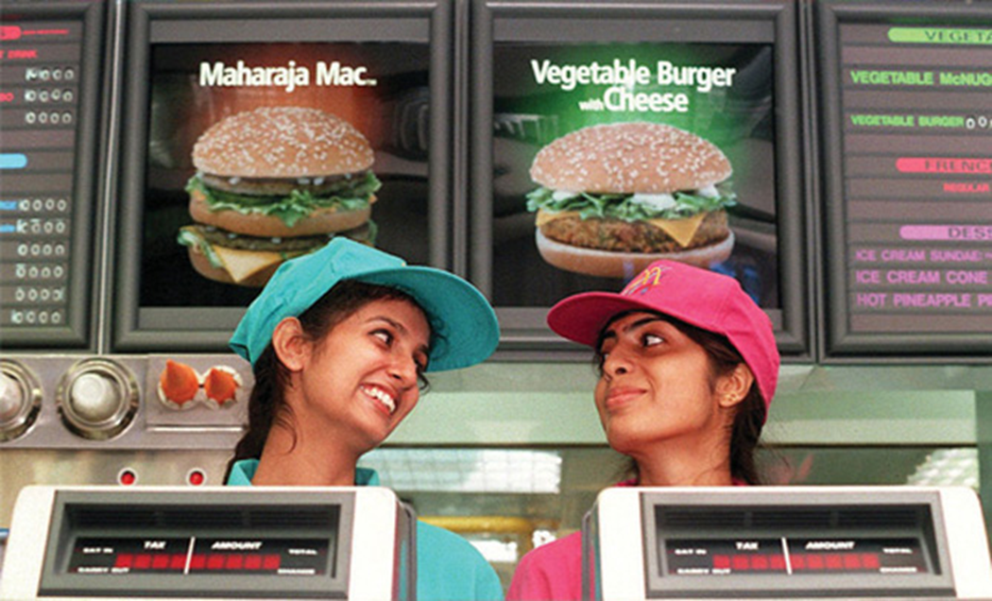
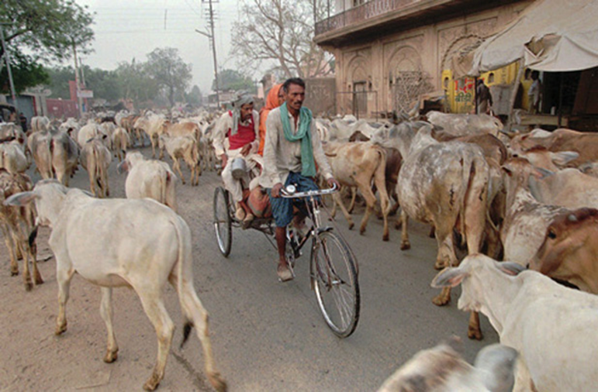
Types of Diffusion cont.
~Stimulus Diffusion: idea promotes a local experiment or change in the way people do things

Slide 11
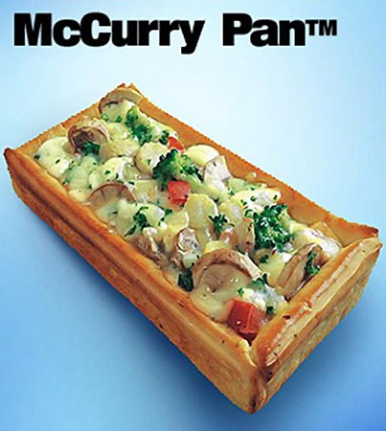
McDonald’s in India

Slide 12
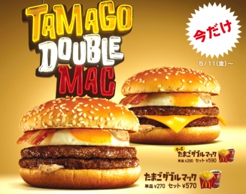
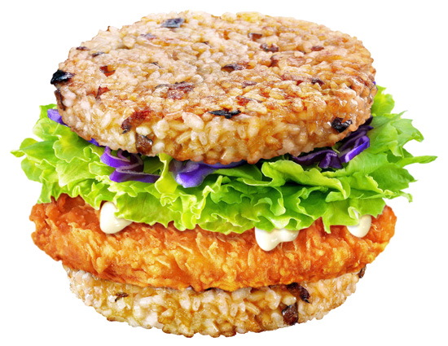
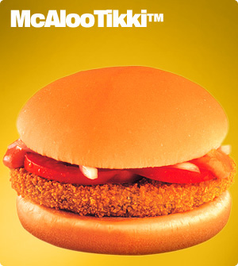
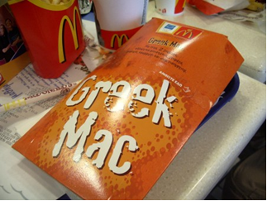
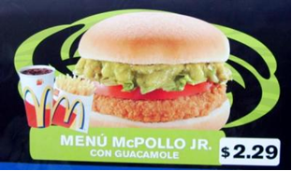

Slide 13
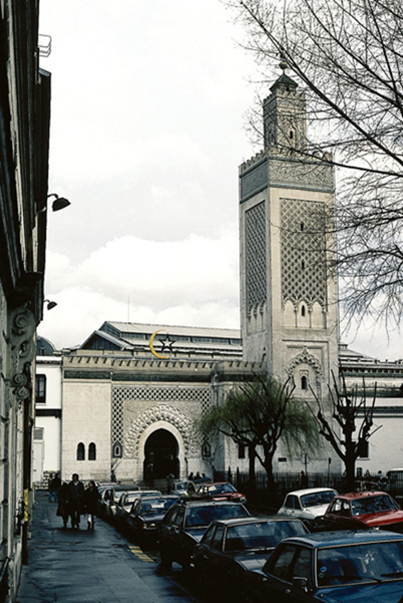
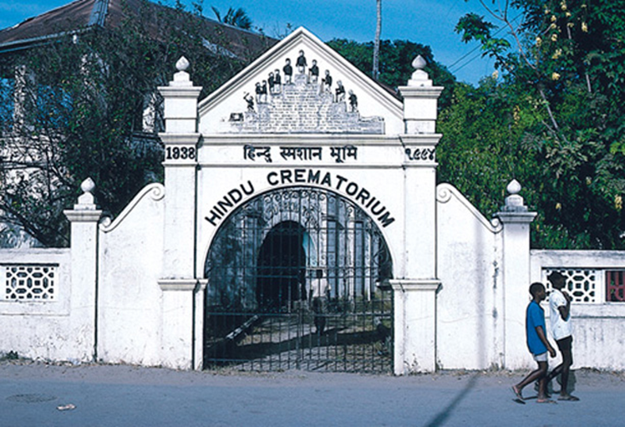
Cultural Diffusion cont…
Relocation Diffusion: movement of individuals who carry an idea or innovation with them to a new, perhaps distant locale
Paris, France
Kenya

Slide 14
Barriers to Diffusion
Time and Distance decay:
the further an innovation is from its source or the longer it takes to reach particular adopters, the less likely it is to be accepted & adopted

Slide 15
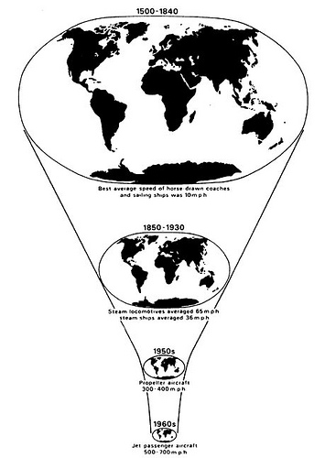
Barriers to Diffusion cont..
Importance of tech. in the speed of diffusion: as we become more tech. advanced, diffusion rates increase

Slide 16
Barriers to Diffusion cont..
Cultural Barriers: language, religion, history, etc.
Physical Barriers: isolation because of oceans, mountains, climate etc.

