Slide 1
Unit One: Basic Skills of
Geography

Slide 2
Location
Location: Where something is
Absolute Location
Describes the exact location of a place.
Often described using Latitude and Longitude or an exact address (14051 Spriggs Rd.)

Slide 3
Location
Relative Location
Describes where a place is in relation to something else.
Ex: Hylton is between Bloom & Saunders Middle School

Slide 4
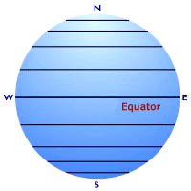
Latitude
--measured north or south of the equator;
are also called parallels

Slide 5
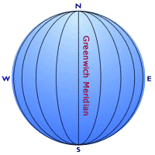
Longitude
--measured east or west of the Prime Meridian; are also called meridians
0º

Slide 6
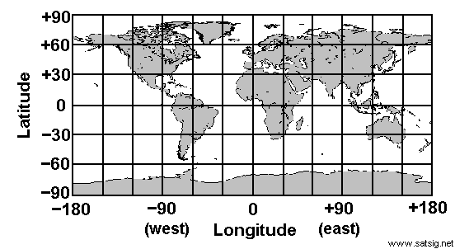
The Global Grid: Using Latitude and Longitude
Coordinates
Every measurement using latitude and longitude has a set of coordinates.
One coordinate will be for degrees latitude north or south of the equator
Ex: 30º North lat. is this line
30º South lat. is this line
The other coordinate will be degrees east or west of the Prime (Greenwich) Meridian
Ex 30 º East Longitude is this line
30 º West Longitude is this line
Put the two together and you have a location
Ex: 30 ºN, 30 ºE
Latitude should always be listed first. Your north/south will be before your east/west coordinate.

Slide 7
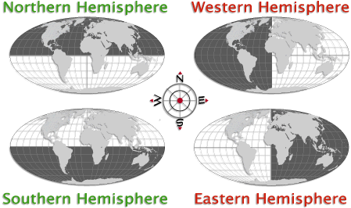
Hemispheres
Hemisphere (part or half of the world)
The earth is divided into 4 hemispheres: North, South, East, and West.
We live in Northern and Western Hemispheres
Summer in N. Hemisphere =
Winter in S. Hemisphere
No change in btwn.
E. & W. for seasons

Slide 8
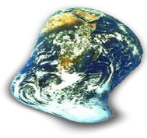
Map Projection
Whenever we attempt to take a round globe and make it flat, we run into a problem.
It is impossible to take a round Earth and make it look flat without stretching or “messing up” part of the earth.
This part that gets messed up is called:
Distortion

Slide 9
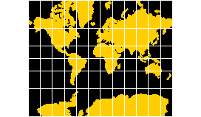
Distortion
There are several ways that a map can be distorted:
Shape:
The shape of the landmasses change
Area:
The size of the landmasses change
Distance:
The distances btwn the landmasses change
The directions between the landmasses change
Direction:

Slide 10
Orientation
Compass Rose
North
Which way is up??
Maps will usually give you a way to determine orientation.
This may be a single direction arrow or a compass rose.
NE
NW
East
West
SE
SW
South

Slide 11
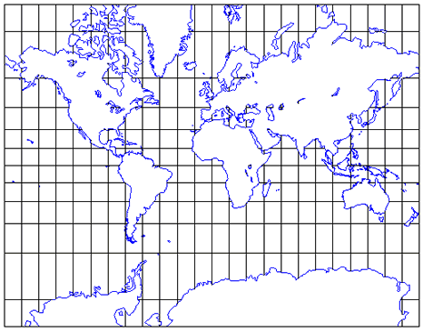
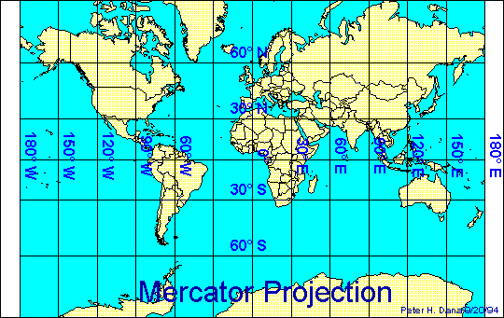
Mercator Projection
-- distorted greatly at the poles and is least distorted near the equator. (ex: Greenland is huge compared to South America)
-- useful for ship navigation bc direction is accurate.

Slide 12
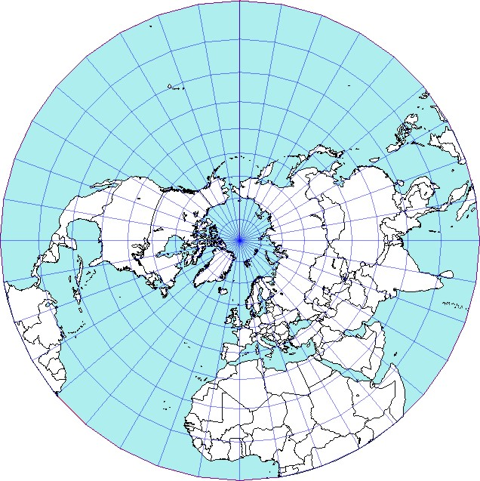
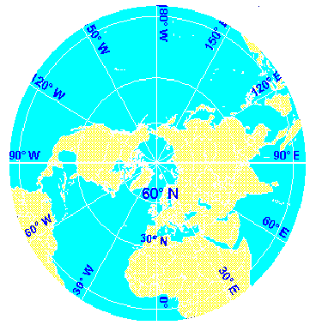
Polar Projection
-- major problem = does not show all of the earth at one time.
-- useful for airplane navigation bc distance is shown correctly

Slide 13
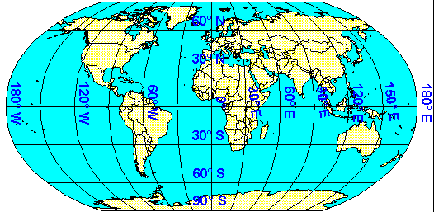
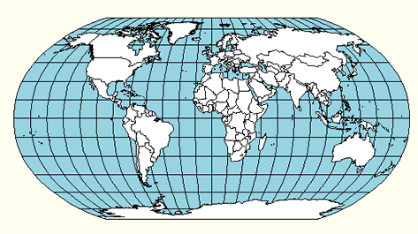
Robinson Projection
-- most commonly used map
-- minimizes distortion
-- used most often for data representation bc it has minimal distortion.

Slide 14
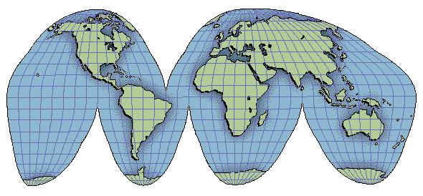
Interrupted Projection
-- Shows correct sizes and shapes of landmasses by cutting out parts of oceans
-- Impossible to measure distances accurately

Slide 15
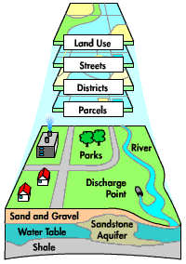
Information can come from a variety of Geographic Sources
GIS - Geographic Information Systems
collects info. from a variety of sources and compiles it by computer into useful forms.

Slide 16
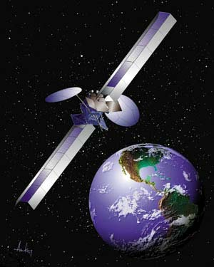
Information can come from a variety of Geographic Sources
Satellite Images
Images taken from space used for:
Weather
Cartography
Defense

Slide 17
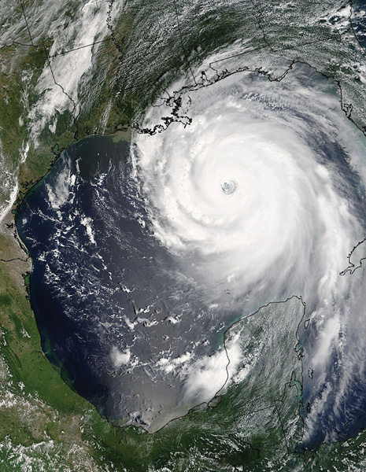
Aerial Photography &
Remote Sensing

Slide 18
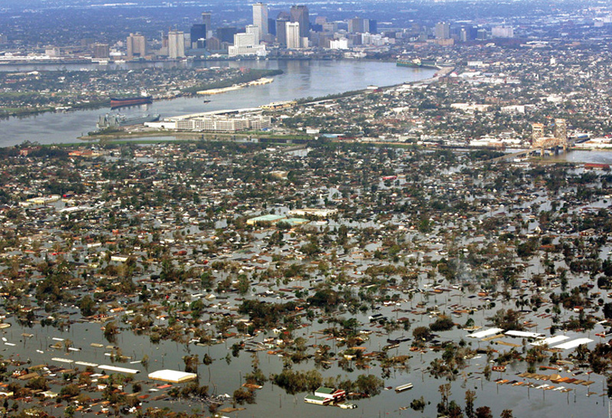

Slide 19
Isoline

Slide 20
Isoline - Contour

Slide 21
Dot map

Slide 22
Choropleth

Slide 23
Cartogram

