Slide 1
‘WINNING’ THE FRQS
That’s ‘winning’ NOT ‘whining!’ ☺

Slide 2
THE FIRST TYPE – DIG IN!
Part A is designed to pull you in.
Usually a definition or description of a geographical concept, theory, or vocabulary word.
A. Define the following concepts as they apply to human geography
Nation
State
Nation-state

Slide 3
THE FIRST TYPE – DIG IN!
Part B - examples/explanation!
Make sure they are real-world and as specific as possible
“Many poor countries” – NO
“Countries of Sub-Saharan Africa” – mayyyybe
“Swaziland and Malawi in Sub-Saharan Africa” – YES!
B. For each of these concepts, give a specific late-20th century nation from Region A in the map above.

Slide 4
THE FIRST TYPE – DIG IN!
Part C (sometimes) – Use or apply the definitions or examples
Be thorough!
C. Explain how the pursuit of the nation-state ideal in recent decades has led to conflicts in the regions above.

Slide 5
THE SECOND TYPE - CONNECTIONS
All parts are connected
Can have A – D
The A – D all refer back to the initial statement.
In the 1990’s the central business and residential districts of cities in the US began a revitalization process. Discuss how each of the following has contributed to this process.
A. Economic factors
B. Demographic composition
C. Urban policy
D. Sense of place
Remember, don’t just define here – DISCUSS! This means explanations, examples, reasons why and how, etc…

Slide 6
THE THIRD TYPE – CRITICAL THINKING
Many of these will combine units/chapters
Think of this as WEAVING – not answering each letter in isolation
Remember when you were told to use AP vocabulary within another definition? Here’s where to do it!
The picture above shows a customer call center in a small town in Arkansas. The building once housed an automotive parts manufacturing plant.
A. Identify two reasons why businesses would choose to locate their call centers in small southern towns.
B. Discuss three disadvantages in the use of call centers as a local economic development strategy.

Slide 7
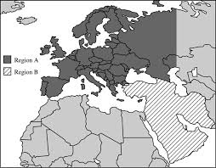
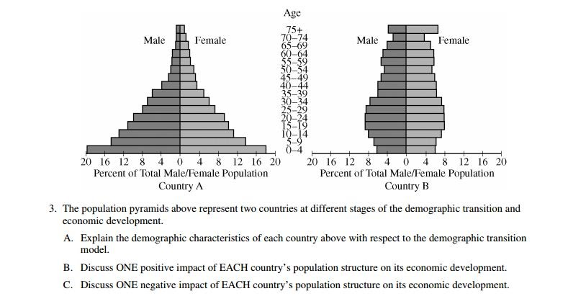
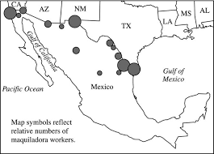
AT LEAST 1 WILL HAVE A GRAPH, CHART, MAP OR PICTURE

Slide 8
AP = ANSWER THE PROMPT (WELL NOT REALLY, BUT…)
You can write a novel, but if the answer’s not there, no one will give you mercy points!
Know thy verbs!
Explain, identify, discuss, define & describe are the most common. They sound the same, but are different!
Notes:
Explain - make (an idea, situation, or problem) clear to someone by describing it in more detail or revealing relevant facts or ideas.
Identify - establish or indicate who or what (someone or something) is.
Discuss - talk or write about (a topic) in detail, taking into account different ideas and opinions.
Define - state or describe exactly the nature, scope, or meaning of
Describe - give an account in words of (someone or something), including all the relevant characteristics, qualities, or events.

Slide 9
Which of the following best identifies Von Thunen’s theory of rural land use?
A) This model shows the location of land uses in the past and how the distribution of certain crops shifted with changing transport costs. Today, distances are shorter, so many items can be shipped in refrigerated trucks, but a number of perishable products are still grown close to the city.
B) Von Thunen’s land-use model consists of multiple rings which are 1) dairying and market gardening, 2) specialty farming, 3) cash grain and livestock, 4) mixed farming, 5) extensive grain farming or stock raising.
C) Von Thunen’s land-use model consists of multiple rings which are 1) dairying and market gardening, 2) specialty farming, 3) cash grain and livestock, 4) mixed farming, 5) extensive grain farming or stock raising. Von Thunen’s model recognizes that as distance from market increases, the value of land decreases. The most intensively produced crops are found on land close to the market; the less intensively produced commodities are located at more distant points.
D) Von Thunen’s land-use model pertains to agriculture and Burgesses model pertains to urban forms.
E) Organic fresh fruit is grown close to market because of restrictions on the use of preservatives or other modifications that may create a longer ripeness.

Slide 10
Which of the following accurately assesses Von Thunen’s theory of rural land use?
A) This model shows the location of land uses in the past and how the distribution of certain crops shifted with changing transport costs. Today, distances are shorter, so many items can be shipped in refrigerated trucks, but a number of perishable products are still grown close to the city.
B) Von Thunen’s land-use model consist of multiple rings which are 1) dairying and market gardening, 2) specialty farming, 3) cash grain and livestock, 4) mixed farming, 5) extensive grain farming or stock raising.
C) Von Thunen’s land-use model consist of multiple rings which are 1) dairying and market gardening, 2) specialty farming, 3) cash grain and livestock, 4) mixed farming, 5) extensive grain farming or stock raising. Von Thunen’s model recognizes that as distance from market increases, the value of land decreases. The most intensively produced crops are found on land close to the market; the less intensively produced commodities are located at more distant points.
D) Von Thunen’s land-use model pertains to agriculture and Burgesses model pertains to urban forms.
E) Organic fresh fruit is grown close to market because of restrictions on the use of preservatives or other modifications that may create a longer ripeness.
Notes:
Remind them that assess = evaluate

Slide 11
Which of the following accurately explains genetically modified (GM) crops:
A) GM crops played a key role in the Green Revolution by increasing crop yields, but recent gains are falling off due to consumer concerns of environmental impacts.
B) GM crops include soybeans, wheat, and corn.
C) Genetically modified crops (GMCs, GM crops, or biotech crops) are plants used in agriculture, the DNA of which has been modified using genetic engineering techniques.
D) Roundup Ready soybeans and insect resistant crops have been the most important and the most responsible for the significant increase in productivity.
E) GM crops have had their genetic material altered in some capacity and are typically more resistant and hardy to various environmental factors, increasing overall yields. Farmers purchase these seeds from companies like Monsanto.

Slide 12
Which of the following accurately discusses genetically modified (GM) crops:
A) GM crops played a key role in the Green Revolution by increasing crop yields, but recent gains are falling off due to consumer concerns of environmental impacts.
B) GM crops include soybeans, wheat, and corn.
C) Genetically modified crops (GMCs, GM crops, or biotech crops) are plants used in agriculture, the DNA of which has been modified using genetic engineering techniques.
D) Roundup Ready soybeans and insect resistant crops have been the most important and the most responsible for the significant increase in productivity.
E) GM crops have had their genetic material altered in some capacity and are typically more resistant and hardy to various environmental factors, increasing overall yields. Farmers purchase these seeds from companies like Monsanto.

Slide 13
REVIEWING THE FORMAT
Question | Answer
Do I write an opening and closing paragraph? | Nope
Flowery Language Needed? Repeating the question needed? | Nope and Nope!
Can I use bullet points? | Again, NEVER, EVER, EVER, EVER, EVER WRITE YOUR ANSWERS IN BULLET FORM!!
Is it true, “Less is more?” | In the APHG exam, More is More!
What is value-added scoring? | Blah, blah, blah, point, blah, blah, point, blah, blah, blah, blah, point
What does it “mean” to be above the mean? | Like Nike says, “Just do it.!”
Where do I put my thesis statement? | On your WHAP exam NEXT YEAR!
Will they grade my outline notes? | Not if you put them by the question. NOTHING is graded on that page – even if the right answer is there!

