Slide 1
Human Geography: People, Place,
and Culture, 11th Edition

Slide 2
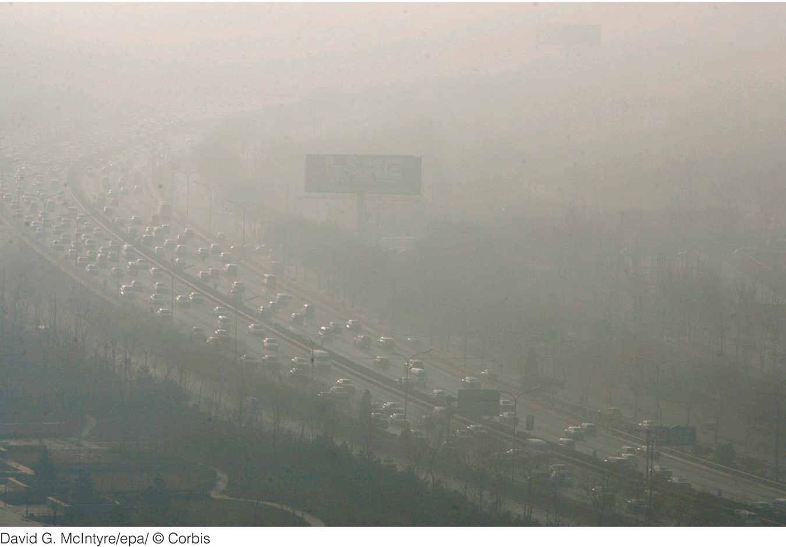
Chapter 13: The Humanized Environment
Notes:
Figure 13.23
Beijing, China. Smog covers the traffi c on
a motorway in the central business districts of
Beijing just a few months before the opening
of the 2008 Olympics in Beijing. © David G.
McIntyre/ epa /Corbis

Slide 3
Key Question: How Has Earth’s Environment Changed over Time?
Humans have always altered their environment.
Now, the combined impact of humanity’s destructive and exploitative actions is capable of producing environmental changes at the global scale.
The twentieth-century surge in the size of the human population, combined with a rapid escalation in consumption, magnifies humanity’s impact on Earth in unprecedented ways.
Anthropocene: the incredible role humans play in shaping Earth’s environment.

Slide 4
Tectonic Plates
Alfred Wegener’s continental drift hypothesis.
Pangaea: supercontinent that broke apart into what we now know as Africa, the Americas, Eurasia, and Australia.
At plate boundaries, tectonic plates either diverge (spread apart), converge (come together) or transform (slide past one another).
Subduction zone: When an oceanic plate converges with a continental plate; earthquakes are common.
Transform plate boundary: two tectonic plates are moving past each other; earthquakes are common.

Slide 5
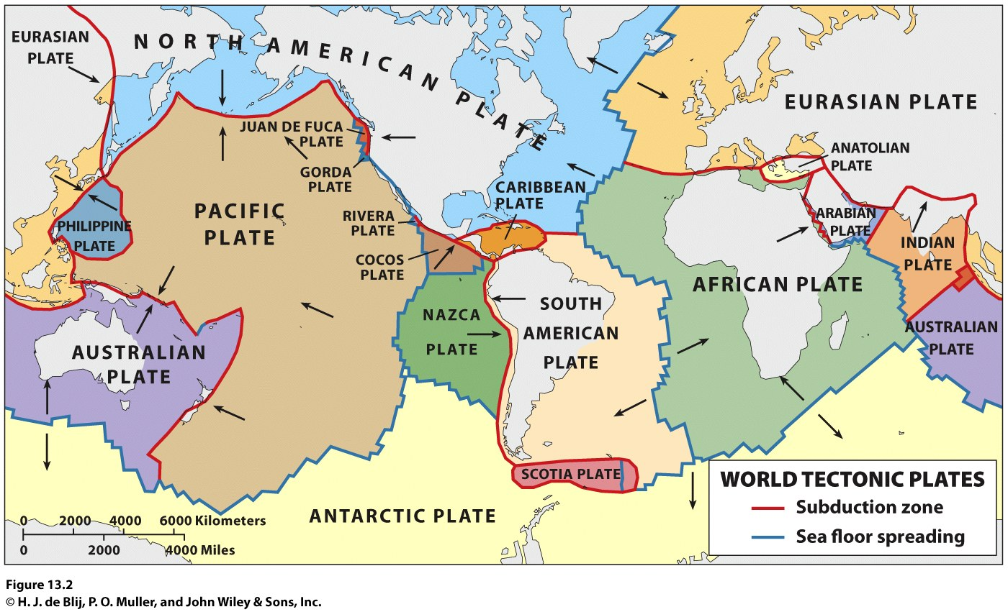

Slide 6
Ocean and Atmosphere
Concept Caching:
Fenway Park, Boston, MA
Earth = the Blue Planet
Several hypotheses exist about the Earth’s acquisition of so much water, including the comet hypothesis.
Uncertainty about how the atmosphere formed.
Photosynthesis: The conversion of carbon dioxide and water into carbohydrates and oxygen through the absorption of sunlight.
The protozoa: the first single celled animals.

Slide 7
Fire and Ice
Volcanic activity has led to mass depletions (loss of diversity through a failure to produce new species).
Volcanic activity has contributed to the three mass extinctions (mass destruction of most species) known to have occurred over the past 500 million years.
Pacific Ring of Fire: an ocean-girdling zone of crustal instability, volcanism, and earthquakes.

Slide 8
Fire and Ice
When Pangaea still was a supercontinent, an Ice Age cooled the Earth and may have contributed to, if not caused, the greatest known extinction crisis in the history of life on Earth.
The Pleistocene epoch was marked by long glaciations and short, warm interglacials.
The Wisconsinan Glaciation left its mark on much of the Northern Hemisphere.
Human communities—fishing, hunting and gathering, and using increasingly sophisticated tools exploited the milder times to expand their frontiers, then hunkered down when it got cold again.

Slide 9
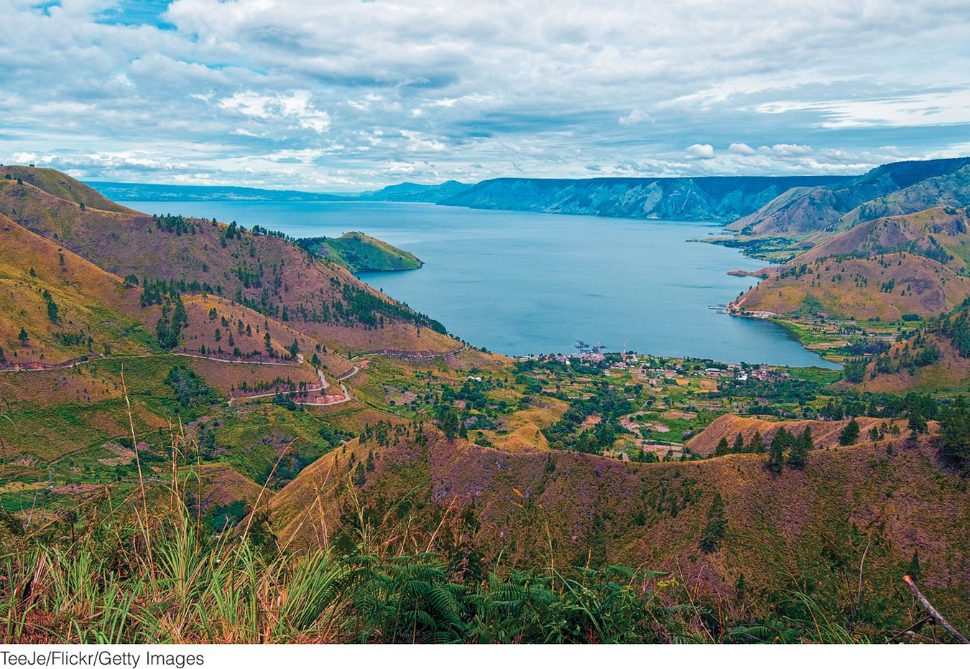
Figure 13.8
Mount Toba, Indonesia. The lake in this photo fi lls in the gigantic caldera left from the
eruption of Mount Toba on the island of Sumatra in Indonesia.
Notes:
Figure 13.7
Mount Toba , Indonesia. The lake in this
photo fills in the gigantic caldera left from
the eruption of Mount Toba on the island of
Sumatra in Indonesia. © TeeJe/Flickr/Getty Images .

Slide 10
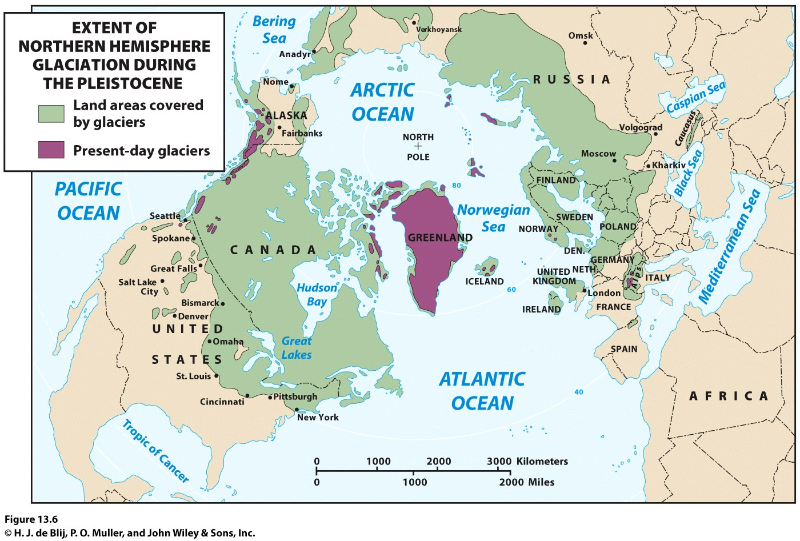
Fire and Ice
Wisconsinan Glaciation eventually gave way to a full-scale interglacial, the current warm interlude that has been given its own designation, the Holocene.

Slide 11
The Little Ice Age in the Modern Era
The Little Ice Age helps explain why the Jamestown colony collapsed so fast.
The Jamestown area experienced a seven-year drought between 1606 through 1612.
April 5, 1815, the Tambora Volcano on the island of Sumatra erupted.
The island’s entire population of 12,000 was killed (26 survived).

Slide 12
The Little Ice Age in the Modern Era
What causes alternating cycles of global warming and cooling?
How large is the human contribution to the associated greenhouse effect (that results when greenhouse gases trap heat and raise temperatures)?

Slide 13
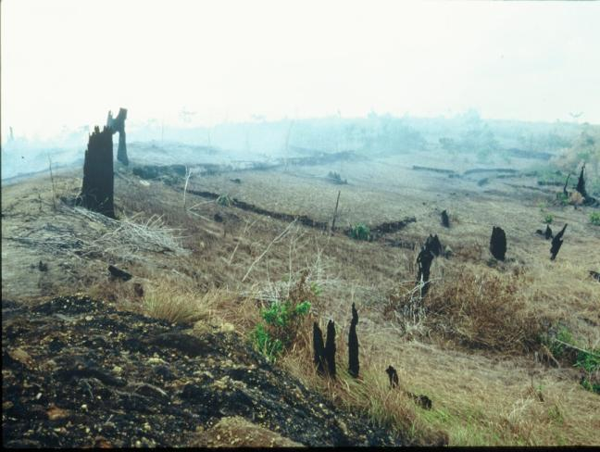
Key Question: How have humans altered Earth’s environment?
Environmental stress: natural environment is being modified and stressed by human activity.
Concept Caching: Forest Fires/Borneo
Concept Caching:
Deforestation in Para, Brazil
© Barbara Weightman

Slide 14
Water
Renewable resources are replenished even as they are being used, e.g., water.
Nonrenewable resources are present infinite quantities.
Water-holding rocks called aquifers provide millions of wells with steady flows.
In many areas of the world, people have congregated in places where water supplies are insufficient, undependable, or both.

Slide 15
Water
Nearly three quarters of all the fresh water used annually is consumed in farming, not in cities
Industries use another 20 percent of the world’s water supply, contributing heavily to pollution when the used water is returned to streams, lakes, and aquifers
Hydrologic cycle: where water from oceans, lakes, soil, rivers, and vegetation evaporates, condenses, and then precipitates on landmasses.
Physical geographer Jamie Linton argues that the hydrologic cycle does not take into account the role of humans and culture and the norms of water in arid regions of the world

Slide 16
Water
Water security: When relations between countries and peoples are problematic, disputes over water can make them even worse.
Water and Politics in the Middle East
Water supply is a particularly difficult problem affecting relations among Israel and its neighbors.
The water supply complicates the relationships between Israel and its Palestinian neighbors in the West Bank and Gaza.
The water issue will complicate any hoped-for settlement of territorial disputes among Israel and its neighbors.

Slide 17
Atmosphere
Earth’s atmosphere is a thin layer of air lying directly above the lands and oceans.
Scientists are concerned that human pollution of the atmosphere will result in longer lasting, possibly permanent, damage.
The United States remains the world’s largest per capita leader in terms of pollutants generated.

Slide 18
Climate Change
Atmosphere
Growing populations and increased human activity are having an unprecedented impact on the atmosphere.
An overwhelming majority of climate scientists have concluded that tropospheric pollution from anthropogenic (human) sources is causing the Earth to retain increasing amounts of heat.
Climate change is sometimes called global warming.

Slide 19
Atmosphere
Extreme Weather Events
The Little Ice Age
Atmospheric scientists are investigating the relationship between current changes in the climate and extreme weather events.
Acid Rain
A byproduct of the enormous volume of pollutants spewed into the atmosphere is acid rain.
Although acid rain usually consists of relatively mild acids, it is caustic enough to harm certain natural ecosystems.
The geography of acid rain is most closely associated with patterns of industrial concentration and middle- to long-distance wind flows.

Slide 20
The Land
Deforestation
The destruction of vast tracts of forest
The rate of deforestation worldwide declined in the last decade.
Deforestation has been going on for centuries, and the motivations for defo restation vary vastly.
Soil Erosion
The loss of potentially productive soil to erosion has been called a “quiet crisis” of global proportions.
Soil erosion is caused by a variety of factors:
Grazing livestock destroy the natural vegetation
Dry land is plowed, wind erosion follows
Farmers under pressure can’t leave land fallow

Slide 21
The Land
Waste Disposal
The United States, the world’s largest consumer of resources, is also the largest producer of solid waste.
The number of suitable sites for sanitary landfills is decreasing.
Toxic wastes: the danger is caused by chemicals, infectious materials, and the like.
Radioactive wastes: low-level and high-level radioactive wastes.
Transportation of waste.
The dimensions of the waste-disposal problem are growing and globalizing.

Slide 22
Biodiversity
Biodiversity: the diversity of all aspects of life found on the Earth.
Where is biodiversity most threatened?
Threat of extinction depends on the range of the species, its scarcity, and its geographic concentration.
Human impacts on biodiversity have increased over time.

Slide 23
What is the greatest environmental concern facing the region where you live, and in what other regions of the world is that concern also present? How do differences between your region and the other regions sharing the concern influence how it is understood and approached?

Slide 24
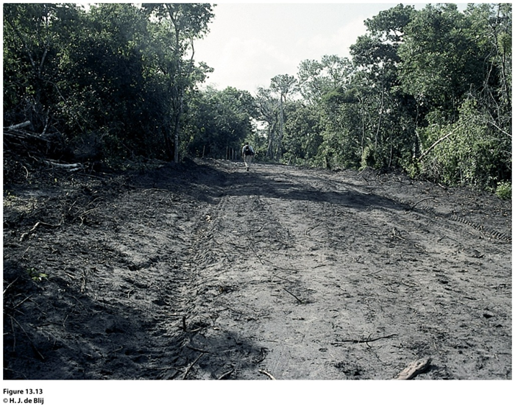
Key Question: What are the major factors contributing to environmental change today?

Slide 25
Political Ecology
Leslie Gray and William Moseley describe the field of political ecology as a way of considering the roles of “political economy, power and history in shaping human-environmental interactions.”
Political ecologists use scale to consider how attempts to affect environmental change, such as deforestation, differ depending on the level of spatial detail used to examine the issue.

Slide 26
Population
More people=More environmental change.
Populations impact Environment differently
Affluent regions and neighborhoods produce a higher demand for consumer goods, etc.
Natural disaster hits:
wealthier area, the place will more likely be hit financially
poorer area, the place will likely be hit by both financial loss and the loss of lives.

Slide 27
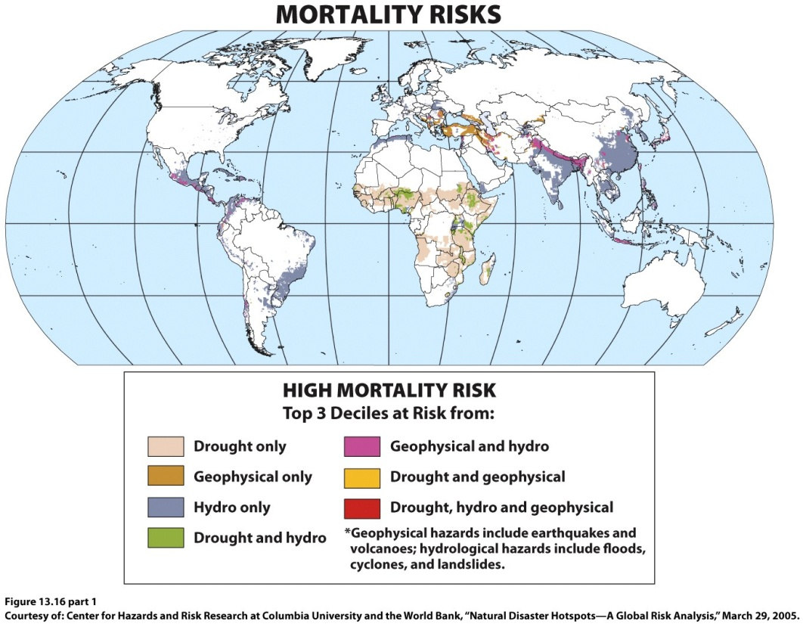
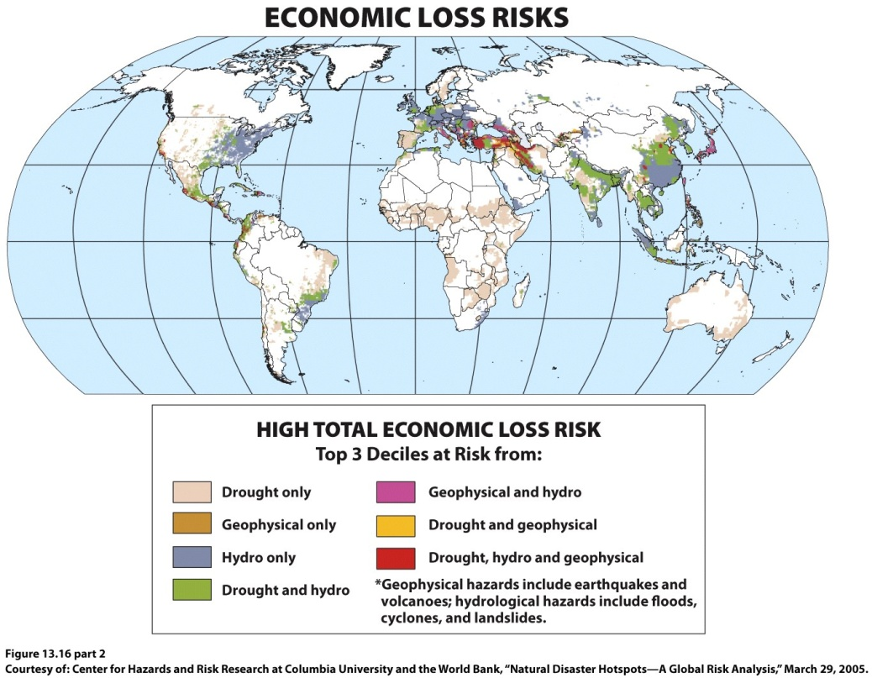
Notes:
Figure 13.16
Natural Disaster Hot Spots. The top map shows the potential mortality risks if major natural
disasters occur in global natural disaster hot spots, and the bottom map shows the potential
economic risks if major natural disa s ters occur in natural disaster hot spots. Courtesy of: Center
for Hazards and Risk Research at Columbia University and the World Bank, “Natural Disaster
Hotspots—A Global Risk Anal y sis,” March 29, 2005.

Slide 28
Patterns of Consumption
Many societies now consume resources at a level and rate that far exceed basic subsistence needs.
People in the ‘core’ make far greater demands on Earth’s resources than do the much larger numbers in the poorer countries.
Globally, consumption is tied to technology.

Slide 29
Industrial Technology
Resource extraction practices such as mining and logging, which provide the materials to produce technologies, have created severe environmental problems.
Technology has enabled humans to alter large portions of the planet in a short period of time.
Impacts include degradation of the oceans, land surfaces, the biosphere, and the atmosphere.

Slide 30
Transportation
Each innovation in transportation has required increased resource use.
Transportation innovations offer access to remote areas of the planet, which in turn have been altered by human activity.
Advances in transportation have produced significant pollution.

Slide 31
Energy
Much of our energy supply comes from nonrenewable fossil fuels, such as coal, oil, and natural gas.
As populations grow, so does the demand for energy.
Oil is a finite resource. The effects of a shift away from oil will certainly be felt to some degree in the industrial and postindustrial countries.

Slide 32
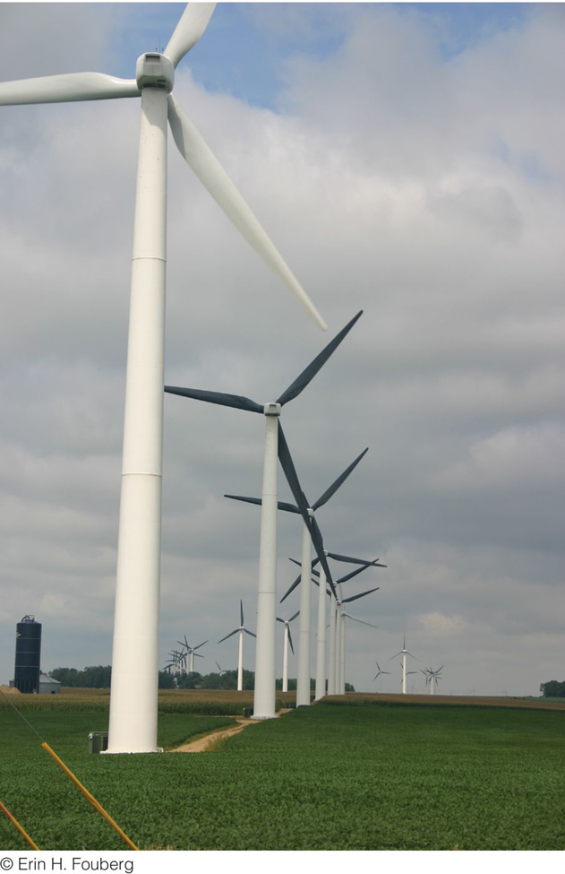
Alternative Energy
Energy
Even alternative energy sources have environmental effects.
At the core of the wind turbines that generate “clean” energy are rare earth minerals, the extraction and processing of which have negative environmental consequences are considered rare earth elements.
Figure 13.19
Lake Benton, Minnesota. The wind park near Lake Benton, Minnesota, was developed beginning in 1994 and now includes more than 600 wind turbines. © Erin H. Fouberg.

Slide 33
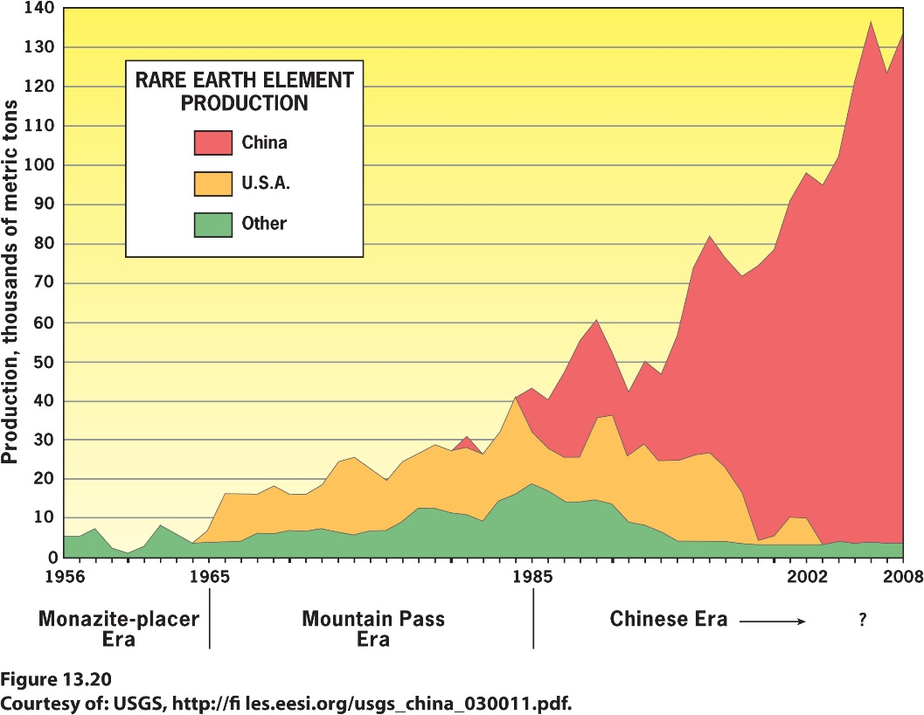
Energy
Alternative Energy
Rare earth elements are in demand because they are used not only in wind turbines but also in alternative energy cars, computers, screens, compact fluorescent light bulbs, cell phones, MRI machines, and advanced weapons systems
The environmental consequences of rare earth element mining have historically been costly enough that production stopped at Mountain Pass Mine in California in 2002
Notes:
Rare earth element production since
1964. Courtesy of : USGS, http://fi les.eesi.
org/usgs_china_030011.pdf

Slide 34
Key Question: What Policies Are Being Adopted in Response to Environmental Change?
A major challenge in confronting environmental problems is that many of those problems do not lie within a single jurisdiction.
With the 1972 United Nations Conference on the Human Environment in Stockholm, international governmental organizations began playing a major role in environmental policy.
United Nations Conference on Environment and Development (UNCED).

Slide 35
What Policies Are Being Adopted in Response to Environmental Change?
The delegates to UNCED gave the Global Environment Facility (GEF) significant authority over environmental action on a global scale.
The GEF funds projects related to six issues: loss of biodiversity, climate change, protection of international waters, depletion of the ozone layer, land degradation, and persistent organic pollutants.
Individual states continue to influence decision making in many ways.

Slide 36
Biological Diversity
The biodiversity convention calls for establishing a system of protected areas and a coordinated set of national and international regulations on activities that can have significant negative impacts on biodiversity.
Also provides funding for developing countries that are trying to meet the terms of the convention.
Has proved difficult to implement.

Slide 37
Protection of the Ozone Layer
The ozone layer is of vital importance because it protects Earth’s surface from the sun’s harmful ultraviolet rays.
Studies revealed that the main culprits in ozone depletion were a group of human-made gases collectively known as CFCs (chlorofluorocarbons).
Vienna Convention for the Protection of the Ozone Layer
Montreal Protocol: 1987; phase-out of production and consumption of CFCs

Slide 38
Global Climate Change
Earth Summit: called on developed countries to take measures aimed at reducing their emissions to 1990 levels by the year 2000.
Kyoto Agreement: set a target period of 2008–2012 for the United States, the European Union, and Japan to cut their greenhouse gas emissions.
Neither the United States nor China, the world’s two largest emitters of carbon dioxide, signed the Kyoto Protocol.

Slide 39
Global Climate Change
The United States continues to be the largest producer of carbon dioxide emissions, per person, in the world.
In 2009, the Copenhagen Agreement endorsed the continuation of the Kyoto Accord by stating that the countries agreeing to the accord will work to keep global temperature increases less than 2 degrees Celsius above preindustrial levels.

Slide 40
Additional Resources
Geography and environmental hazards http://www.bbc.co.uk/scotland/education/int/geog/envhaz/index.shtml
Links on Geography Education
Environment, Tectonics, Anthropocene, Water, Political Ecology, Energy, Climate Change.
Notes:
http://www.bbc.co.uk/scotland/education/int/geog/envhaz/index.shtml

