Slide 1
Human Geography: People, Place,
and Culture, 11th Edition

Slide 2
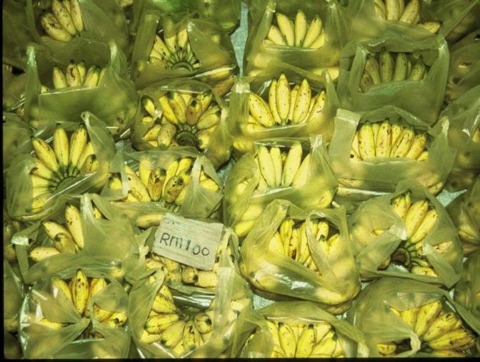
Chapter 11: Agriculture
Concept Caching:
Banana Production-Malaysia
© Barbara Weightman

Slide 3
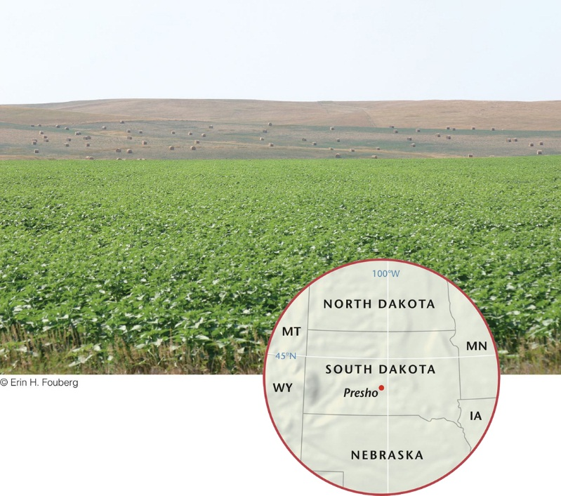
Key Question: What is agriculture, and where did agriculture begin?
Agriculture is the deliberate tending of crops and livestock to produce food, feed, fiber, and fuel.
Primary economic activities: involve the extraction of economically valuable products from the earth (including agriculture, ranching, hunting and gathering, fishing, forestry, mining, and quarrying).

Slide 4
Secondary economic activities: Activities (e.g., manufacturing, construction) that take a primary product and change it into something else.
Tertiary economic activities are service industries that connect producers to consumers and facilitate commerce and trade or help people meet their needs.
Some analysts separate specialized services into quaternary and quinary economic activities, distinguishing between those services concerned with information or the exchange of money or goods (quaternary) and those tied to research or higher education (quinary).

Slide 5
Agricultural Labor: In the United States, less than 2 percent of the workforce is involved in agricultural production.
In the United States, total agricultural production is at an all-time high, but the proportion of the labor force in agriculture is at an all-time low.
The drive toward economic efficiency has meant that the average size of farms (acres in production) in the United States has been growing, regardless of the kind of agricultural good produced.

Slide 6
Food Security
National Research Council of the U.S. National Academy of Sciences identifies four major issues that affect food security worldwide:
Varying abilities to balance production and consumption across regions and countries
Accelerating conversions of agricultural land to urban uses
Increasingly energy-intensive food production methods in a world of shrinking fossil fuel resources
Expanding use of food crops for biofuel production

Slide 7
Hunting, Gathering, and Fishing
Concept Caching:
Fenway Park, Boston, MA
Before the advent of agriculture, hunting, gathering, and fishing were the most common means of subsistence throughout the world.
The size of hunting and gathering clans varied
according to climate and resource availability.
Hunting and gathering communities in areas of abundance could support larger populations.

Slide 8
Terrain and Tools
The first tools used in hunting were simple clubs—tree limbs that were thin at one end and thick and heavy at the other.
The use of bone and stone and the development of spears made hunting far more effective.
The first opportunities to control fire were offered by natural conditions.
In addition to hunting game on land, humans harvested shellfish, trapped fish by cutting small patches of standing water off from the open sea, and invented tools to catch fish, including harpoons, hooks, and baskets.
Using tools and fire, human communities altered their environments, which helped to establish more reliable food supplies.

Slide 9
The First Agricultural Revolution
Geographer Carl Sauer: the experiments necessary to establish agriculture and settle in one place would occur in lands of plenty.
Sauer suggested that Southeast and South Asia may have been where the first tropical plant domestication occurred, more than 14,000 years ago.
Root crops: crops that are reproduced by cultivating either the roots or cuttings from the plants.

Slide 10
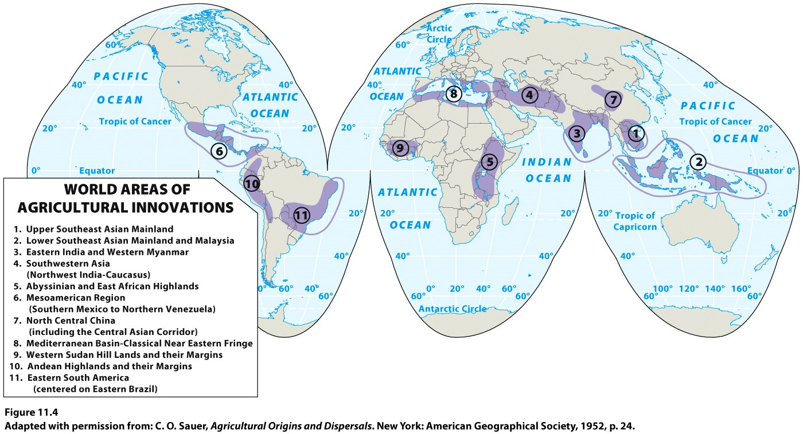
The First Agricultural Revolution
Seed crops: plants that are reproduced by cultivating seeds
marked the First Agricultural Revolution.
Likely first took place in the Fertile Crescent.

Slide 11
Domestication of Animals
Some scholars believe that animal domestication began earlier than plant cultivation, but others argue that animal domestication began as recently as 8000 years ago—well after crop agriculture.
The advantages of animal domestication—their use as beasts of burden, as a source of meat, and as providers of milk—stimulated the rapid diffusion of this idea among interlinked places and gave the sedentary farmers of Southwest Asia and elsewhere a new measure of security.
Jared Diamond, Guns, Germs, and Steel: only five domesticated mammals are important throughout the world: the cow, sheep, goat, pig, and horse.

Slide 12
Subsistence Agriculture
Subsistence agriculture: growing only enough food to survive; norm throughout most of human history.
Subsistence agriculture is returning in parts of the world where farmers feel production for the global market has not benefited them financially or culturally.
Shifting cultivation: many farmers move from place to place in search of better land.
Found primarily in tropical and subtropical zones, where traditional farmers had to abandon plots of land after the soil became infertile.
Slash-and-burn agriculture: farmers use tools (machetes and knives) to slash down trees and tall vegetation, and then burn the vegetation on the ground. A layer of ash from the fire settles on the ground and contributes to the soil’s fertility.

Slide 13
Settling down in one place, a rising population, and the switch to agriculture are interrelated occurrences in human history. Hypothesize which of these three happened first, second, and third and explain why.

Slide 14
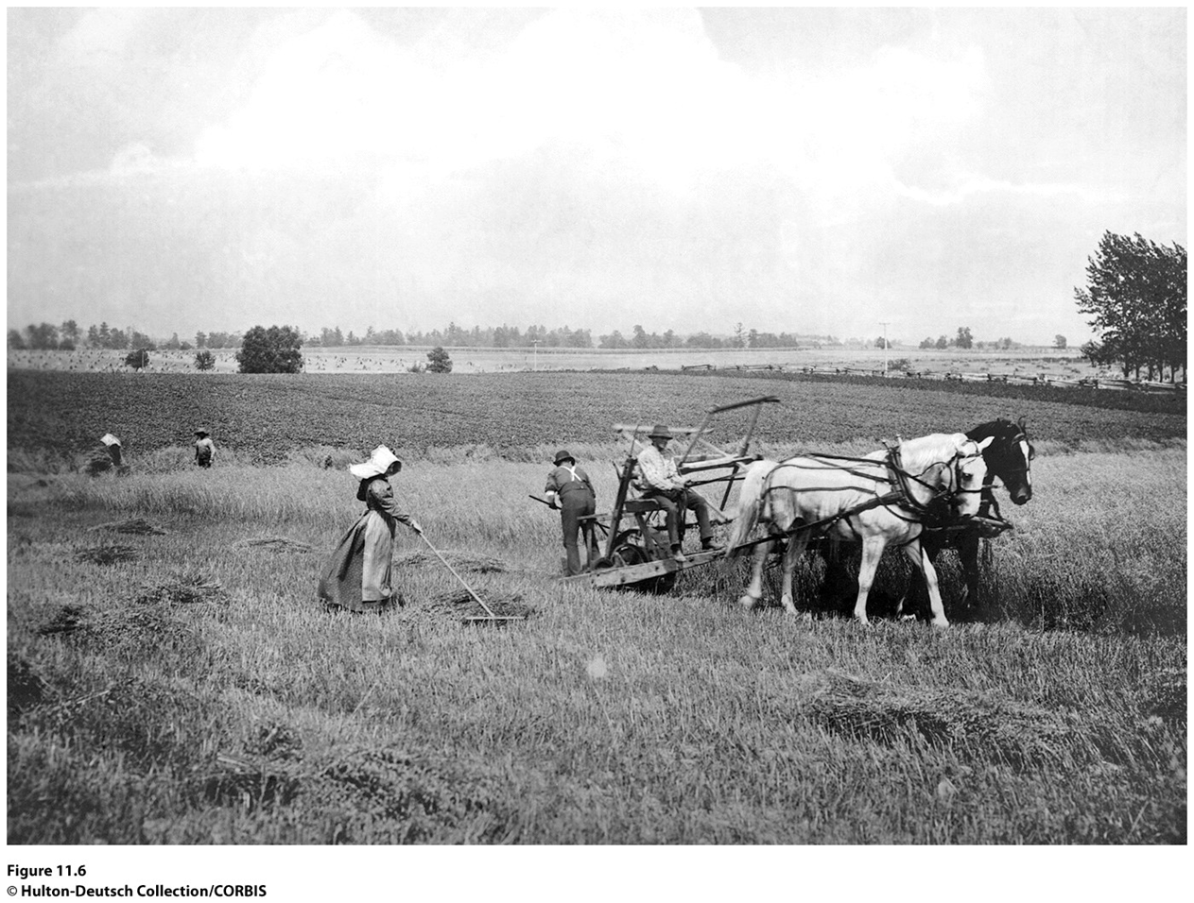
Key Question: How did agriculture change with industrialization?

Slide 15
Second Agricultural Revolution
Would move agriculture beyond subsistence to generate the kinds of surpluses needed to feed thousands of people working in factories instead of in agricultural fields.
Great Britain’s Enclosure Act: encouraged field consolidation into large, single-owner holdings.
New technologies (i.e., the seed drill).
Mechanical reaper perfected in 1831 by farmer Cyrus McCormick.
Advances in breeding livestock.
Innovations in machinery that occurred with the
Industrial Revolution in the late 1800s and early 1900s helped sustain the Second Agricultural Revolution.

Slide 16
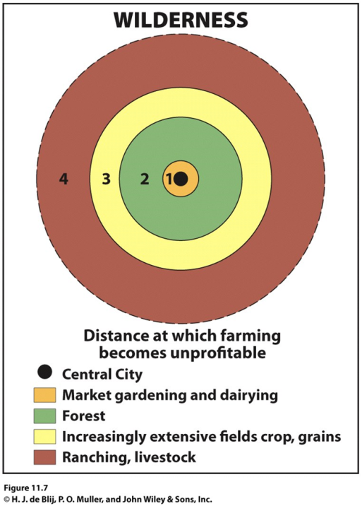
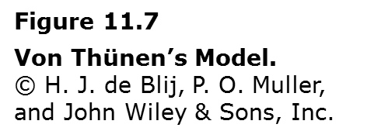
Understanding the Spatial Layout of Agriculture
Farmer Johann Heinrich von Thünen: As one moved away from the town one commodity or crop gave way to another.
The greater the distance to market, the higher the transport costs that had to be added to the cost of producing a crop or commodity.

Slide 17
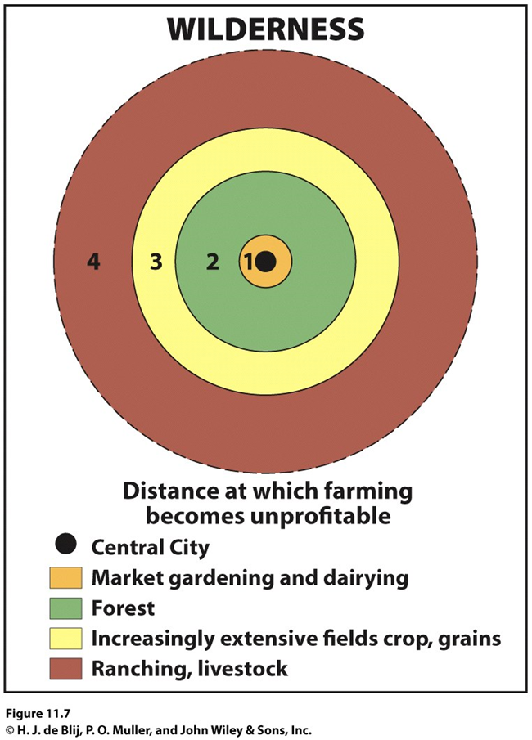
The Von Thünen Model
The first effort to analyze the spatial character of economic activity.
Even when agricultural production does not conform to the concentric rings of von Thünen’s model, his underlying concern with the interplay of land use and transportation costs frequently still explains agricultural patterns.
Figure 11.7
Von Thünen’s Model. © H. J. de Blij, P. O. Muller, and John Wiley & Sons, Inc.

Slide 18
The Third Agricultural Revolution
Also called the Green Revolution.
Since the 1930s agricultural scientists experimented with technologically manipulated seed varieties to increase crop yields.
1940s: Maize (corn)
1960s: the focal point of the Green Revolution shifted to India (Rice-IR8).
The Green Revolution also brought new high-yield varieties of wheat and corn from the United States to other parts of the world, particularly South and Southeast Asia.

Slide 19
Criticism of the Green Revolution
Environmentalists have speculated about the impacts of pollen dispersal from genetically modified plants and the potential for disease-resistant plants to spur the evolution of super-pests.
The large-scale monocropping that is often part of Green Revolution agriculture can make farms vulnerable to changes in climate or the infestation of particular pests.
Higher inputs of chemical fertilizers, herbicides, and pesticides associated with Green Revolution agriculture can lead to reduced organic matter in the soil and to groundwater pollution.
Scientific American (2005) explains that the Green Revolution has done little to alleviate poverty in areas where most farmers still work small plots of land.
The need for capital from the West to implement Green Revolution technologies has led to a shift away from production for local consumers toward export agriculture.

Slide 20
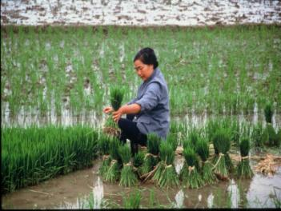
New Genetically Modified Foods
Genetically modified organisms (GMOs) are found in 75 percent of all processed foods in the United States
Many of the poorer countries of the world do not have access to the necessary capital and technology.
Ideological resistance to genetically engineered foods
In regions where seeds are a cultural commodity, reflecting agricultural lessons learned over generations, many resist the invasion of foreign, genetically engineered crops.
Concept Caching:
Planting Rice Seedlings-China
© Barbara Weightman

Slide 21
Regional and Local Change
Shifts from subsistence agriculture to commercial agriculture have had dramatic impacts on rural life.
Dramatic increases in the production of export crops have occurred at the expense of crop production for local consumption.
Environmental, economic, and social changes have affected local rural communities.

Slide 22
The Impacts of Agricultural Modernization on Earlier Practices
Unlike hunting and gathering, subsistence farming continues to be a relatively common practice in Africa, Middle America, tropical South America, and parts of Southeast Asia.
From 1500 to 1950, European powers sought to “modernize” the economies of their colonies by ending subsistence farming and integrating farmers into colonial systems of production and exchange.
The colonial powers would demand that farmers pay some taxes.
The colonial powers would conduct soil surveys, build irrigation systems, and establish lending agencies that provided loans to farmers.
Concept Caching:
Mount Vesuvius

Slide 23
Many arguments have been raised about the impacts of the Green Revolution, both pro and con. How might the scale at which the Green Revolution is examined affect the arguments that are made about it? What types of factors are likely to be considered if the question is, “has the Green Revolution been good for Asia” as opposed to “has the Green Revolution been good for a village or a particular agricultural community in India?”

Slide 24
Key Question: What imprint does agriculture make on the cultural landscape?
The cadastral system: the method of land survey through which land ownership and property lines are defined.
Rectangular survey system: The prevailing survey system throughout much of the United States, the one that appears as checkerboards across agricultural fields
The pattern of farms on the landscape in the interior of the United States reflects the township-and-range system, with farms spaced by sections, half sections, or quarter sections.

Slide 25
Metes and bounds survey: natural features were used to demarcate irregular parcels of land.
Long-lot survey system: divided land into narrow parcels stretching back from rivers, roads, or canals.
Primogeniture: the Germanic practice in which all land passes to the eldest son.
In areas where land is divided among heirs, considerable fragmentation can occur over time.

Slide 26
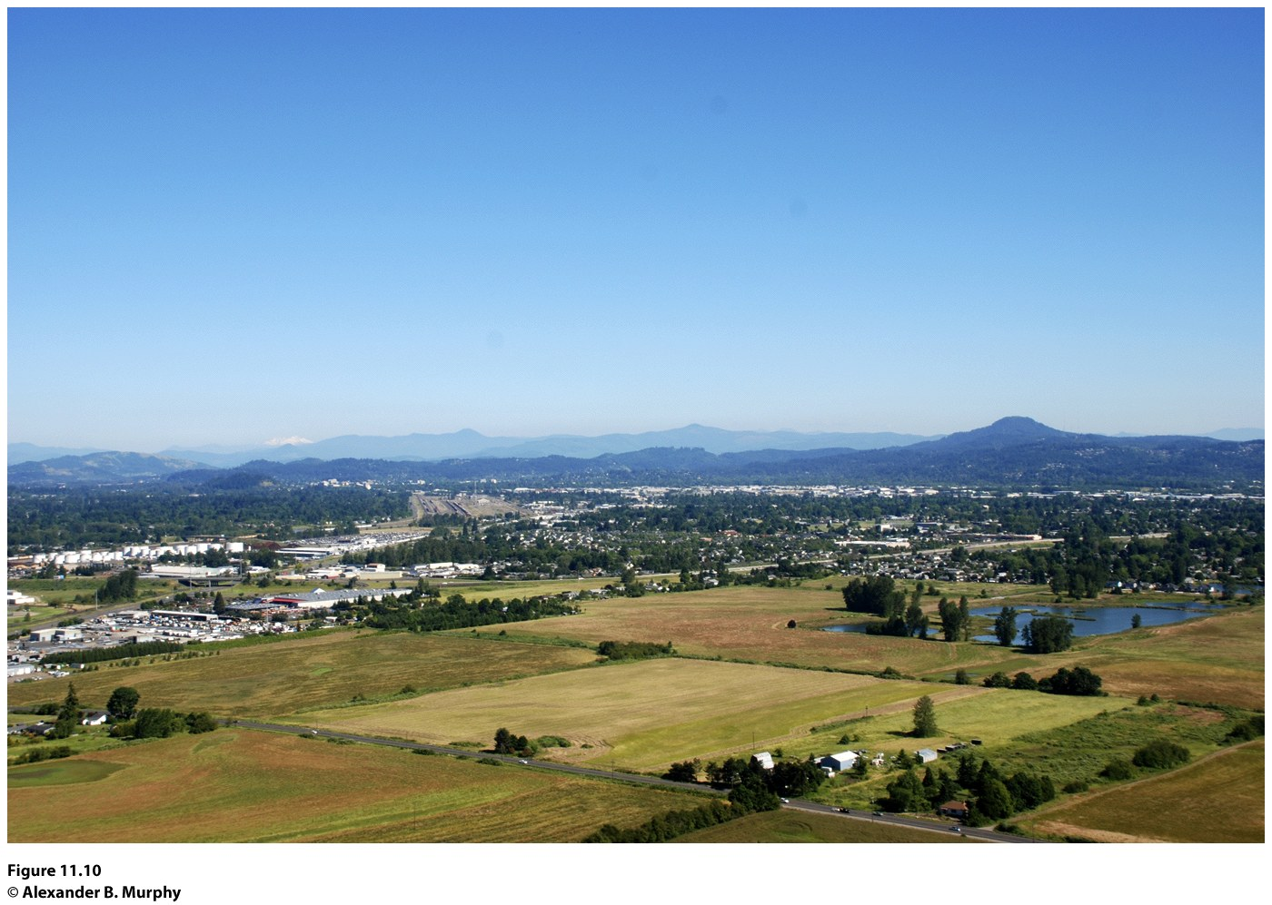
Figure 11.10
Willamette Valley, Oregon. The township-and-range system has left its imprint on the landscape near Eugene, Oregon, where the grid pattern of six mile by six mile townships and the sections of one square mile each are marked by property lines and roads. © Alexander B. Murphy.

Slide 27
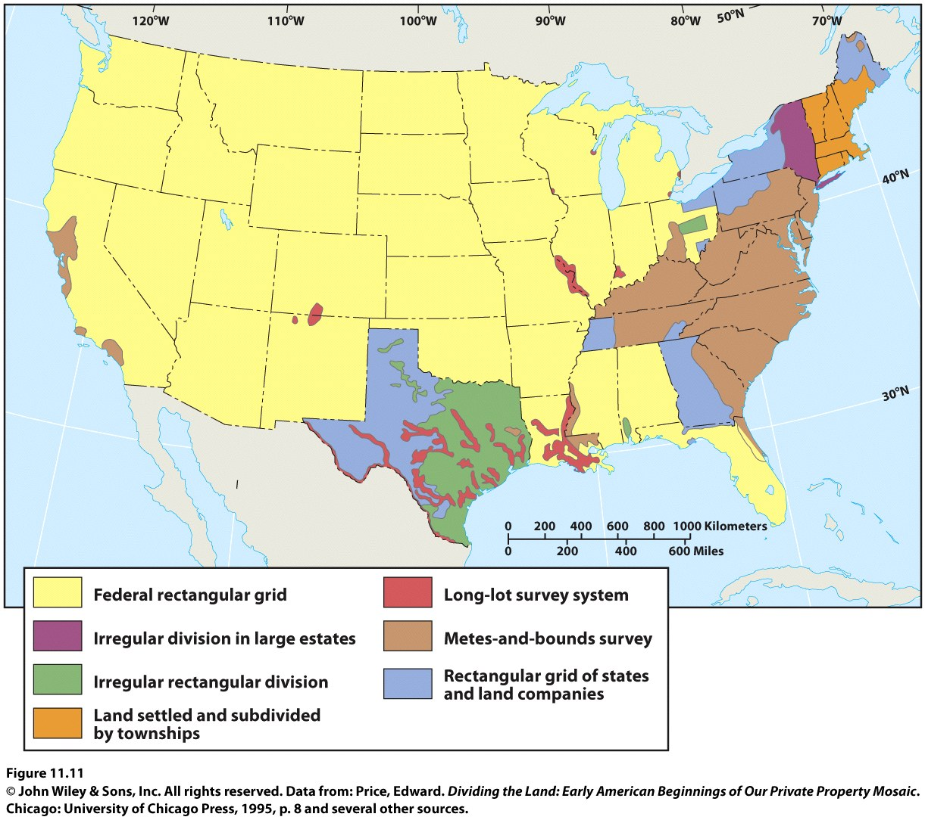

Slide 28
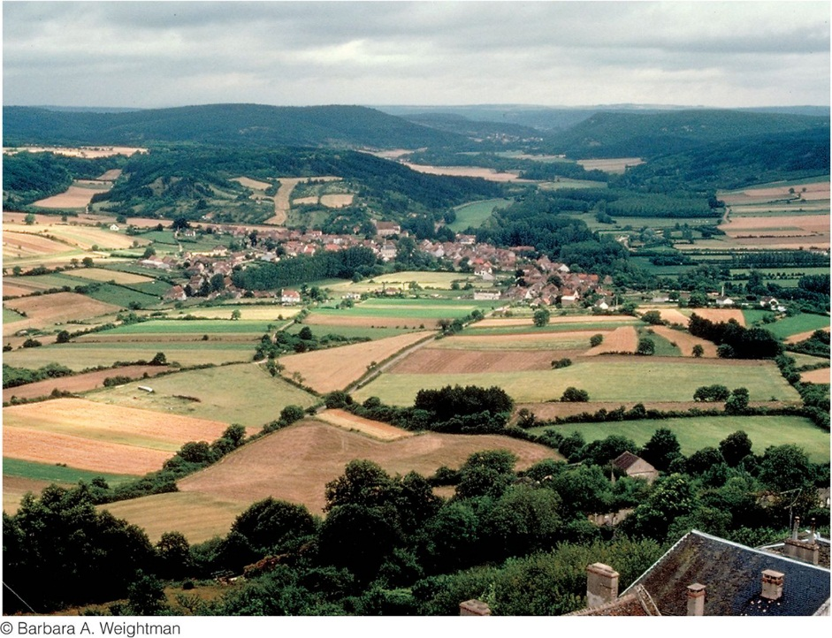
Villages
True farm villages, in which farming or providing services for farmers are the dominant activities, are disappearing
Dispersed settlement pattern: individual farmhouses lie quite far apart and the land is intensively cultivated but by machine rather than by hand Ex: United States Midwest
Nucleated settlement: the most prevalent rural residential pattern in agricultural areas
Figure 11.12
Acquitaine, France. The agricultural landscape of Aquitaine demonstrates three features of rural France: people living in nucleated villages, a highly fragmented land ownership pattern, and land divided according to the French long-lot system.
© Barbara A. Weightman.

Slide 29
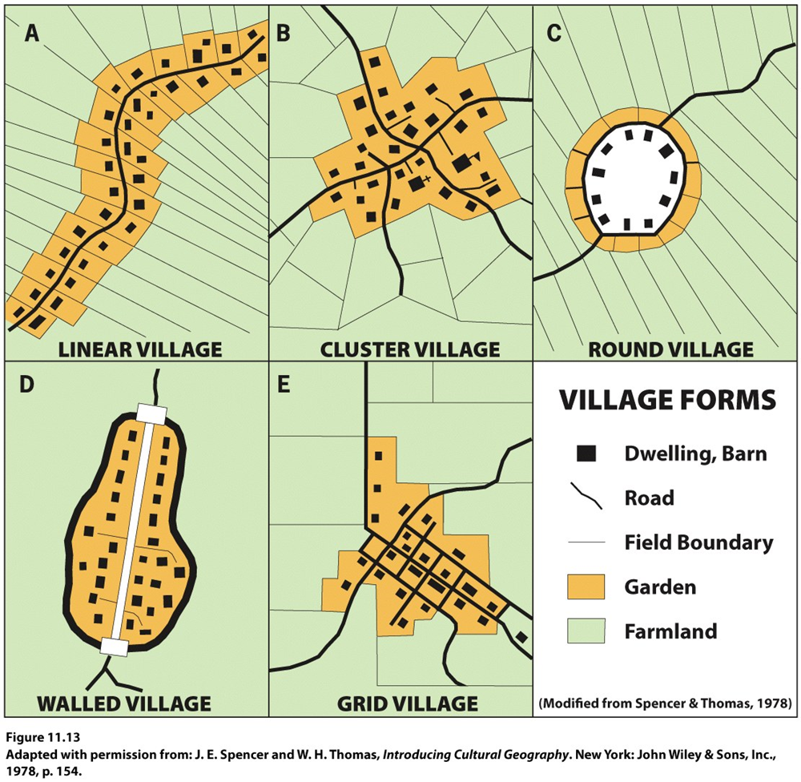
Linear village: In many low-lying areas of Western Europe, villages are located on dikes and levees.
Cluster village may have begun as a small hamlet at the intersection of two roads and then developed by accretion.
Round village or rundling was first used by Slavic farmer-herdsmen in eastern Europe and was later modified by Germanic settlers.
Walled village: as a means of protection.
Grid village: more modern.

Slide 30
Functional Differentiation within Villages
Social stratification: reflected in the range in size and quality of houses, representing their owners’ wealth and standing in the community.
The functional differentiation of buildings within farm villages is more elaborate in some societies than in others.
Protection of livestock and storage of harvested crops are primary functions of farm villages.

Slide 31
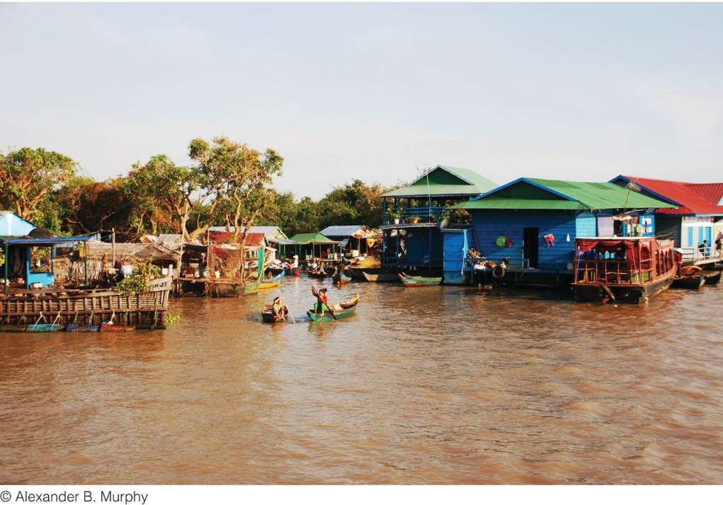
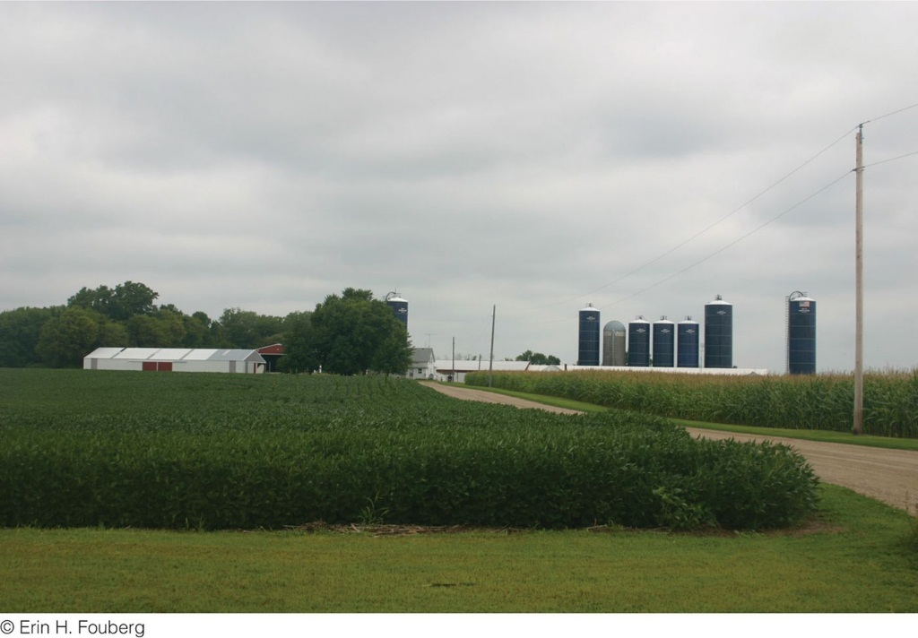
Figure 11.14
Siem Reap, Cambodia. A stilt village along the shores of Tonle Sap, the largest lake in Cambodia. The houses in this village in the Cambodian countryside are designed on stilts or floats to handle seasonal changes in water levels in the Tonle Sap Lake. In the dry fall and winter, the lake reduces in size and the stilts of the houses are exposed. In the wet spring and summer, the lake swells and inundates the village, covering the stilts with water.
Figure 11.15
Winthrop, Minnesota. The modern American farm typically has a two-story farm house surrounded
by several outbuildings.

Slide 32
Key Question: How is agriculture currently organized geographically, and how has agribusiness influenced the contemporary geography of agriculture?
The end of colonial rule did not signal the end of the agricultural practices and systems that had been imposed on the former colonial areas.
Commercial farming has come to dominate in the world’s economic core, as well as some of the places in the semi-periphery and periphery.

Slide 33
Commercial agriculture: began in the eighteenth and nineteenth centuries when Europe became a market for agricultural products from around the world.
Monoculture: dependence on a single agricultural commodity; a major impact of colonial agriculture.

Slide 34
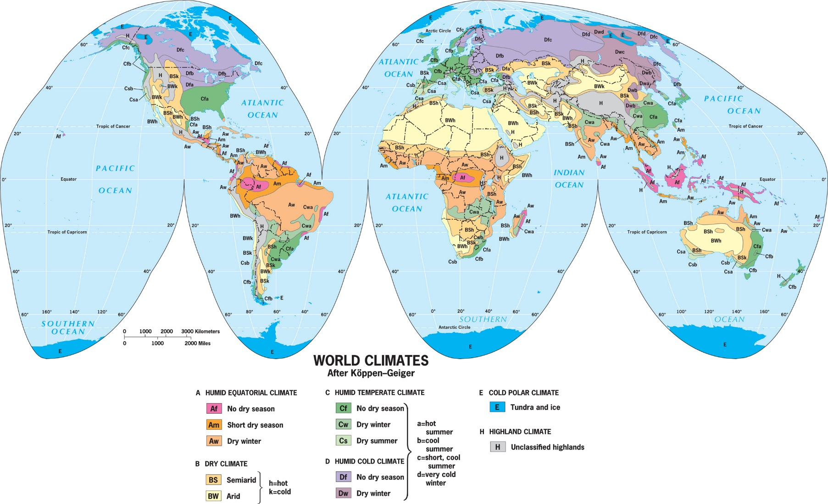
The World Map of Climates
Wladimir Köppen: Köppen climate classification system for classifying the world’s climate regions on the basis of temperature and precipitation.

Slide 35
The World Map of Climates
The “no dry season” (Af) regions are equatorial rainforest regions.
The “short dry season” (Am) climate is known as the monsoon climate.
BW is desert and BS is steppe.
“Dry summer” (C) climates are known as Mediterranean climates.
Polar climates, where tundra and ice prevail, are found poleward of (D) climates.

Slide 36
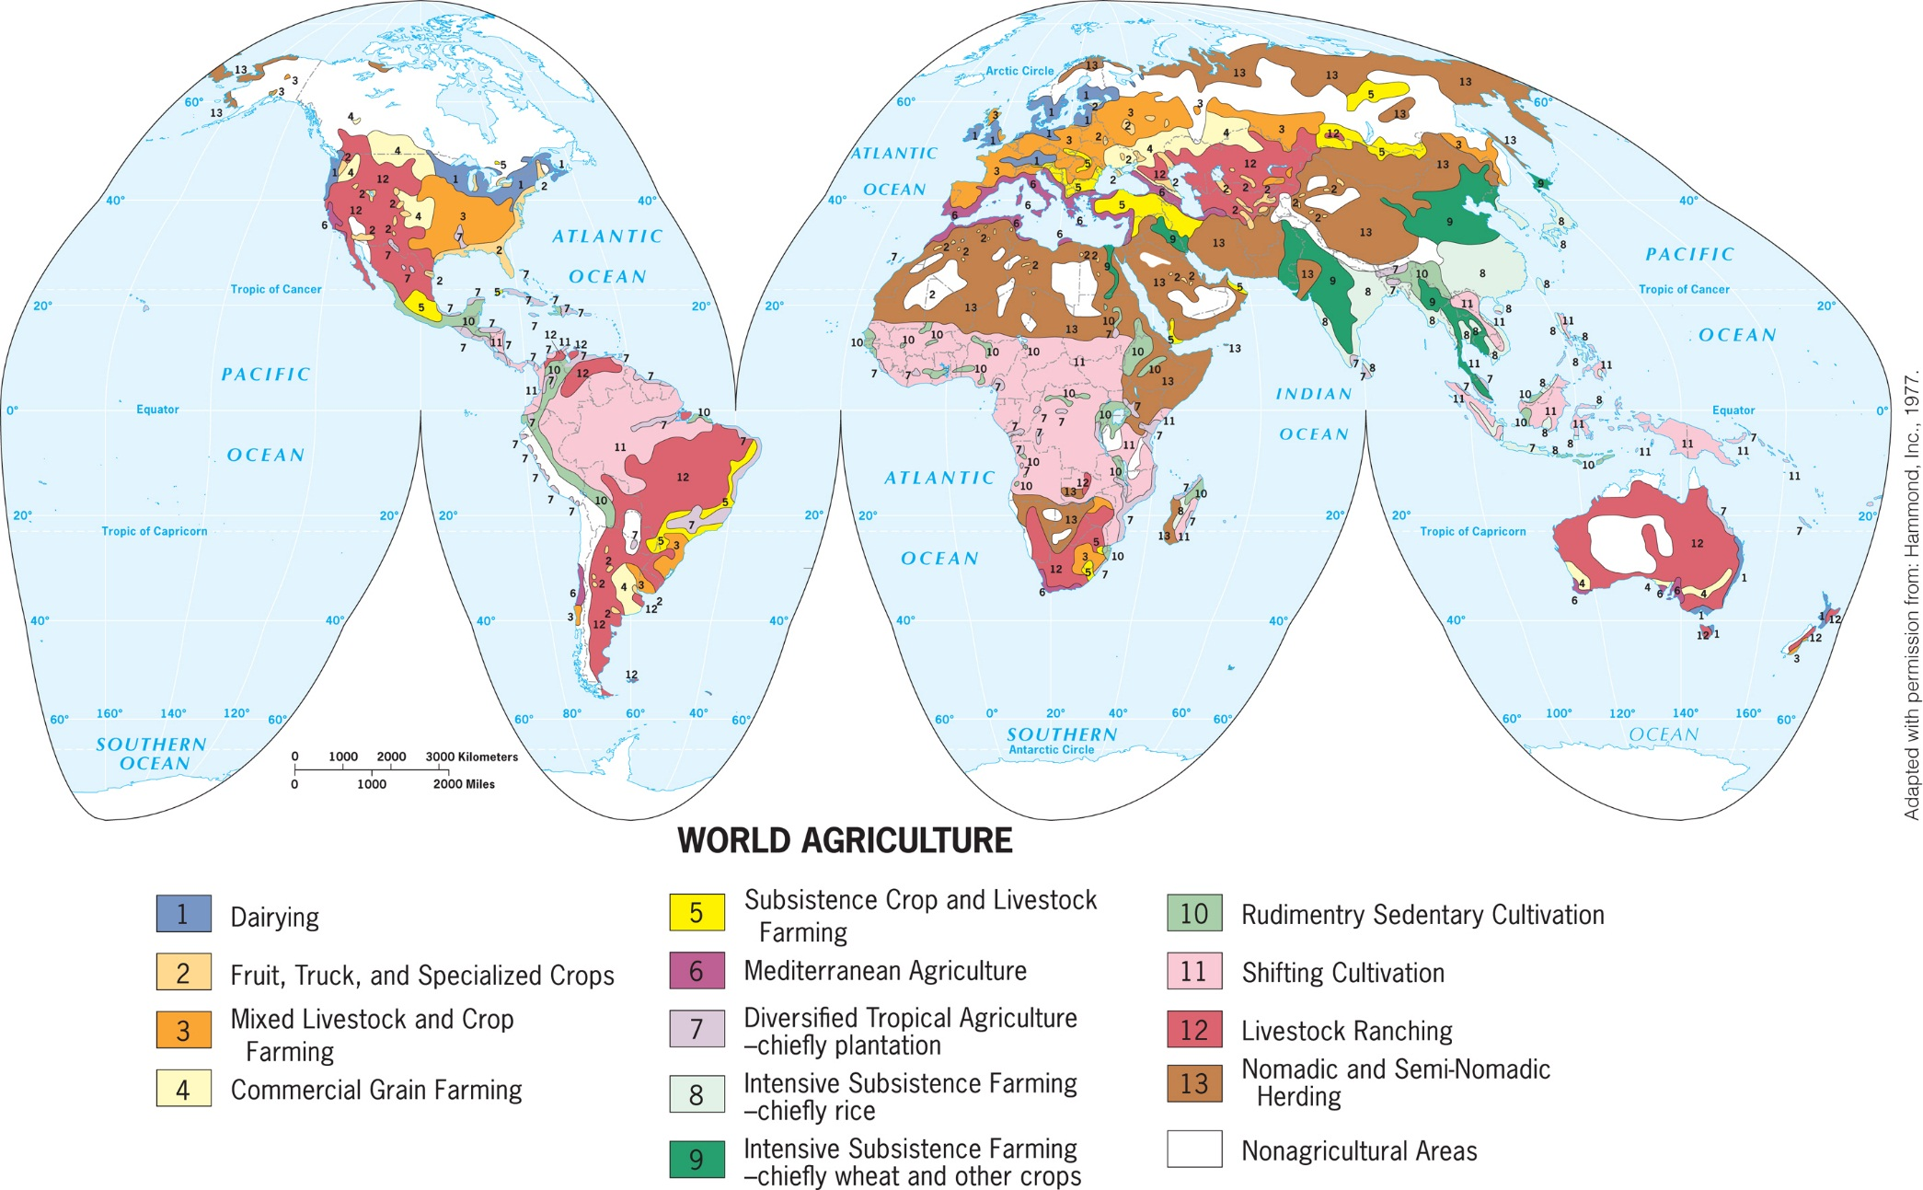
The World Map of Agriculture
Notes:
Figure 11.18
World Agriculture. Different kinds of agricultural areas are shown throughout the world.
Adapted with permission from: Hammond, Inc., 1977.

Slide 37
Cash Crops and Plantation Agriculture
The World Map of Agriculture
Cash farming continues to provide badly needed money, even if the conditions of sale to the urban industrial world are unfavorable.
Occasionally, producing countries consider forming a cartel in order to present a united front to the importing countries and to gain a better price, as oil-producing states did during the 1970s.
Plantation agriculture: When cash crops are grown on large estates:
Plantations are colonial legacies that persist in poorer, primarily tropical, countries along with subsistence farming.

Slide 38
Commercial Livestock, Fruit, and Grain Agriculture
Commercial Livestock, Fruit, and Grain Agriculture
Livestock ranching: the raising of domesticated animals for the production of meat and byproducts, such as leather and wool
Subsistence agriculture
Subsistence crop and livestock farming
Intensively subsistence farming (chiefly rice)
Intensively subsistence farming (chiefly wheat and other crops
Mediterranean Agriculture: specialized farming occurs only in areas where the dry summer Mediterranean climate prevails

Slide 39
Drug Agriculture
Because of the high demand for drugs—particularly in the global economic core—farmers in the periphery often find it more profitable to cultivate poppy, coca, or marijuana plants than to grow standard food crops.
Drug cartels that oversee the drug trade have brought crime and violence to the places where they hold sway.
Mexicans now control 11 of the 13 largest drug markets in the United States.

Slide 40
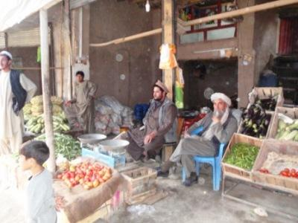
Informal agriculture: Millions of people cultivate small plots of land in and around their homes for domestic consumption or to trade informally with others.
Such practices are encouraged in some places—notably China—but more often they are ignored, or even discouraged.
Concept Caching: Produce bazaar in Ghazni City, Afghanistan
© Barbara Weightman

Slide 41
Political Influences on Agriculture
Cash crop: cotton
Colonial powers established a trading network that led to the globalization of the cotton industry.
Cotton cultivation expanded greatly when the Industrial Revolution produced machines for cotton ginning, spinning, and weaving that increased productive capacity, brought prices down, and put cotton goods within the reach of mass markets.
Even as countries emerged from colonial control, they were left with a legacy of large landholdings owned or controlled by wealthy individuals or business entities.
Tax regulations and subsidies favoring certain land uses.

Slide 42
Socio-cultural Influences on Agriculture
Luxury crops, such as coffee:
In most cases coffee is produced on enormous, foreign-owned plantations, where it is picked by local laborers who are hired at very low wage rates
Fair trade: guarantees coffee producers a “fair trade price” of $1.40 per pound of coffee (plus bonuses of $0.30 per pound for organic)
People’s changing tastes also shape the geography of agriculture (e.g., tea)

Slide 43
Agribusiness and the Changing Geography of Agriculture
Agribusiness: the businesses that provide a vast array of goods and services to support the agricultural industry.
A global network of farm production is oriented to the one-fifth of the world’s population that is highly urbanized, wealthy, and powerful.
Few farmers in distant lands have real control over land-use decisions, for the better off people in the global economic core continue to decide what will be bought at what price.

Slide 44
Environmental Impacts of Commercial Agriculture
Overfishing
Land clearing and deforestation
Concerns over the introduction of chemical fertilizers and pesticides into the environment—as well as soil erosion.
Ecological degradation and desertification
The growth of organic farming and the move toward the use of local foods in some communities can benefit the environment.

Slide 45
The Challenge of Feeding Everyone
Worldwide, about 1 billion people are malnourished.
Inadequate distribution systems and widespread poverty.
Some of the most fertile, productive farmlands are lost to housing and retail developments.
Commercial agricultural areas are converted into regions for second homes.
Population growth and the loss of agricultural land help to explain why global food prices have been on the rise for more than a decade.
Food deserts are areas with limited access to fresh, nutritious foods.

Slide 46
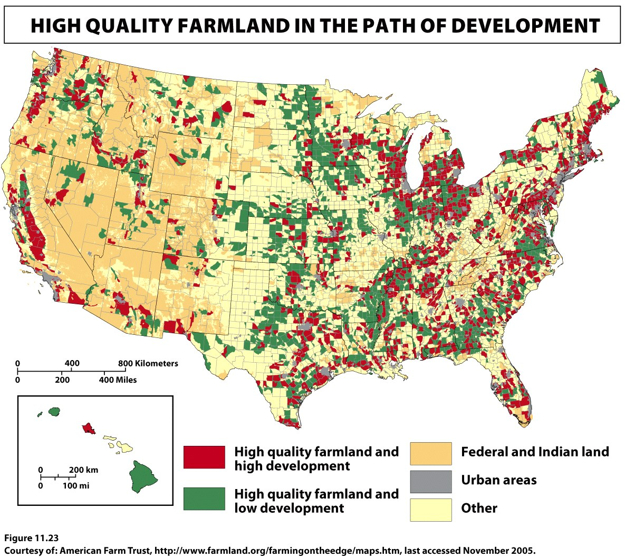
INSERT FIGURE 11.23
Notes:
Figure 11.23
Farming on the Edge: High-Quality Farmland in the Path of Development, 2002. This
map from American Farmland Trust, whose charge is to preserve farmland, highlights farmland
that is endangered of being suburbanized as cities expand into neighboring farmlands. Courtesy of:
American Farm Trust, http://www.farmland.org/farmingontheedge/maps.htm, last accessed November 2005.

Slide 47
Additional Resources
Food production and development http://www.foodfirst.org/media/opeds/2000/4-greenrev.html
Preservation of agricultural lands http://www.farmland.org/
Additional Resources on Geography Education
Agriculture, Agribusiness, Food Production, locavore, GMOs, organic

