Slide 1
Human Geography: People, Place,
and Culture, 11th Edition

Slide 2
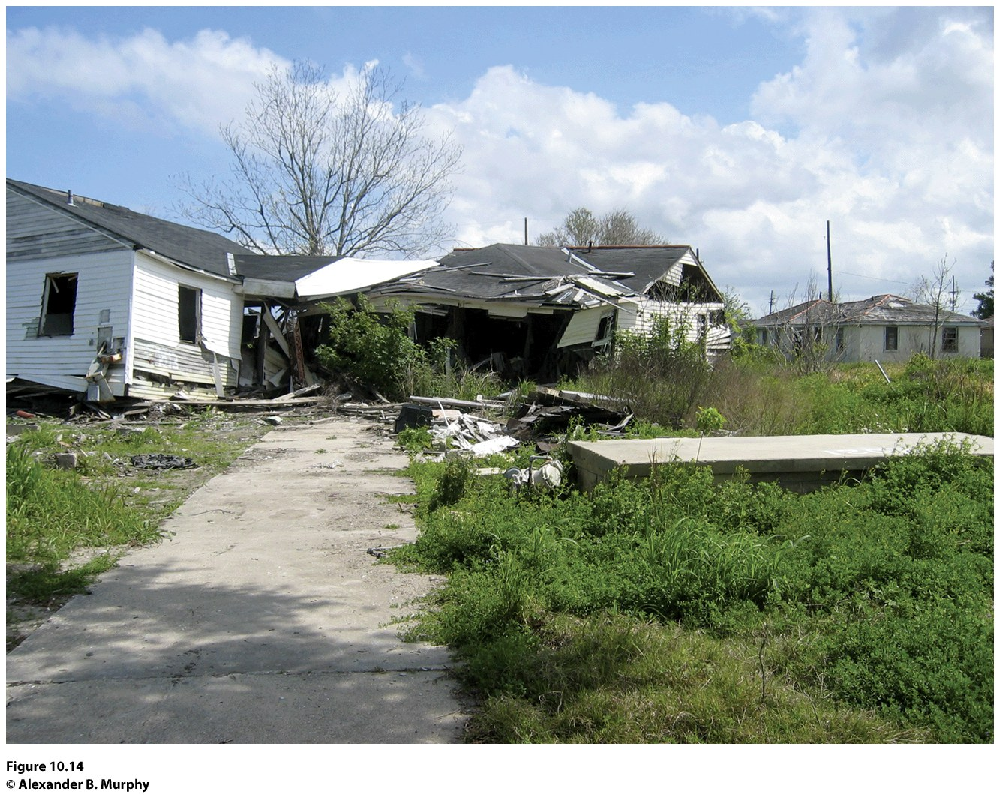
Chapter 10: Development
Notes:
Concept Caching: New Orleans, Louisiana

Slide 3
Key Question: How Is Development Defined and Measured?
Wealth does not depend solely on what is produced; it depends in large part on how and where it is produced.
A country that is developing is making progress in technology, production, and socioeconomic well- being.
Ways of measuring development fit into three major areas of concern: development in economic welfare, development in technology and production, and development in social welfare.

Slide 4
Gross National Income
Gross national income (GNI): monetary worth of what is produced within a country plus income received from investments outside the country minus income payments to other countries.
The most common way to standardize GNI data is to divide it by the population of the country, yielding the per capita GNI.
Formal economy: the legal economy that governments tax and monitor.
Informal economy: uncounted or illegal economy that governments do not tax and keep track of.

Slide 5
Gross National Income
Gross National Product (GNP) is a measure of the total value of the officially recorded goods and services produced by the citizens and corporations of a country in a given year, and includes things produced both inside and outside the country’s territory.
Gross Domestic Product (GDP), which encompasses only goods and services produced within a country during a given year.

Slide 6
Gross National Income
GNI per capita masks extremes in the distribution of wealth within a country.
GNI per capita measures only outputs (i.e., production). It does not take into account the nonmonetary costs of production.
The limitations of GNI have prompted some analysts to look for alternative measures of economic development, ways of measuring the roles that technology, production, transportation, and communications play in an economy.

Slide 7
Social Measures of Development
Dependency ratio: a measure of the number of dependents, young and old, that each 100 employed people must support.
A high dependency ratio can result in significant economic and social strain.
Countless other statistics can measure a dimension of social welfare
including literacy rates, infant mortality, life expectancy, caloric intake per person, percentage of family income spent on food, and amount of savings per capita.

Slide 8
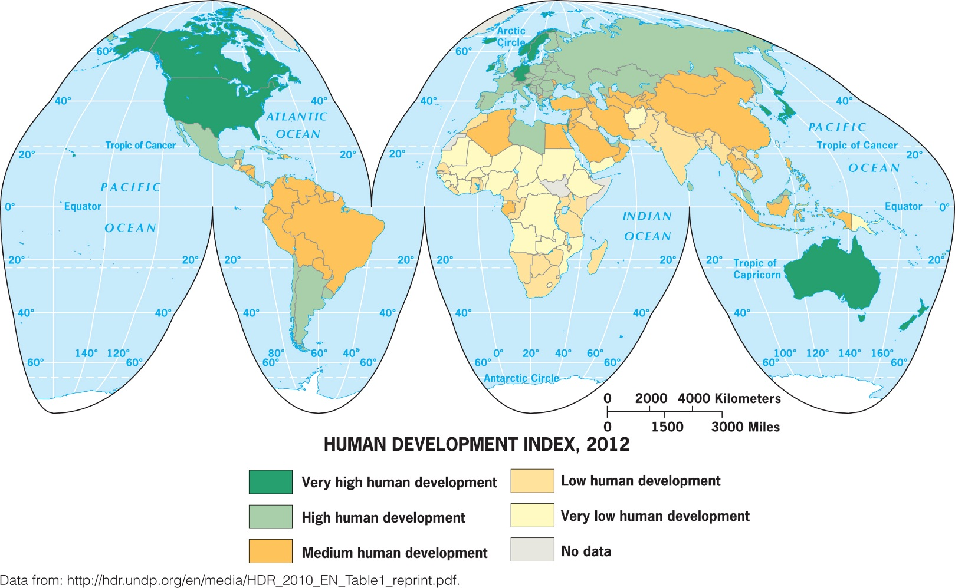
UN Human Development Index (HDI): Quantify aspects of human development
Long and Healthy Life
Knowledge
Decent standard of living

Slide 9
Development Models
Criticism of the development model:
It does not take geographical differences very seriously.
The conceptualization of development has a Western bias.
It does not consider the ability of some countries to influence what happens in other countries.

Slide 10
Walt Rostow’s modernization model: assumes that all countries follow a similar path to development or modernization, advancing through five stages of development:
The society is traditional, and the dominant activity is subsistence farming.
Preconditions of takeoff: New leadership moves the country toward greater flexibility, openness, and diversification.
Takeoff: the country experiences something akin to an Industrial Revolution, and sustained growth takes hold.
Drive to maturity: Technologies diffuse, industrial specialization occurs, and international trade expands.
High mass consumption: high incomes and widespread production of many goods and services.

Slide 11
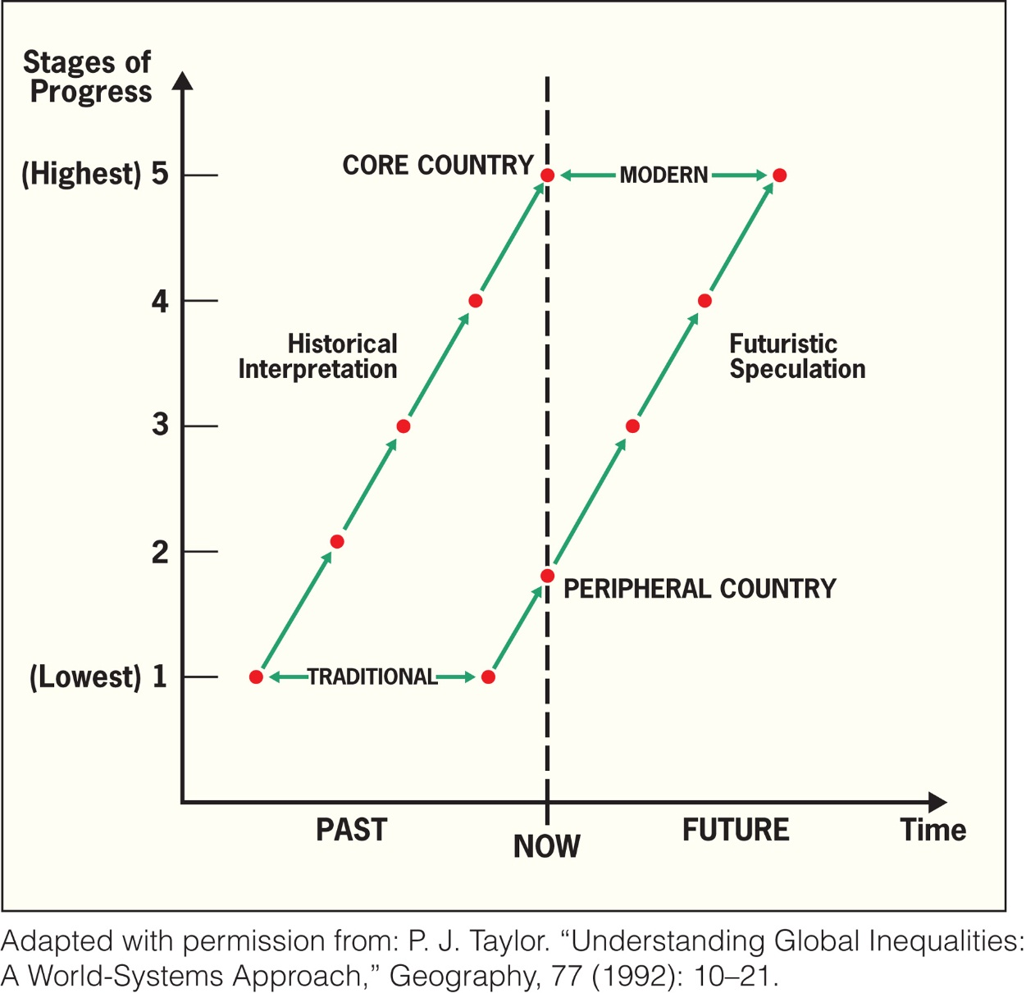
Figure 10.8
Rostow’s Ladder of Development. This ladder assumes that all countries can reach the same level of development and that all will follow a similar path. Adapted with permission from: P. J. Taylor. “Understanding Global Inequalities: A World-Systems Approach,” Geography, 77 (1992): 10–21.
Notes:
Figure 10.8
Rostow’s Ladder of Development. This ladder assumes that
all countries can reach the same level of development and that
all will follow a similar path. Adapted with permission from: P. J.
Taylor. “Understanding Global Inequalities: A World-Systems
Approach,” Geogr a phy , 77 (1992): 10–21.

Slide 12
Is the idea of economic development inherently Western? If the West (North America and Europe) were not encouraging the “developing world” to “develop,” how would people in the regions of the “developing world” think about their own economies?

Slide 13
Key Question: How Does Geographical Situation affect Development?
Development happens in context: it reflects what is happening in a place as a result of forces operating concurrently at multiple scales.
Neocolonialism: the major world powers continue to control the economies of the poorer countries, even though the poorer countries are now politically independent states.
Structuralist theory holds that difficult-to-change, large-scale economic arrangements shape what can happen in fundamental ways.

Slide 14
Dependency Theory
Holds that the political and economic relationships between countries and regions of the world control and limit the economic development possibilities of poorer areas.
Dollarization: the country’s currency, the colon, was abandoned in favor of the dollar.
Figure 10.9
San Salvador, El Salvador. A woman and young boy use dollars to pay for groceries in El Salvador, a country that underwent dollarization in 2001.
© AFP/News Com

Slide 15
Geography and Context
Immanuel Wallerstein’s world-systems theory
Three-tier structure—the core, periphery, and semiperiphery—helps explain the interconnections between places in the global economy.
When core processes are embedded in a place, wealth is generated for the people in that place.
Peripheral processes require little education, lower technologies, and lower wages and benefits.
The semiperiphery exhibits both core and peripheral processes, and semiperipheral places serve as a buffer between the core and periphery in the world-economy.

Slide 16
Geography and Context
World-systems theory makes the power relations among places explicit and does not assume that socioeconomic change will occur in the same way in all places.
World-systems theorists see domination (exploitation) as a function of the capitalist drive for profit in the global economy.
World-systems theory is applicable at scales beyond the state.

Slide 17
Compare and contrast Rostow’s ladder of development with Wallerstein’s three-tier structure of the world economy as models for understanding a significant economic shift that has occurred in a place with which you are familiar.

Slide 18
Millennium Development Goals:
Key Question: What Are the Barriers to and the Costs of Economic Development?
1. Eradicate extreme poverty and hunger.
2. Achieve universal primary education.
3. Promote gender equality and empower women.
4. Reduce child mortality.
5. Improve maternal health.
6. Combat HIV/AIDS, malaria, and other diseases.
7. Ensure environmental sustainability.
8. Develop a global partnership for development.

Slide 19
Barriers to Economic Development
Social Conditions
High birth rates and low life expectancies at birth, high infant and child mortality rates, lack of access to healthcare, lack of access to education: trafficking
Foreign Debt
structural adjustment loans, neoliberalism (the idea that government intervention into markets is inefficient and undesirable, and should be resisted wherever possible)

Slide 20
Barriers to Economic Development
Disease
Those living in the global economic periphery experience comparatively high rates of disease and a corresponding lack of adequate health care:
Vectored diseases: those spread by one host (person) to another by an intermediate host or vector
Malaria: the “silent tsunami”

Slide 21
Political Corruption and Instability
Can greatly impede economic development.
In peripheral countries, a wide divide often exists between the very wealthy and the poorest of the poor.
Countries of the core have established democracies for themselves but countries in the periphery and semiperiphery have had a much harder time establishing and maintaining democracies.
In places where poverty is rampant, politicians often become corrupt, misusing aid and exacerbating the plight of the poor.
In low-income countries, corrupt leaders can stay in power for decades.

Slide 22
Costs of Economic Development
Industrialization
Export processing zones (EPZs) offer favorable tax, regulatory, and trade arrangements to foreign firms.
Mexican maquiladoras
Special economic zones of China
In 1992, the United States, Mexico, and Canada established the North American Free Trade Agreement (NAFTA), which prompted further industrialization of the border region.

Slide 23
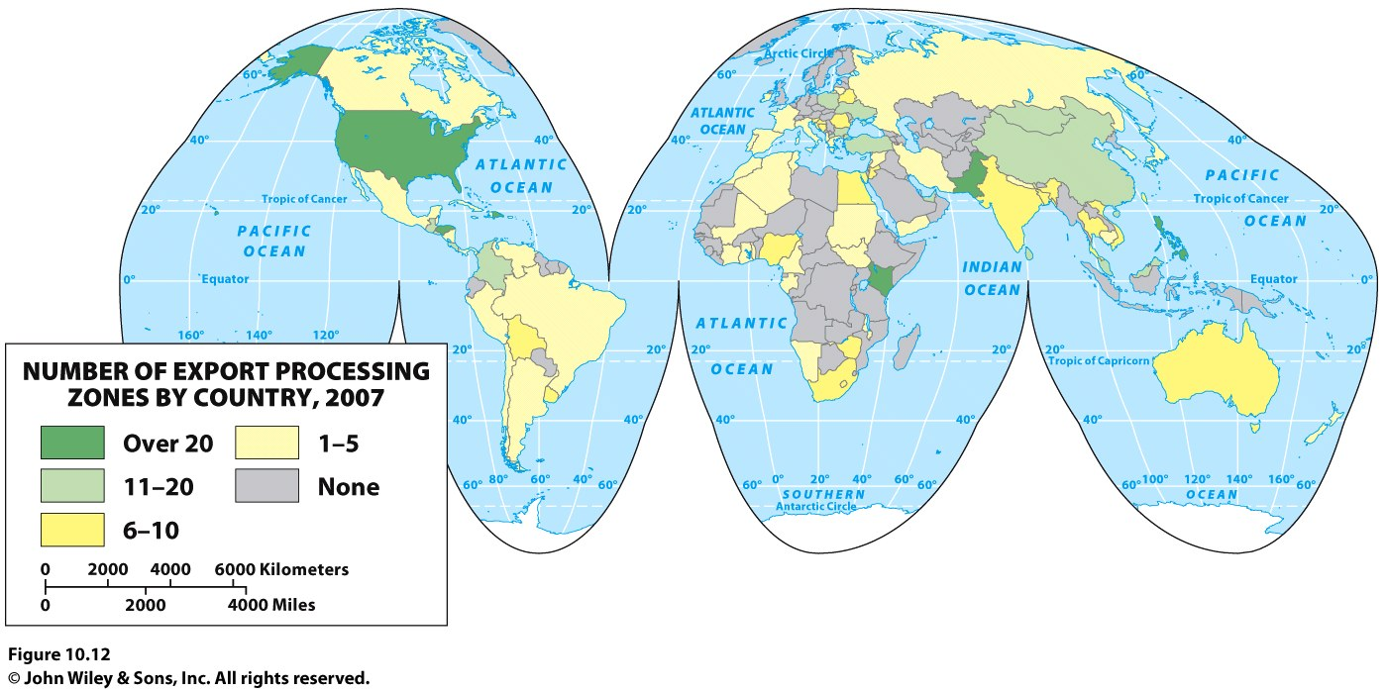
Notes:
Figure 10.12
Export Processing Zones. Number of export processing zones by country, 2006. Data from:
International Labor Organization.

Slide 24
Agriculture
In peripheral countries, agriculture typically focuses on personal consumption or on production for a large agricultural conglomerate.
Little is produced for the local marketplace because distribution systems are poorly organized.
On the farms in the periphery, yields per unit area are low, subsistence modes of life prevail, and many families are constantly in debt.
Desertification is more often exacerbated by humans destroying vegetation and eroding soils through the overuse of lands for livestock grazing or crop production.
Africa has been hit hardest by desertification.

Slide 25
Tourism
Now one of the major industries in the world and has surpassed oil in its overall economic value.
To develop tourism, the “host” country must make a substantial investment.
Much of the income a country receives from tourism revenues are reinvested in the construction of airports, cruise-ports, and other infrastructure that supports more tourism.
Tourism can create local jobs, but they are often low-paying and have little job security.
Tourism frequently strains the fabric of local communities.
The cultural landscape of tourism is frequently a study in harsh contrasts.

Slide 26
Think of a trip you have made to a poorer area of the country or a poorer region of the world. Describe how your experience in the place as a tourist was fundamentally different from the everyday lives of the people who live in the place.

Slide 27
Key Question: How Do Political and Economic Institutions Influence Uneven Development within States?
Regional contrasts in wealth are a reminder that per capita GNI does not accurately represent the economic development of individual places.
Every government policy has a geographical expression (some regions favored over others)
The contrasts between rich and poor areas are not simply the result of differences in the economic endowments of places.

Slide 28
The Role of Governments
The distribution of wealth is affected by tariffs, trade agreements, taxation structures, land ownership rules, environmental regulations.
Government policies play an important role at the interstate level, but they also shape patterns of development within states.
Government policy can also help alleviate uneven development.
Economist Pietra Rivola: The Travels of a T-Shirt in the Global Economy: described the significant influences governments have on the distribution of wealth between and within states.

Slide 29
Islands of Development
In most states, the capital city is the political nerve center of the country, its national headquarters and seat of government.
In many countries of the periphery, capital cities are by far the largest and most economically influential cities in the state.
Some newly independent states have built new capital cities, away from the colonial headquarters.
Island of development: a government or corporation builds up and concentrates economic development in a certain city or small region.

Slide 30
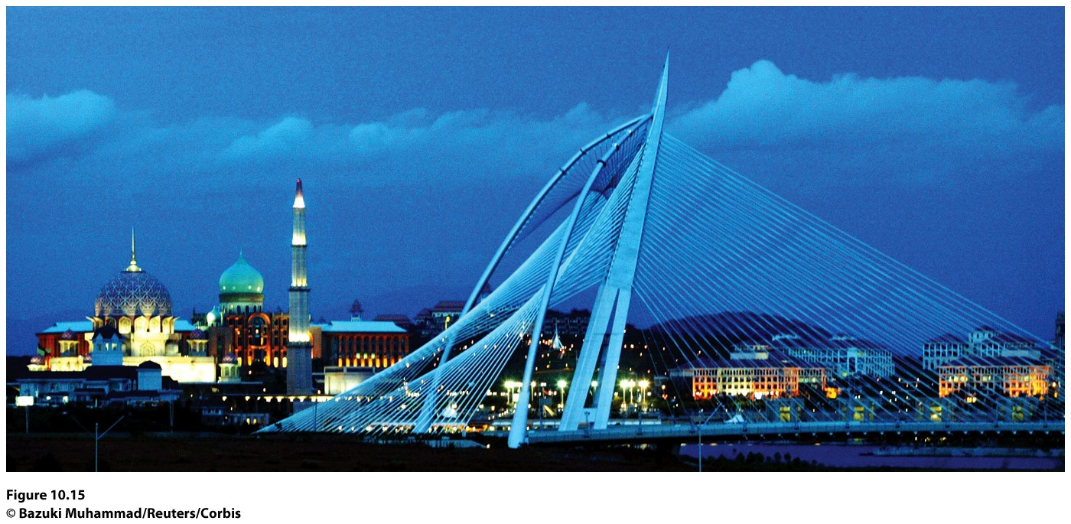
Figure 10.15
Putrajaya, Malaysia. Putrajaya is the newly built capital of Malaysia, replacing Kuala Lumpur.
© Bazuki Muhammad/Reuters/Corbis.

Slide 31
Creating Growth in the Periphery of the Periphery
In the most rural, impoverished regions of less prosperous countries, some nongovernmental organizations (NGOs) try to improve the plight of people.
Each NGO has its own set of goals, depending on the primary concerns outlined by its founders and financiers.
Microcredit programs give loans to poor people, particularly women, to encourage development of small businesses.

Slide 32
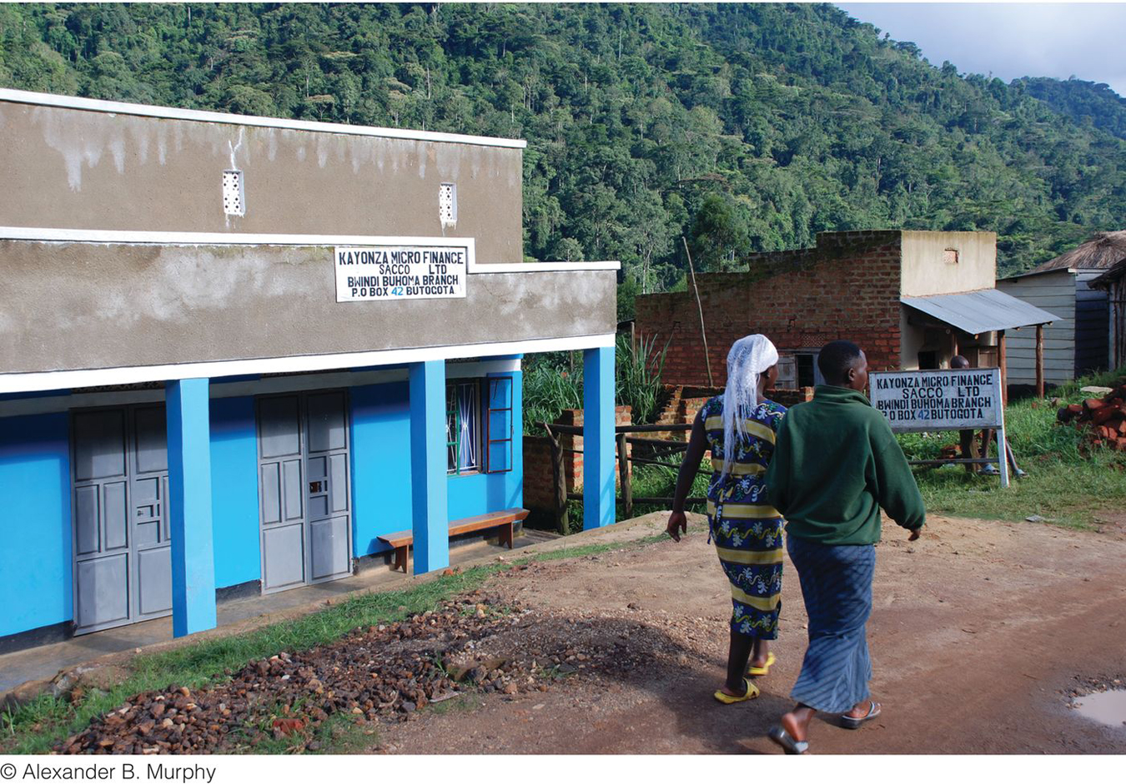
Figure 10.18
Bwindi, Uganda. Women walk by a microcredit agency that works to facilitate economic development in the town. © Alexander B. Murphy.

Slide 33
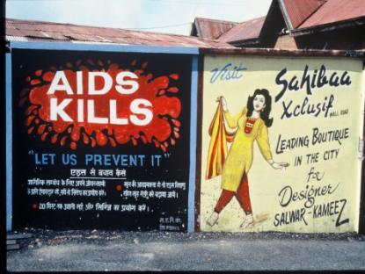
Creating Growth in the Periphery of the Periphery
Some microcredit programs are credited with lowering birth rates in parts of developing countries and altering the social fabric of cultures by diminishing men’s positions of power.
Microcredit programs have been less successful in places with high mortality rates from diseases such as AIDS.
Concept Caching:
AIDS sign—India
© Barbara Weightman

Slide 34
Additional Resources
Global Poverty: http://www.worldbank.org/poverty
Additional Resources on Geography Education:
Development, Poverty, Economic, Globalization.

