Slide 2
Key Question: Where Are Cities Located, and Why?
Urban geographers discovered that every city and town has a trade area, an adjacent region within which its influence is dominant.
Three key components arise frequently in urban geography: population, trade area, and distance.
Concept Caching:
Mount Vesuvius

Slide 3
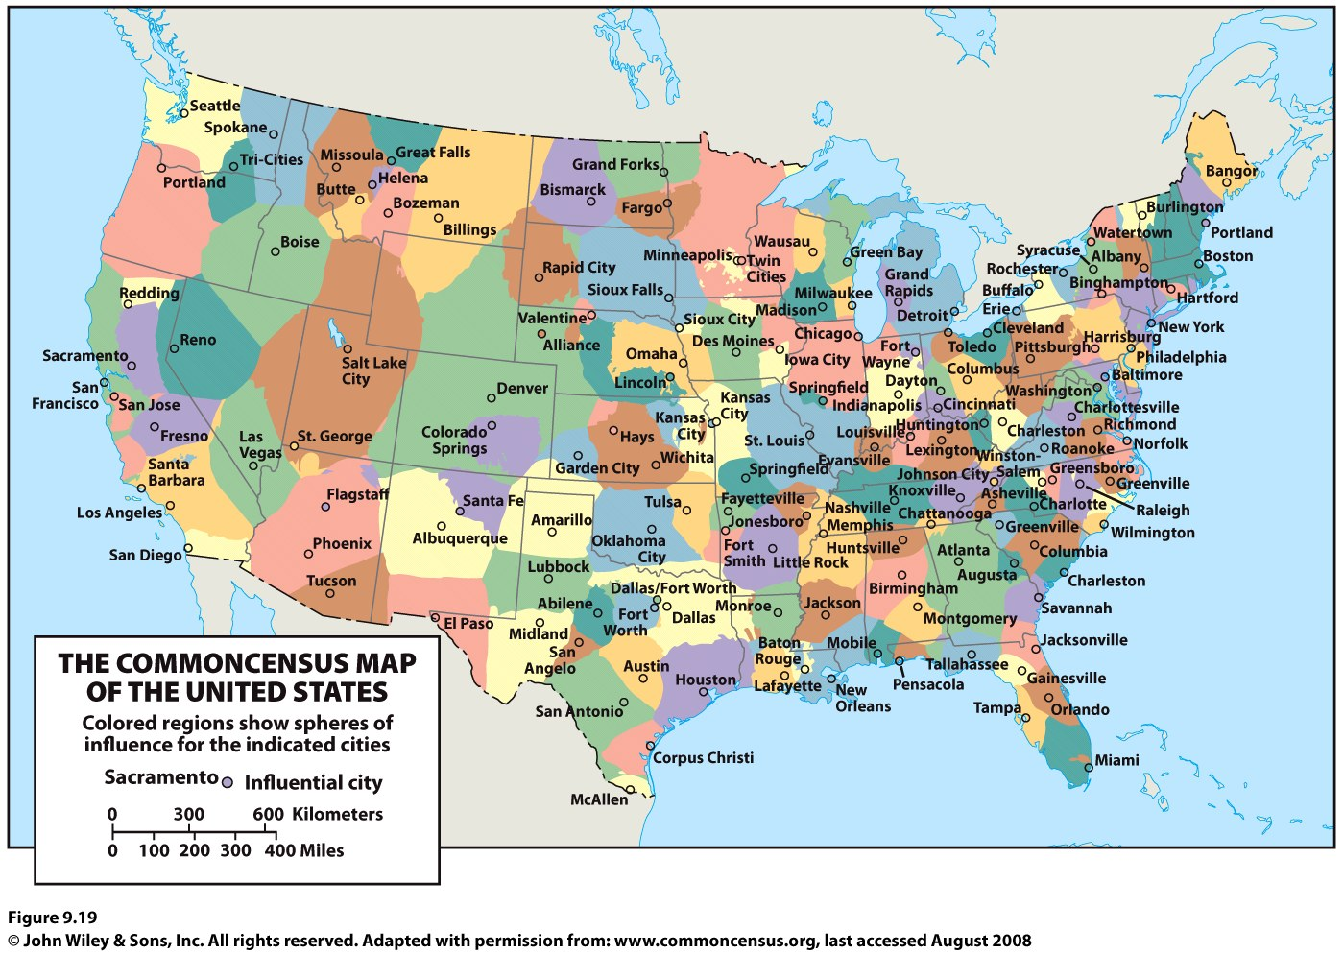

Slide 4
Rank and Size in the Urban Matrix
The rank-size rule holds that in a model urban hierarchy, the population of a city or town will be inversely proportional to its rank in the hierarchy.
German Felix Auerbach, linguist George Zipf.
Random growth (chance) and economies of scale (efficiency) explain why the rank-size rule works where it does.
The rank-size rule does not apply in all countries, especially countries with one dominant city.
Mark Jefferson: A primate city is “a country’s leading city, always disproportionately large and exceptionally expressive of national capacity and feeling.”

Slide 5
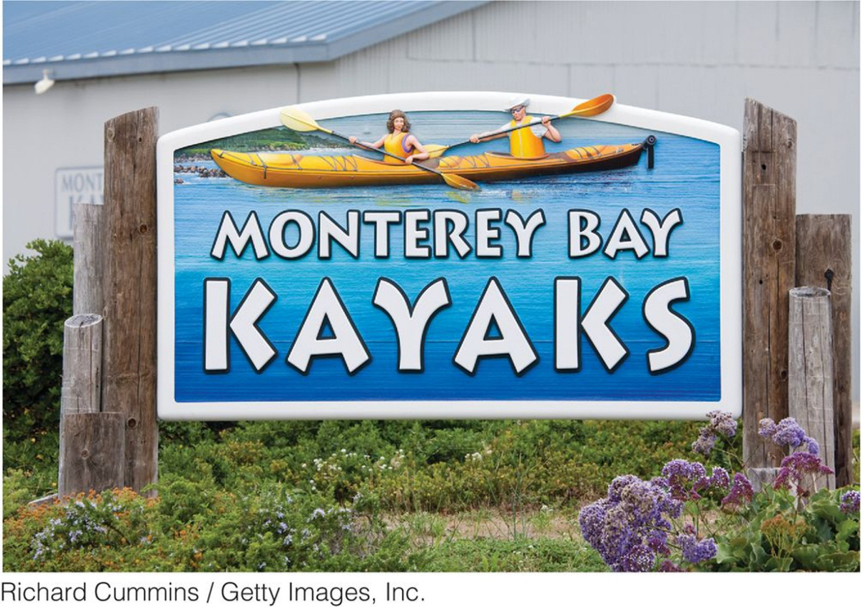
Figure 9.20
Monterey, California. Business names often reflect the trade area where they are located. Many trade areas have a toponym in the local vernacular that those in the region use. When you travel to a new trade area, you may see the toponymn, such as “Bay Area,” “Northern Virginia” or “South Florida,” on service vehicles, billboards, and business names. Around Santa Cruz, Elkhorn, and Monterey, California, may businesses use the toponym “Monterey Bay” to describe the trade area.

Slide 6
Central Place Theory
Central place theory: Walter Christaller, The Central Places in Southern Germany (1933), had five assumptions:
The surface of the ideal region would be flat and have no physical barriers.
Soil fertility would be the same everywhere
Population and purchasing power would be evenly distributed.
The region would have a uniform transportation network to permit direct travel from each settlement to the other.
From any given place, a good or service could be sold in all directions out to a certain distance.

Slide 7
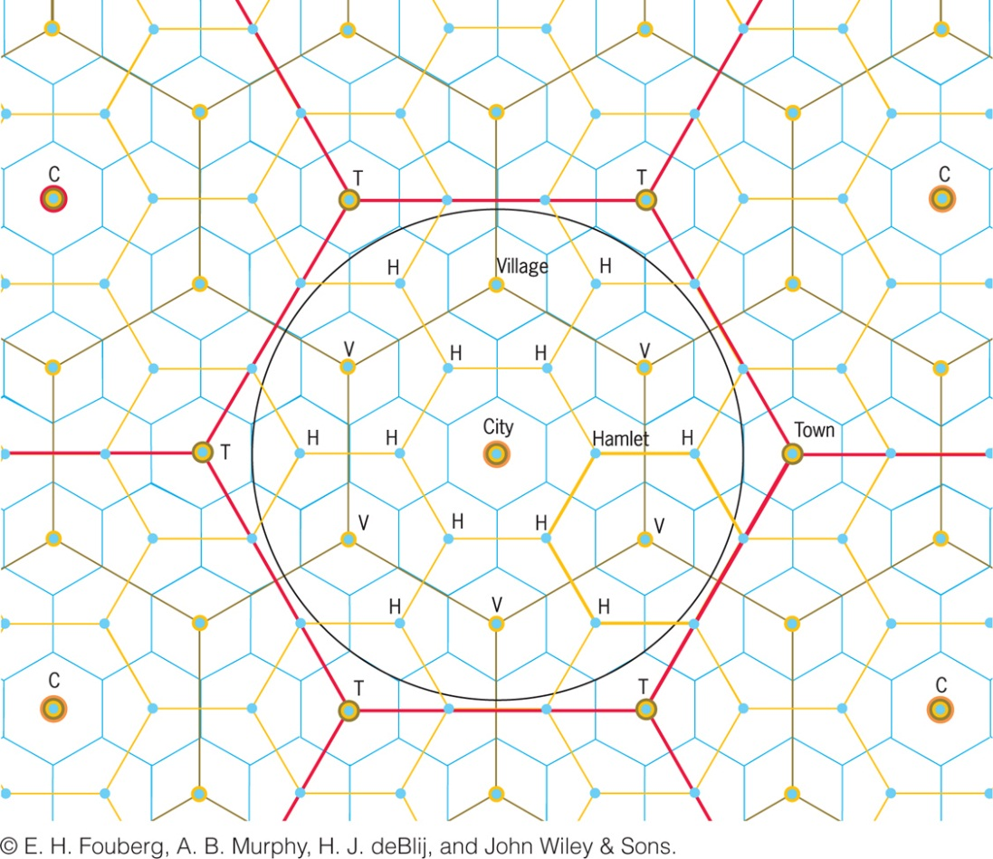
Central Place Theory
Each central place has a surrounding complementary region, an exclusive trade area within which the town has a monopoly on the sale of certain goods.
Hexagonal Hinterlands
Christaller chose perfectly fitted hexagonal regions as the shape of each trade area.

Slide 8
Central Places Today
New factors, forces, and conditions not anticipated by Christaller’s models and theories make them less relevant today.
Ex.: The Sun Belt phenomenon: the movement of millions of Americans from northern and northeastern states to the South and Southwest.

Slide 9
Key Question: How Are Cities Organized, and How Do They Function?
Models of the City
Functional zonation: the division of the city into certain regions (zones) for certain purposes (functions).
Globalization has created common cultural landscapes in the financial districts of many world cities.
Regional models of cities help us understand the processes that forged cities in the first place and understand the impact of modern linkages and influences now changing cities.

Slide 10
Functional Zones
Zone is typically preceded by a descriptor that conveys the purpose of that area of the city.
Most models define the key economic zone of the city as the central business district (CBD).
Central city describes the urban area that is not suburban. In effect, central city refers to the older city as opposed to the newer suburbs.
A suburb is an outlying, functionally uniform part of an urban area, and is often (but not always) adjacent to the central city.
Suburbanization is the process by which lands that were previously outside of the urban environment become urbanized, as people and businesses from the city move to these spaces.

Slide 11
Functional Zones
Since the 1980s, suburban cities ready to compete with the central city for leading urban economic activities.
Suburbanization rapidly creates distinct urban regions complete with industrial, commercial, and educational components.

Slide 12
Modeling the North American City
Concentric zone model: resulted from sociologist Ernest Burgess’s study of Chicago in the 1920s. Burgess’s model divides the city into five concentric zones, defined by their function:
CBD is itself subdivided into several subdistricts.
Zone of transition is characterized by residential deterioration and encroachment by business and light manufacturing.
Zone 3 is a ring of closely spaced but adequate homes occupied by the blue-collar labor force.
Zone 4 consists of middle-class residences.
Zone 5 is the suburban ring.

Slide 13
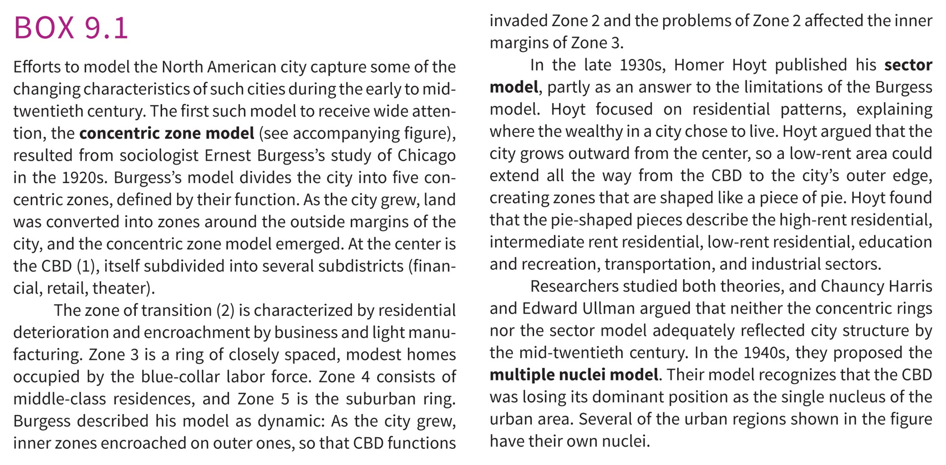

Slide 14
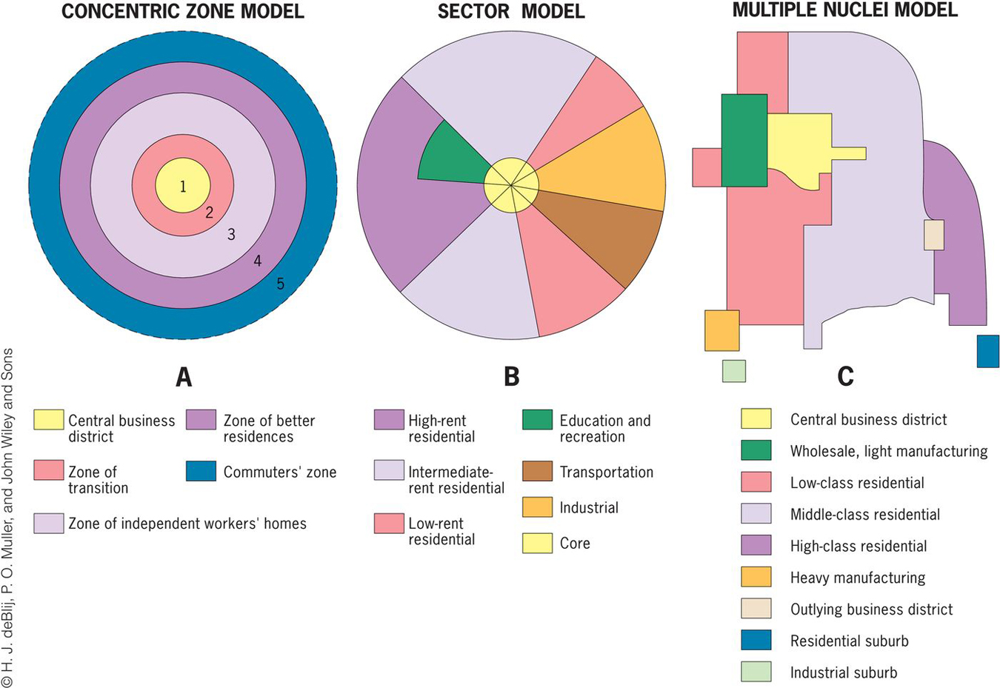

Slide 15
Modeling the North American City
Homer Hoyt: Sector model
The city grows outward from the center, so a low-rent area could extend all the way from the CBD to the city’s outer edge, creating zones that are shaped like a piece of pie.
The pie-shaped pieces describe the high-rent residential, intermediate rent residential, low-rent residential, education and recreation, transportation, and industrial sectors.

Slide 16
Modeling the North American City
Chauncy Harris and Edward Ullman: multiple nuclei model
This model recognizes that the CBD was losing its dominant position as the single nucleus of the urban area.
Edge cities: Suburban downtowns developed mainly around big regional shopping centers; they attracted industrial parks, office complexes, hotels, restaurants, enter-tainment facilities, and sports stadiums.

Slide 17
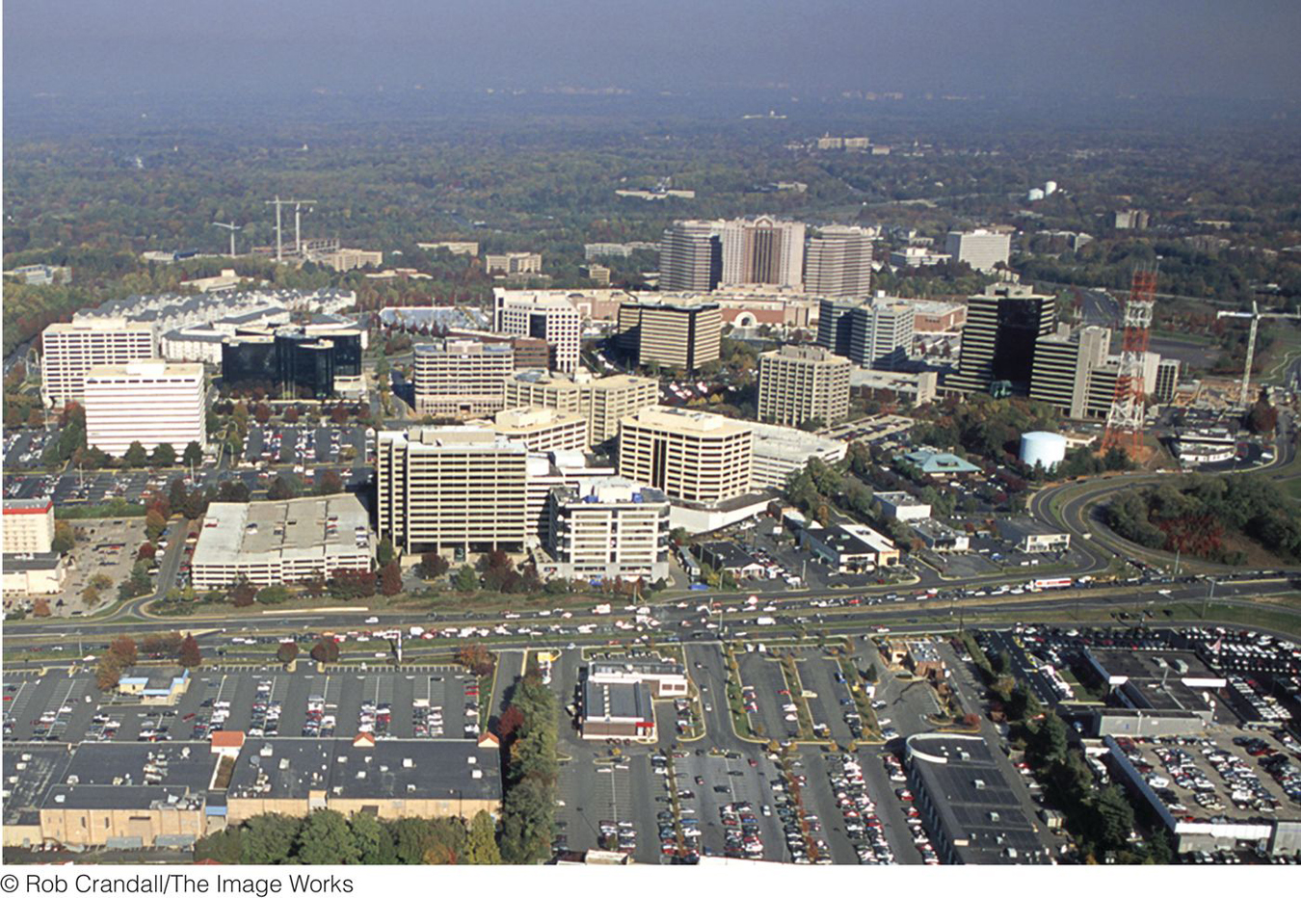
Figure 9.22
Tysons Corner, Virginia. In the suburbs of Washington, D.C., on Interstate 495 (the Beltway), Tysons Corner has developed as a major edge city, with offices, retail, and commercial services. © Rob Crandall/The Image Works.
Notes:
Figure 9.23
Tysons Corner, Virginia. In the suburbs of Washington, D.C., on Interstate 495 (the Beltway),
Tysons Corner has developed as a major edge city, with offi ces, retail, and commercial services. © Rob
Crandall/The Image Works.

Slide 18
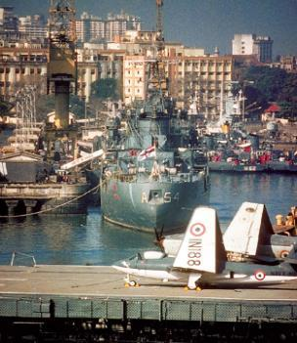
Modeling the Cities of the Global Periphery and Semiperiphery
Primate cities in developing countries are called megacities when the city has a large population, a vast territorial extent, rapid in-migration, and a strained, inadequate infrastructure.
Concept Caching:
Mumbai, India
© Harm de Blij

Slide 19
The South American City
Griffin-Ford model
South American cities blend traditional elements of South American culture with globalization forces that are reshaping the urban scene, combining radial sectors and concentric zones.
The thriving CBD anchors the model.
Shantytowns are unplanned groups of crude dwellings and shelters made of scrap wood, iron, and pieces of cardboard that develop around cities.

Slide 20
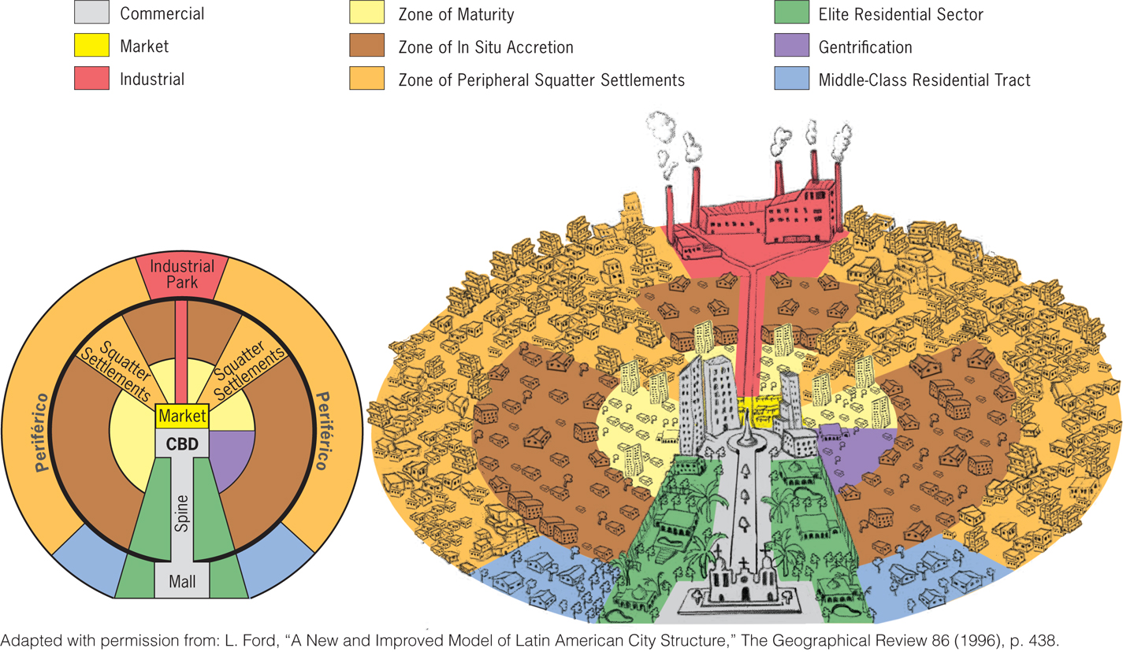
Figure 9.23
Latin American City Model. This model includes both the zones created in the original Griffin–Ford model and the new Ford model of the South American city.

Slide 21
The African City
The imprint of European colonialism can still be seen in many African cities.
During colonialism, Europeans laid out prominent urban centers.
The centers of South Africa’s major cities (Johannesburg, Cape Town, and Durban) remain essentially Western.
Studies of African cities indicate that the central city often consists of not one but three CBDs: a remnant of the colonial CBD, an informal and sometimes periodic market zone, and a transitional business center where commerce is conducted.

Slide 22
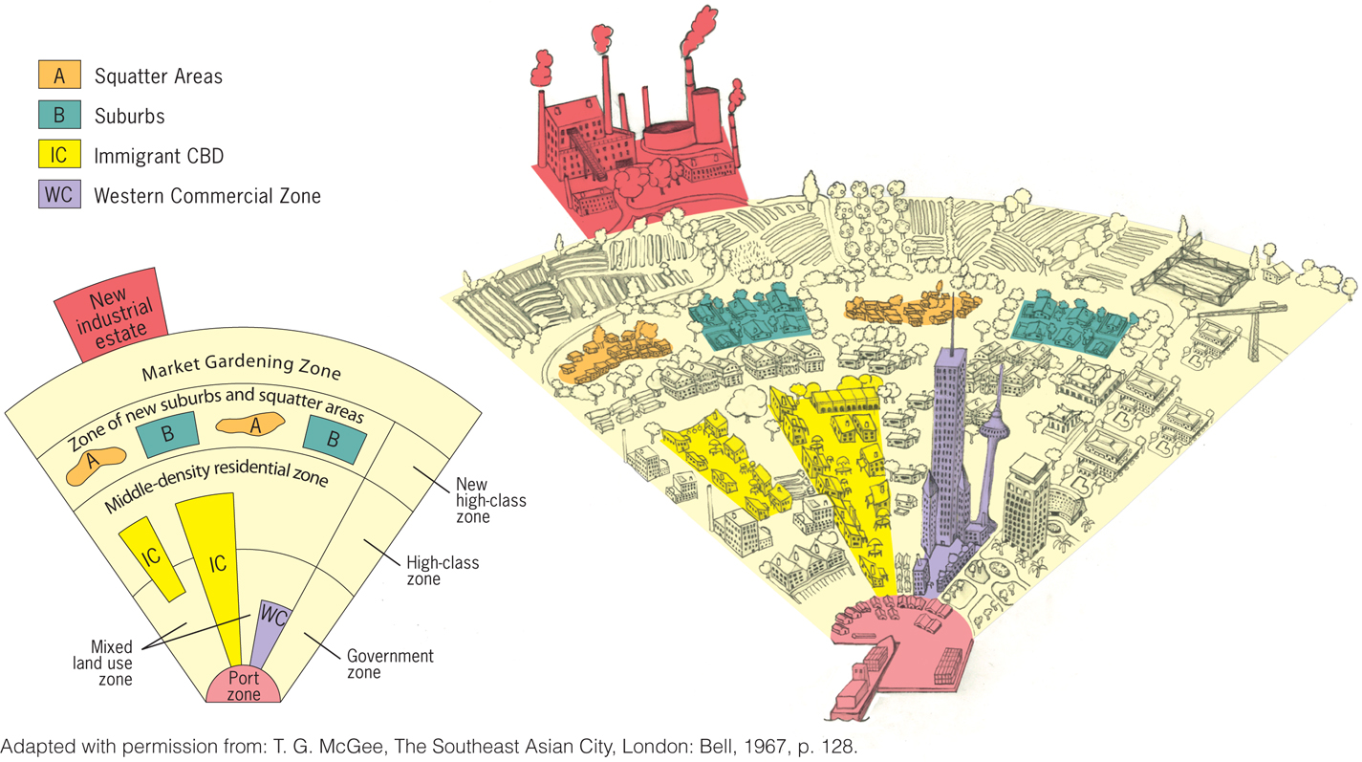
The Southeast Asian City
Figure 9.26
Model of the Large Southeast Asian City. A model of land use in the medium-sized Southeast Asian city includes sectors and zones within each sector.
Notes:
Figure 6.19
Llanfairpwllgwyngyllgogerychwyrndrobwllllantysiliogogogoch, Wales. The town with
the self-proclaimed longest name in the world attracts hordes of tourists each year to a place
whose claim to fame is largely its name. © Alexander B. Murphy.

