Slide 1

Human Geography: People, Place,
and Culture, 11th Edition

Slide 2
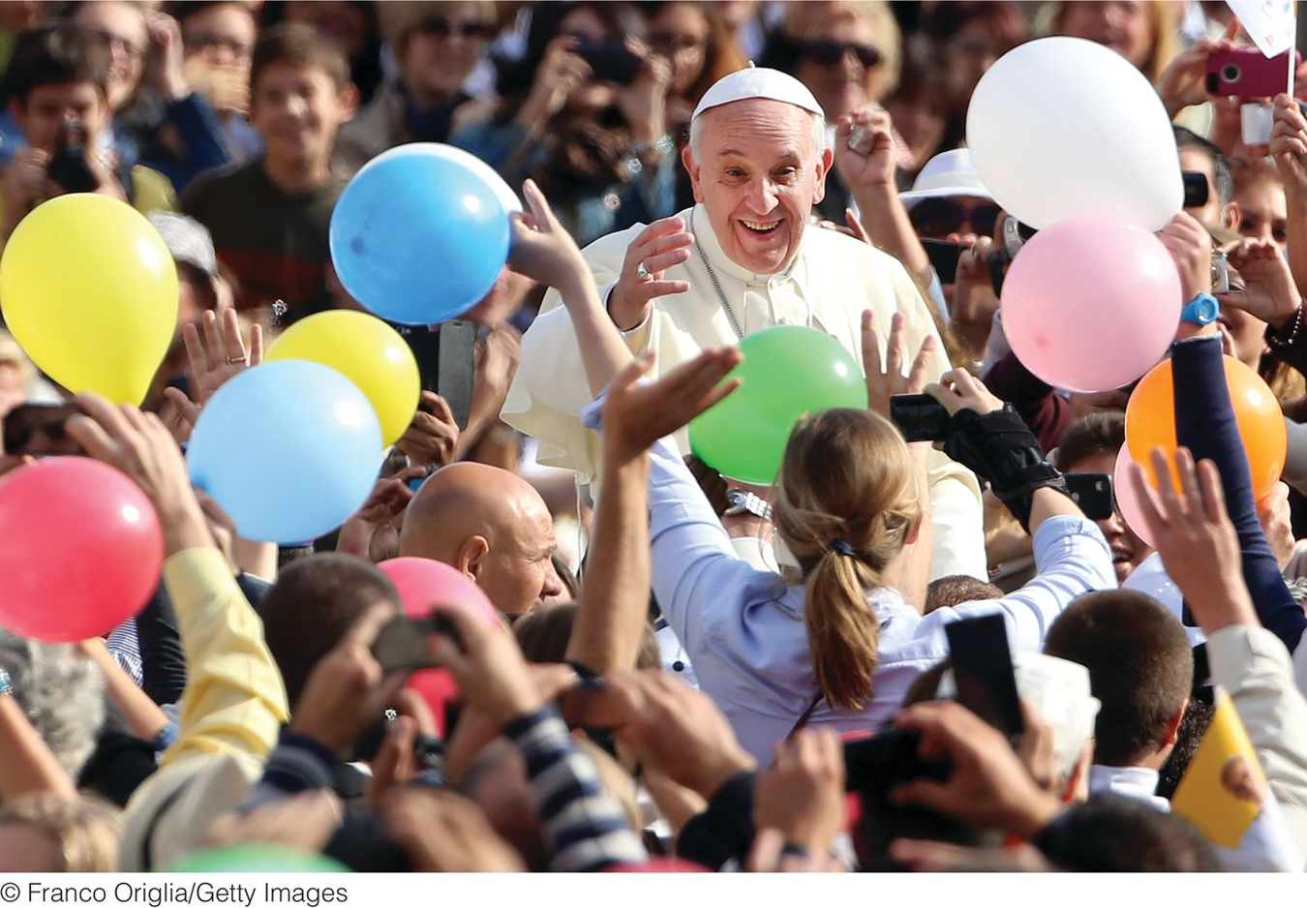
Chapter 7: Religion
Notes:
2

Slide 3
KEY QUESTION: What Is Religion, and
What Role Does It Play in Culture?
A religion is “A system of beliefs and practices that attempts to order life in terms of culturally perceived ultimate priorities.”
Religions set standards for how people “should” behave.
Notes:
3

Slide 4
Cultural Religious Manifestations
Worship
Prayer
Rituals
  Take place through regular intervals
  Birth, marriage, and death
  Attainment of adulthood
Secularism is the indifference to or rejection of religion.
Notes:
4

Slide 5

Describe how religion and language affect and change each other to shape cultures. Consider what happens to a society’s religion and language when a different religion or language diffuses to the place.
Notes:
5

Slide 6
Key Question: Where did the major religions of the world originate, and how do religions diffuse?
Monotheistic religions: single god
Polytheistic religions: many gods
Animistic religions: inanimate objects possess spirits
Notes:
6

Slide 7
Major types of religion
Universalizing religions:
  Actively seek converts
  Believe that they offer universal appropriateness and appeal
  Christianity, Islam, Buddhism
Ethnic religions:
  Adherents are born into the faith
  Do not actively seek converts
  Spatially located, Judaism the exception

Slide 8
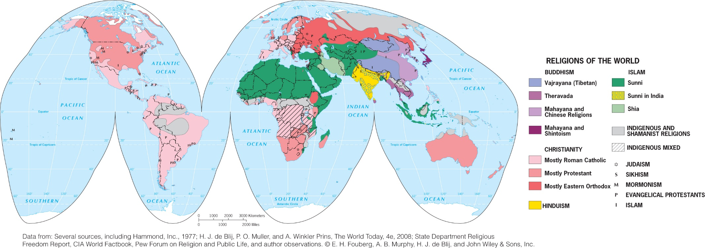
Religious Hearths: South Asia
Hinduism
  Polytheistic religion is over 4000 years; originated in the Indus River Valley
Ancient practices include ritual bathing (esp. in Ganges River) and reincarnation

Slide 9
Religious Hearths: South Asia
Buddhism
Splintered from Hinduism 2500 years ago
Siddhartha
Approximately 347 million adherents
Shintoism
Japan
Focused on nature and ancestor worship

Slide 10
Religious Hearth: Huang He River Valley
Taoism
Lao-Tsu worship
Tao-te-ching
Feng Shui
Confucianism
Confucius 551 to 479 BCE
Confucian Classics

Slide 11
Religious Hearth: Eastern Mediterranean
Judaism
  Teachings of Abraham
  Orthodox and reformed
Diffusion of Judaism
  Diaspora
  Zionism

Slide 12
Religious Hearth: Eastern Mediterranean
Christianity
  Teachings of Jesus
  Split from Judaism
  Church split led to Eastern Orthodox and Roman Catholic Church
  Protestant reformation challenged fundamental Roman Catholic teachings

Slide 13
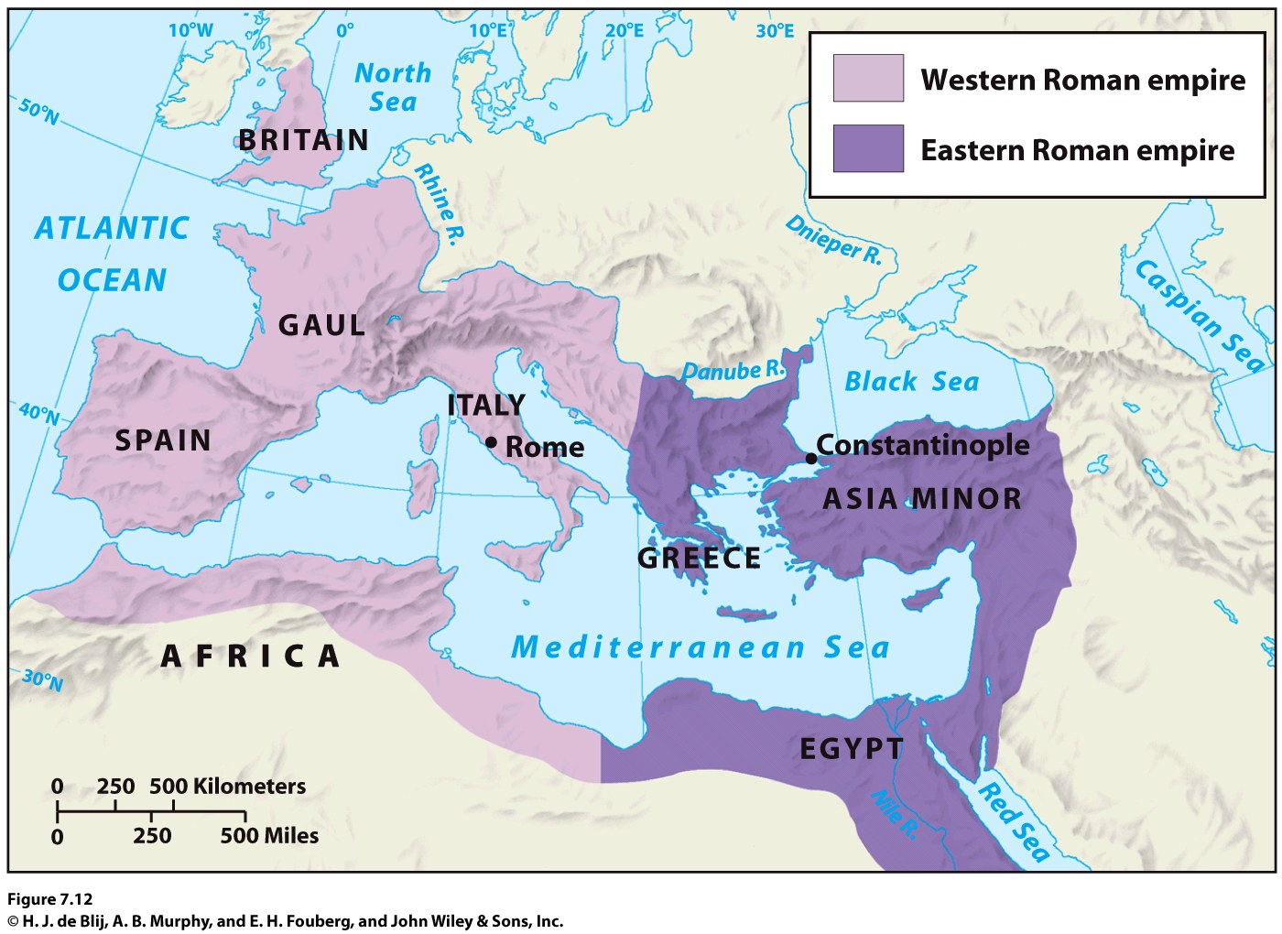
Religious Hearth: Eastern Mediterranean
Diffusion of Christianity
European Colonialism in the sixteenth century
33,000 denominations

Slide 14
Religious Hearth: Eastern Mediterranean--Islam
Founder Muhammad, Five pillars
Sacred text is the Qu’ran (Koran)
Shi’ite and Sunni
Diffusion of Islam
  Kings used armies to spread faith across Arabian Peninsula.
  Islam later spread by trade.
  1.57 billion followers worldwide; is fastest-growing religion.

Slide 15
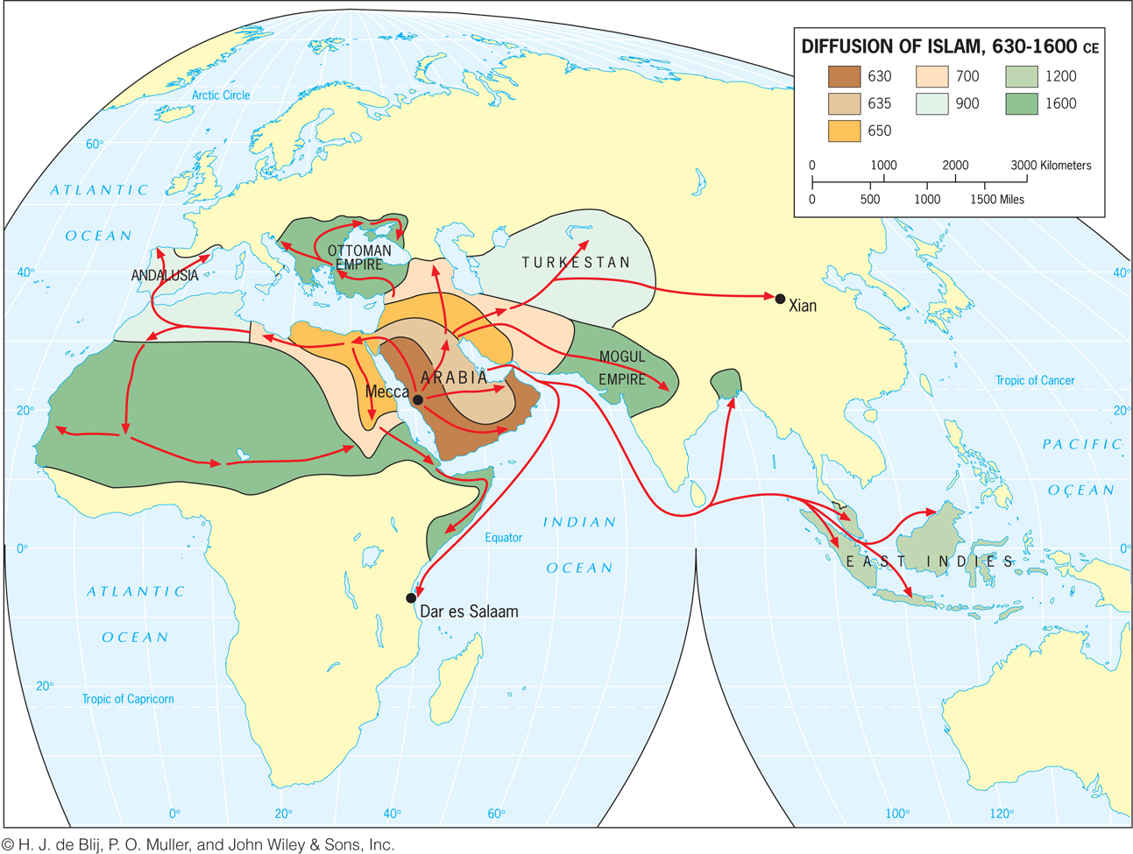

Slide 16
Indigenous and Shamanist
Where Did the Major Religions of the World Originate, and How Do Religions Diffuse?
Indigenous
  Local in scope
  Reverence for nature
  Passed down through tribes
Shamanism
  Community faith
  Follow the practices and teachings of the shaman

Slide 17
The Rise of Secularism
Indifference to or rejection of organized religious affiliations and idea
  Varies greatly from country to country and within countries.
  Antireligious ideologies can contribute to the decline of organized religions.
Church membership figures do not accurately reflect active participation.

Slide 18
Migration plays a large role in the diffusion of religions, both universalizing and ethnic. As Europe becomes more secular, migrants from outside of Europe continue to settle in the region. Imagine Europe 30 years from now. Predict where in Europe secularism will be the most prominent and where religious adherence will strengthen.
Notes:
18

Slide 19
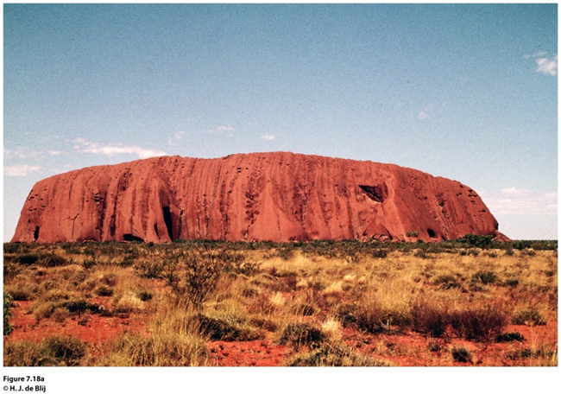
Key Question: How Is Religion Seen in the Cultural Landscape?
Sacred sites: Places or spaces people infuse with religious meaning
Pilgrimage: Adherents voluntarily travel to a religious site to pay respects or participate in a ritual at the site
Figure 7.18a
Uluru, Australia

Slide 20
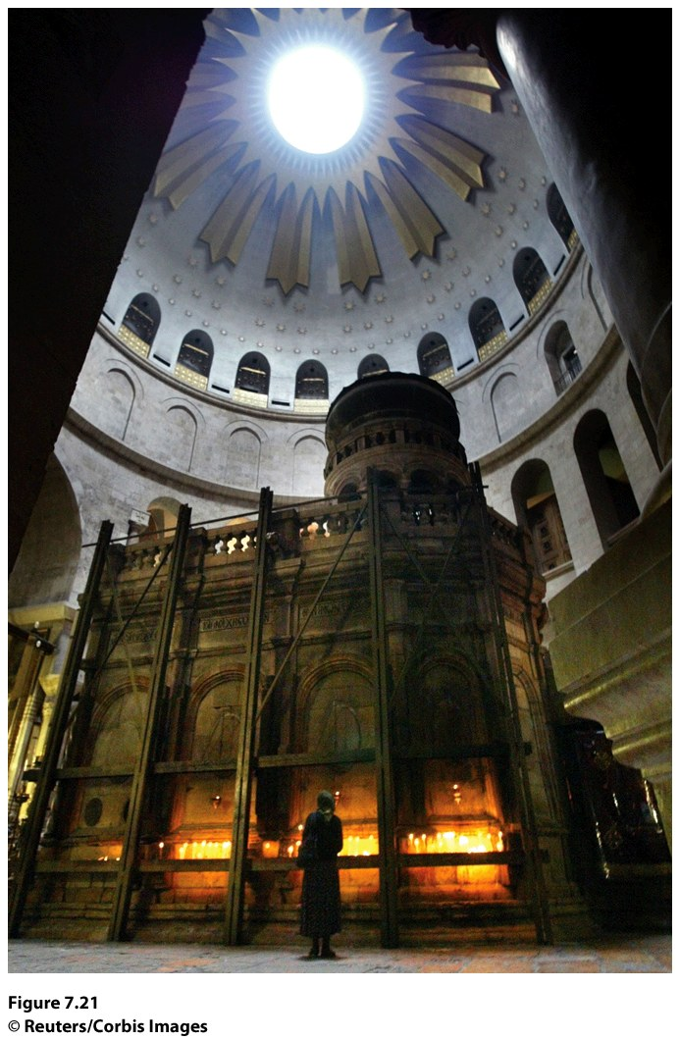
Figure 7.21
Jerusalem, Israel. The Church of the Holy Sepulchre is sacred to Christians who believe it is the site where Jesus Christ rose from the dead. Inside the church, a Christian worshipper lights a candle at Jesus Christ’s tomb. © Reuters/Corbis Images.
Sacred Sites of Jerusalem
Sacred to Jews, Christians, and Muslims
Wailing Wall, Temple Mount, Dome of the Rock

Slide 21
Landscapes of Hinduism and Buddhism
Hinduism
  Temples, shrines
  Holy animals, ritual bathing
Buddhism
  The Bodhi (enlightenmnt) tree
  Stupus: bell shaped structures that protect burial mounds
  Pagoda
Cremation in both Hinduism in Buddhism

Slide 22
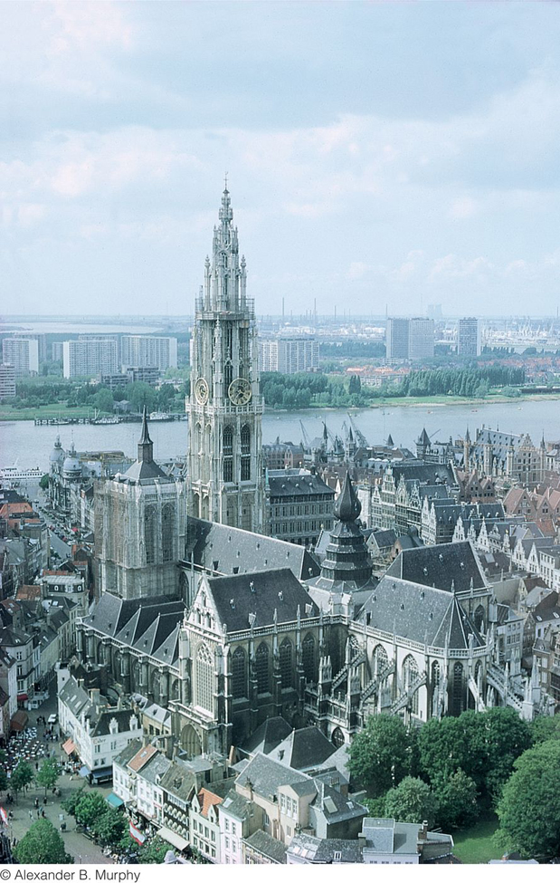
Landscapes of Christianity
Medieval Europe
  Cathedral, church, or monastery
Burial more commonly practiced
Figure 7.25
Antwerp, Belgium. The cathedral in Antwerp was built beginning in 1352 and still dominates the central part of town.

Slide 23
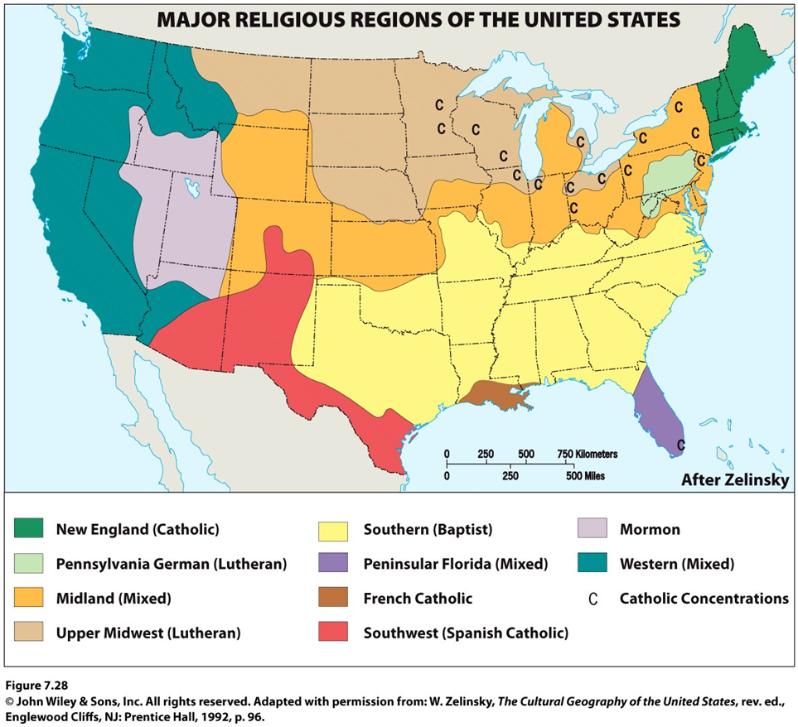
Landscapes of Christianity: USA
New England: Catholic
South: Baptist
Upper Midwest: Lutheran
Southwest: Spanish Catholic
West, Midlands: no dominant denomination
Notes:
Figure 7.28
Major Religious Regions of the United States.
A generalized map of the religious regions of the United States shows concentrations of the major religions.
Adapted with permission from: W. Zelinsky, The Cultural Geography of the United States, rev. ed., Englewood Cliffs, NJ: Prentice Hall, 1992, p. 96.

Slide 24
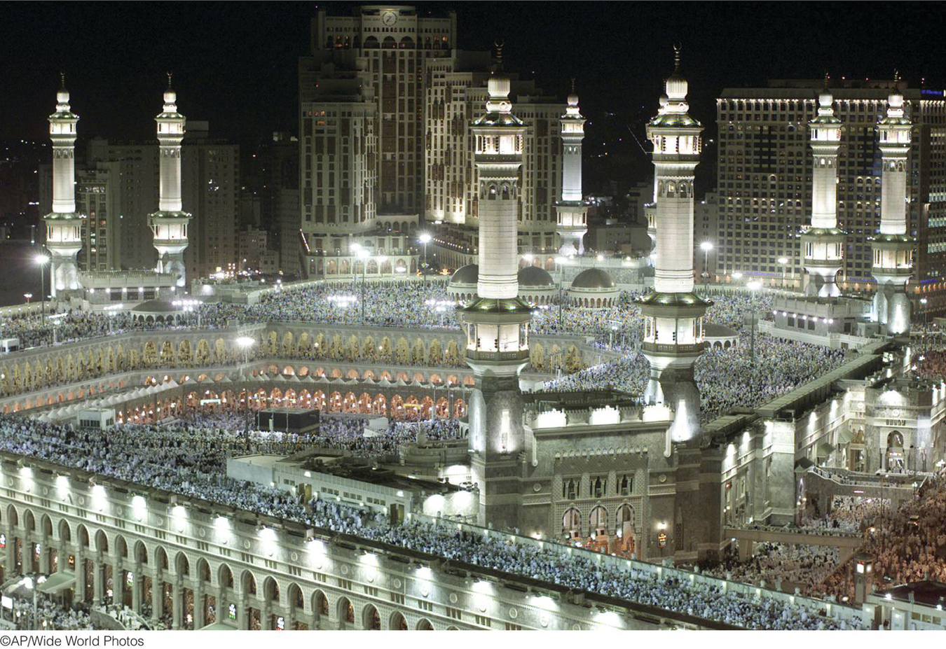
Landscapes of Islam
Prohibition against depicting the human form (more calligraphy and geometric design)
Hajj: Pilgrimage to Mecca
Notes:
Figure 7.33
Mecca, Saudi Arabia. Pilgrims circle the holy Kaaba in the Grand Mosque in Mecca during the hajj. © Amel Emric/AP/Wide World Photos.

Slide 25
Choose a pilgrimage site, such as Mecca, Vatican City, or the Western Wall, and describe how the act of pilgrimage (in some cases by millions) alters this place’s cultural landscape and environment.
Notes:
25

Slide 26
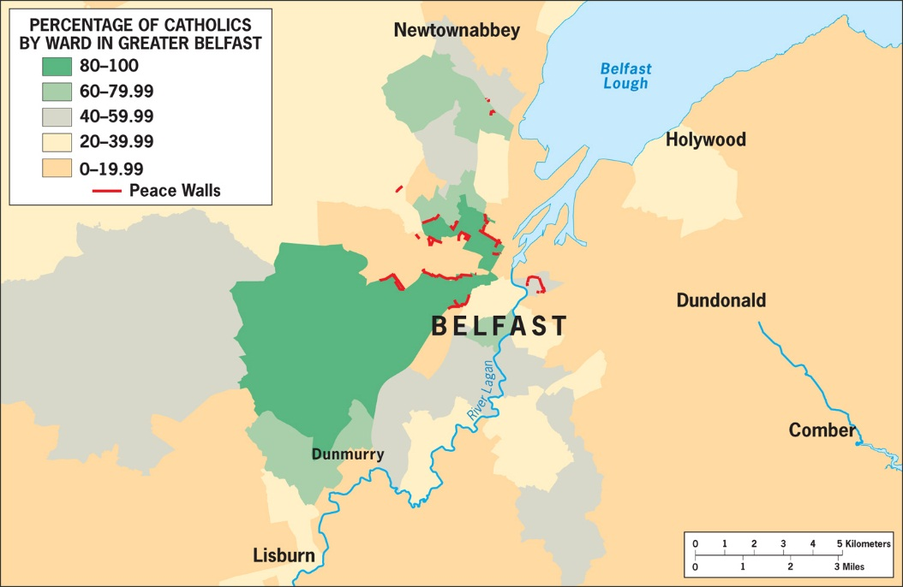
Conflicts along Religious Borders
Key Question: What Role Does Religion Play in Political Conflicts?
Interfaith boundaries: between major faiths
  Ex.: Christian-Muslim boundaries in Africa
Intrafaith boundaries: within a single major faith
  Ex.: Protestants and Catholics
Figure 7.39
Religious Affiliation and Peace Lines in Belfast, Northern Ireland. Catholic neighborhoods are clustered west of the Central Business District and west of the River Lagan. Protestant neighborhoods are separated from Catholic neighborhoods by Peace Walls in West Belfast.

Slide 27
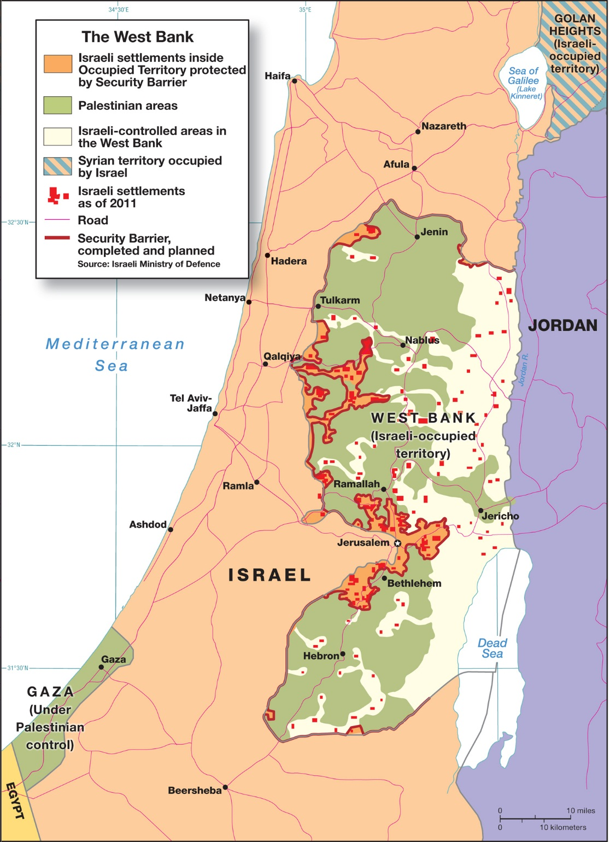
Figure 7.36
The West Bank. Adapted with permission from: C. B. Williams and C. T. Elsworth, The NewYork Times, November 17, 1995, p. A6. © The New York Times.

Slide 28
What Role Does Religion Play in Political Conflicts?
Israel and Palestine
  WWII, 1967 Arab-Israeli War, West Bank, Hamas
Nigeria
  Muslim North/Christian South
The Former Yugoslavia
  Balkan Peninsula separates the Roman Catholic Chruch and the Eastern Orthodox Church
Northern Ireland
  Catholics and Protestants in the North

Slide 29
Fundamentalism and Extremism
Religious fundamentalism
  Beliefs are nonnegotiable and uncompromising
Religious extremism
  Fundamentalism carried to the point of violence
  Fundamentalists can be extremists but this does not mean that all fundamentalists (of any faith) are extremists

Slide 30
Fundamentalism and Extremism
Christianity
  Traditionalist Catholic Movement
  Protestant fundamentalism
Judaism
  Orthodox conservatives
  Extremist groups Kach and Kahane Chai
Islam
  Jihad: Taliban in Afghanistan

Slide 31
Boal’s studies in Northern Ireland demonstrate that solving a religious conflict is typically not about theology; it is about identity. You are assigned the potentially Nobel Prize–winning task of “solving” the conflict either in Northern Ireland or in Israel and Palestine. Using Boal’s example, determine how you can alter activity spaces and change identities to create the conditions for long-lasting peace in this conflict zone.
Notes:
31

Slide 32
Additional Resources
On Geography Education:
  Religion, Landscape, Diffusion, Christianity, Islam, Buddhism, Hinduism, Judaism.

