Slide 1
Human Geography: People, Place,
and Culture, 11th Edition

Slide 2
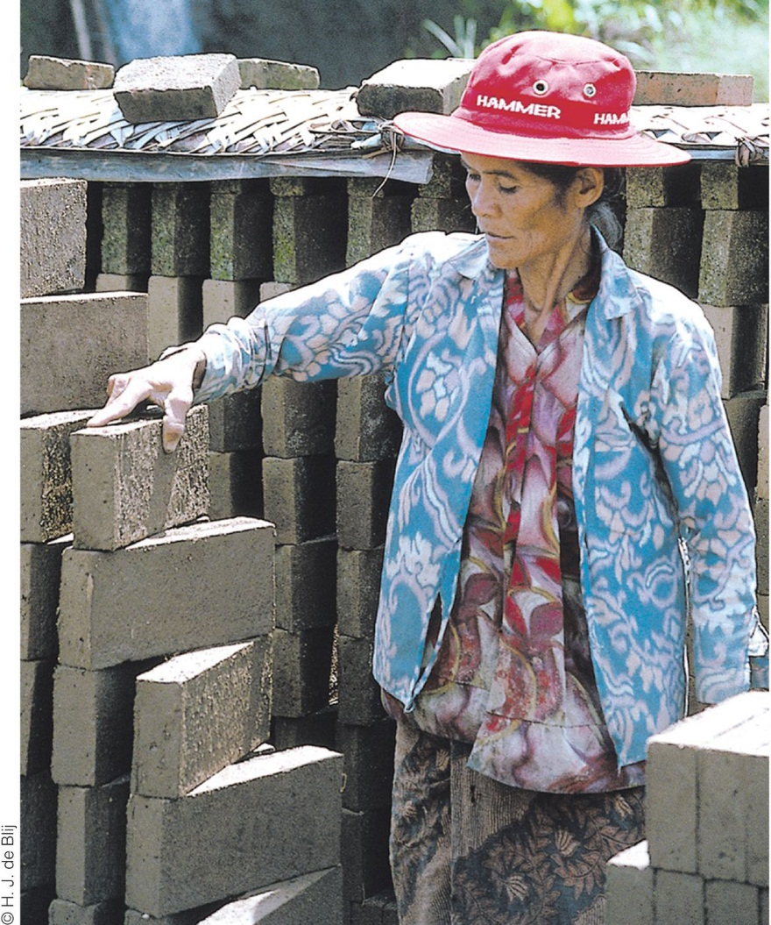
Field Note: Building Walls
“Traveling on the Indonesian island of Bali, I saw a brick-making facility and stopped to visit. Boys and women were building bricks by hand, in the hot sun. I watched young boys scoop wet mud from a quarry by a creek into their wheelbarrows. They poured the mud into wooden forms. Once the bricks began to dry and harden in the sun, someone had to turn the bricks repeatedly to prevent them from cracking. The woman in Figure 5.1 worked ten hours a day, six days a week, turning, stacking, and re-stacking bricks to prevent them from cracking. For her work, she earned about 45 cents (U.S.) per hour.”
“
Notes:
Figure 5.1
Bedugul, Indonesia. This woman working at a brick-making
facility in the village of Bedugul on the Indonesian island of Bali
makes about 45 cents (U.S.) per hour and works 10 hours a day,
6 days a week. © H. J. de Blij.

Slide 3
Key Question:
What is identity, and how are identities constructed?

Slide 4
Identity
Geographer Gillian Rose defines identity as “how we make sense of ourselves.”
We construct our own identities through experiences, emotions, connections, and rejections
Identifying against other people: define the “Other,” and then we define ourselves in opposing terms

Slide 5
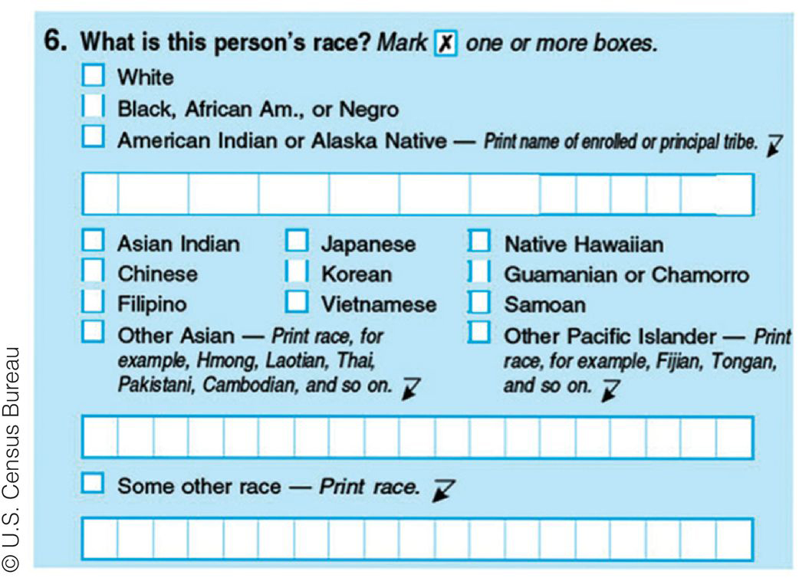
Race
“Races” are the product of ways of viewing minor genetic differences that developed as modern humans spread around the world
Notes:
Figure 5.2
United States. Although biologically there is only one human
race, we are constantly asked to choose race “boxes” for ourselves.
This page of the 2010 United States Census asks the
individual, “What is your race?” and directs the individual to
“Mark one or more races to indicate what you consider yourself to be.” © U.S. Census Bureau

Slide 6
Race and Racism
Race
Many of societies’ modern assumptions about race grew out of the period of European exploration and colonialism
Racism
What society typically calls a “race” is in fact a combination of physical attributes in a population
Skin color is not a reliable indicator of genetic closeness

Slide 7
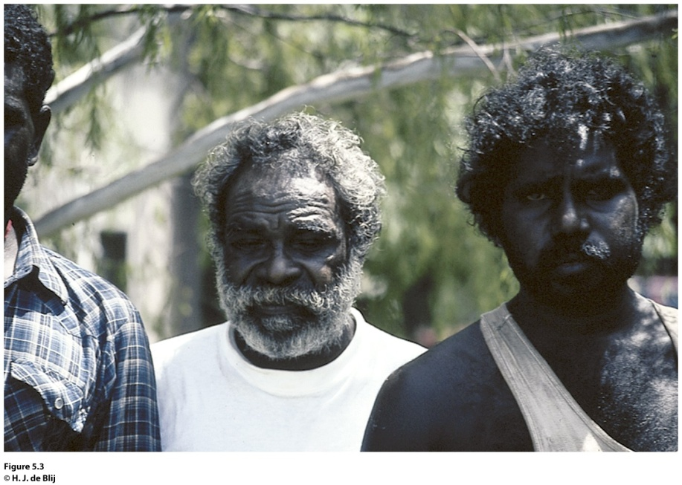
Field Note
Concept Caching:
Fenway Park, Boston, MA
“We were traveling in Darwin, Australia, in 1994 and decided to walk away from the modern downtown for a few hours. Darwin is a multicultural city in the midst of a region of Australia that is largely populated by Aboriginals. At the bus stops on the outskirts of the city, Aboriginals reached Darwin to work in the city or to obtain social services only offered in the city. With a language barrier between us, we used hand gestures to ask the man in the white shirt and his son if we could take their picture. Gesturing back to us, they agreed to the picture. Our continued attempts at sign language soon led to much laughter among the people waiting for the next bus.”
Notes:
Figure 5.3
Darwin, Australia. © H. J. de Blij

Slide 8
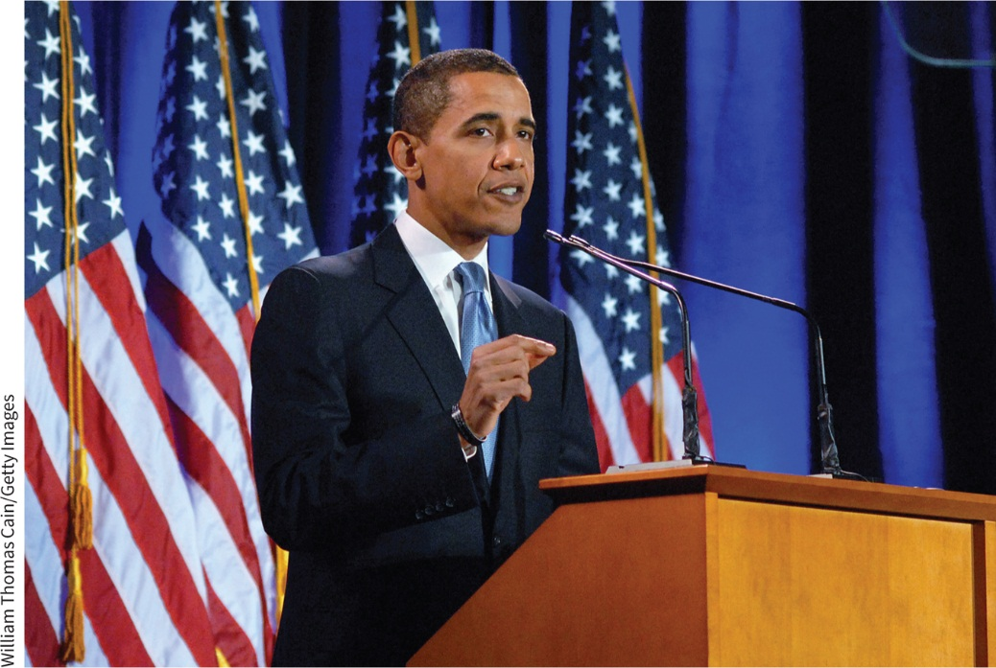
Race and Ethnicity in the U.S.
Unlike a local culture or ethnicity to which we may choose to belong, race is an identity that is more often assigned.
U.S. racial categories are reinforced through residential segregation, racialized divisions of labor, and categories of races recorded by the Census Bureau and other government and nongovernmental agencies.
Because of immigration and differences in fertility rates, the United States is increasingly “nonwhite.”
How Americans define “race” is changing.

Slide 9
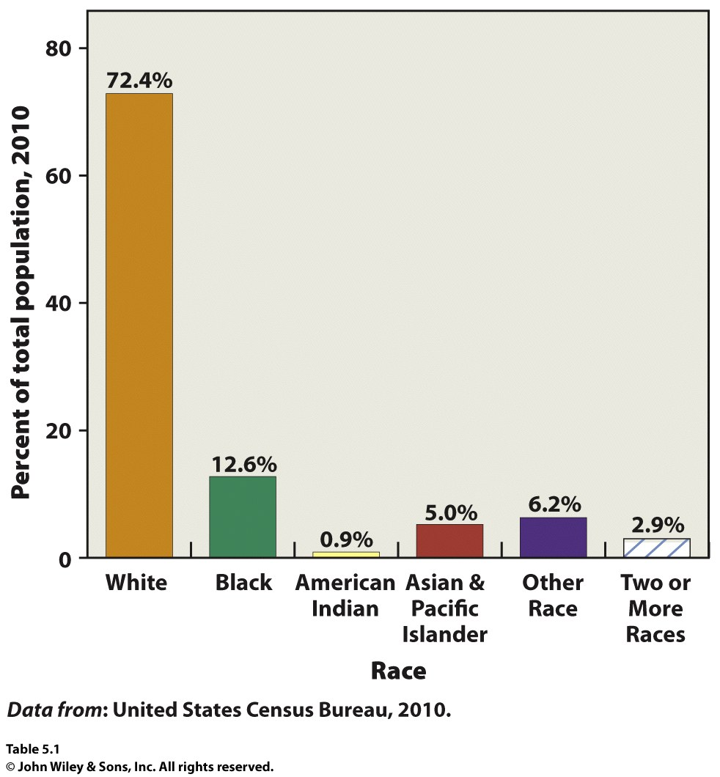
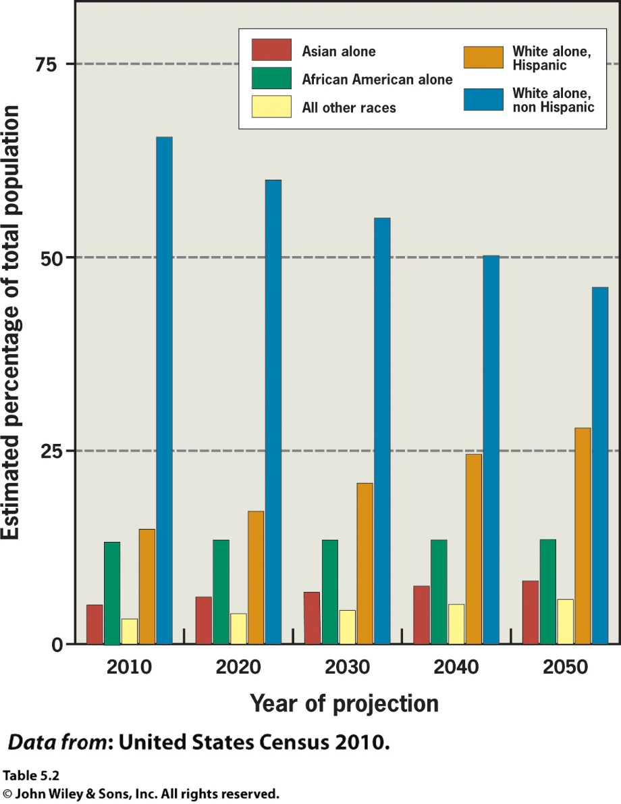

Slide 10
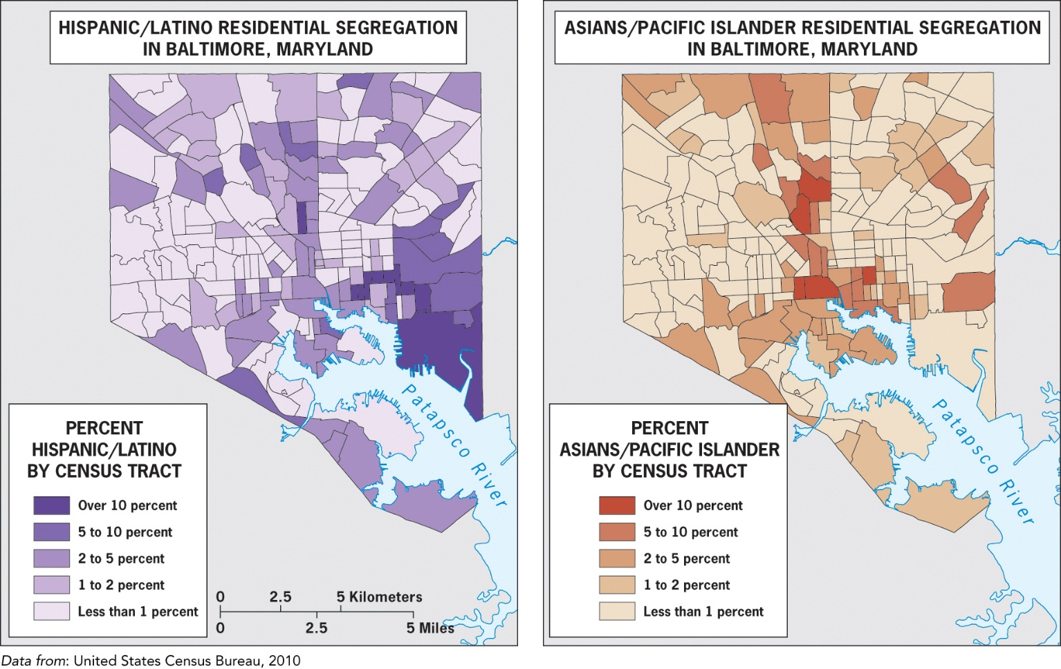
Residential Segregation:
“the degree to which two or more groups live separately from one another, in different parts of the urban environment.” -Geographers Douglas Massey and Nancy Denton
Notes:
The Quote comes from Geographers Douglas Massey and Nancy Denton

Slide 11
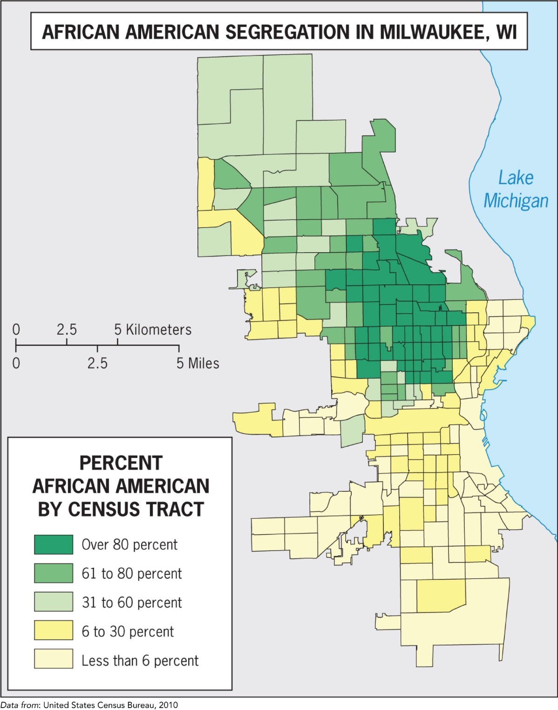
Five measures of segregation:
Evenness
Exposure
Concentrated
Centralized
Clustered

Slide 12
Identities across Scales
Different identities at different scales:
Individual: brother, sister, student
Local: residents of a neighborhood
Regional: Southerners
National: American
Global: Western, free
Appropriate identity is revealed at the appropriate scale.

Slide 13
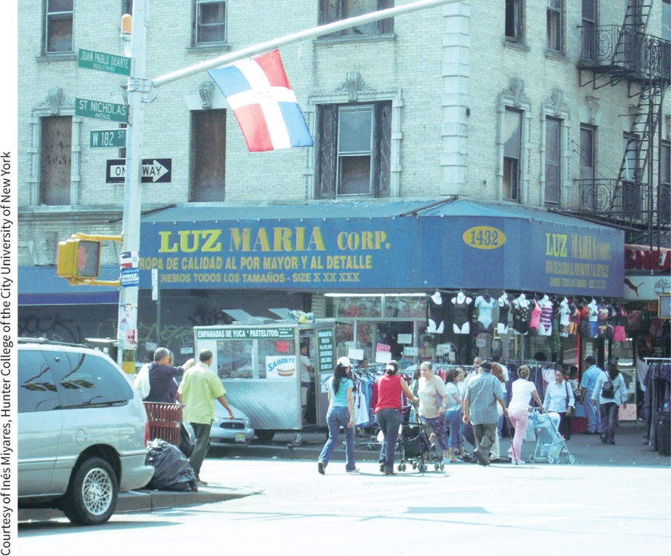
The Scale of New York
NYC has more immigrants from more diverse backgrounds than other U.S. cities.
Succession: New immigrants to a city often move to low-income areas being slowly abandoned by older immigrant groups.
Many new immigrants focus on the streetscapes, creating businesses to serve their community and reflect their culture.

Slide 14
Recall the last time you were asked to check a box for your race. Does that box factor into how you make sense of yourself
individually, locally, regionally, nationally, and globally? What impact might it have on how other people view you?

Slide 15
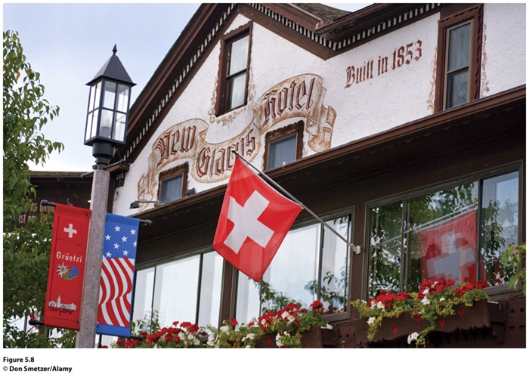
Key Question:
How do places affect identity, and how can we see identities in places?
Figure 5.8
New Glarus, Wisconsin. The town of New Glarus was
established by immigrants from Switzerland in 1845. The Swiss American town takes pride in its history and culture, as the flags at the New Glarus Hotel Restaurant demonstrate.

Slide 16
Ethnicity and Place
Ethnicity: people are bounded in a certain place over time.
Ethnos = “people”
Sense of Place: Places are infused with meanings, memories and experiences.
Ethnic identity is greatly affected by scale and place.
Ethnicities create a sense of place in their nations and neighborhoods, landscapes and locations.

Slide 17
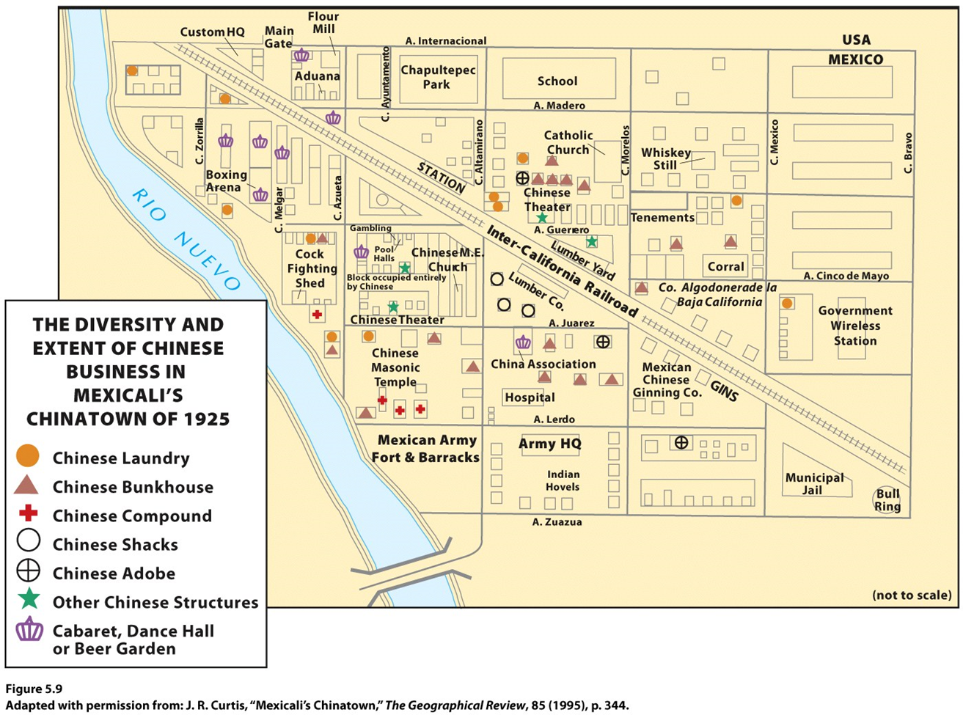
Case Study: Chinatown in Mexicali
Crucible of Chinese ethnicity in the Mexicali Valley during 20th century.
Now a symbol and functions to preserving group identity and consciousness.

Slide 18
Identity and Space
Space: “social relations stretched out”
Place: “particular articulations of those social relations as they have come together, over time, in that particular location.”
Gendered places: Social use of places change based on identities, especially gender. Social norms heavily influence individual and group behaviors.

Slide 19
Sexuality and Space
Glen Elder, Lawrence Knopp, and Heidi Nast: queer theory
Gary Gates and Jason Ost: The Gay and Lesbian Atlas
Concentrations of same-sex households in the United States are in cities with well-established gay and lesbian neighborhoods.

Slide 20
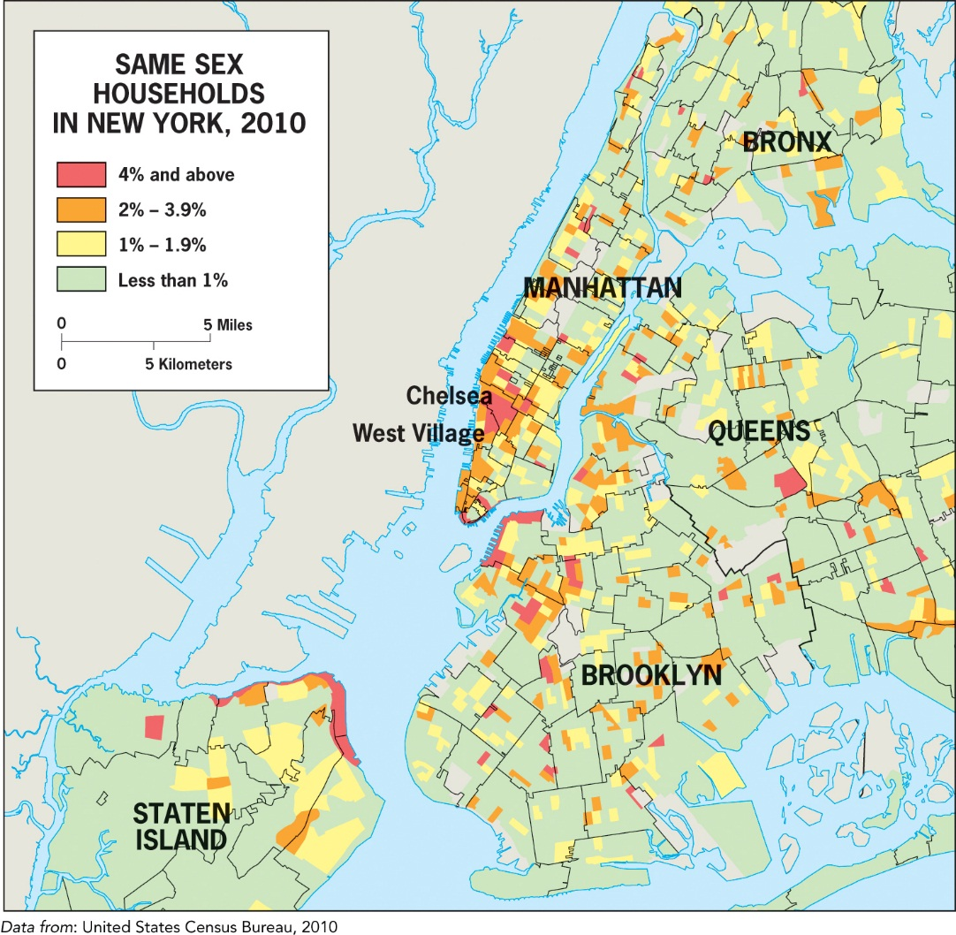
In the 2010 census, the government tallied the number of households where a same-sex couple (with or without children) lived. Study the map of same-sex households in New York by census tract in Figure 5.10. How would the map change if sexuality were one of the “boxes” every person filled out on the census?

Slide 21
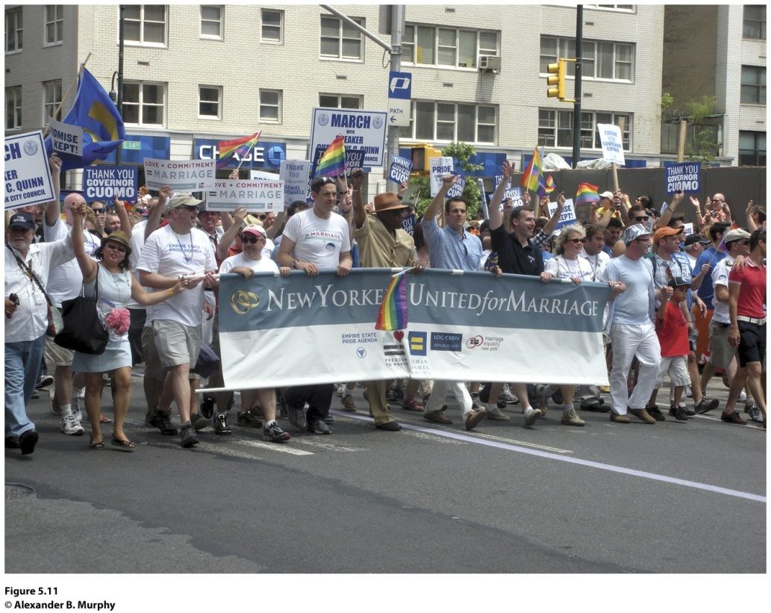
Field Note
“It’s July 26, 2011, and I happen to be in New York City the weekend just after the State of New York legalized same-sex marriages. I cut it close getting to the airport so I could catch the first part of the annual Gay Pride parade. The parade, which started on the edge of the Chelsea neighborhood at 36th Street, traveled down 5th Avenue toward where I took this photograph near Union Square and ended in the West Village. Always a boisterous, celebratory event, the parade has a special feel this year as celebrants cheer what many describe as one of the great civil rights victories of the current era.”
Notes:
Figure 5.11
New York, New York. © Alexander B. Murphy.

Slide 22
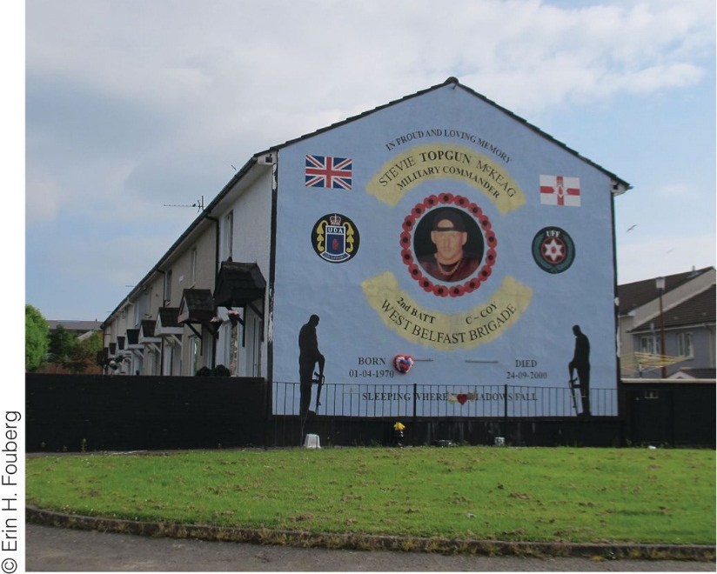
Key Question:
How Does Geography Reflect and Shape Power Relationships Among Groups of People?
Figure 5.12
Belfast, Northern Ireland. Signs of the conflict in Northern Ireland mark the cultural landscape throughout Belfast. In the Shankhill area of Belfast, where Protestants are the majority population, a mural commemorating Steve McKeag, member of the
Ulster Defence Association, a Protestant paramilitary organization, stands in the middle of a residential neighborhood. McKeag is called “Top Gun” for killing 12 Catholics, most of whom were ordinary
citizens, in the 1990s. He died in his home of a drug overdose in 2000 at the age of 30.

Slide 23
Power Differences among Groups
Power relationships can subjugate entire groups of people, enabling society to enforce ideas about the ways people should behave or where people should be welcomed or turned away
Jim Crow Laws
Belfast, Northern Ireland

Slide 24
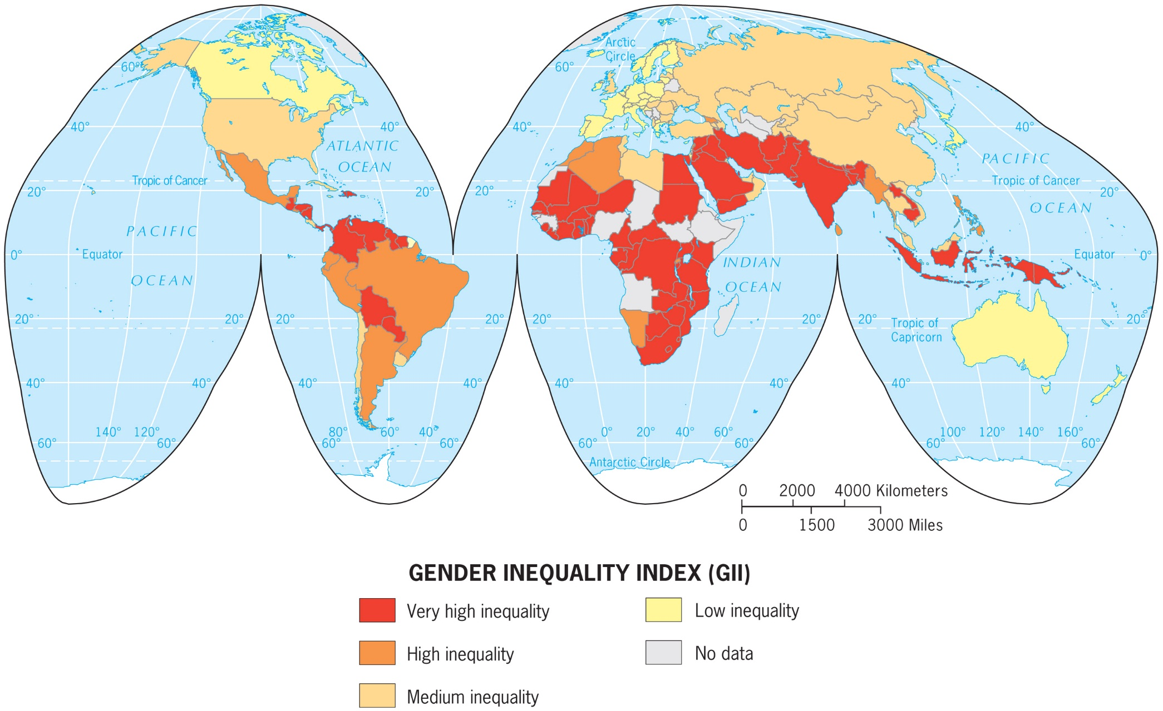
Gender Empowerment

Slide 25
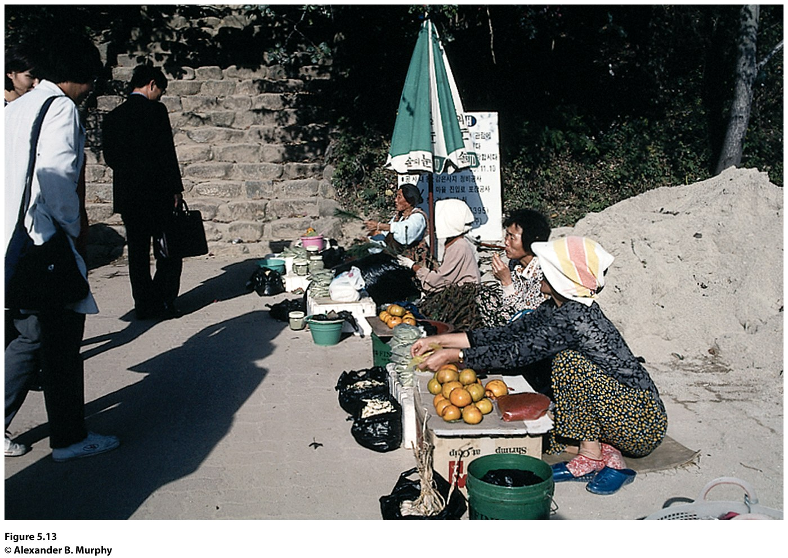
Just Who Counts?
Statistics and Power
Women continue to be paid less than men
The World’s Women 2010: Trends and Statistics
Regional variations in agriculture employment
Figure 5.13
South Korea. The women in this photo sat near one of the ancient temples in southern Korea, selling the modest output from their own market
gardens. This activity is one part of the informal economy, the “uncounted” economy in which women play a large role.

Slide 26
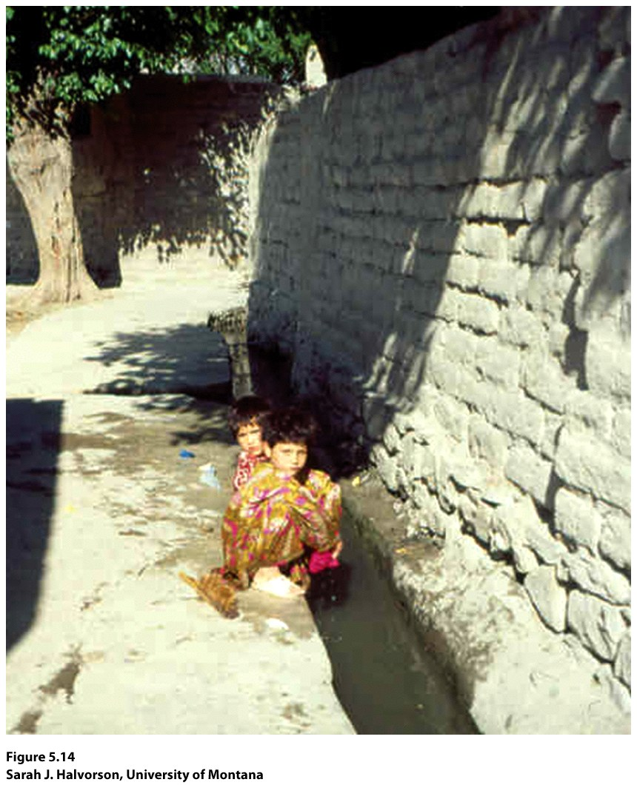
Guest Field Note
“One of the leading causes of mortality and morbidity among children under the age of five in developing countries is waterborne disease. My research has focused on building an understanding of the factors that contribute to the vulnerability of young children to this significant public health problem.”
Concept Caching:
Mount Vesuvius
Notes:
Credit: Sarah J. Halvorson, University of Montana

Slide 27
Vulnerable Populations
Geographers use mapping and spatial analysis to predict and explain what populations or people will be affected most by natural hazards such as earthquakes, volcanoes, hurricanes, and tsunamis or by environmental policies.
Vulnerability is fundamentally influenced by geographically specific social and environmental circumstances.
Through fieldwork and interviews, geographers can see differences in vulnerability within groups of people.

Slide 28
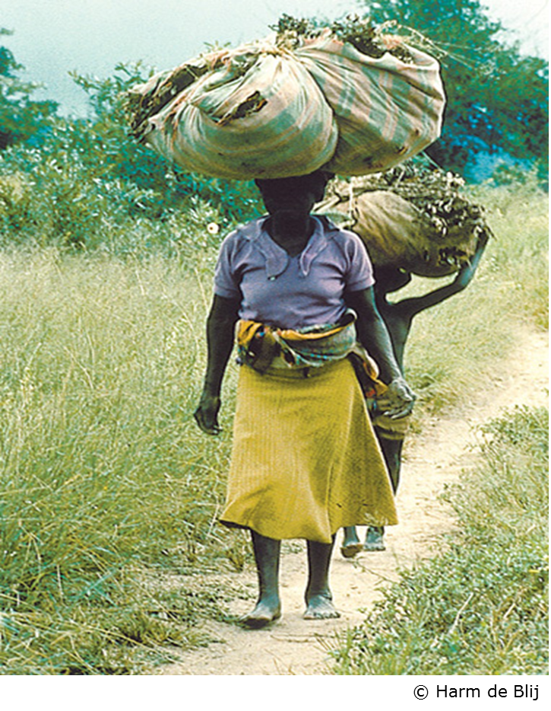
Women in Subsaharan Africa
Women numerically dominate rural Subsaharan Africa.
Women produce an estimated 70 percent of the region’s food, almost all of it without the aid of modern technology.
In East Africa, cash crops such as tea are sometimes called “men’s crops” because the men trade in what the women produce.
Concept Caching: Kanye, Botswana

Slide 29
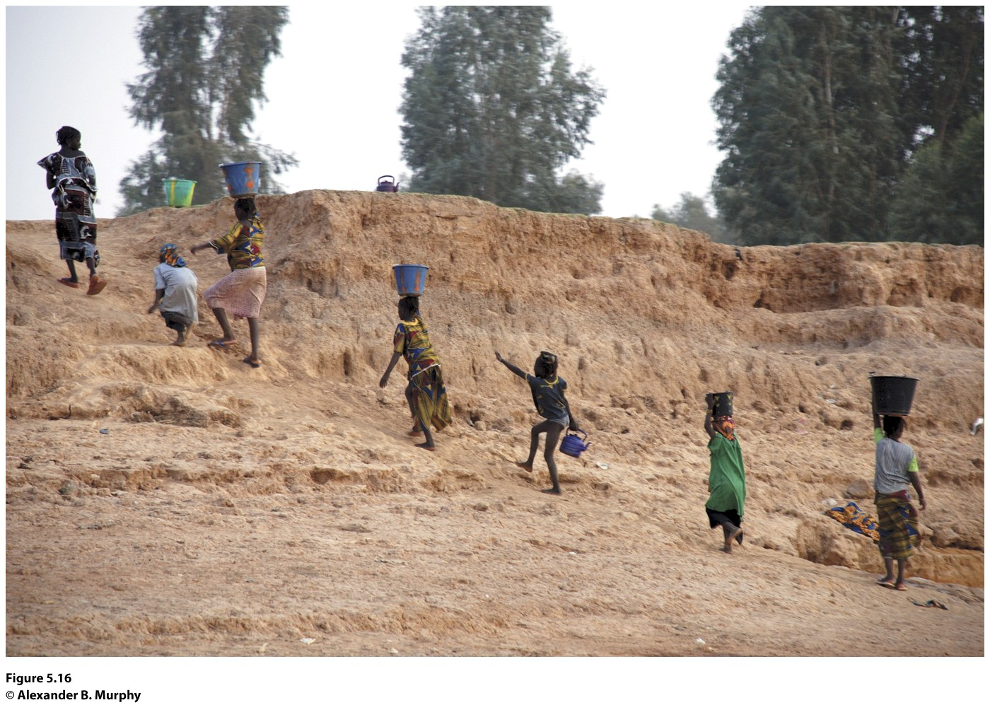
Field Note
“I am filled with admiration for the women carrying water on their heads up the bank from the Niger River. Other women are at the water’s edge, filling their buckets. These women are performing a daily ritual requiring incredible endurance and strength. Once they carry their buckets to their dwellings, they will likely turn to preparing the evening meal.”
Figure 5.16
Along the banks of the Niger River just outside Mopti, Mali. © Alexander B. Murphy

Slide 30
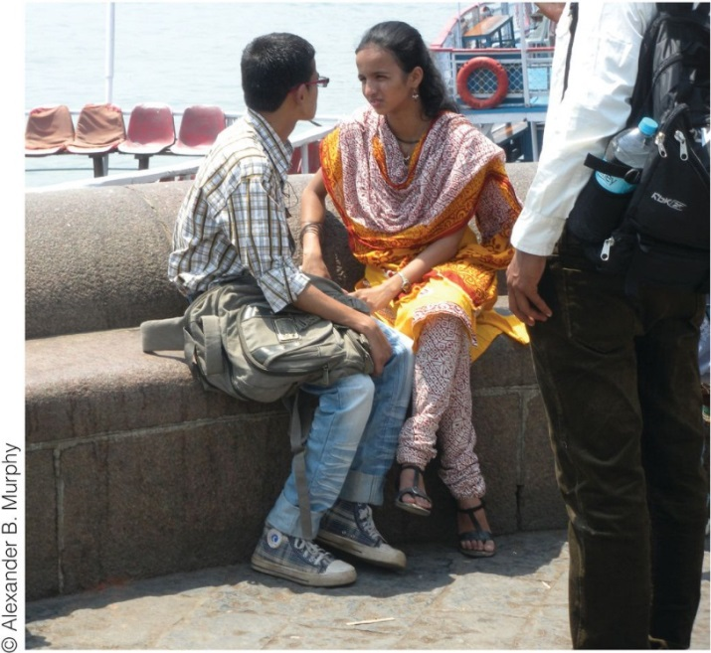
Case Study: Dowry Deaths in India
In an arranged marriage, the dowry is the price to be paid by the bride’s family to the groom’s father.
In extreme cases, disputes over the dowry have led to the death of the bride.
Power relationships place women below men in India.
Family Courts Act passed in 1984 to provide support for women who feared dowry death.

Slide 31
Dowry Deaths in India, continued
The practice of dowry deaths is not declining in India.
The number of love marriages is on the rise and many couples in love marriages are meeting online.
The number of divorces is also on the rise, with 1 in 1,000 marriages ending in divorce in India today.
Just as some statistics point to an improving place of women in Indian society, other statistics confirm India still has a preference for males overall.

Slide 32
Shifting Power Relations among Ethnic Groups
Urban geographers, John Frazier, Florence Margai, and Eugene Tettey-Fio: Race and Place: Equity Issues in Urban America
Areas with multiple ethnicities often experience an ebb and flow of acceptance over time.
In California and in much of the rest of the United States, the “Asian” box is drawn around a stereotype of what some call the “model minority.”
The myth of the model minority: “paints Asians as good, hardworking people who, despite their suffering through discrimination, harassment, and exclusion, have found ways to prosper through peaceful means.”

Slide 33
Power Relations in Los Angeles
Shifting Power Relations among Ethnic Groups, continued
Geographer James Curtis: southeastern Los Angeles County is today “home to one of the largest and highest concentrations of Latinos in Southern California.”
Barrioization: describes a change that saw the Hispanic population of a neighborhood jump from 4 percent in 1960 to over 90 percent in 2000.
April 29–30, 1992: Riots in Los Angeles after the verdict in the Rodney King case led to deaths, injuries, and about $1 billion in property loss.

Slide 34
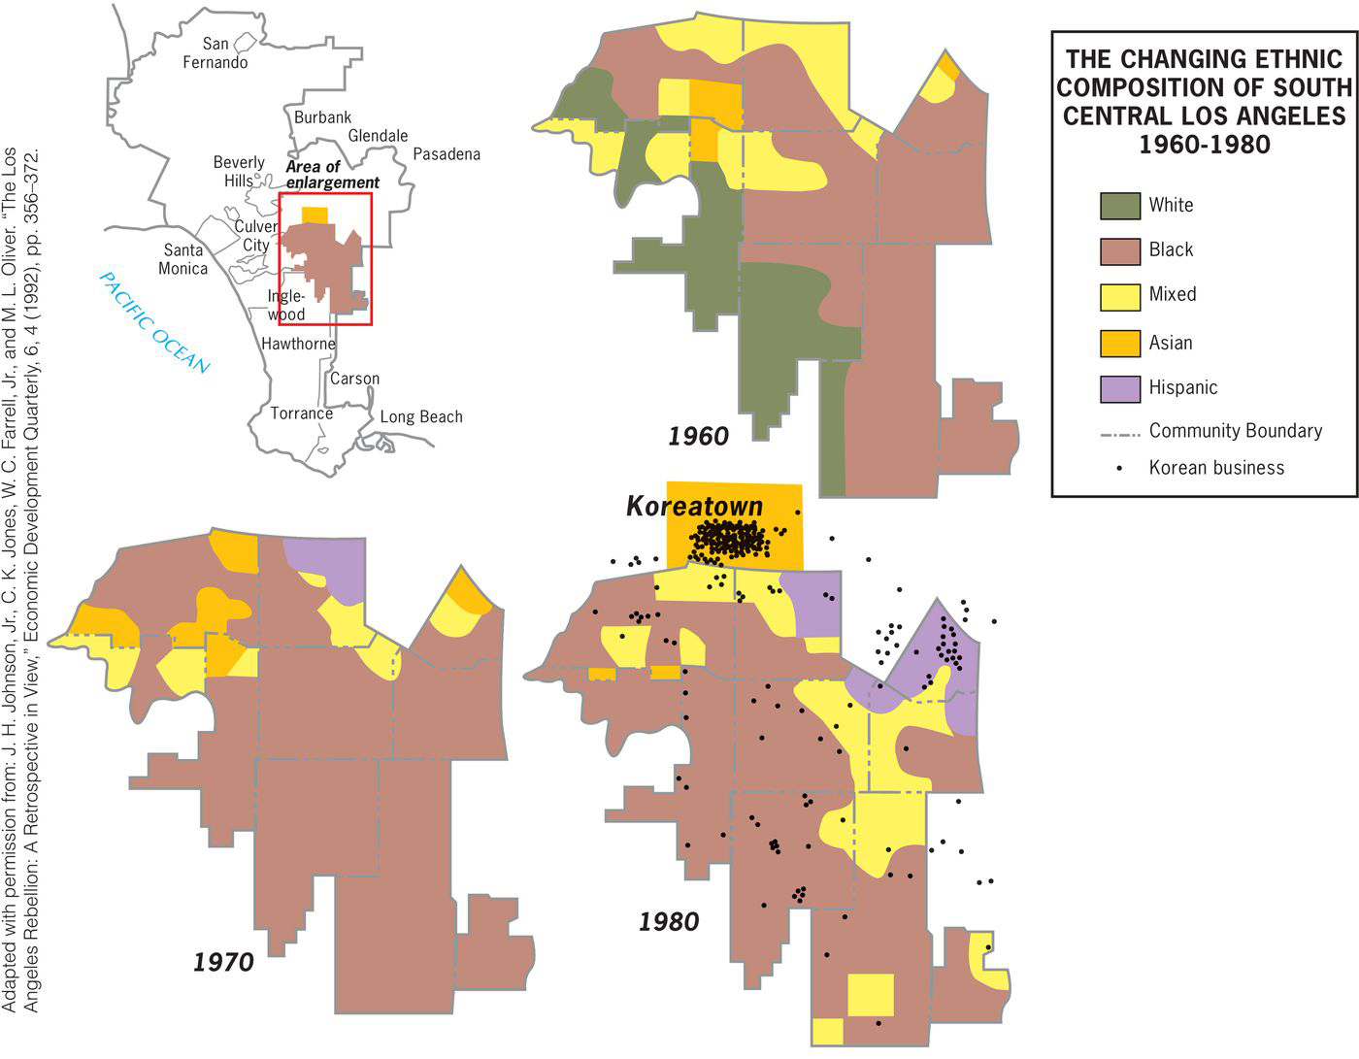

Slide 35
Geographers who study race, ethnicity, gender, or sexuality are interested in the power relations embedded in a place from which assumptions about “others” are formed or reinforced. Consider your own place, your campus, or your locality. What power relations are embedded in this place?

Slide 36
Additional Resources
Gay and Lesbian Atlas www.urban.org/pubs/gayatlas/
Racial and Ethnic Segregation in the United States, 1980–2000 http://www.census.gov/hhes/www/housing/resseg/papertoc.html
Murals in Northern Ireland http://cain.ulst.ac.uk/mccormick/intro.htm
Related resources on Geography Education: Race, Ethnicity, Gender, Sexuality

