Slide 1
Human Geography: People, Place,
and Culture, 11th Edition

Slide 2
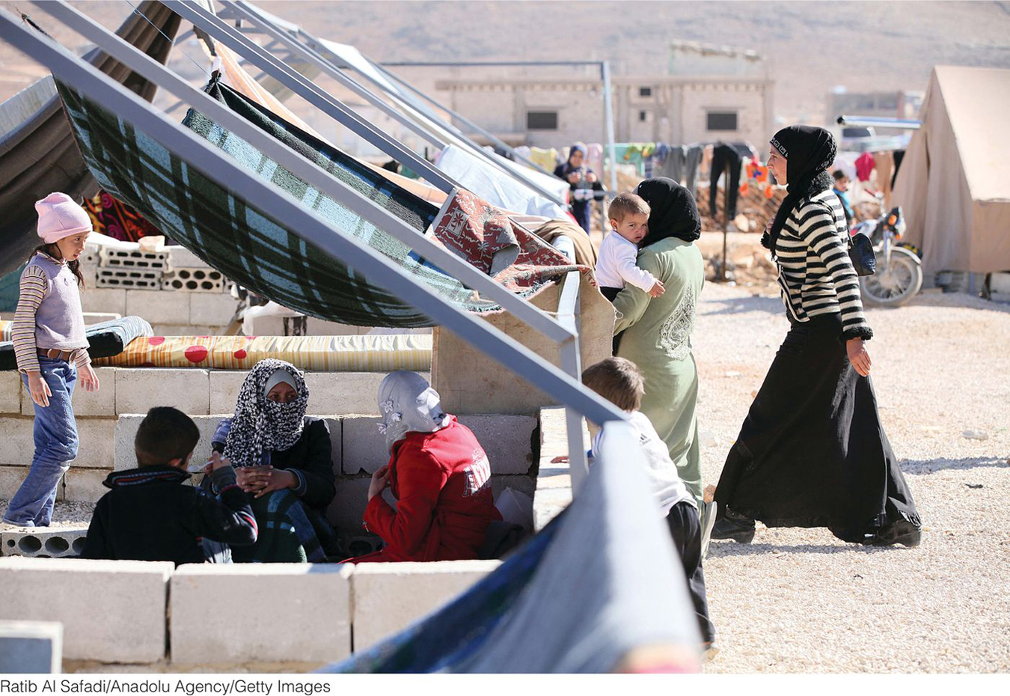
Chapter 3: Migration

Slide 3
Key Question: What is migration?
Movement is inherently geographical.
All movement involves leaving home.
Three types of movement:
Cyclic
Periodic
Migration

Slide 4
Cyclic Movement
Involves journeys that begin at our home base and bring us back to it
Regular sequences of short moves within a local area = activity spaces
Commuting
Seasonal movement
Nomadism

Slide 5
Periodic Movement
Involves a longer period of time away from the home base than cyclic movement
Migrant labor
Transhumance, a system of pastoral farming where ranchers move livestock according to the seasonal availability of pastures
College attendance
Military service

Slide 6
Migration
Permanent relocation across significant distances
International migration/Transnational migration
Emigrant = migrates out of country
Immigrant = migrates into country
Internal migration varies according to the mobility of the population.

Slide 7
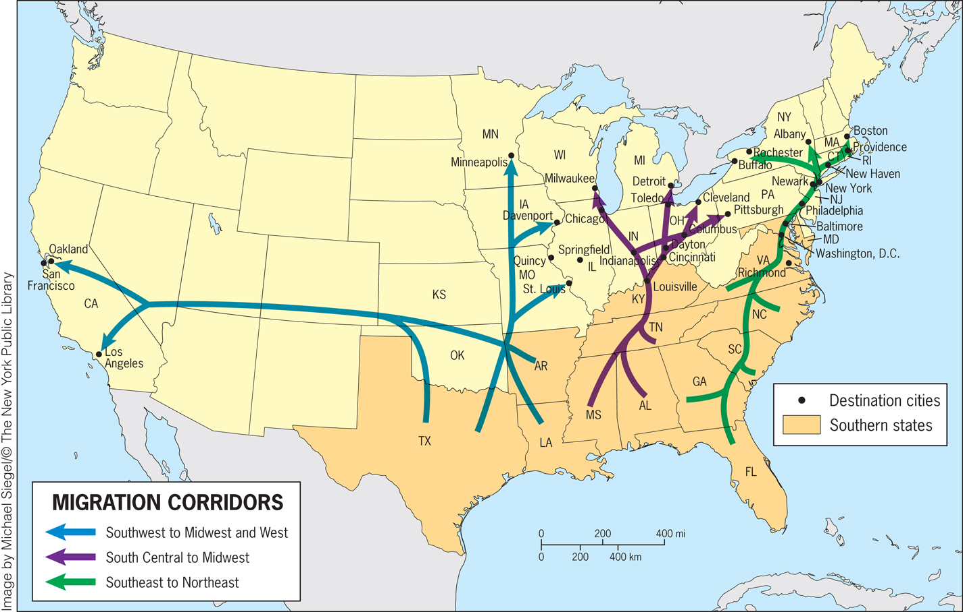

Slide 8
Choose one type of cyclic or periodic movement and then think of a specific example of the kind of movement you chose. Now, determine how this movement changes both the home and the destination as a result of this cyclic or period movement.

Slide 9
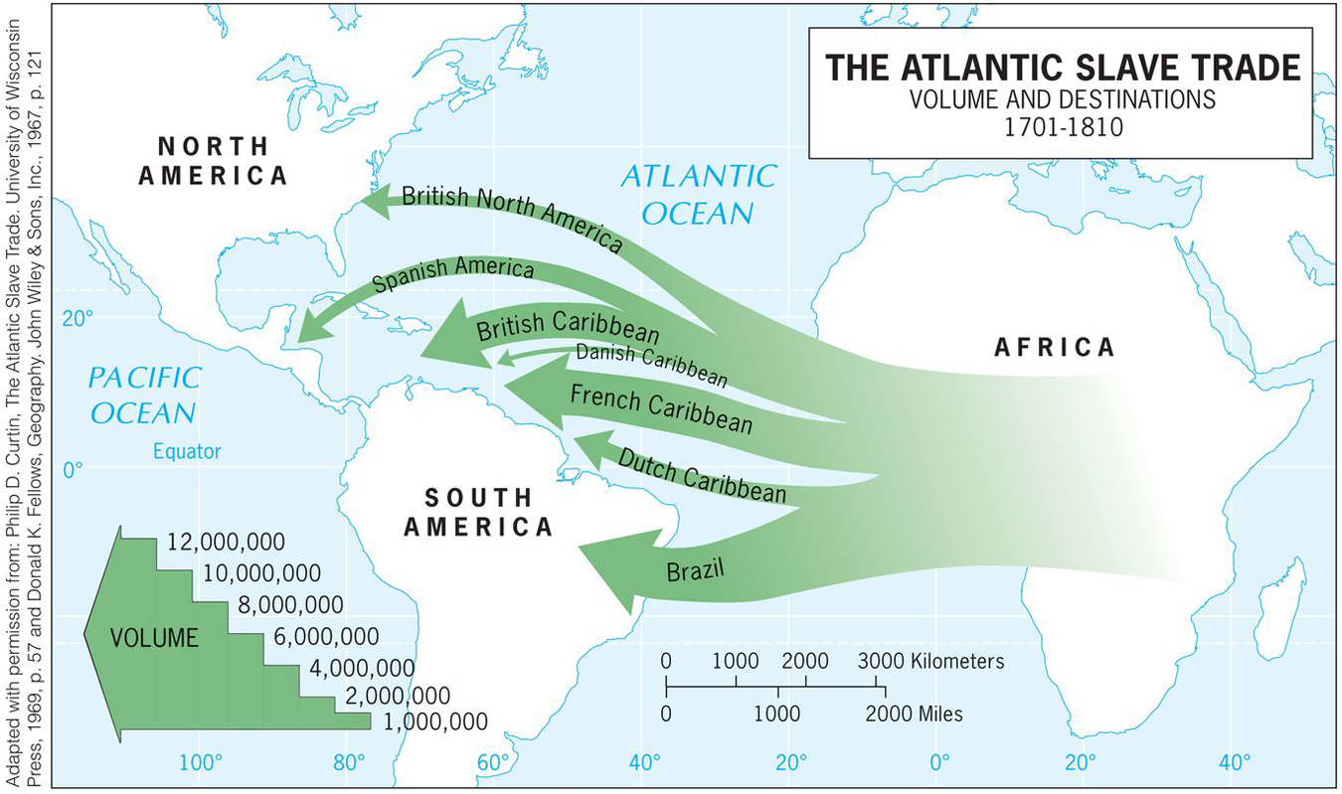
Key Question: Why do people migrate?
Forced Migration
Atlantic slave trade: the largest and most devastating forced migration in the history of humanity
Human Trafficking

Slide 10
Forced Migration
Forced migration still happens today.
Example: countermigration, in which governments detain migrants who enter or attempt to enter their countries illegally and return the migrants to their home countries.

Slide 11
Push and Pull Factors in Voluntary Migration
Ernst Ravenstein proposed laws of migration:
Every migration flow generates a return or countermigration.
The majority of migrants move a short distance.
Migrants who move longer distances tend to choose big-city destinations.
Urban residents are less migratory than inhabitants of rural areas.
Families are less likely to make international moves than young adults.

Slide 12
Push and Pull Factors in Voluntary Migration
Gravity model:
Predicts interaction between places on the basis of their population size and distance between them
Assumes that spatial interaction (such as migration) is directly related to the populations and inversely related to the distance between them

Slide 13
Push and Pull Factors in Voluntary Migration
Push factors are the conditions and perceptions that help the migrant decide to leave a place.
They include individual considerations such as work or retirement conditions, cost of living, personal safety and security, and, for many, environmental catastrophes or even issues like weather and climate.

Slide 14
Push and Pull Factors in Voluntary Migration
Pull factors are the circumstances that effectively attract the migrant to certain locales from other places, the decision of where to go.
They tend to be vaguer and may depend solely on perceptions construed from things heard and read rather than on experiences in the destination place.

Slide 15
Push and Pull Factors in Voluntary Migration
Distance decay: Prospective migrants are likely to have more complete perceptions of nearer places than of farther ones.
Since interaction with faraway places generally decreases as distance increases, prospective migrants are likely to feel much less certain about distant destinations than about nearer ones.
Less important with better travel and communication technologies.

Slide 16
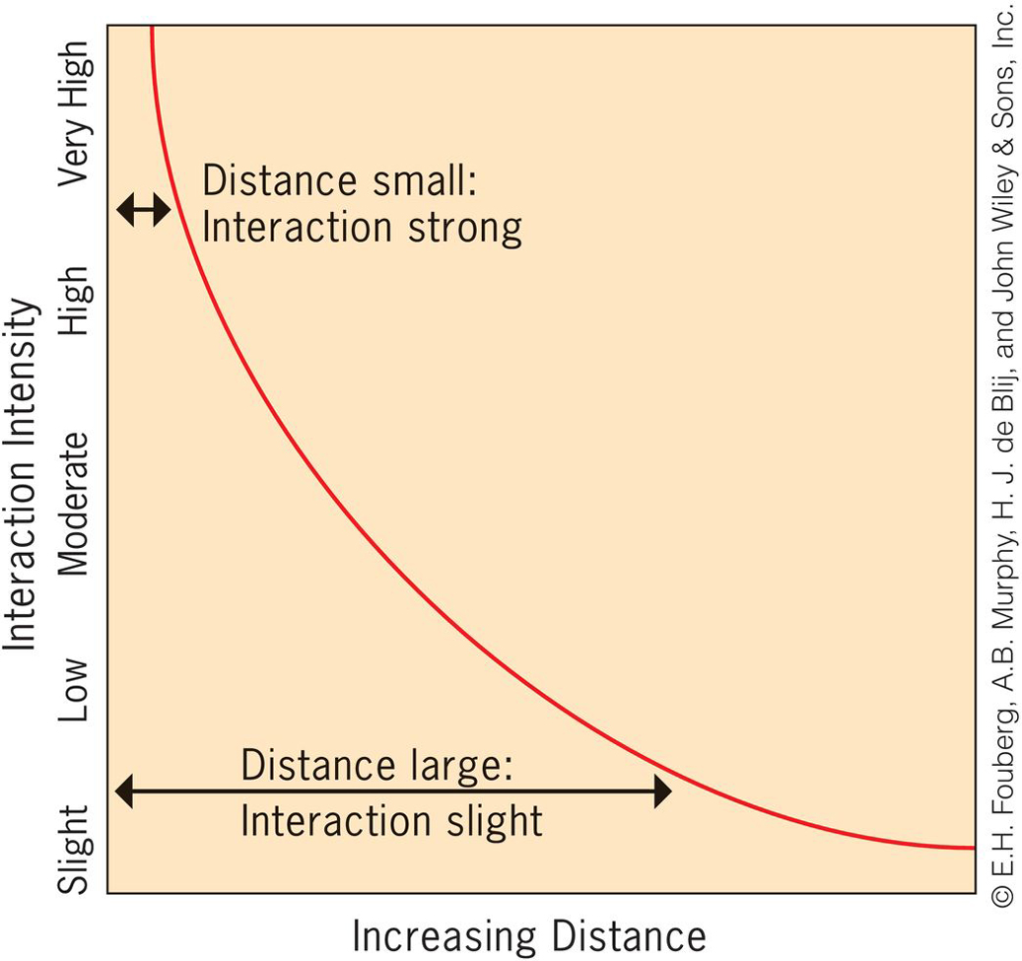

Slide 17
Push and Pull Factors in Voluntary Migration
Step migration: Migration streams consist of a series of stages.
Intervening opportunity: Many migrants encounter an opportunity along their migration stream that keeps them from getting to the metropolis that impelled them to move in the first place. Example: during the Great Migration

Slide 18
Types of Push and Pull Factors
Legal status: Migrants can arrive in a country with or without consent of the host country.
Economic conditions: Poverty has driven countless millions from their homelands.
Power relationships: Power relationships already embedded in society enable the flow of migrants around the world.

Slide 19
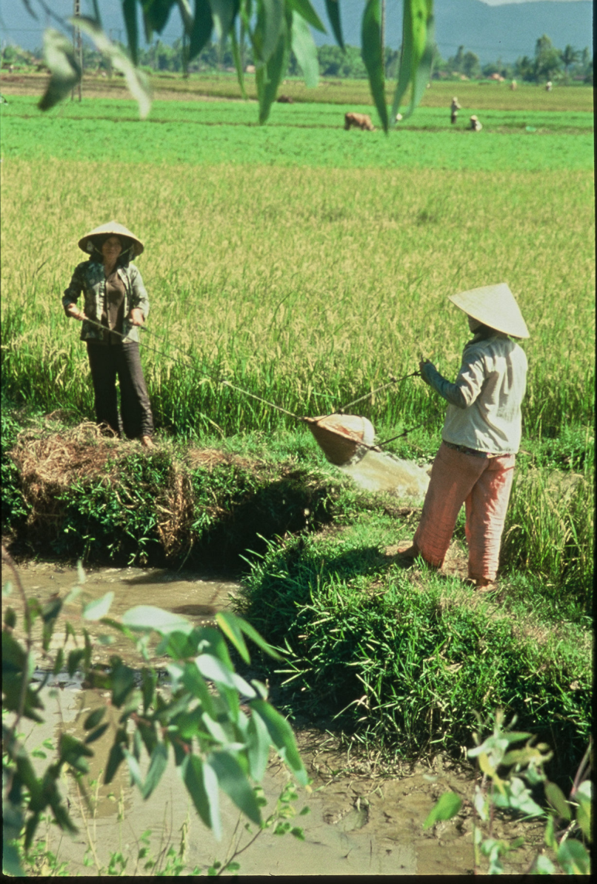
Political Circumstances
Politically driven migration flows are marked by both escape and expulsion.
Example: Desperate migrants fled Vietnam by the hundreds of thousands after the communists took control of
the country in 1975.
Concept Caching:
Vietnam
© Barbara Weightman

Slide 20
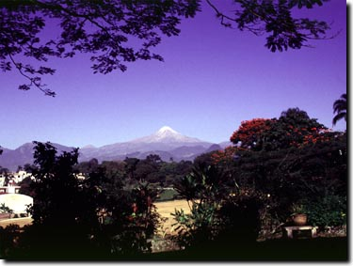
Armed Conflict and Civil War
Environmental Conditions:
Earthquakes
Hurricanes
Volcanoes
Human disasters
Climate refugees
Nuclear refugees
Concept Caching:
Pico de Orizaba Pan American Highway
Concept Caching:
Mount Vesuvius
© Barbara Weightman

Slide 21
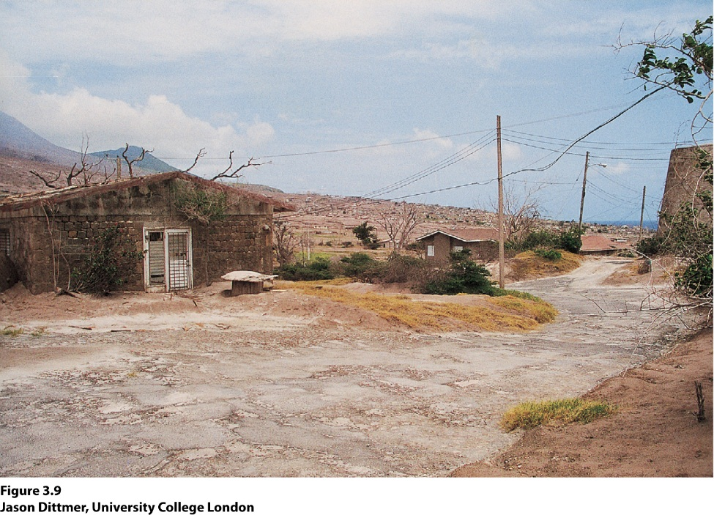
Guest Field Note Plymouth, Montserrat
“This photo shows the damage caused by the 1995 eruption of the Sourfriere Hills volcano on the Caribbean Island of Montserrat… Many Montserratians fled to the United States when Plymouth was destroyed and were given “temporary protected” immigration status. The U.S. government told Montserratian refugees to leave in 2005—not because the volcanic crisis was over or because the housing crisis caused by the volcano was solved. Rather, the U.S. government expected the volcanic crisis to last at least 10 more years; so, the Monsterratians no longer qualified as “temporary” refugees.”
Notes:
*Credit: Jason Dittmer, University College London

Slide 22
Culture and Traditions
People who fear that their culture and traditions will not survive a major political transition, and who are able to migrate to places they perceive as safer, will often do so.
Technological Advances
Television, radio, cell phones, and telephone stimulate millions of people to migrate by relaying information about relatives, opportunities, and already established communities in destination lands.

Slide 23
Technological Advances
Kinship links: Communication strengthens their role of push/pull factors.
Chain migration: flows along and through kinship links.
Chains of migration built upon each other create immigration waves or swells in migration from one origin to the same destination.

Slide 24
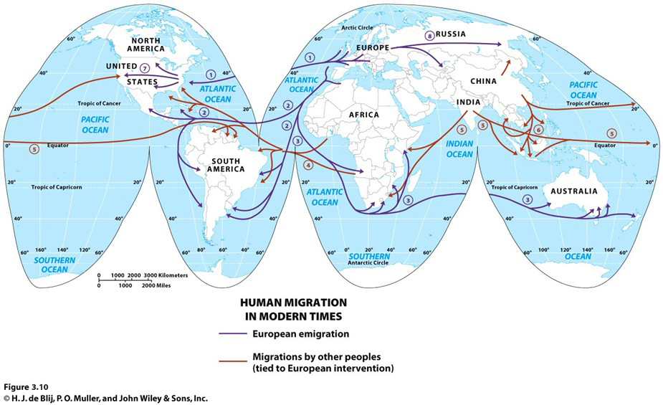
Key Question: Where do people migrate?
Global Migration Flows
Global-scale migration
Explorers
Colonization

Slide 25
Where Do People Migrate?
Global-scale migration
Explorers
Colonization
Global Migration Flows

Slide 26
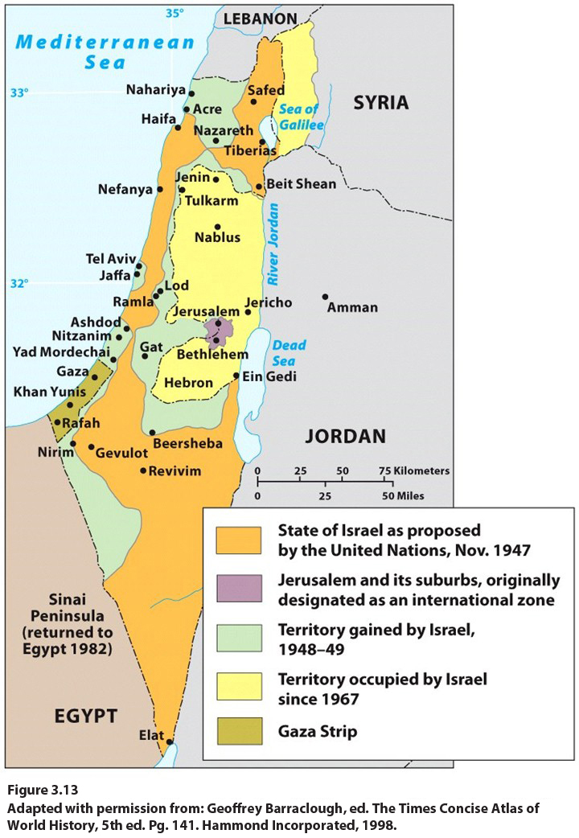
Regional Migration Flows
Economic opportunities
Islands of development
Role of globalization and colonialism
Reconnection of cultural groups
Conflict and war

Slide 27
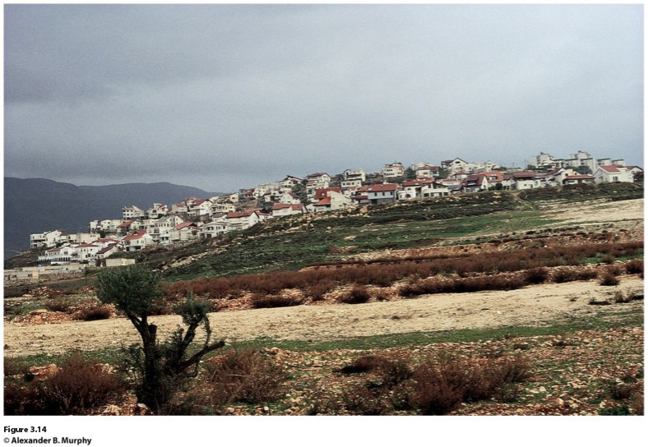
Field Note
“Just a few miles into the West Bank, not far from Jerusalem, the expanding Israeli presence could not be missed. New settlements dot the landscape, often occupying strategic sites that are also easily defensible. These ‘facts on the ground’ will certainly complicate the effort to carve out a stable territorial order in this much-contested region. That, of course, is the goal of the settlers and their supporters, but it is salt on the wound for those who contest the Israeli right to be there in the first place.”

Slide 28
National Migration Flows
Historically, two of the major migration flows before 1950 occurred internally in the United States and in Russia.
Russification sought to assimilate all the people in the Soviet territory into the Russian culture, during the communist period, by encouraging people to move out of Moscow and St. Petersburg and fill in the country.

Slide 29
Guest Workers
Millions of guest workers live outside of their home country and send remittances from their jobs home.
Their home states are fully aware that their citizens have visas and are working abroad.
Despite the legal status of guest workers, many employers abuse them because guest workers are often unaware of their rights.
Guest workers are legal, documented migrants who have work visas, usually short term.

Slide 30
Refugees
The United Nations High Commissioner on Refugees (UNHCR) estimates that 83 percent of refugees flee to a country in the same region as their home country.
The 1951 Refugee Convention defines a refugee as “a person who has a wellfounded fear of being persecuted for reasons of race, religion, nationality, membership of a particular social group, or political opinion.”

Slide 31
The Special Case of Refugees
Internally displaced persons are people who have been displaced within their own countries, but they do not cross international borders as they flee.
Asylum: the right to protection in the first country in which the refugee arrives.
Repatriation: a process by which the UNHCR helps return refugees to their homelands once violence and persecution subside.

Slide 32
Regions of Dislocation
North Africa and Southwest Asia: This geographic region, extending from Morocco in the west to Afghanistan in the east, contains some of the world’s longest-lasting and most deeply entrenched conflicts that generate refugees.
Africa: 2 million refugees are accounted for by international relief agencies, but also millions more are internally displaced persons.

Slide 33
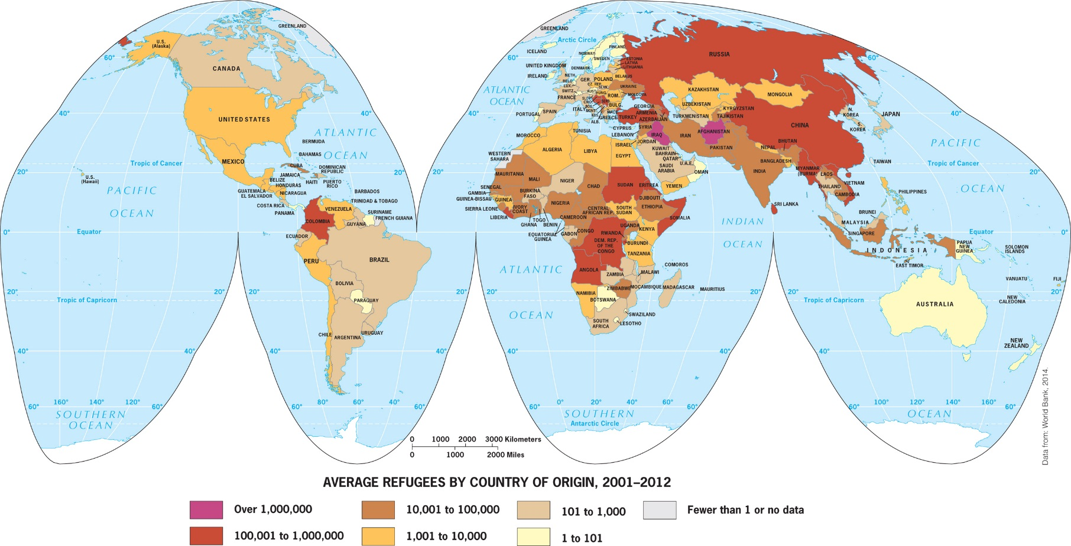
Regions of Dislocation
South Asia: 3rd ranking realm--Pakistan accommodates Afghanistan’s refugee
Southeast Asia: a reminder that refugee problems can change quickly. Example: Indochina’s refugee crisis

Slide 34
Regions of Dislocation
Europe: even after the cessation of armed conflict and the implementation of a peace agreement known as the Dayton Accords, the UNHCR still reports over 100,000 IDPs in the area.
Other Regions: The number of refugees and internally displaced persons in other geographic realms is much smaller.

Slide 35
Key Question: How do governments affect migration?
Legal Restrictions
Oriental Exclusion Acts (1882–1907): U.S. Congress designed immigration laws to prevent the immigration of Chinese people to California.
In 1901, the Australian government approved the Immigration Restriction Act, which ended all nonwhite immigration into the newly united country.
White Australia Policy

Slide 36
Waves of Immigration in the United States
The United States experienced two major waves of immigration before 1930 and is in the midst of another great wave of immigration today.
Immigration quotas
National Origins Law in 1929
Immigration and Nationality Act: 1952
Selective immigration

Slide 37
Post–September 11
New government policies affect asylum-seekers, illegal immigrants, and legal immigrants.
9/11 Commission Report was released in 2004.

Slide 38
One goal of international organizations involved in aiding refugees is repatriation—return of the refugees to their home countries once the threat against them has passed. Take the example of refugees from the Darfur region of Sudan. Think about how their land and their lives have changed since they became refugees. You are assigned the daunting task of repatriating refugees from Darfur to Sudan once a peace solution is reached. What steps would you have to take to rediscover a home for these refugees?
A functional region is defined by a particular set of activities or interactions that occur within it. Ex: the City of Chicago

Slide 39
Additional Resources
Immigration to the United States www.uscis.gov
Refugees www.unhcr.org
Geographic Mobility and Movement in the United States www.census.gov/population/www/socdemo/migrate.html
Related Resouces on ‘Geography Education’
Migration, Refugees

