Slide 1
Population Composition
The composition is the structure of a population in terms of age, sex, and other properties such as marital status and education.
Age and sex are key indicators of population composition, and demographers and geographers use population pyramids to represent these traits visually.

Slide 2
Population Composition (cont’d)
Geographers are concerned with both spatial distribution and population composition
Young vs. elderly in any population will determine different social needs
Old-Age Dependency Ratio:65+/15-64
Child Dependency Ratio: under 15/15-64

Slide 3
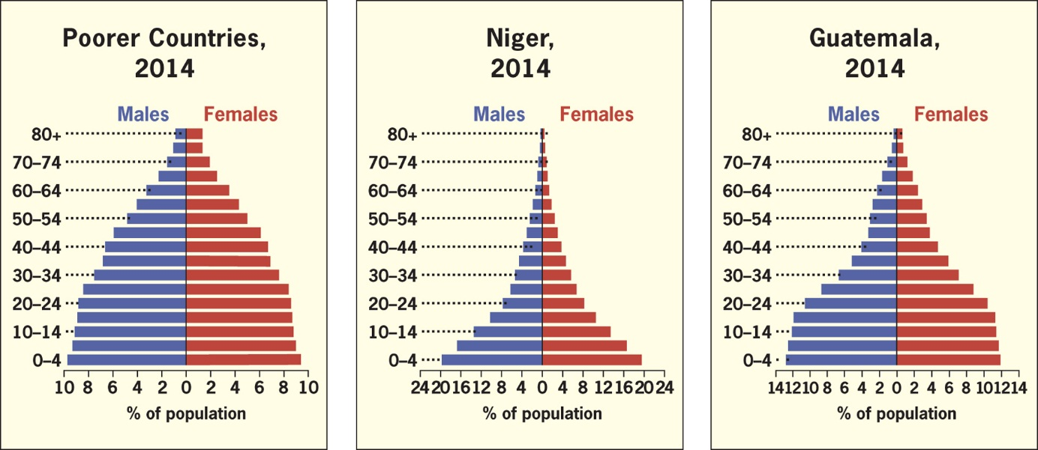
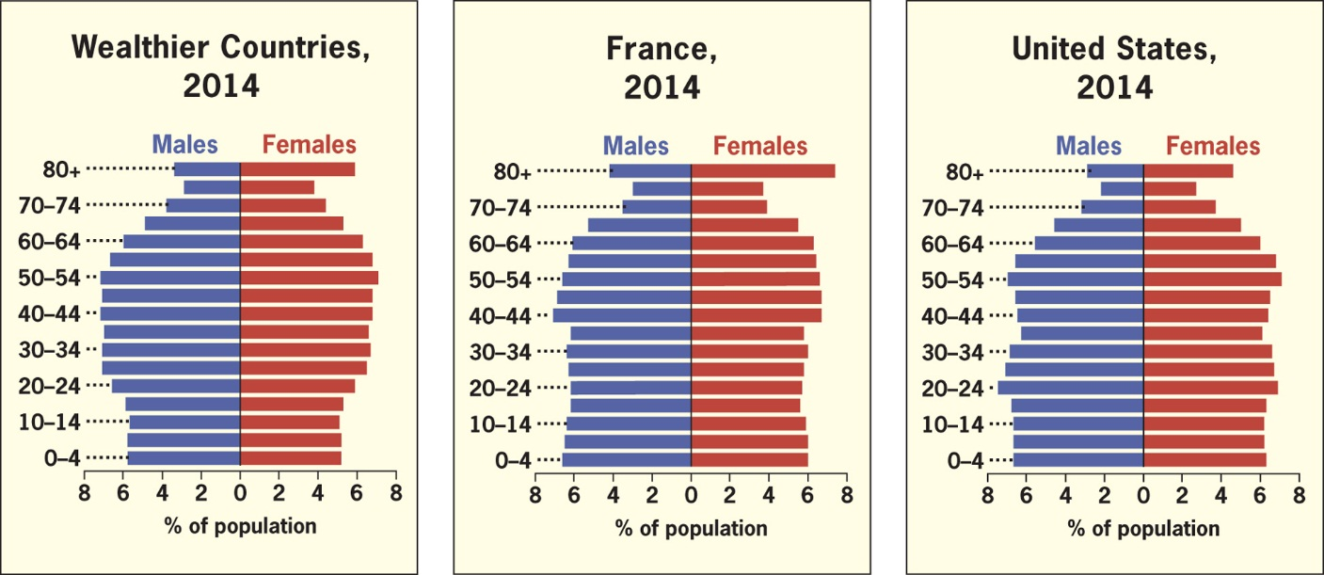
Figure 2.16 Age–Sex Population Pyramids for Countries with High Population Growth Rates. Countries with high total fertility rates, high infant mortality rates and low life expectancies will have population pyramids with wide bases and narrow tops.
Data from: United States Census Bureau, International Data Base, 2014.
Figure 2.17 Age–Sex Population Pyramids for Countries with Low Population Growth Rates. Countries with lower total fertility rates and longer life expectancies have population pyramids shaped more uniformly throughout.
Data from: United States Census Bureau, International Data Base, 2014.

Slide 4
Key Question: How Does the Geography of Health Influence Population Dynamics?
Infant Mortality
Child Mortality
Life Expectancy

Slide 5
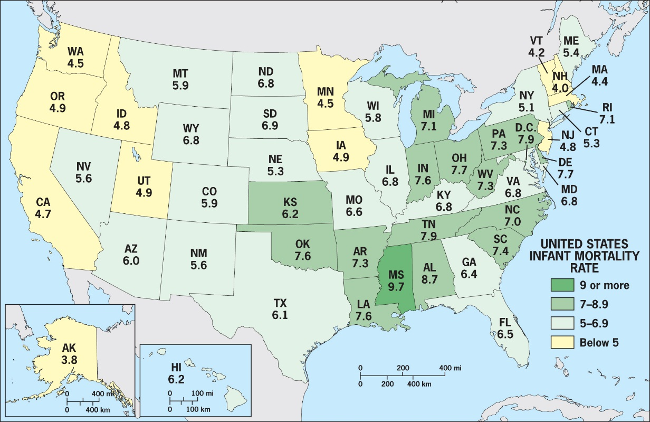
Study Figure 2.19, the infant mortality rate (IMR) by state in the United States. Hypothesize why the IMR is low in some regions of the country and high in others. Shift scales in your mind, and take one state and choose one state to consider: how do you think IMR varies within this state?
What other factors are involved at this scale and this level of generalization to explain the pattern of IMRs? Use the population Internet sites listed at the end of this chapter to determine whether your hypotheses are correct.
Data from: Centers for Disease Control, National Vital Statistics Reports, 2010.

Slide 6
Influence on Health and Well-Being
Health is closely related to location and environment
When an outbreak of a particular disease occurs its source and diffusion are studied by specialists in medical geography
Medical geographers study diseases, and they also use locational analysis to predict diffusion and prescribe prevention strategies

Slide 7
Infectious Diseases
65% of all diseases are infectious
Nonvectored
Transmitted from person to person
Ex. HIV/AIDS, Influenza, Common Cold

Slide 8
Infectious Diseases
VECTORED
Disease is spread by an vector, such as a mosquito, tick, snail, fleas, etc.
Malaria – Mosquito
Sleeping Sickness – Tsetse fly
HIV/AIDS- Nonvectored

Slide 9
Chronic and Genetic Diseases
Also called degenerative diseases
Afflict middle and old age populations
100 years ago in the United States: tuberculosis, pneumonia, and heart diseases
Today: Cancer, heart disease, stroke and accidents are the leading causes of death in the United States

Slide 10
Population and Government
Expansive population policies:
Encourage large families and raise the rate of natural increase
Eugenic population policies:
Designed to favor one racial or cultural sector of the population over others

Slide 11
Restrictive population policies
e.g., One-Child Policy in China
Limitations: Sweden
Contradictions: Roman Catholic doctrine
© H.J. de Blij
Chengdu, China

Slide 12
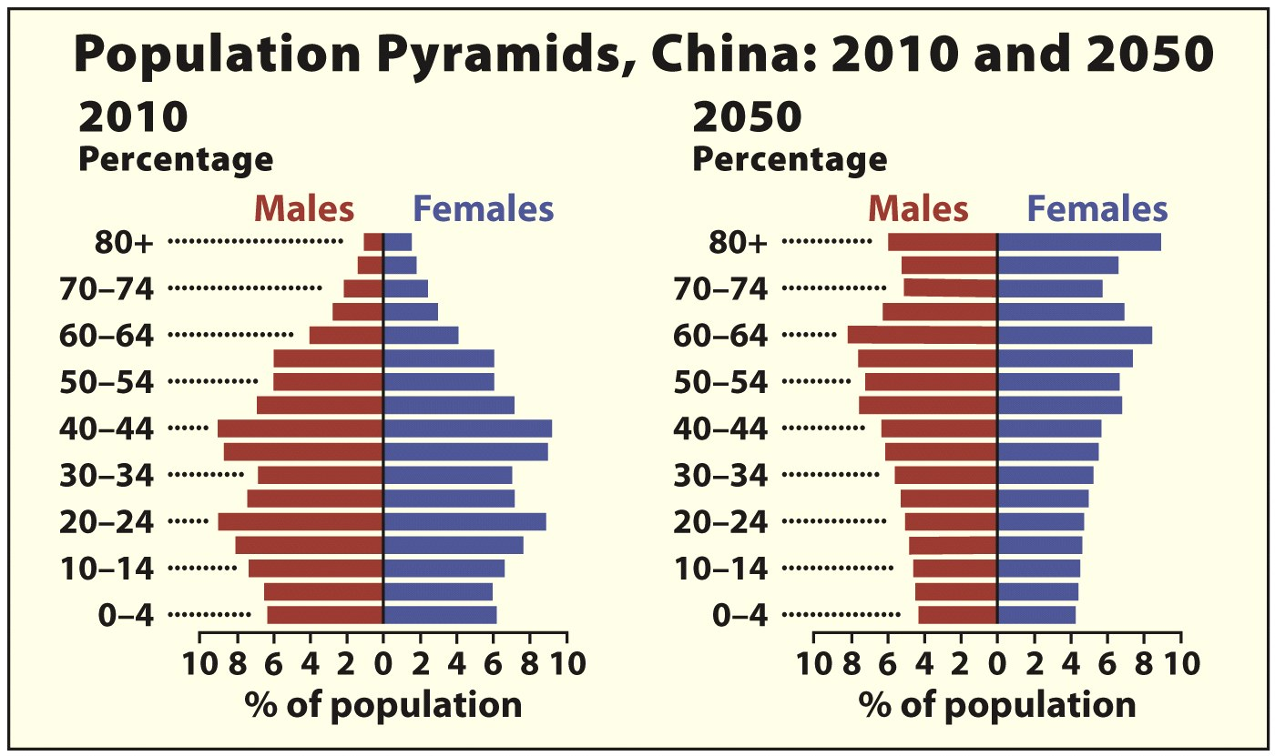
Data from: Population Reference Bureau, 2010.

