Slide 1
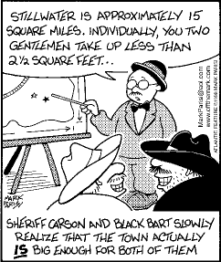
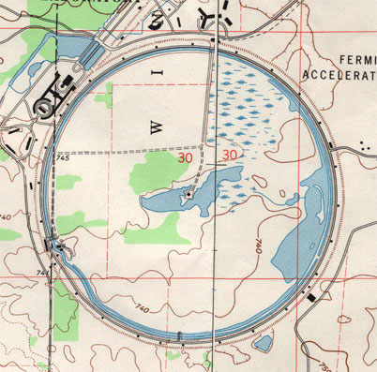
Map Scale

Slide 2
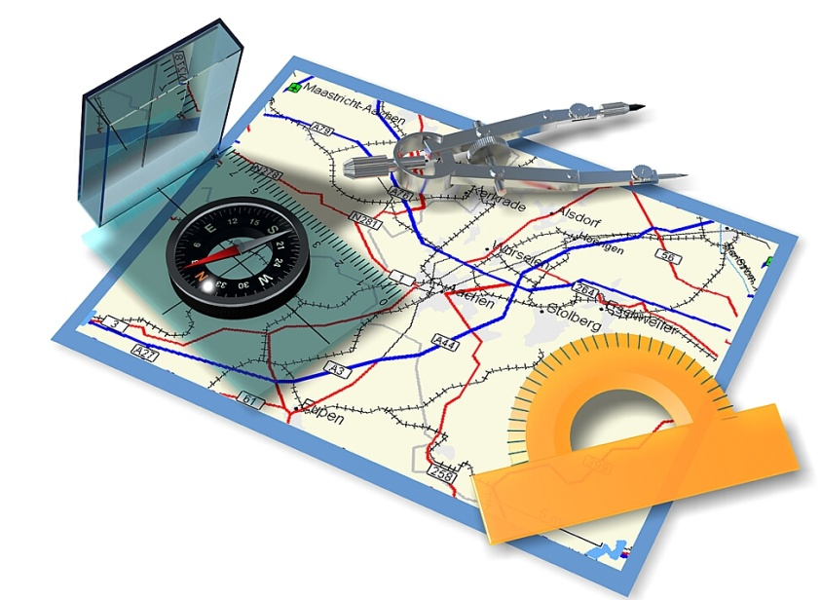
Size and Scale
Scale: relationship btwn. distance on the map & true distance on the Earth’s surface
Scale can be represented 3 different ways:
  Local
  Regional
  Global

Slide 3
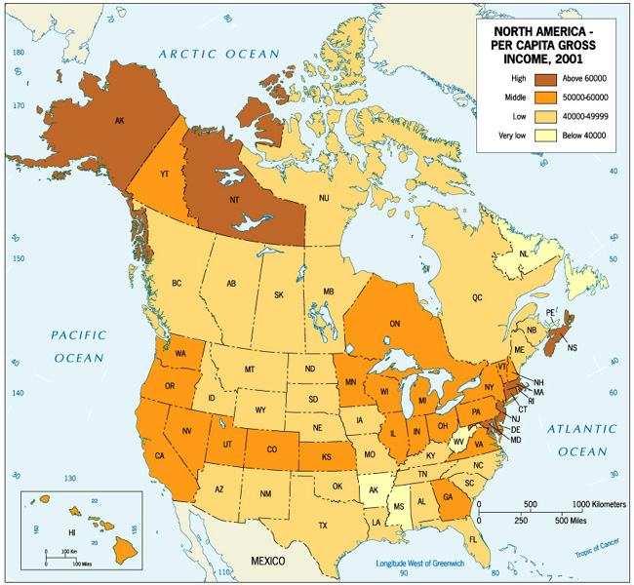
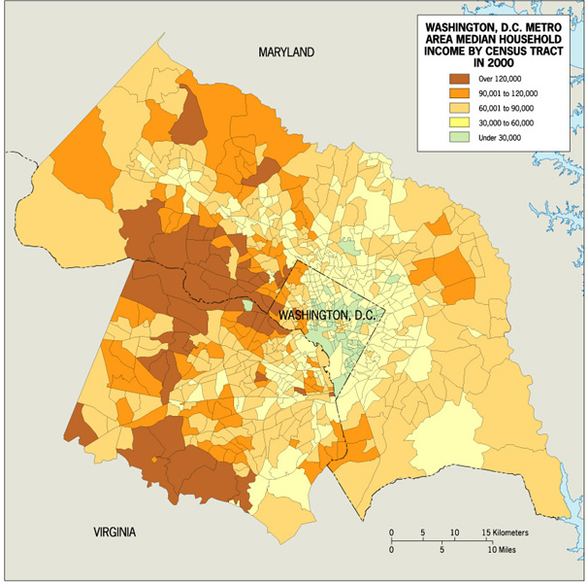
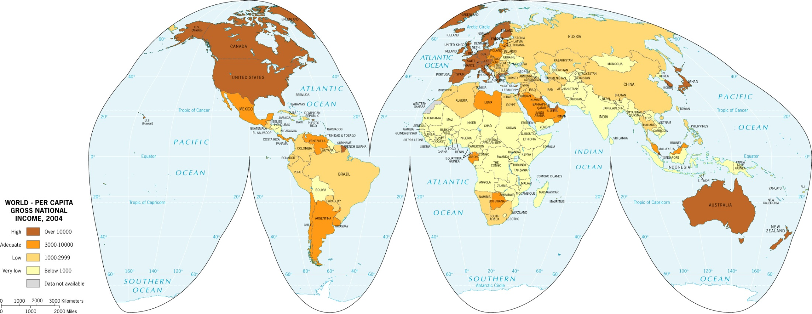
Scale

Slide 4
Scale is a powerful concept because:
Processes operating at different scales influence one another
What is occurring across scales provides context for us to understand a phenomenon

Slide 5
How to use the Scale
To calculate distance measure the distance on the map and then place on the scale to measure the true distance
Be careful to make sure you have the correct unit.
Many maps have both miles and kilometers

Slide 6
Comparing Maps of Different Scales
Different maps show different levels of detail
Sometimes you need to show a lot detail for a small area, and sometimes you need to show little detail of a larger area
A Small-Scale Map shows a large area with small details.
It is good for relative locations
A Large-Scale Map shows a small area with large details.
It is good for detailed looks at small areas

Slide 7
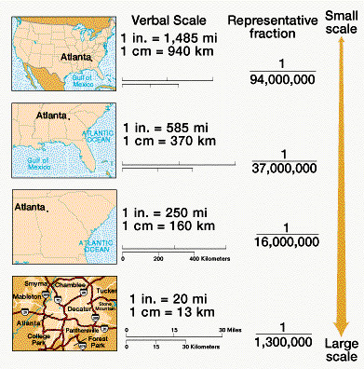
Map Scales
The smaller the right hand number the larger the scale of the map
1:75000 is a more detailed map than 1:600000 which is a small scale map

Slide 8
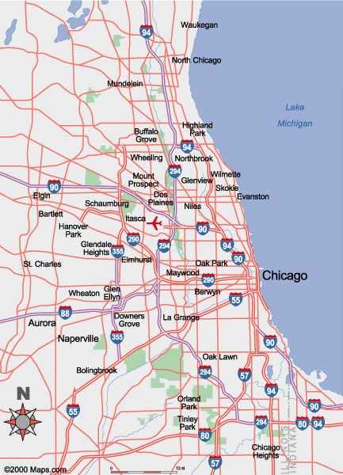
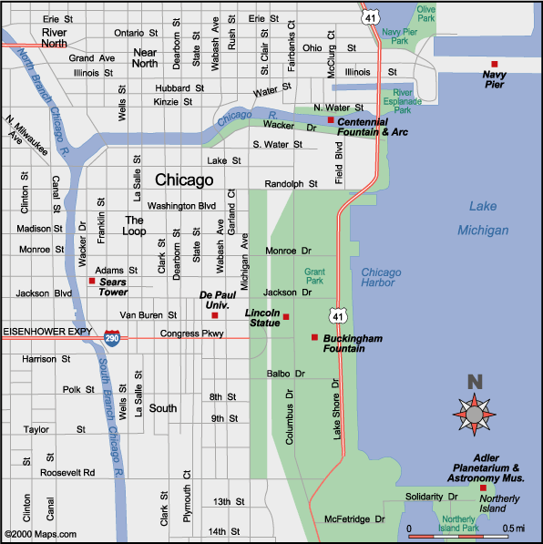

Slide 9
Large-scale
Small-scale

Slide 10
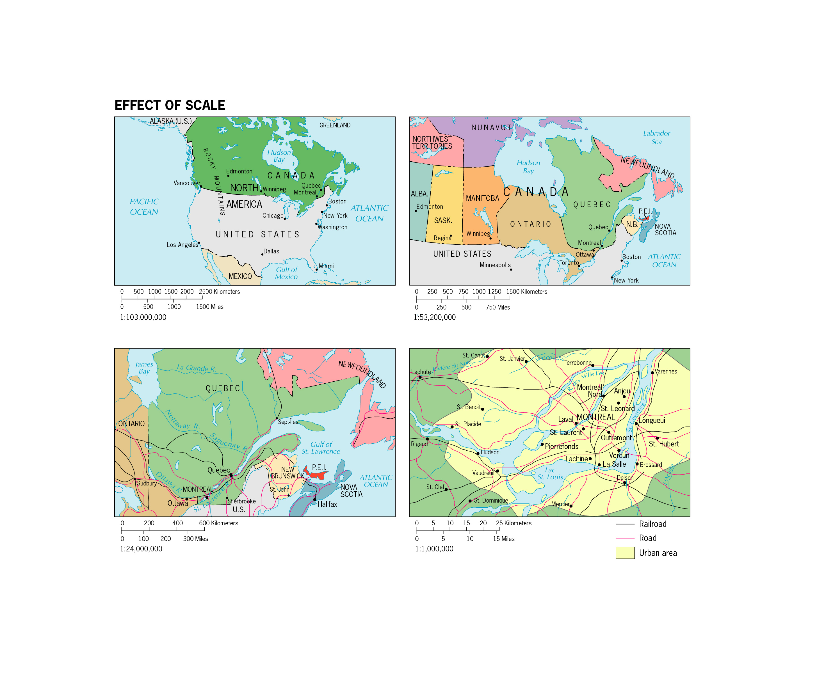

Slide 11

Beware the fallacy of
absolute truth!
What is true at one scale may not be true at a different scale

Slide 12
Mental Map
An image or picture of the way space is organized as determined by an individual’s perception, impression, and knowledge of that space; also known as a cognitive map

Slide 13
MENTAL MAP ACTIVITY!

Slide 14
