Slide 1
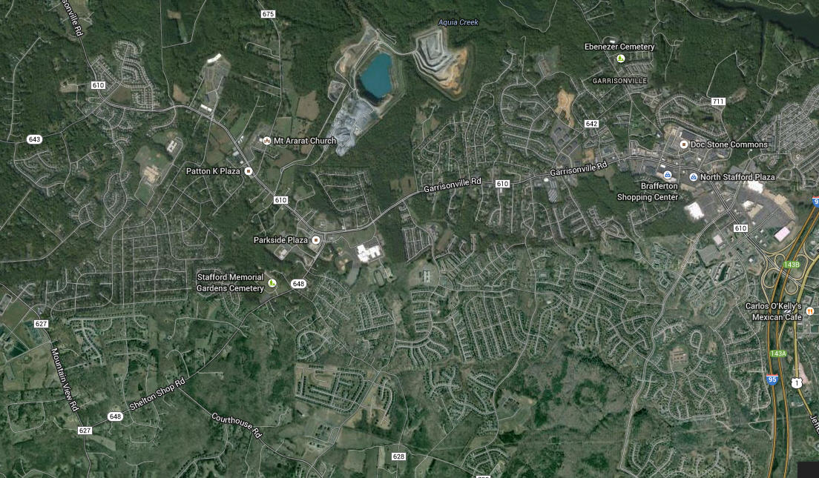

Slide 2
Mental Maps
How does your mental map compare to the street map? Consider differences in detail, distances, directions, etc.
What do the differences between the way you think of the Stafford area and the way it “actually” is on a street (cartographic) map imply?

Slide 3
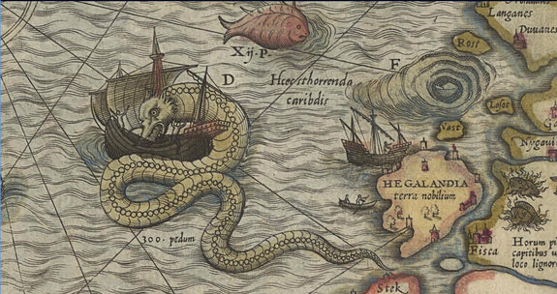

Slide 4
Place vs. Space
Space:
  The Geometric surface of the Earth
Place:
  An area of bounded space that is important to you.
Examples of spaces? Examples of places?

Slide 5
History of Geography
The oldest existing map appears on a clay tablet made in Babylonia before 2000 B.C.
They developed the system of dividing a circle into 360 degrees.
Greek and Roman geographers measured (not always accurately) and devised a grid system of latitudes and longitudes
Ptolemy (2nd c. CE) created first index of locations using grid

Slide 6
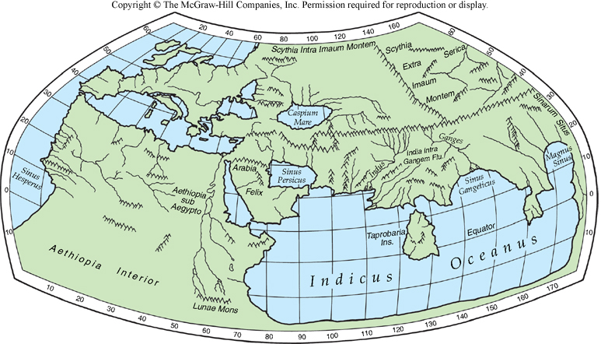
Ptolemy’s Map

Slide 7
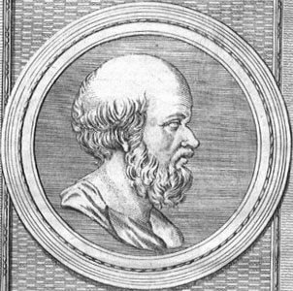
Eratosthenes (273-192 BC)
The First Geographers
Father of Geography
  First to use term
    Geographica
  Calculated circumference of the Earth
Produced map of “Known World”

Slide 8
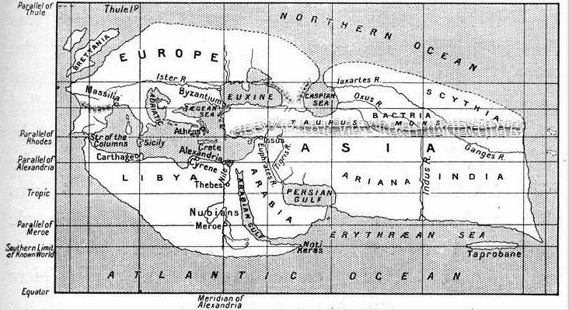

Slide 9
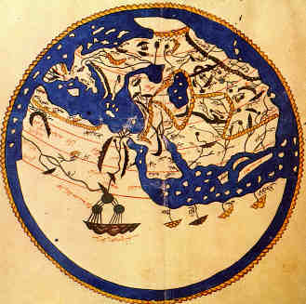
Advances in Geography included:
al Idrisi – Muslim geographic compiler – master of “known world” circa 1050 CE

Slide 10
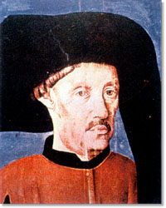
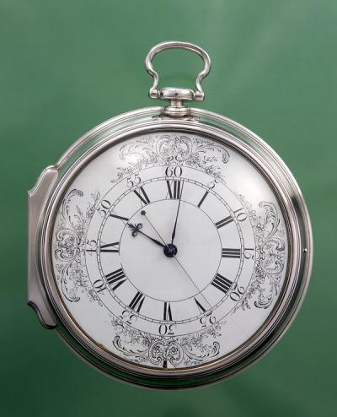
Exploration - 12th to 18th c.
Portugal leads the early explorations – practical in nature
The astrolabe, caravel (ship) and compass assist mariners from Europe who must map what they find
In 1730, John Harrison discovered longitude.

Slide 11
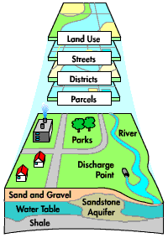
Information can come from a variety of Geographic Sources
GIS - Geographic Information Systems
This system collects information from a variety of sources and compiles it by computer into useful forms.

Slide 12
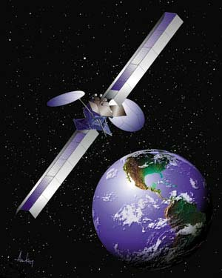
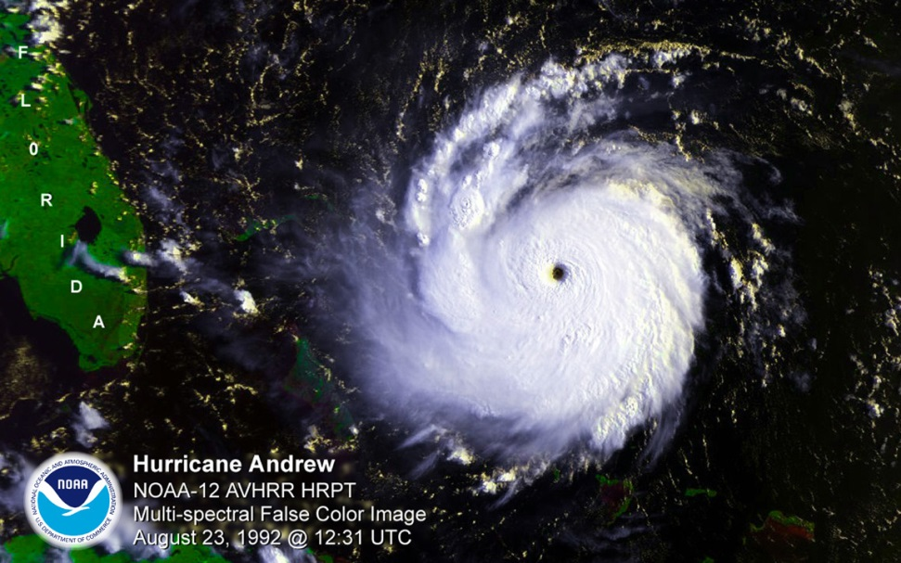
Information can come from a variety of Geographic Sources
Satellite Images
Images taken from space have a variety of different uses:
    Weather
    Cartography
    Defense

Slide 13
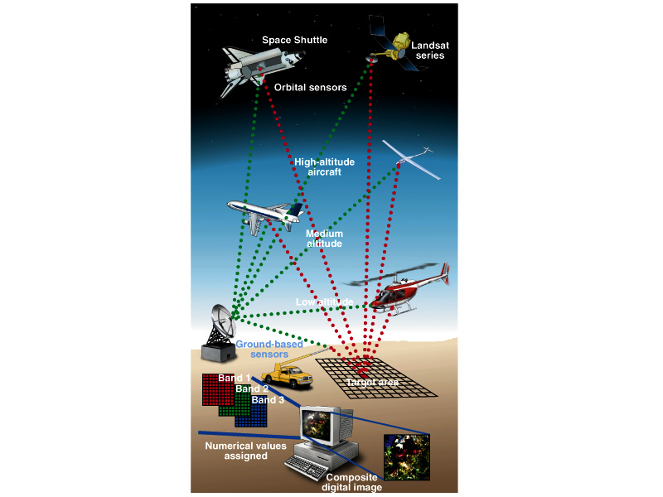
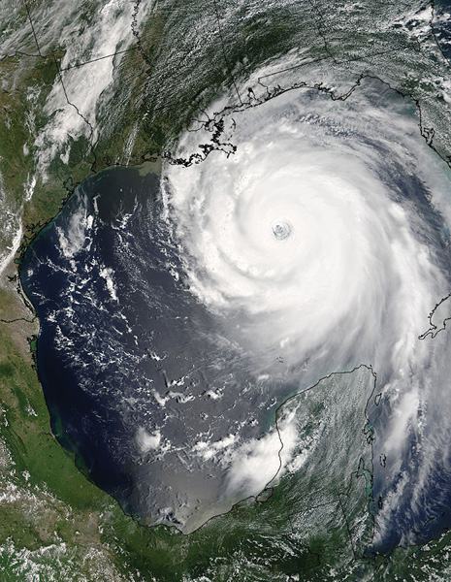
Aerial Photography &
Remote Sensing

Slide 14
Key Concepts
Scale
  truth is scale dependent, phenomena you study at one scale (e.g. local) may well be influenced by developments at other scales (e.g. regional, national, or global)

Slide 15
Comparing maps of different scale
Different maps need to show different levels of detail.
Sometimes you need to show a lot detail for a small area, and sometimes you need to show little detail of a larger area.
A Small-Scale Map shows a large area with small details.
It is good for relative locations
A Large-Scale Map shows a small area with large details.
It is good for detailed looks at small areas

Slide 16
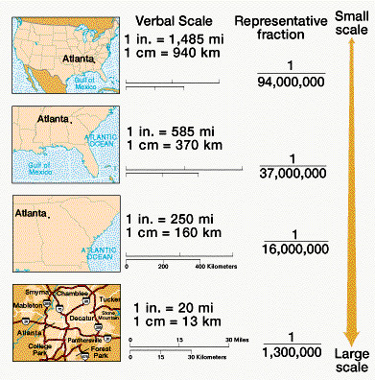
Map Scales
The smaller the right hand number the larger the scale of the map
1:75000 is a more detailed map than 1:600000 which is a small scale map

Slide 17
Key Concepts
Site
  The physical characteristics of a place
Situation
  The place’s relationship with other places.

Slide 18
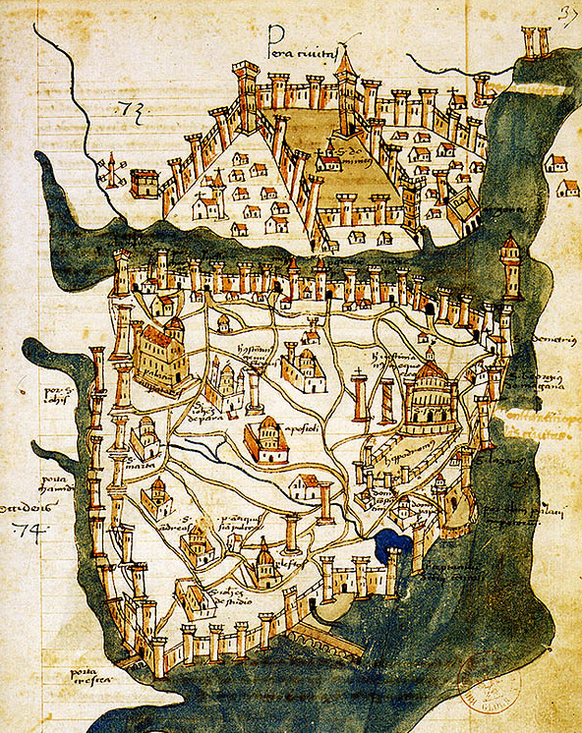
Site and Situation
Constantinople - 1422

Slide 19
Key Concepts
Pattern
  e.g. migration patterns, diffusion of cultures, languages, religions etc.

Slide 20
Key Concepts
Region
  Areas formed by distinctive combinations of features; What do areas have in common?
Interconnections (Globalization)
  Relationships of places and regions; How does one area relate to another?

