Slide 2
Human Geography: People, Place,
and Culture, 11th Edition

Slide 3
Chapter 2: Population
Courtesy of NASA
Notes:
http://apod.nasa.gov/apod/ap001127.html

Slide 4
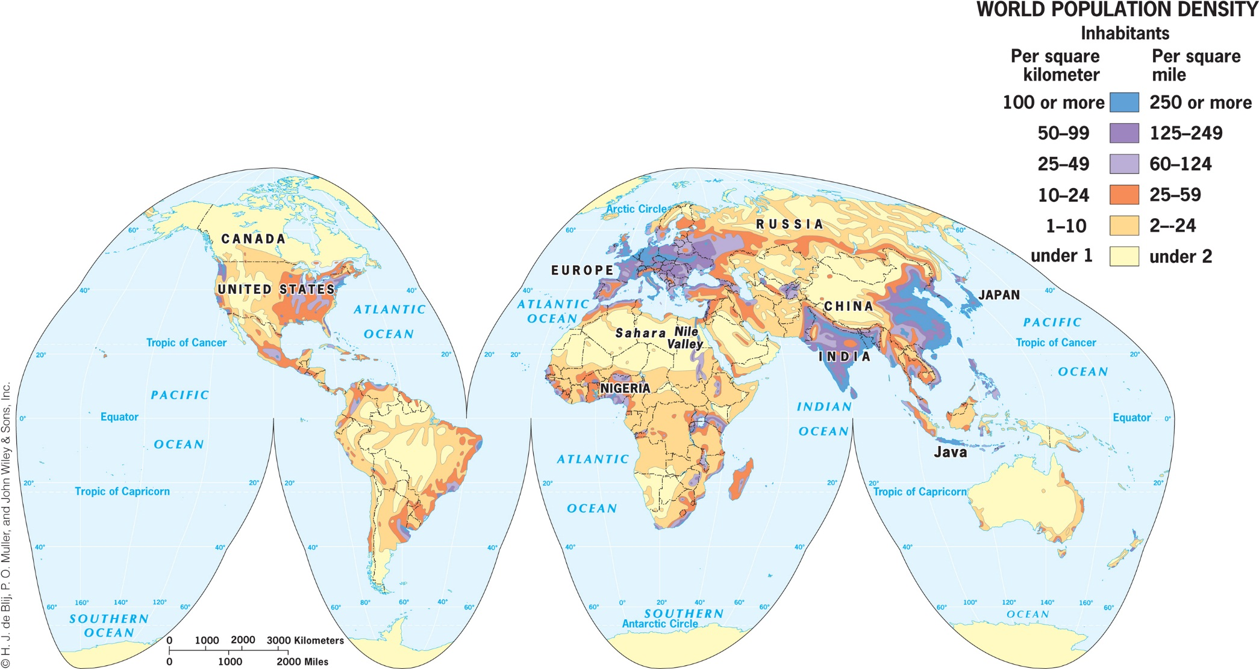
Key Question: Where in the world do people live and why?
Population density: a country’s total population relative to land size
Assumes an even distribution of population to the land

Slide 5
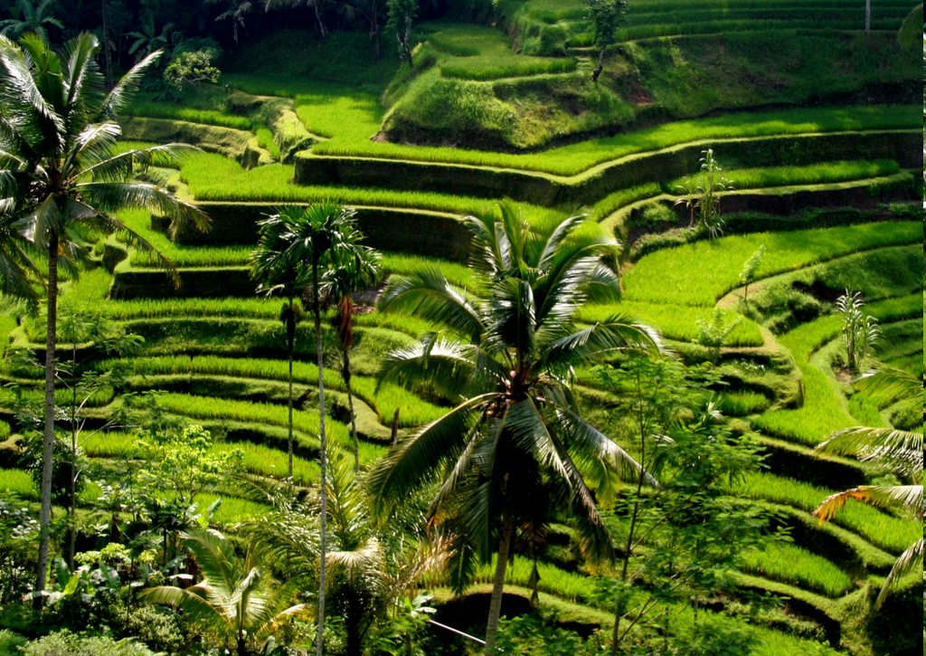
Physiologic Population Density
The number of people per unit area of agriculturally productive land
Concept Caching: Rice Terraces- Bail, Indonesia
© Matt Ebnier

Slide 6
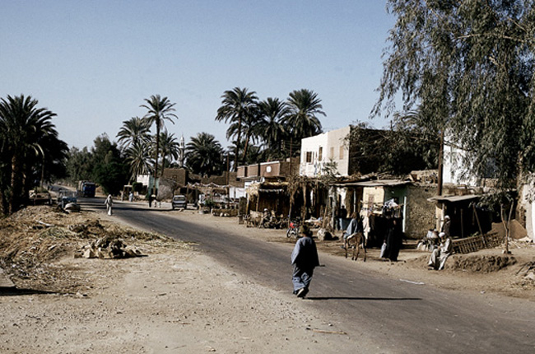
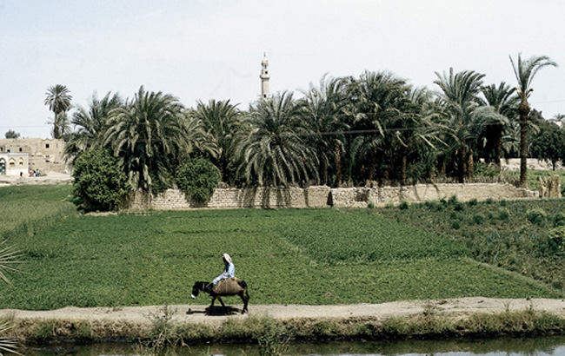
Field Note: Luxor, Egypt
© Alexander B. Murphy
© Alexander B. Murphy
Moving away from the river a few blocks, the land becomes sandy and wind-sculpted.
Egypt’s arable lands are along the Nile River Valley.
“The contrasting character of the Egyptian landscape could not be more striking. Along the Nile River, the landscape is one of green fields, scattered trees, and modest houses, as along this stretch of the river’s west bank near Luxor. But anytime I wander away from the river, brown, wind-sculpted sand dominates the scene as far as the eye can see. Where people live and what they do is not just a product of culture; it is shaped by the physical environment as well.”

Slide 7
Population Distribution
Descriptions of locations on the Earth’s surface where individuals or groups (depending on the scale) live.
Geographers often represent population distributions on dot maps, in which one dot represents a certain number of a population.

Slide 8
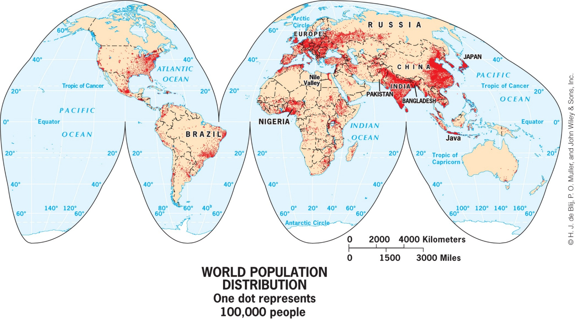
The populations of China and India account for 40 percent of the world currently, and India is predicted to outpace China’s population in the 2030s. How will Figure 2.5 look different 50 years from now? If you were updating this textbook in 50 years, where would the largest population clusters in the world be?

Slide 9
Reliability of Population Data
Census: Federal government funding depends on population data.
Political implications of under-representation of populations.
United Nations, World Bank, and Population Reference Bureau collect data on world populations.

Slide 10
East Asia
Almost 25% of world’s population
Population concentrated in Korea, Japan, China
Over 1.36 billion people in China

Slide 11
South Asia
Physical geography barriers separate population clusters
Himalaya Mountains; Indus River Valley
Confined region with rapidly growing population
Bangladesh: 156 million people in an area the size of Iowa

Slide 12
Europe
715 million
Not clustered in river valleys but coal fields (Industrial Revolution)
Highly Urbanized
80% in UK, 78% in France, 73% in Germany
East and South Asia are 45% urbanized

Slide 13
North America
Megalopolis
Huge urban agglomerations; Boston, NYC, Philadelphia, Baltimore, Washington, D.C
This accounts for more than 20% of US population

Slide 14
Key Question: Why Do Populations Rise and Fall in Particular Places?
Thomas Malthus: An Essay on the Principles of Population
Grows faster than food supply; food grows linearly, population grows exponentially

Slide 15
Population Growth: World, Regional, National Scales
Births – Deaths = Natural Increase
Does not factor immigration (in-migration) or emigration (outmigration) into the equation

Slide 16
Regional and National
Crude Birth Rate (CBR)
Number of births in a year per 1000
Crude Death Rate (CDR)
Number of deaths in a year per 1000
Total Fertility Rate (TFR)
Average number of children born to a woman of
childbearing age

Slide 17
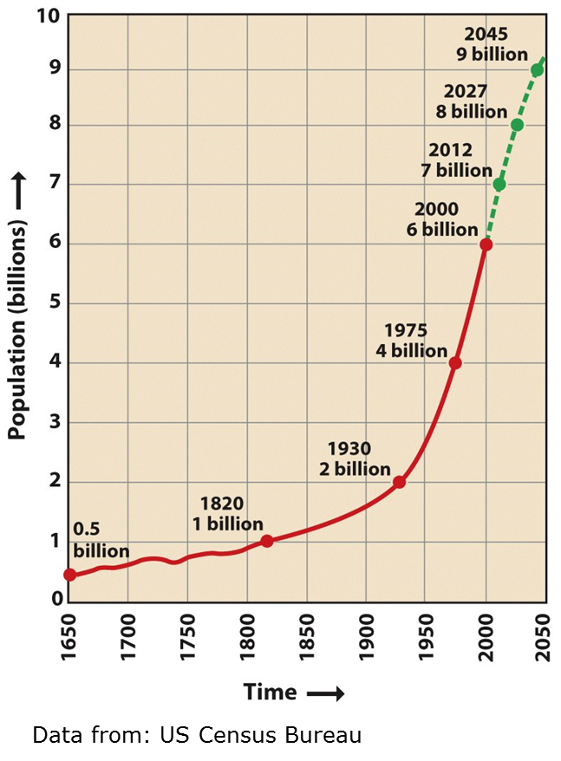
Future Population Growth
Stationary Population Level (SPL)
The level at which a national population ceases to grow
Anticipated dates for population stabilization are often moved back
Ex. Brazil and India

Slide 18
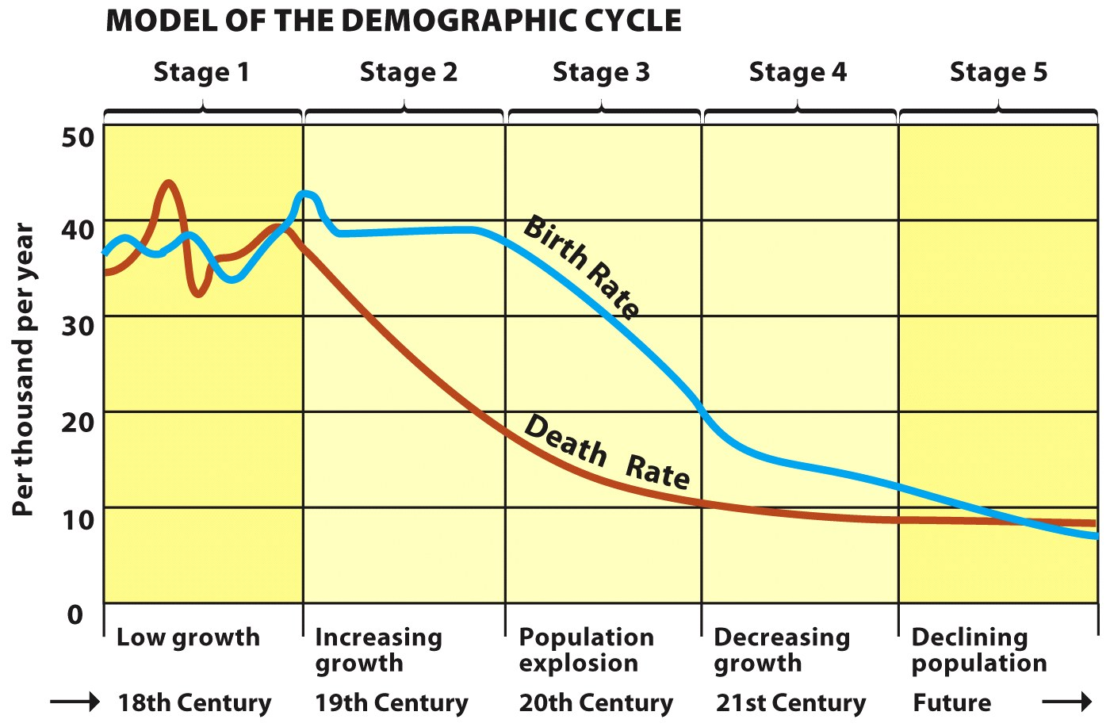
The Demographic Transition
© H.J. de Blij, P.O. Muller, and John Wiley & Sons, Inc.

Slide 19
Demographic Transition
Factors limiting population growth:
Famine, epidemics, plagues, wars
Factors enhancing population growth:
Agricultural advances, Industrial Revolution, sanitation, vaccinations

