Slide 1
Human Geography: People, Place,
and Culture, 11th Edition

Slide 2
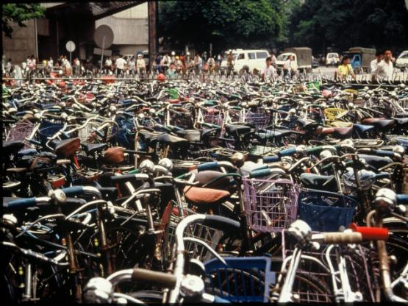
Chapter 12: Industry and Services
Concept Caching: Bicycle Use and Production in China
© Barbara Weightman

Slide 3
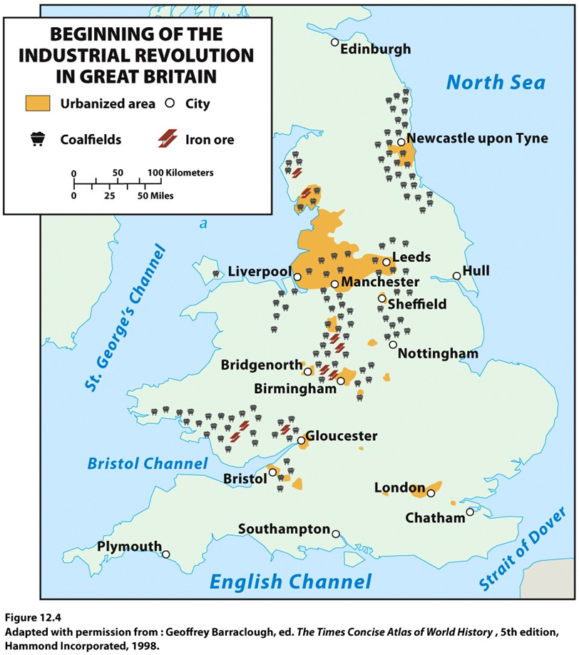
Key Question: Where did the Industrial Revolution begin, and how did it diffuse?
Eighteenth-century inventions brought new uses for known energy sources (coal) and new machines to improve efficiencies (steam engines).

Slide 4
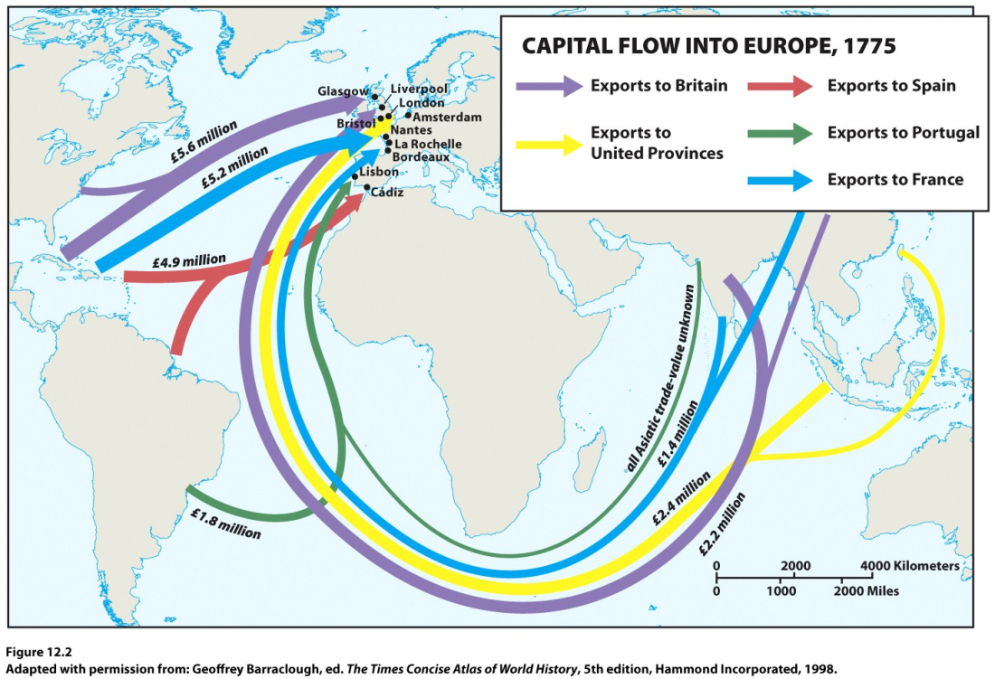
The Industrial Revolution
Manufacturing enabled the production of the steam engine and a variety of other products.
An expanding trade network focused on Western Europe and brought wealth to those in a position to take advantage of changing circumstances.
Railroad and steam ship heightened advantage.

Slide 5
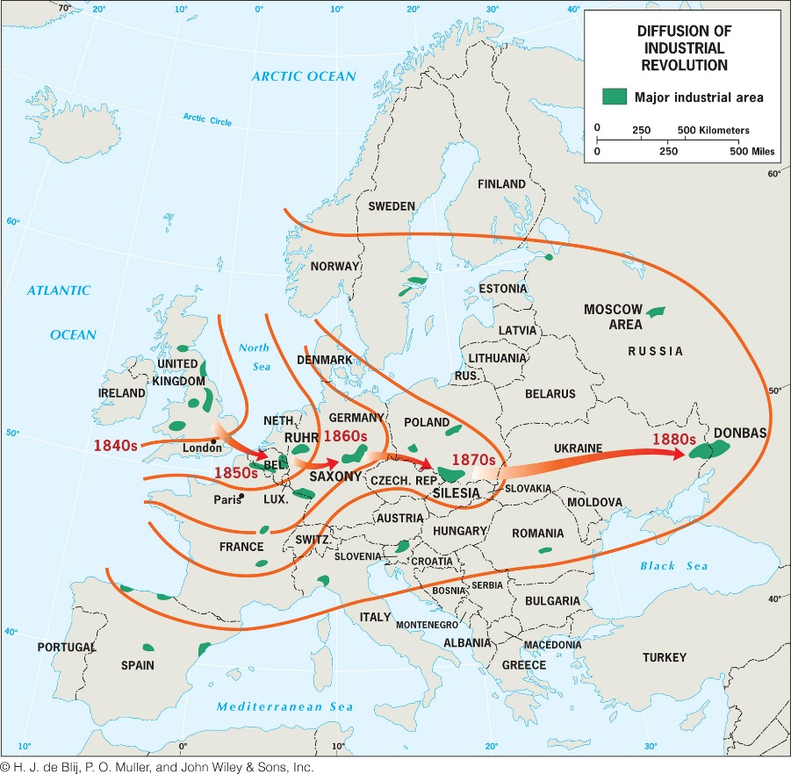
Diffusion to Mainland Europe
Concept Caching:
Fenway Park, Boston, MA
Diffused through port cities and near coal fields.
Developments changed the port cities.
Railroad network expanded inside of existing urban areas with large markets, i.e. London and Paris.

Slide 6
Diffusion Beyond Europe
Primary industrial regions: western Europe, eastern North America, western Russia and Ukraine, and East Asia
North America: Manufacturing began in New England during the colonial period; benefited from the ability of its companies to acquire needed raw materials from overseas sources.
Russia and Ukraine: St. Petersburg attracted industries including shipbuilding, chemical production, food processing, and textile making.
East Asia: manufacturing in Japan depended on raw materials imported from other parts of the world; dominant region is the Kanto Plain.

Slide 7
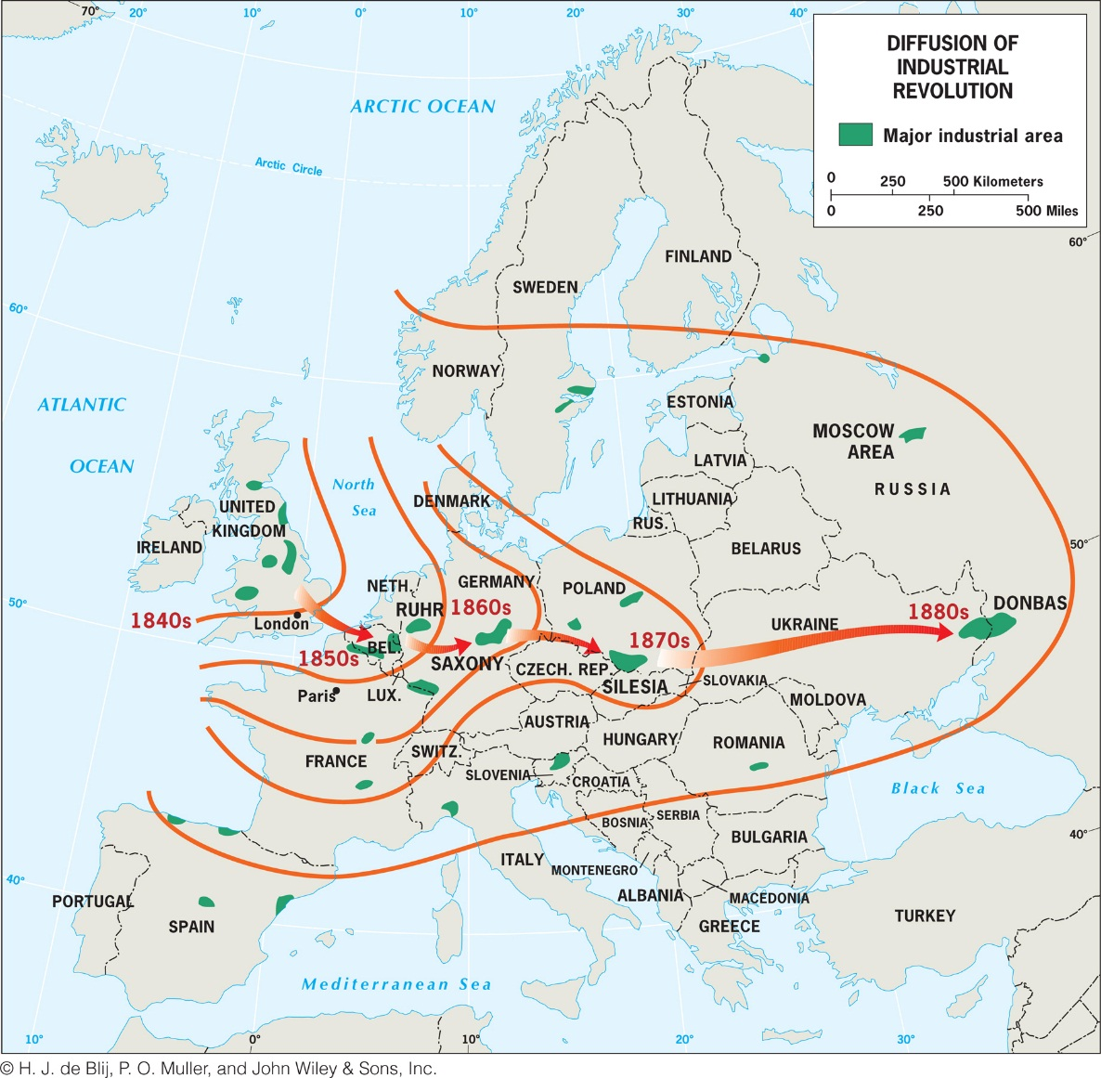
Examine the map of diffusion of the Industrial Revolution into Europe (Fig. 12.5) and hypothesize what other characteristics (aside from the presence of coal) were necessary for industrialization to take hold in these regions.

Slide 8
Key Question: How have the character and geography of industrial production changed?
Fordist production: was the dominant mode of mass production that endured from 1945 to 1970, named for Henry Ford.
The Fordist period is marked by a surge in both mass production and mass consumption.
Vertical integration
Friction of distance: the increase in time and cost that usually comes with increased distance over which commodities must travel.
Ex.: furniture manufacturing

Slide 9
Agglomeration
British economist Alfred Marshall: localization
Geographer Alfred Weber: least cost theory focused on a factory owner’s desire to minimize three categories of costs:
Transportation
Labor
Agglomeration

Slide 10
Flexible Production and Product Life Cycle
Flexible production systems: Firms can pick and choose among a multitude of suppliers and production strategies in distant places, and then quickly shift their choices in response to adjustments in production costs or consumer demand.
Commodification: Goods that were not previously bought, sold, and traded gain a monetary value and are bought, sold, and traded on the market.
Product life cycle: Changes in the production of a good over time take place.

Slide 11
The Global Division of Labor
Labor is concentrated in the global economic periphery and semiperiphery to take advantage of lower labor costs, whereas research and development is primarily located in the core.
David Harvey: time–space compression.
Just-in-time delivery: Companies keep just what they need for short-term production and new parts are shipped quickly when needed.
Spatial fix: In choosing a production site, location is only one consideration.
Outsourced: moved offshore.

Slide 12
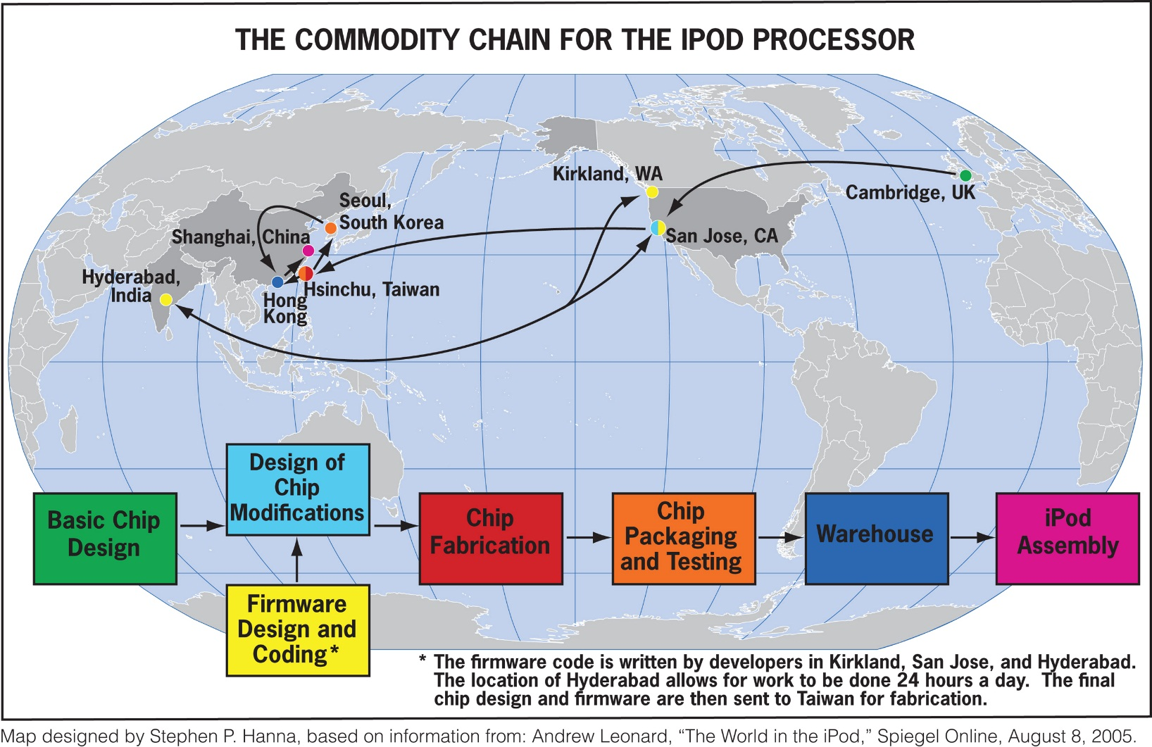
Made in America or Designed in America?
Commodity Chain: Consumption, or purchasing an item, is the end point in a commodity chain that affects places in a variety of ways.

Slide 13
Major Influences on the Contemporary Geography of Manufacturing
Transportation: Intermodal connections, places where two or more modes of transportation meet in order to ease the flow of goods and reduce the costs of transportation.
Regulatory Circumstances: Regional trade organizations such as the North American Free Trade Agreement (NAFTA) and the European Union (EU) have trade agreements that influence where imported goods are produced.
Energy: The role of energy supply as a factor in industrial location decisions has changed over time.

Slide 14
New Centers of Industrial Activity
Deindustrialization is a process by which companies move industrial jobs to other regions.
New industrial regions emerge as shifts in politics, laws, capital flow, and labor availability occur.
East Asia has become a particularly important new region of industrialization.

Slide 15
The Rise of East Asia
New Centers of Industrial Activity
Four Tigers of East and Southeast Asia: South Korea, Taiwan, Hong Kong, and Singapore.
The tigers emerged as the first newly industrializing countries (NICs).
Hong Kong became mainland China’s gateway.
To the world, a bustling port, financial center, and break-of-bulk point, where goods are transferred from one mode of transport to another.

Slide 16
New Centers of Industrial Activity
The Rise of East Asia
The industrial growth of Singapore also was influenced by its geographical setting and the changing global economic division of labor.
In 1997 risky lending practices and government investment decisions caused Thailand’s currency to collapse, followed by its stock market.
By early 1998 one of the Four Tigers, South Korea, required a massive infusion of dollars to prevent economic chaos.

Slide 17
New Centers of Industrial Activity
The Chinese Juggernaut
China’s major industrial expansion occurred during the communist period.
Under state planning rules, the Northeast district became China’s industrial heartland, a complex of heavy industries based on the region’s coal and iron deposits located in the basin of the Liao River.
The second largest industrial region in China, the Shanghai and the Chang Jiang district , developed in and around the country’s biggest city, Shanghai.
Notes:
*

Slide 18
New Centers of Industrial Activity
The Chinese Juggernaut
China’s large labor force has attracted hundreds of international companies.
The Northeast has become China’s “Rust Belt.”
Today, the Chinese government is pushing industrialization into the interior of the country, with new investment flowing into poorer parts of the central and western portions of the country.

Slide 19
New Centers of Industrial Activity
The Chinese Juggernaut
BRICS: Brazil, Russia, India, China, and South Africa; these countries are evidence of a shift in global economic power away from the traditional economic core.
India has recently become the world’s sixth largest economy.
India has no major oil reserves, so it must spend heavily on oil energy.

Slide 20
New Centers of Industrial Activity
Where From Here?
It has been suggested that a combination of technological changes and developments in the global economy have reduced the significance of location and made place differences increasingly insignificant.
What is needed is a greater understanding of how places have changed as a result of new production methods, new corporate structures, and new patterns of industry.

Slide 21
Key Question
How have deindustrialization and the rise of service industries altered the economic geography of production?

Slide 22
Key Question: How Have Deindustrialization and the Rise of Service Industries Altered the Economic Geography of Production?
Service industries (tertiary industries) encompass the range of services that are found in modern societies.
Quaternary industries: the collection, processing, and manipulation of information and capital.
Quinary industries: activities that facilitate complex decision making and the advancement of human capacities.

Slide 23
Geographical Dimensions of the Service Economy
Deindustrialization did little to change the basic disparities between core and periphery that have long characterized the global economy.
The industrial zone of the northeastern United States (around the Great Lakes) lost much of its industrial base and is now commonly called the Rust Belt.
The Sun Belt is a secondary industrial region that has made the transition to a viable service economy fairly successfully.
Concept Caching:
Mount Vesuvius

Slide 24
Geographical Dimensions of the Service Economy
New Patterns of Economic Activity
Technologies such as GIS can help to model the best locations for new businesses, office complexes, government centers, or transportation connections.
Major retailers change the economic prospects and physical landscapes of the places where their headquarters are located. Ex.: Walmart
The locational influences on quaternary services are more diverse.
Those who work in the quinary sector tend to be concentrated around governmental seats, universities, and corporate headquarters.

Slide 25
High-Technology Clusters
The goal of a high-technology corridor is to attract designers of computers, semiconductors, telecommunications, sophisticated medical equipment, etc. Ex.: California’s Silicon Valley
Growth pole spurred economic development in the surrounding area.
Technopole: an area planned for high technology where agglomeration built on a synergy among technological companies occurs.
High-technology industries have become such an important symbol of the postindustrial world that local, regional, and national governments often aggressively pursue firms in this sector.

Slide 26
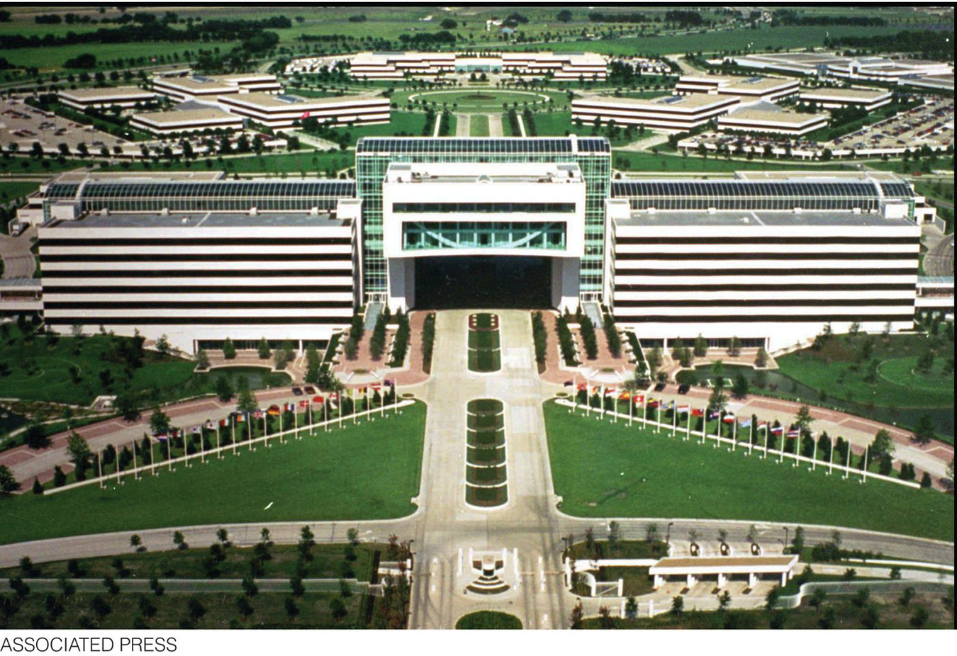
Figure 12.25
Plano-Richardson, Texas. The Plano-Richardson Telecom Corridor is located
just north of Dallas and is home to telecom corporate headquarters, such as
Electronic Data Systems Corporation’s headquarters in this photograph

Slide 27
Tourism Services
The tourism boom began in the global economic core as incomes and leisure time increased for a rapidly expanding segment of the population.
Tourism is likely to continue to expand despite dips in travel at the beginning and end of the first decade of the twenty-first century.
The economic impacts of tourist-related development are far-reaching.

Slide 28
Place Vulnerabilities in a Service Economy
Mechanization can have a negative impact on service jobs.
Places dominated by the service sector cannot exist without extensive connections with other places because those living in such places still need food and material products.
Economic decision making in a globalized economy can easily become disconnected from the fate of individual places and regions.
Ex.: the financial services industry

Slide 29
How does a place change when deindustrialization occurs? Consider a place that has experienced deindustrialization, and research recent news articles on the Internet to find out how the economy of the place has changed since the loss of industry. What has happened to the place and its economy?

Slide 30
Additional Resources
Port of Rotterdam http://www.portofrotterdam.com
Nike http://www.nikebiz.com/company_overview
Walmart’s influence on Bentonville, Arkansas http://www.pbs.org/wgbh/pages/frontline/shows/walmart
Additional Resources on Geography Education
Industry, Labor, Manufacturing, Globalization, Diffusion, Economic.
Concept Caching:
Mount Vesuvius

