Slide 1
Key Question: What Role Do Cities Play in Globalization?
World cities function at the global scale, beyond the reach of the state borders, functioning as the service centers of the world economy.
Felsenstein, Schamp, and Shachar: The world city is a node in globalization, reflecting processes that have “redrawn the limits on spatial interaction.”
World cities do not exist merely to service players in the global economy.
Some countries such as the United States and Germany have two or more world cities within their state borders.

Slide 2
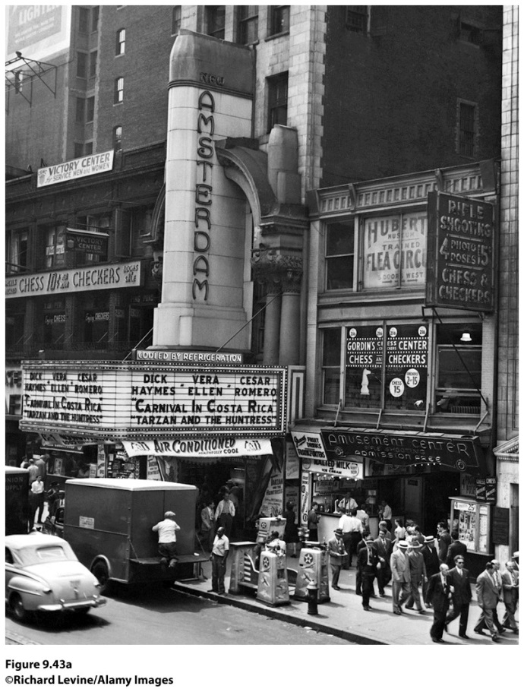
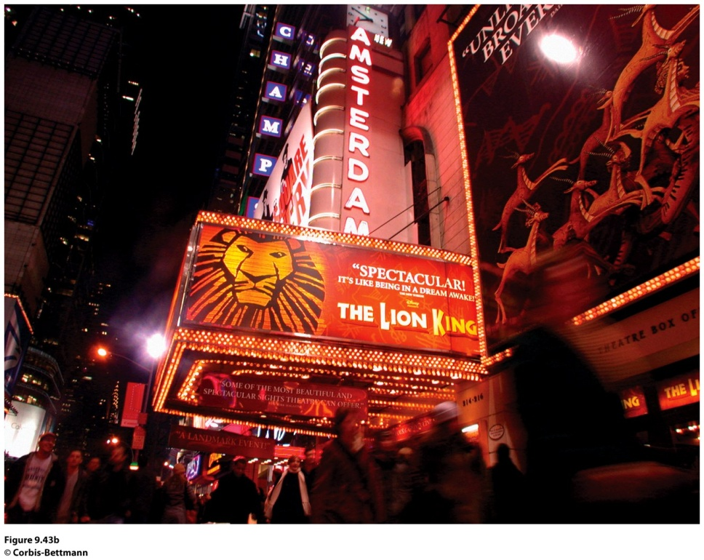
Cities as Spaces of Consumption
Media corporations are helping transform urban centers into major entertainment districts where items are consumed
Notes:
Figure 9.43, left and right
New York, New York. (left) The New Amsterdam Theater in Times Square as it stood in
1947. Note the signs around the building, advertising arcade games and a fl ea circus. (right)
During the 1980s and 1990s, Times Square was “cleaned up” and reinvigorated. The Walt Disney
Company renovated the New Amsterdam Theater and now shows productions of musicals such
as Beauty and the Beast and The Lion King. (left): ©Richard Levine/Alamy Images, (right): © Corbis-Bettmann.
Disney set the new course for a family-friendly entertainment
district in New York. The restored New Amsterdam
Theater hosts Di s ney musicals such as The Lion King and
Beauty and the Beast (both based on Disney movies). The
Times Square area is assuredly a space of consumption and a
variation on a theme park: themed restaurants (Hard Rock
Café, ESPN Zone), cross-promoting themed stores (Warner
Brothers Store, Disney Store), and retail stores that cater to
families (an enormous Toys R Us with a ferris wheel inside).
In 2009, New York Mayor Michael Bloomberg
closed portions of Broadway in Times Square to traffi
c and created an urban esplanade with lawn chairs and
seating to advance his goal of making the city more livable.
New Yorkers and tourists took to the new seating
and moved in with laptops in hand. Times Square and the
Hi-Line Walkway in New York now have bleacher-style
seating as well as chairs to encourage New Yorkers to sit a
spell and enjoy the city.
Potsdamer Platz in Berlin is also becoming a new
space of

Slide 3
Thinking through the challenges to the state presented in Chapter 8, predict whether and under what circumstances world cities could replace states as the basic and most powerful form of political organization in the world.

Slide 4
Additional Resources
Celebration, Florida http://www.celebration.fl .us
Congress for the New Urbanism http://www.cnu.org
Globalization and World Cities http://www.lut.ac.uk/gawc/index.html
Opposition to Urban Sprawl http://www.sierraclub.org/sprawl
Seaside, Florida http://www.seasidefl .com
Supplemental Resources on Geography Education:
Urban, Gentrification, Urban Models, Density.

Slide 5
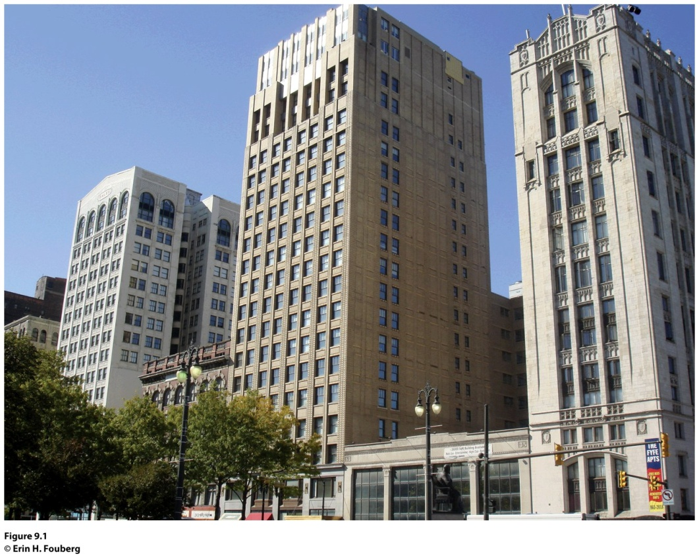
Field Note: Ghosts of Detroit?
“The semicircular shaped Grand Circus Park in Detroit, Michigan is divided by several streets, making it look like the hub and spokes of a bicycle wheel from above. The grouping of buildings along Grand Circus Park (Fig 9.1) reflects the rise, fall, and revitalization of the central business district (CBD) in Detroit. The central business district is a concentration of business and commerce in the city’s downtown…Abandoned high-rise buildings called the ghosts
of Detroit are joined by empty single-family homes to account for 10,000 abandoned buildings in the city.”
Notes:
*Could be an audio file.
Figure 9.1
Detroit, Michigan. The buildings along West Adams Street face Grand Park Circus in
Detroit, Michigan. From left to right, the Kales Building, Adams Theater, Grand Park Centre,
and Fyfe Apartments have experienced the rise, decline, and revitalization of the neighborhood,
which is located in the Central Business District. © Erin H. Fouberg.
Figure 6.1
Brussels, Belgium. A health insurance offi ce in the bilingual capital city of Brussels displays
duplicates of each of their posters, one in French and one in Flemish. © Erin H. Fouberg.

Slide 6
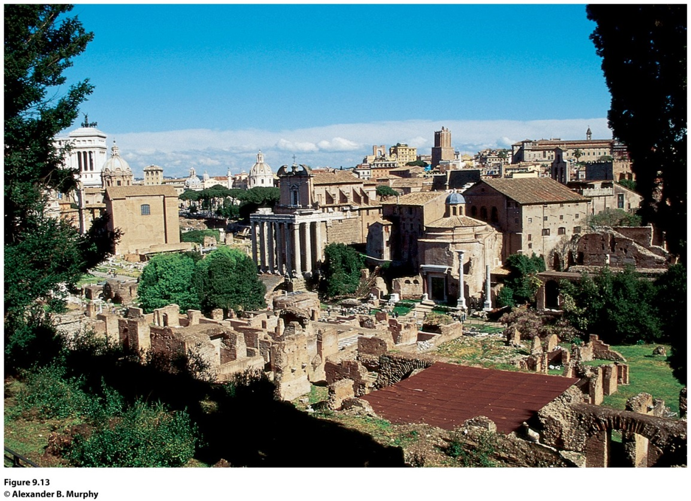
Field Note
“There can be few spaces of greater significance to the development of Western civilization than the Roman Forum. This was the nerve center of a vast empire that transformed the face of western Europe, Southwest Asia, and North Africa. It was also the place where the decisions were made that carried forward Greek ideas about governance, art, urban design, and technology. The very organization of space found in the Roman Forum is still with us: rectilinear street patterns; distinct buildings for legislative, executive, and judicial functions; and public spaces adorned with statues and fountains.”
Notes:
*Could be an audio file.
Figure 9.13
Rome, Italy. © Alexander B. Murphy.

Slide 7
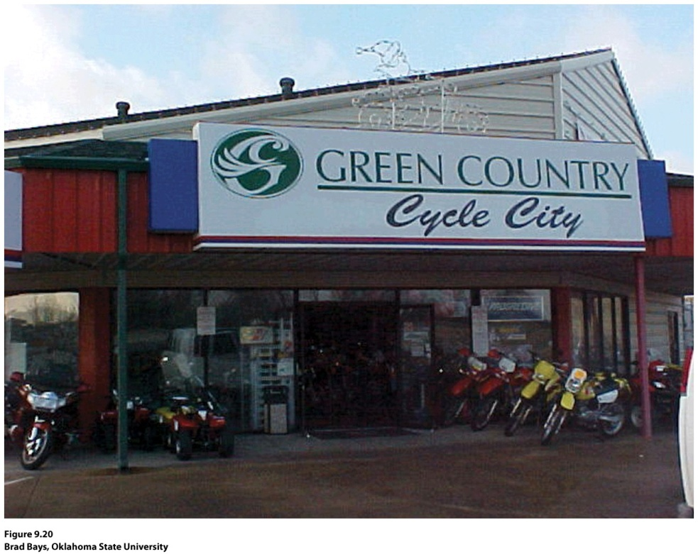
Guest Field Note:
Broken Arrow, Oklahoma
“Many trade areas in the United States are named, and their names typically coincide with the vernacular region, the region people perceive themselves as living in. In promoting a trade area, companies often adopt, name, or shape the name of the vernacular region. In Oklahoma, the label Green Country refers to the northeastern quarter of the state, the trade area served by Tulsa.”
Credit: Brad Bays, Oklahoma State University
Notes:
Figure 9.20
Credit: Brad Bays, Oklahoma State University

Slide 8
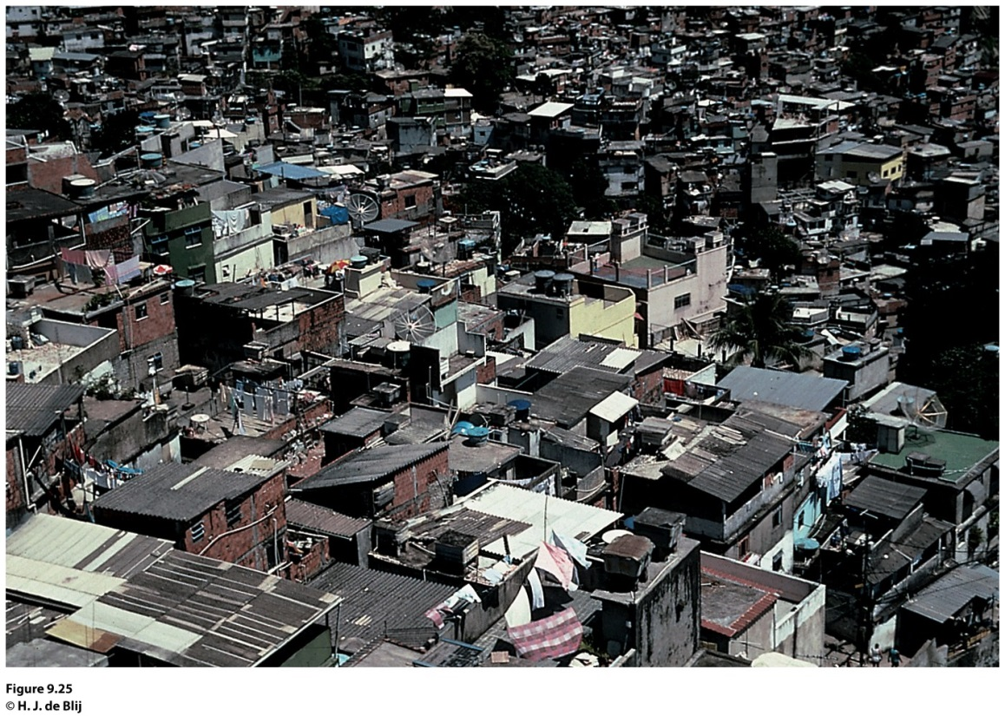
Field Note
“February 1, 2003. A long-held hope came true today: thanks to a Brazilian intermediary I was allowed to enter and spend a day in two of Rio de Janeiro’s hillslope favelas, an eight-hour walk through one into the other. Here live millions of the city’s poor, in areas often ruled by drug lords and their gangs, with minimal or no public services, amid squalor and stench, in discomfort and danger.
Notes:
*Could also be an audio file.
Figure 9.25
Rio de Janeiro, Brazil. © H. J. de Blij.

Slide 9
Archaeologists have found that the houses in Indus River cities, such as Mohenjo-Daro and Harappa, were a uniform size: each house had access to a sewer system, and palaces were absent from the cultural landscape. Derive a theory as to why these conditions were present in these cities that had both a leadership class and a surplus of agricultural goods.

Slide 10
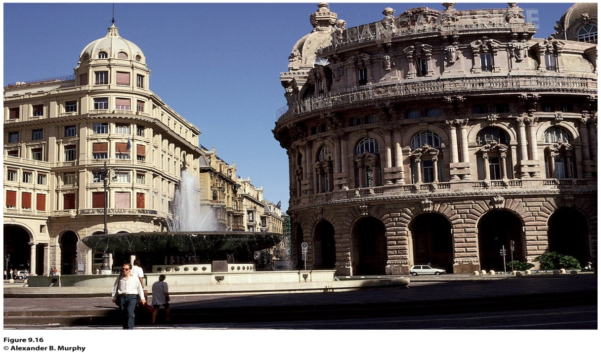
Field Note
“The contemporary landscape of Genoa stands as a reminder of the city’s historic importance. Long before Europe became divided up into states, a number of cities in northern Italy freed themselves from the strictures of feudalism and began to function autonomously. Genoa and Venice were two of these, and they became the foci of significant Mediterranean maritime trading empires. In the process, they also became magnificent, wealthy cities. Although most buildings in Genoa’s urban core date from a more recent era, the layout of streets and public squares harkens back to the city’s imperial days. Is it a surprise that the city gave birth to one of the most famous explorers of all time: Christopher Columbus?”
Notes:
*Could be an audio file.
Figure 9.16
Genoa, Italy. © Alexander B. Murphy.

Slide 11
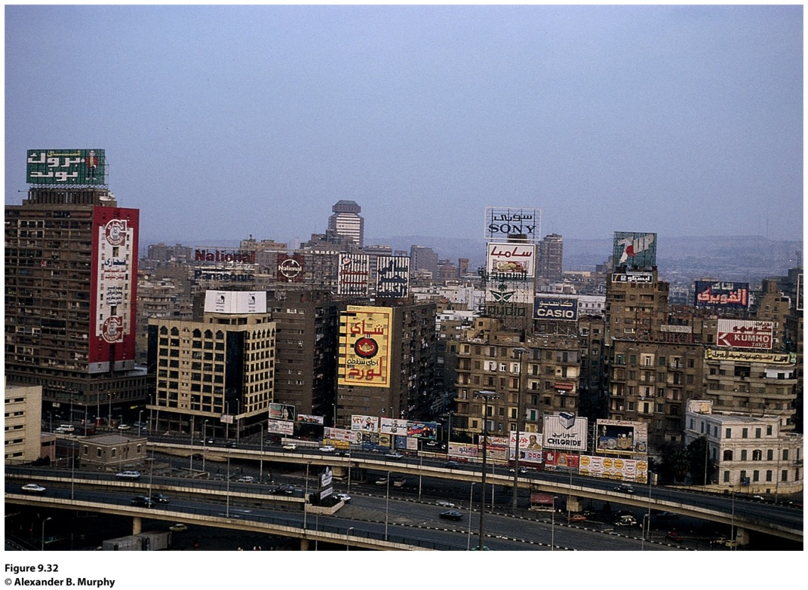
Field Note
“Central Cairo is full of the multistory buildings, transportation arteries, and commercial signs that characterize most contemporary big cities. Outside of a number of mosques, few remnants of the old medieval city remain. The first blow came in the nineteenth century, when a French educated ruler was determined to recast Cairo as a world-class city. Inspired by the planning ideas of Paris’s Baron von Hausman, he transformed the urban core into a zone of broad, straight streets. In more recent years the forces of modern international capitalism have had the upper hand. There is little sense of an overall vision for central Cairo. Instead, it seems to be a hodge-podge of buildings and streets devoted to commerce, administration, and a variety of producer and consumer services.”
Notes:
*Could be an audio file.
Figure 9.32
Cairo, Egypt. © Alexander B. Murphy

Slide 12
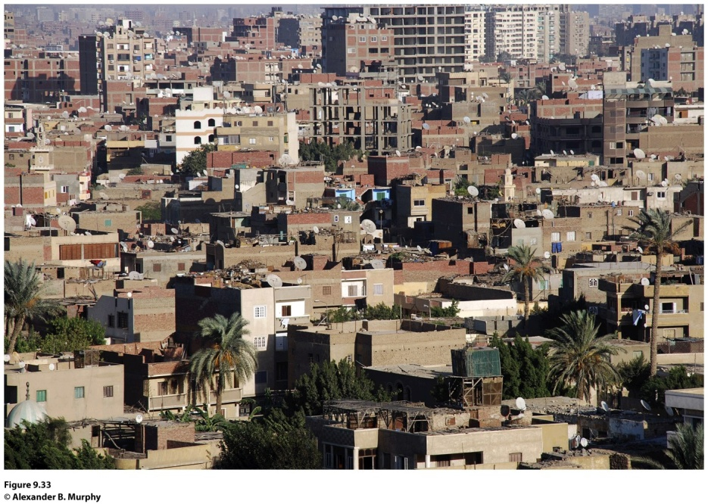
Field Note
“Moving out from central Cairo, evidence of the city’s rapid growth is all around you. These hastily built housing units are part of the (often losing) effort to keep up with the city’s exploding growth. From a city of just one million people in 1930, Cairo’s population expanded to six million by 1986. And then high growth rates really kicked in. Although no one knows the exact size of the contemporary city, most estimates suggest that Cairo’s population has doubled in the last 20 years. This growth has placed a tremendous strain on city services. Housing has been a particularly critical problem—leading to a landscape outside the urban core dominated by hastily built, minimally functional, and aesthetically non-descript housing projects.”
Notes:
*Could be an audio file.
Figure 9.33
Cairo, Egypt. © Alexander B. Murphy.

Slide 13
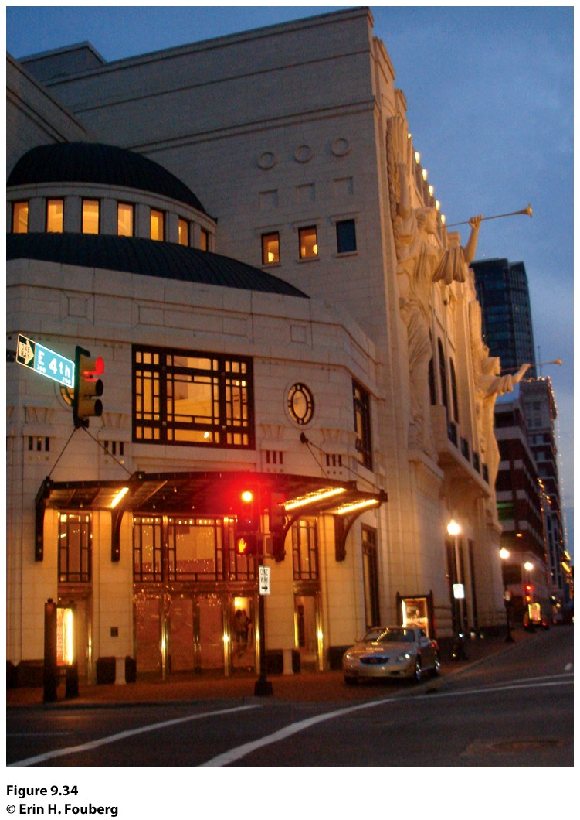
Field Note
“In 2008, downtown Fort Worth, Texas looked quite different than it did when I first visited in 1997. In that eleven year period, business leaders in the City of Fort Worth gentrified the downtown. The Bass family, who has a great deal of wealth from oil holdings and who now owns about 40 blocks of downtown Fort Worth, was instrumental in the city’s gentrification. In the 1970s and 1980s, members of the Bass family looked at the empty, stark, downtown Fort Worth, and sought a way to revitalize the downtown. They worked with the Tandy family to build and revitalize the spaces of the city, which took off in the late 1990s and into the present century. The crown jewel in the gentrified Fort Worth is the beautiful cultural center called the Bass Performance Hall, named for Nancy Lee and Perry R. Bass, which opened in 1998.”
Concept Caching:
Forth Worth, Texas
Notes:
*Could be an audio file.
Figure 9.34
Fort Worth, Texas. © Erin H. Fouberg.

Slide 14
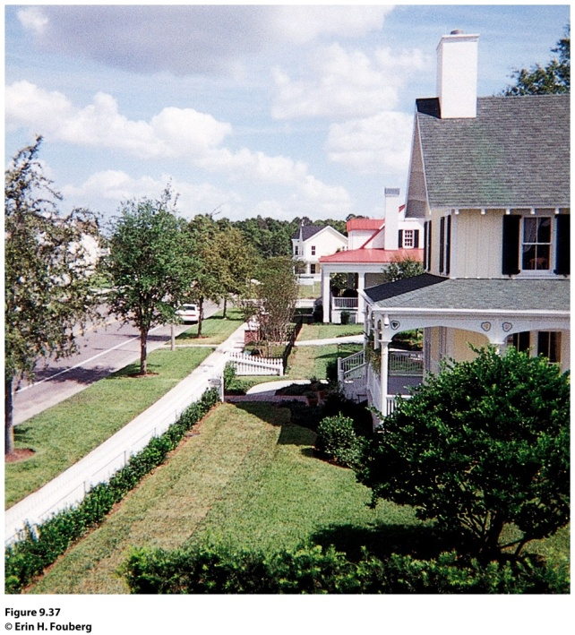
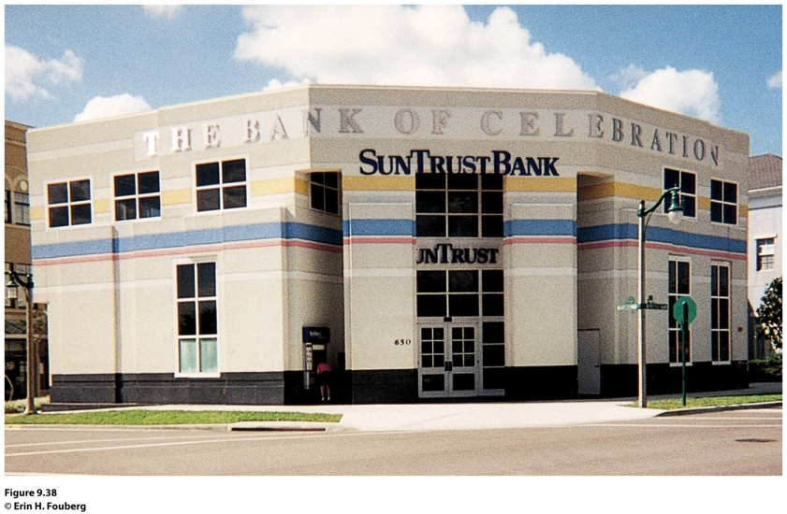
Field Note
“When I visited Celebration, Florida, in 1997, I felt like I was walking onto a movie or television set. The architecture in the Walt Disney designed new urbanist development looked like the quintessential New England town. Each house has a porch, but on the day I was there, the porches sat empty—waiting to welcome the arrival of their owners at the end of the work day. We walked through town, past the 50s-style movie marquee, and ate lunch at a 50s-style diner. At that point, Celebration was still growing. Across the street from the Bank of Celebration’ stood a sign marking the future home of the ‘Church in Celebration.’”
Notes:
*Could be an audio file.
Figure 9.37 and 9.38
Celebration, Florida. © Erin H. Fouberg

