Slide 2
Human Geography: People, Place,
and Culture, 11th Edition

Slide 3
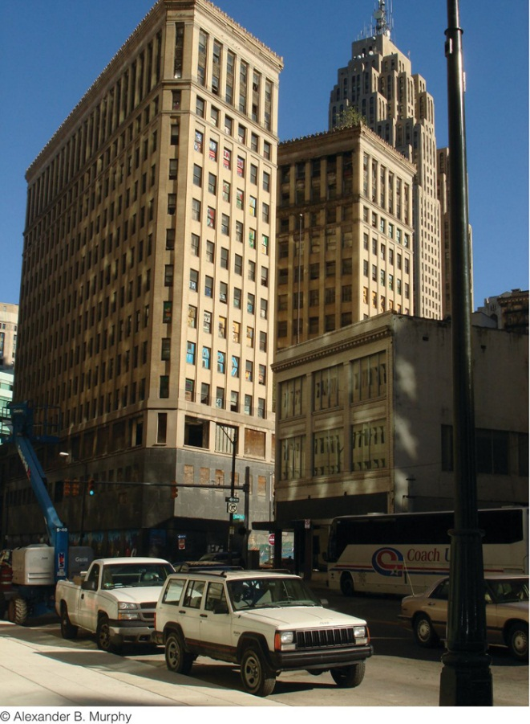
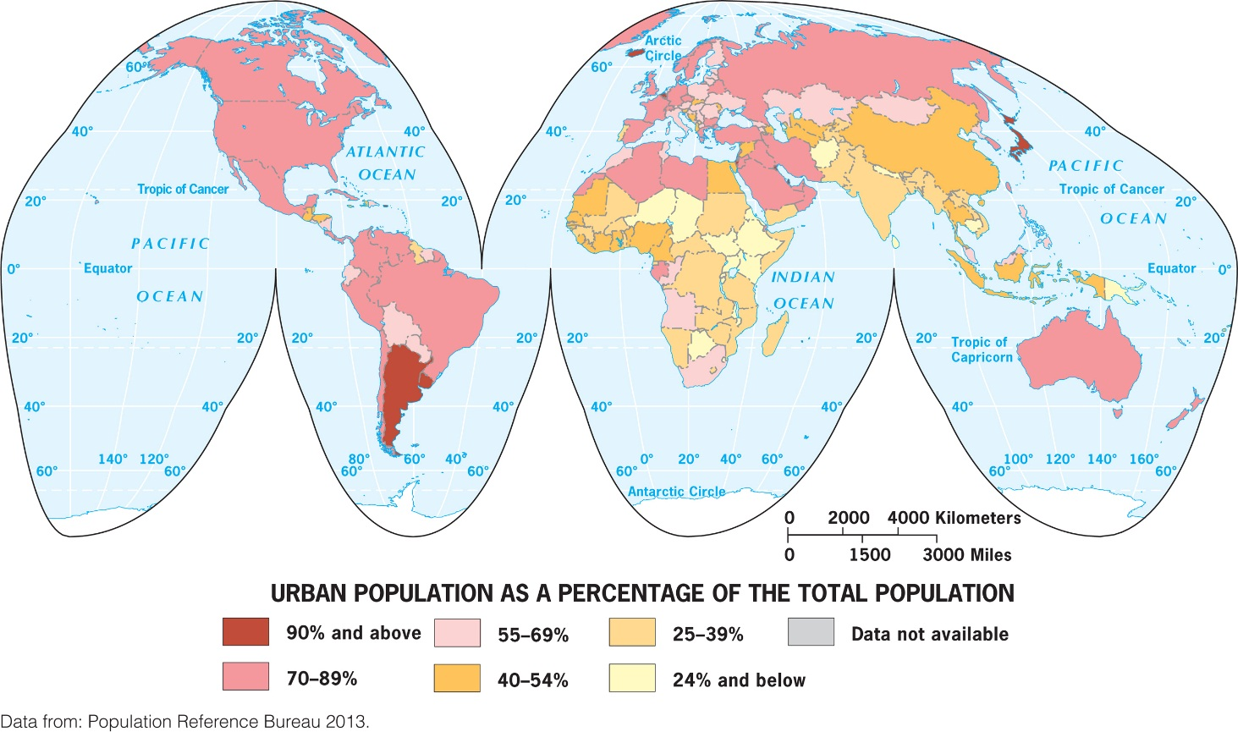
Chapter 9: Urban Geography
Notes:
Figure 9.2
Detroit, Michigan. The Lafayette Building once housed the offices of the Michigan Supreme Court. This photo from 2008 shows the boarded-up first and second floors and broken windows on the third floor. Urban explorers broke into and photographed abandoned buildings in Detroit (several websites are devoted to their photographs and videos), and vandals painted graffiti on the windows of Lafayette and other so-called ghosts of Detroit. © Erin H. Fouberg.

Slide 4
Key Question: When and Why Did People Start Living in Cities?
Urban: the built-up space of the central city and suburbs
Includes the city and surrounding environs connected to the city
Is distinctively nonrural and nonagricultural

Slide 5
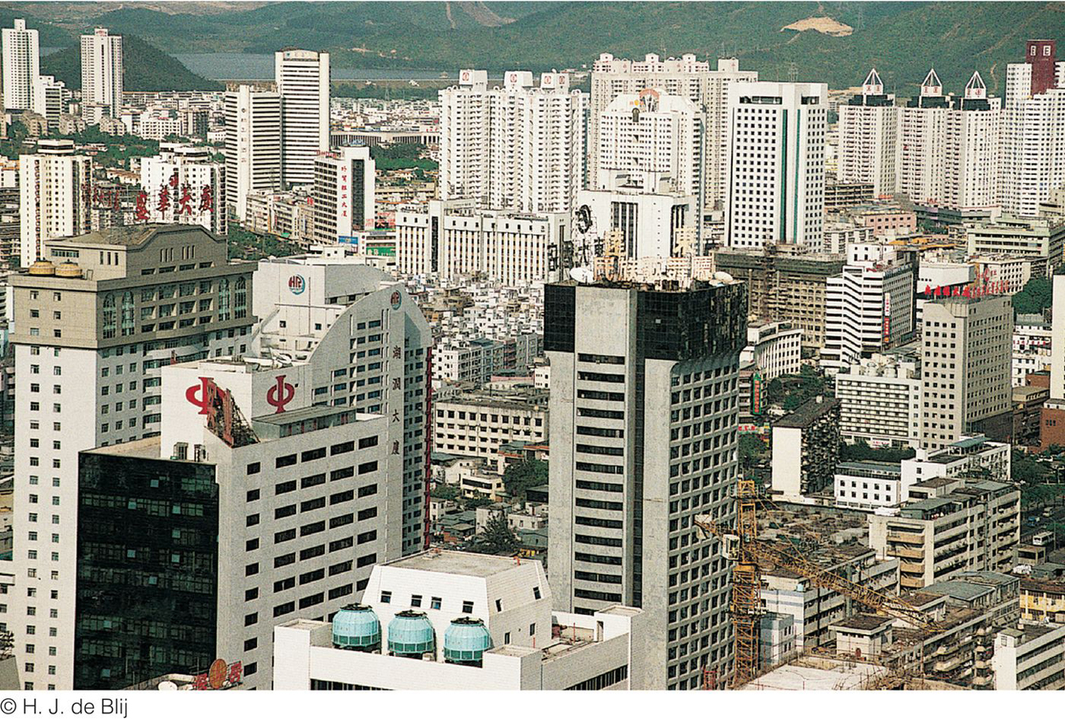
A city is an agglomeration of people and buildings clustered together to serve as a center of politics, culture, and economics.
Concept caching:
Kansas City, MO

Slide 6
The Hearths of Urbanization
The first agricultural hearth was the area of Southwest Asia called the Fertile Crescent.
Agricultural surplus and social stratification enabled cities to stabilize and grow.
The leadership class, or urban elite, consisted of a group of decision makers and organizers who controlled the resources.

Slide 7
The Hearths of Urbanization
The innovation of the city is called the first urban revolution, and it occurred independently in six separate hearths, a case of independent invention.
The six urban hearths are tied closely to agriculture.

Slide 8
Six Early Hearths of Urbanization
Mesopotamia, 3500 B.C.E.
Nile River Valley, 3200 B.C.E.
Indus River Valley, 2200 B.C.E.
Huang He Valley, 1500 B.C.E.
Mesoamerica, 1100 B.C.E.
Peru, 900 B.C.E.

Slide 9
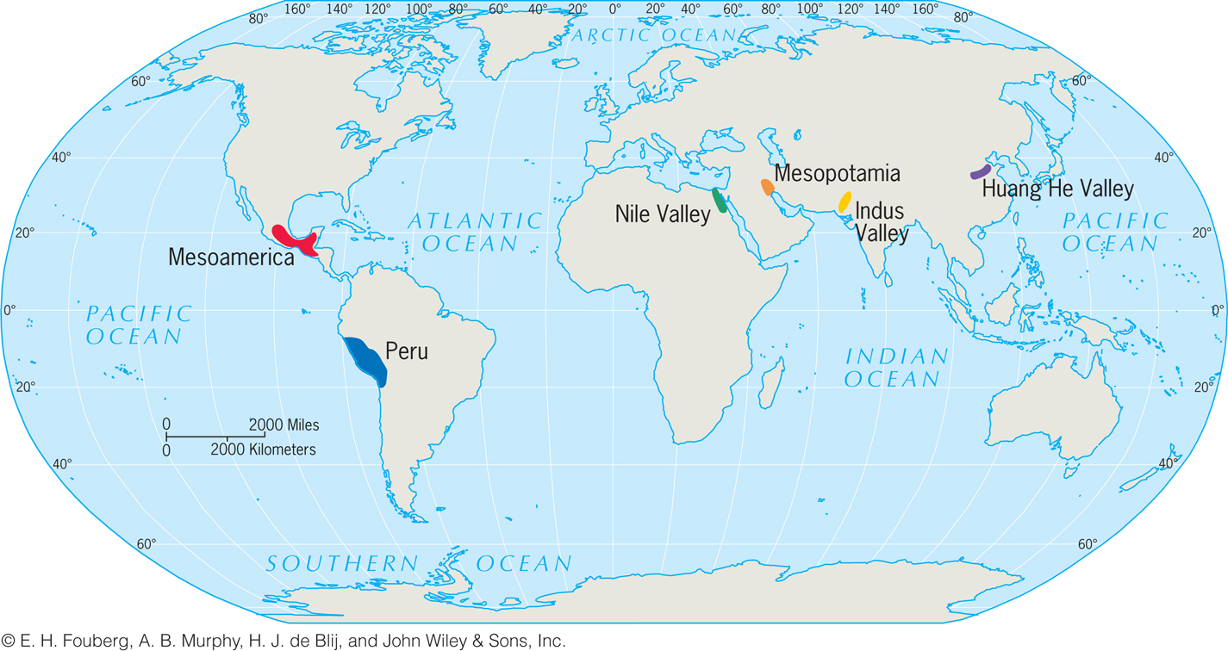

Slide 10
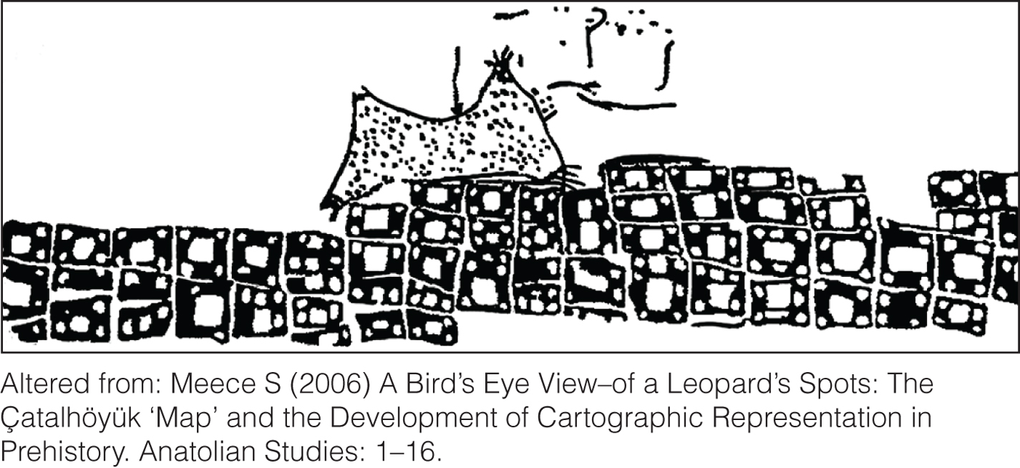
The City in Ancient Society
Served as economic nodes
Were the chief marketplaces
Were the anchors of culture and society, the focal points of power, authority, and change

Slide 11
Populations in Mesopotamia grew with the steady food supply and a sedentary lifestyle
People migrated out from the hearth, diffusing their knowledge of agriculture and urbanization
Diffusion of Urbanization

Slide 12
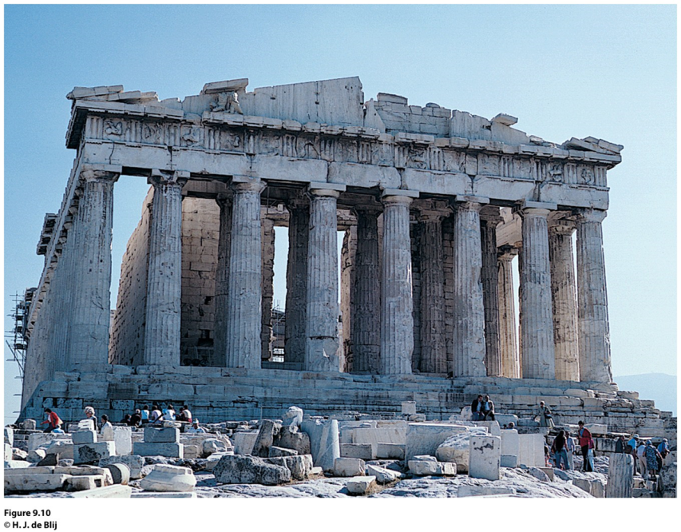
Greek Cities
Greece is described as a secondary hearth of urbanization because the Greek city form and function diffused around the world centuries later through European colonialism.
Every city had its acropolis, on which the people built the most impressive structures.
Agora (market) became the focus of commercial activity.
Urbanization diffused from Greece to the Roman Empire.

Slide 13
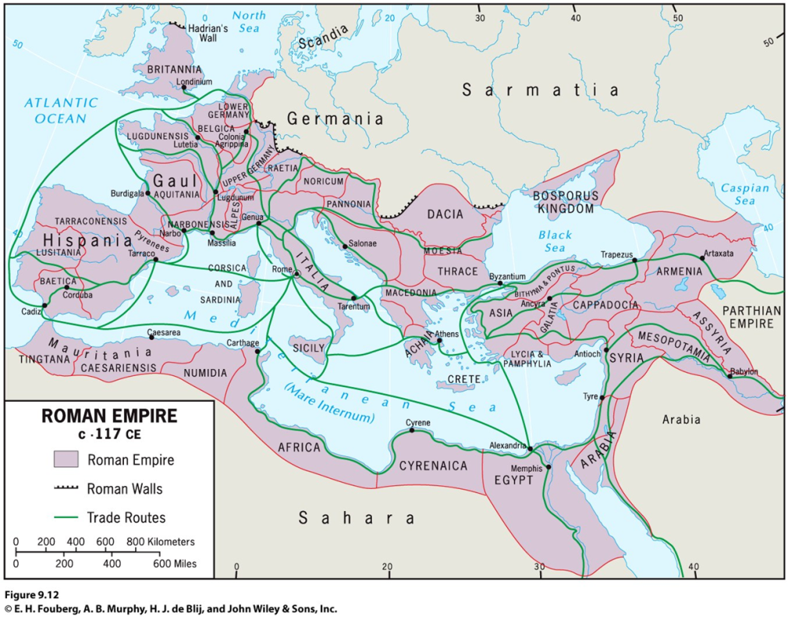
A city’s situation changes with times.
Ex.: Rome becoming the center of the Roman Catholic Church.
Roman Cities
The Roman Empire extended urbanization.
The site of a city is its absolute location, often chosen for its advantages in trade or defense, or as a center for religious practice.
The situation of a city is based on its role in the larger, surrounding context:

Slide 14
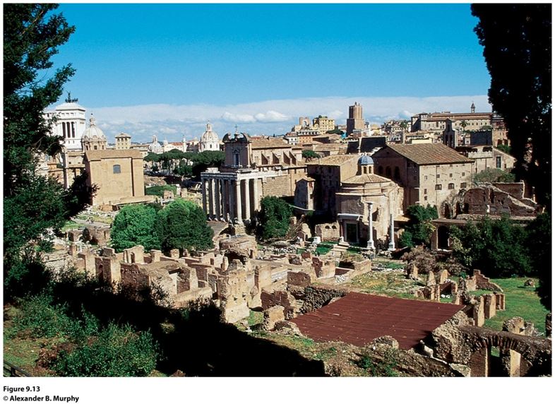
Roman Cities
Urban morphology: a city’s layout; its physical form and structure.
Whenever possible, Romans adopted the way the Greeks planned their colonial cities; in a rectangular, grid pattern.
Functional zonation reveals how different areas or segments of a city serve different purposes or functions within the city.
Ex.: the Forum

Slide 15
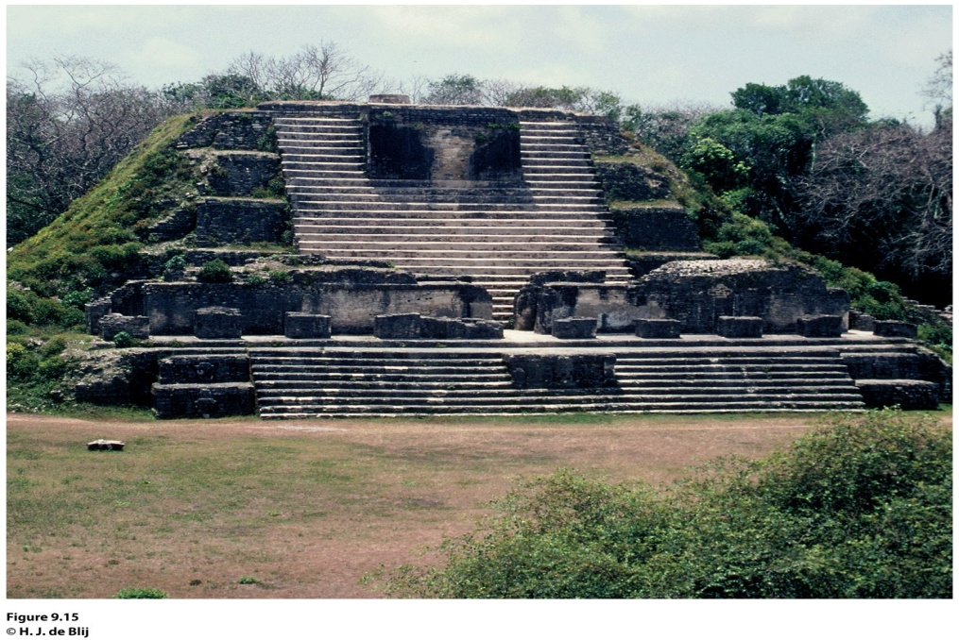
Urban Growth After Greece and Rome
During Europe’s Middle Ages, urbanization continued vigorously outside of Europe.
In West Africa, trading cities developed along the southern margin of the Sahara.
The Americas also experienced significant urban growth, especially within Mayan and Aztec empires.
Notes:
Figure 9.15
ltun Ha, Belize. Between 300 and 900 ce, Altun Ha served as
a thriving trade and distribution center for the Caribbean merchant
canoe traffi c. Some of the trails in Altun Ha led all the way
to Teotihuacan. © H. J. de Blij.

Slide 16
Site and Situation during European Exploration
The relative importance of the interior trade routes changed when European maritime exploration and overseas colonization ushered in an era of oceanic, worldwide trade.
The situation of cities like Paris and Xian changed from being crucial in an interior trading route to being left out of an oceanic trade.
After European exploration took off during the 1400s, the dominance of interior cities declined.

Slide 17
Site and Situation during European Exploration
Coastal cities remained crucial after exploration led to colonialism
The trade networks European powers commanded (including the slave trade) brought unprecedented riches to Europe’s burgeoning medieval cities, such as Amsterdam (the Netherlands), London (England), Lisbon (Portugal), Liverpool (England), and Seville (Spain)
As a result, cities that thrived during mercantilism took on similar properties

Slide 18
A Second Urban Revolution
Around 1800, Western Europe was still overwhelmingly rural. As thousands migrated to the cities with industrialization, cities had to adapt to the mushrooming population, the proliferation of factories and supply facilities, the expansion of transport systems, and the construction of tenements for the growing labor force.

Slide 19
A Second Agricultural Revolution
During the late seventeenth century and into the eighteenth century, Europeans invented a series of important improvements in agriculture.
The second agricultural revolution also improved organization of production, market collaboration, and storage capacities.
Many industrial cities grew from small villages or along canal and river routes.

Slide 20
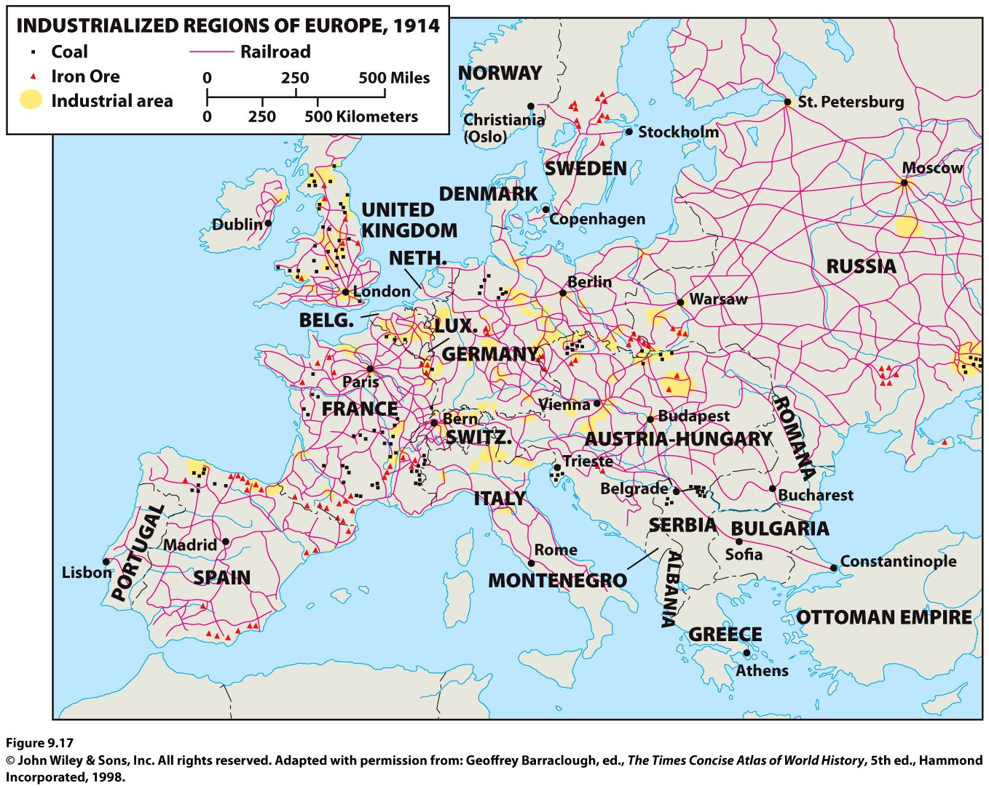
Industrialization and Urbanization
When industrialization diffused from Great Britain to the European mainland, the places most ready for industrialization had undergone their own second agricultural revolution, had surplus capital from mercantilism and colonialism, and were located near coal fields.

Slide 21
The Chaotic Industrial City
With industrialization, cities became unregulated jumbles of activity.
Living conditions were dreadful for workers in cities, and working conditions were shocking.
The soot-covered cities of the British Midlands were deemed the “black towns.”

Slide 22
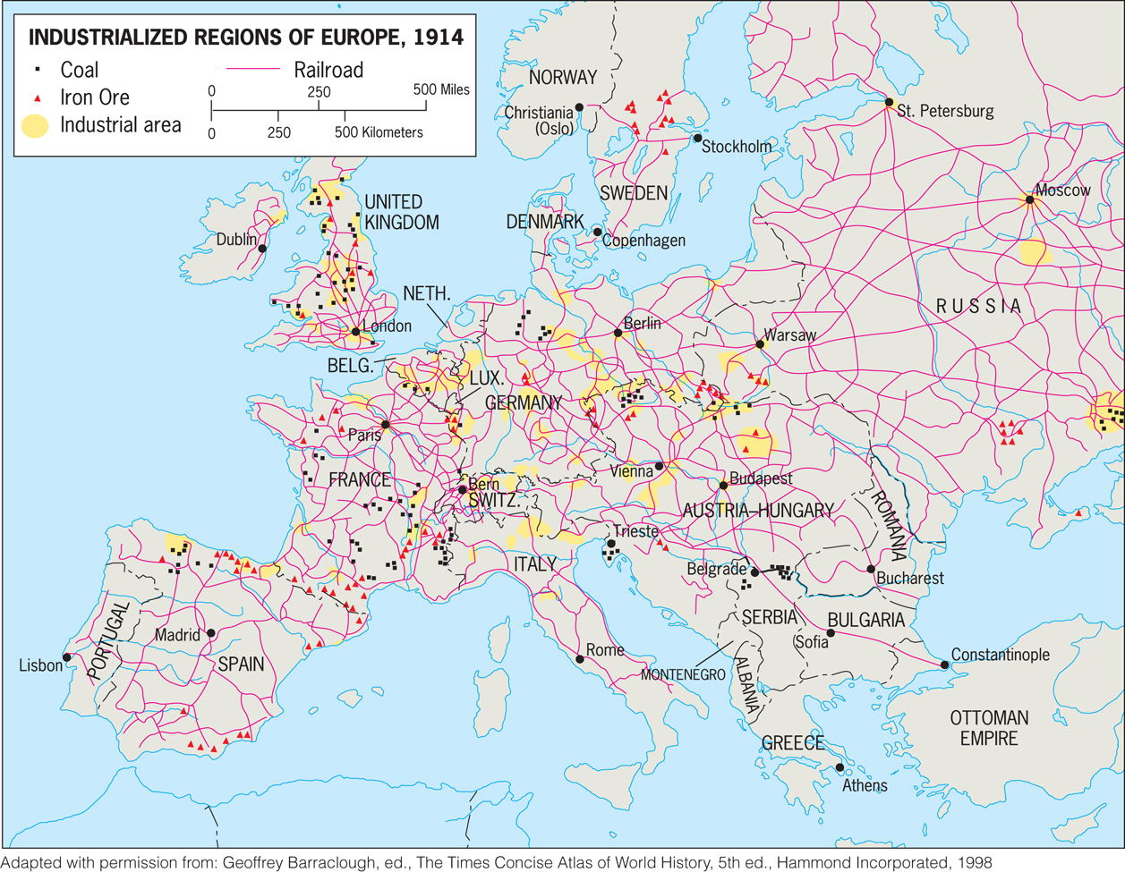

Slide 23
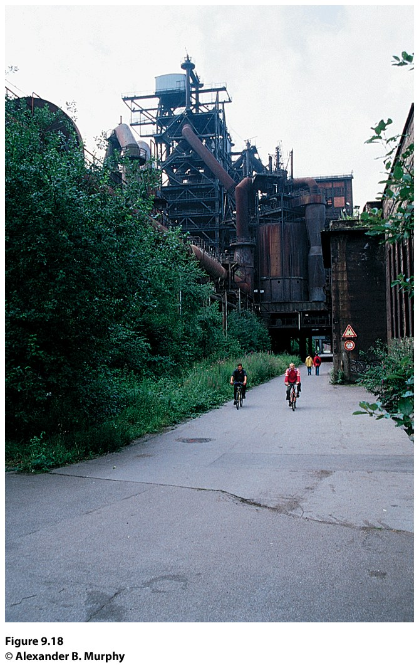
The Chaotic Industrial City
In mid-1800s, as Karl Marx and Frederick Engels encouraged “workers of the world” to unite, conditions in European manufacturing cities gradually improved.
During the second half of the twentieth century, the nature of manufacturing changed, as did its location.
Concept Caching:
Duisburg, Germany

