Slide 1
Human Geography: People, Place,
and Culture, 11th Edition

Slide 2
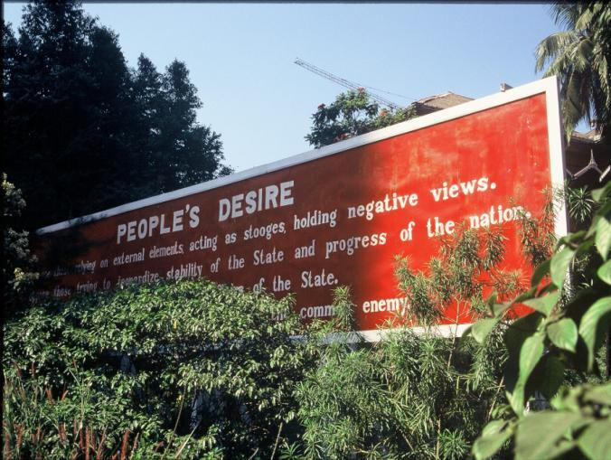
Chapter 8: Political Geography
Concept Caching: Burma, Myanmar
© Barbara Weightman

Slide 3
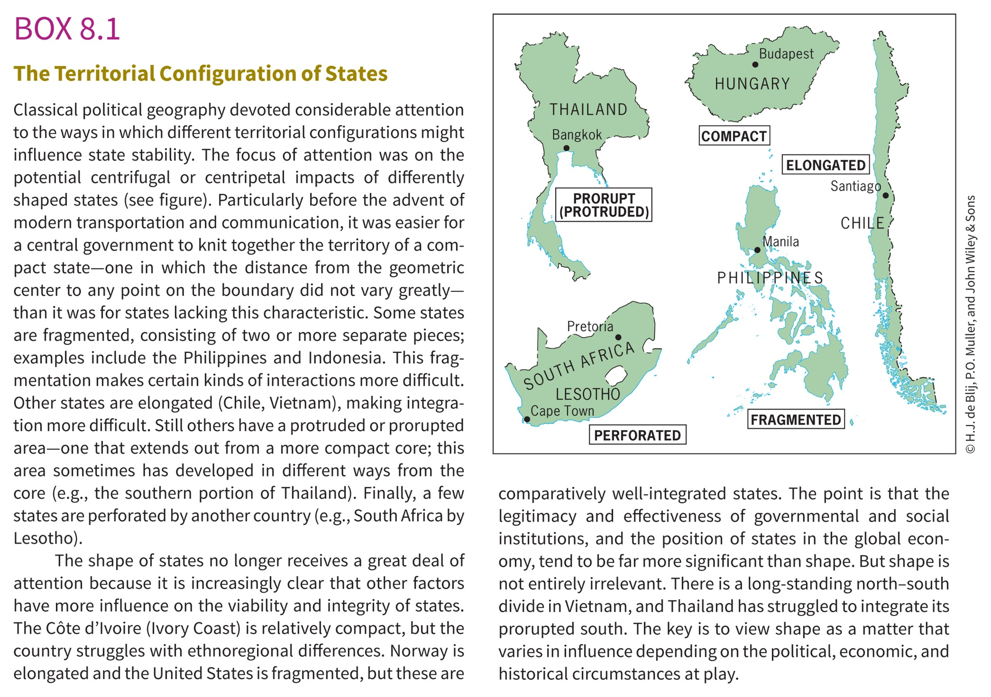

Slide 4
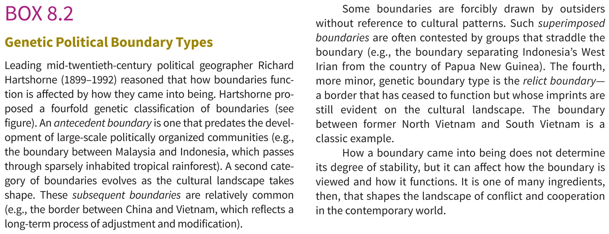

Slide 5
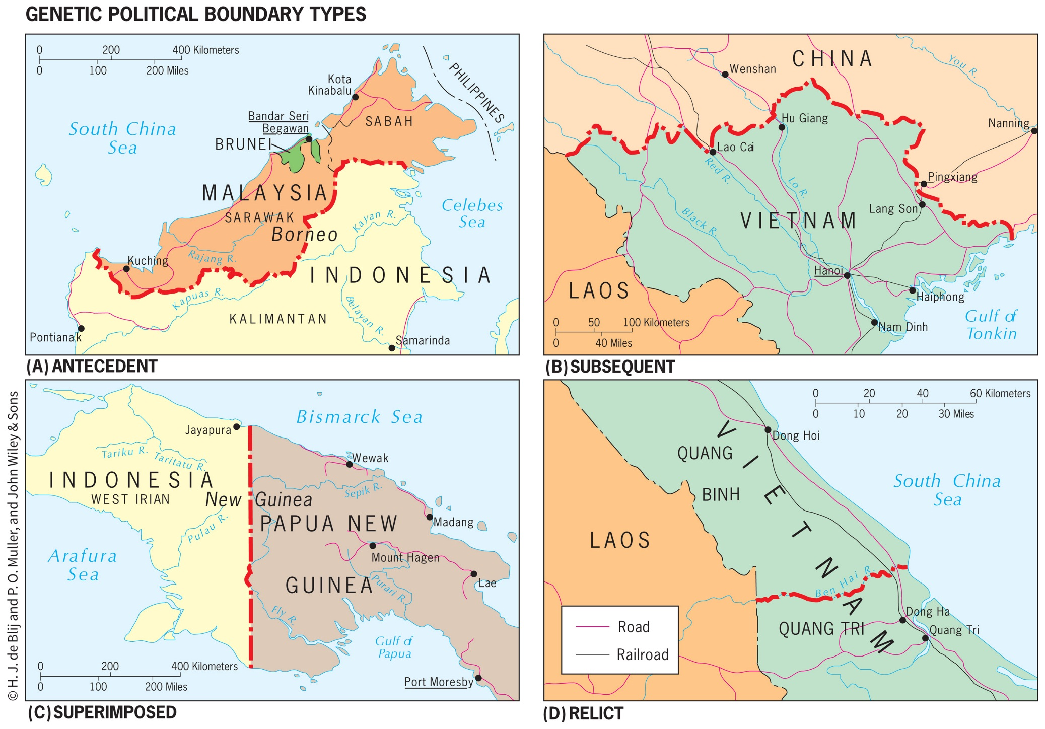

Slide 6
Key Question: How Is Space Politically Organized into States and Nations?
Political geography is the study of the political organization of the world.
A state is a politically organized territory with a permanent population, a defined territory, and a government.
Modern concept of territory arose in early modern Europe as a system of political units emerged with distinct boundaries and independent governments.
This process is called territoriality.

Slide 7
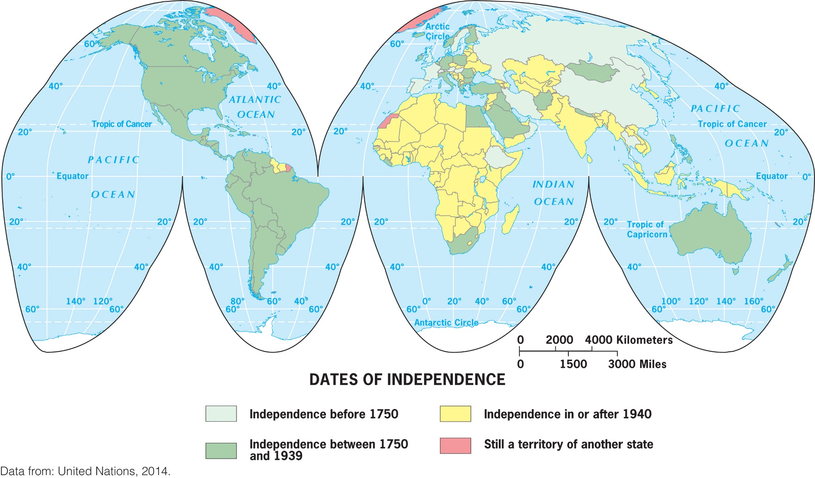
Sovereignty: a recognized right to control a territory both politically and militarily.
Under international law, states are sovereign, and they have the right to defend their territorial integrity against incursion from other states.

Slide 8
The Modern State Idea
Idea of the state appeared in various forms across world regions 400 or 500 years ago
The European state idea most influenced the development of the modern state system
Emerging political state was accompanied by mercantilism, which led to the accumulation of wealth through plunder, colonization, and the protection of home industries and foreign markets

Slide 9
The Modern State Idea
The Peace of Westphalia, negotiated in 1648, marks the beginning of the modern state system.
In the Westphalian system it became the territory that defined the society.
Territory is treated as a fixed element of political identification, and states define exclusive, nonoverlapping territories.

Slide 10
Nations
Nation is a culturally defined term, and few people agree on exactly what it means.
The term was originally meant to refer to a group of people who think of themselves as one based on a sense of shared culture and history, and who seek some degree of political-territorial autonomy.
All nations are ultimately mixtures of different peoples.
A nation is identified by its own membership; therefore, we cannot simply define a nation as the people within a territory

Slide 11
Nation-State
A nation-state is a politically organized area in which nation and state occupy the same space.
The goal of creating nation-states dates to the French Revolution: democracy
Key problem associated with the idea of the nation-state is that it assumes the presence of reasonably well-defined, stable nations living contiguously in discrete territories.

Slide 12
Nation-State
When people have a strong sense of nationalism, they have a loyalty to and a belief in the nation itself.
A state, in contrast, seeks to promote a sense of nationhood that coincides with its own borders.
To help people within the borders relate to the dominant national ideal, states provide security, infrastructure, and goods and services for their citizens.

Slide 13
Multistate Nations, Multinational States, and Stateless Nations
Nearly every state in the world is a multinational state, a state with more than one nation inside its borders.
When a nation stretches across borders and across states, the nation is called a multistate nation.
When multiple nations or states claim attachments to the same piece of territory, the potential for conflict is significant.

Slide 14
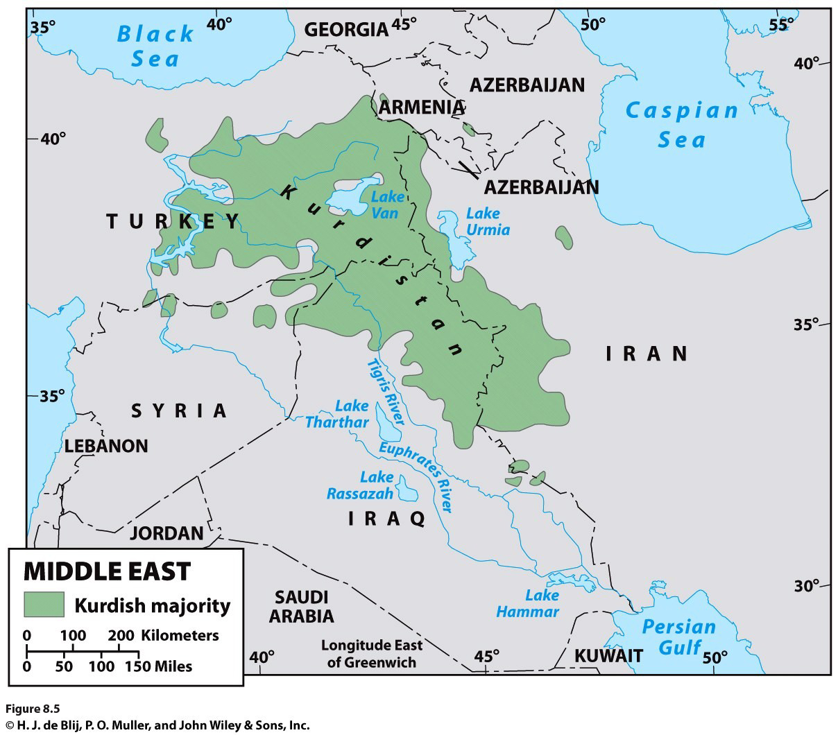
Another complication that arises from the lack of fit between nations and states is that some nations do not have a state; they are stateless nations.
Ex.: the Kurds
Notes:
Figure 8.5
Kurdish Region of the Middle East. © H. J.
de Blij , P. O. Muller, and John W i ley & Sons.

Slide 15
European Colonialism and the Diffusion of the Nation-State Model
Europe exported its concepts of state, sovereignty, and the desire for nation-states to much of the rest of the world through two waves of colonialism.
During the heyday of colonialism, imperial powers exercised ruthless control over their domains and organized them for maximum economic exploitation.
Despite the end of colonialism, the political organization of space and the global world economy persist.

Slide 16
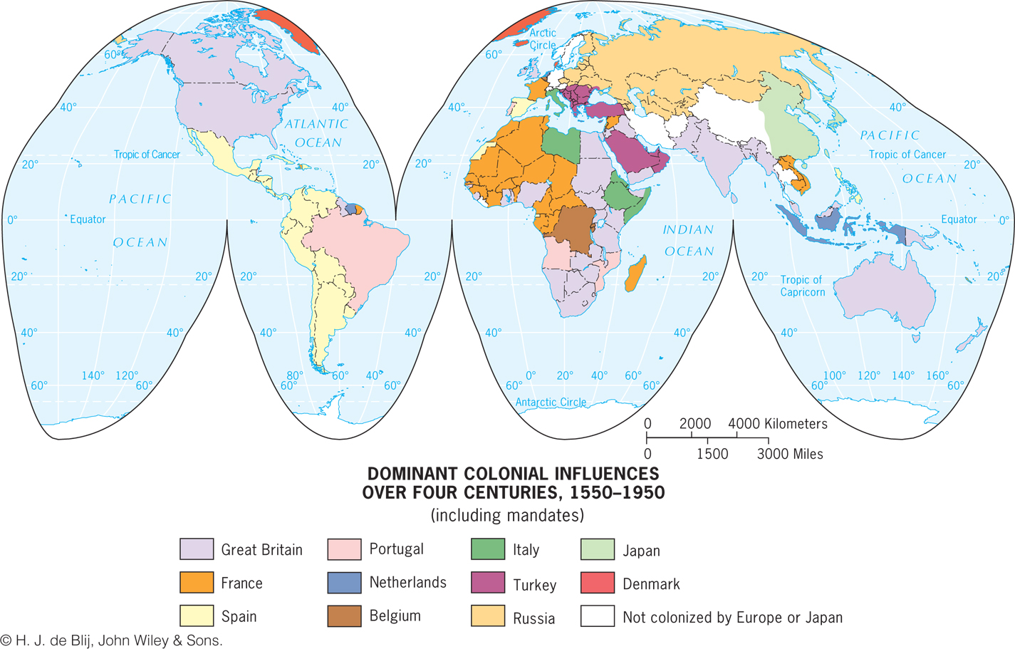
Notes:
Figure 8.7
Dominant Colonial Infl uences, 1550–1950. The map shows the dominant European or
Japanese colonial infl uence in each country over the four centuries. © H. J. de Blij , John W i ley & Sons.

Slide 17
Construction of the Capitalist World Economy
One of the most powerful impacts of colonialism was the construction of a global order characterized by great differences in economic and political power.
The concentration of wealth that colonialism brought to Europe, and to parts of the world dominated by European settlers.
Colonialism is at the heart of highly uneven global distribution of power that continues even today.

Slide 18
Construction of the Capitalist World Economy
Social scientists seek to see how each “dot” fits into the whole.
Proponents of world-systems theory view the world as much more than the sum total of the world’s states.

Slide 19
World Systems Theory
The three basic tenets of world-systems theory, as Immanuel Wallerstein defines them:
1. The world economy has one market and a global division of labor.
Capitalism: in the world economy, individuals, corporations, and states produce goods and services that are exchanged for profit.
Commodification is the process of placing a price on a good, service, or idea and then buying, selling, and trading that item.

Slide 20
World Systems Theory
2. Although the world has multiple states, almost everything takes place within the context of the world economy:
Colonialism played a major role in establishing this system by exporting the European state idea and facilitating the construction of an interdependent global economy.

Slide 21
World Systems Theory
3. The world economy has a three-tier structure:
Core is where one is most likely to find higher levels of education, higher salaries, and more technology
Periphery: processes associated with a more marginal position in the world economy
Semiperiphery: places where core and periphery processes are both occurring

Slide 22
Construction of the Capitalist World Economy
Major concerns of the world-systems theory:
Overemphasizes economic factors in political development
Very state-centric
Does not fully account for how places move from one category to another

Slide 23
World-Systems and Political Power
Each state is theoretically sovereign, but not all states have the same ability to influence others or achieve their political goals.
World-systems theory helps explain how Europe politically reorganized the world during colonialism.
Regardless of many problems and lack of simple solutions to nation and state conflicts, the European territorial state idea became the world model and still shapes the political organization of space worldwide.
Legacy of the Nation-State Concept

Slide 24
Imagine you are the leader of a newly independent state in Africa or Asia. Determine what your government can do
to build a nation that corresponds with the borders of your state. Consider the roles of education, government, military, and culture in your exercise in nation-building.

Slide 25
Key Question: How Do States Spatially Organize Their Governments?
Centripetal forces: forces within the state that unify the people
Centrifugal forces: forces that divide them
A state continues to exist depends on the balance between centripetal and centrifugal forces.

Slide 26
Form of Government
Unitary governments: centralized states whose administrative framework is designed to ensure the central government’s authority over all of the state.
In a strong federal system, the regions have much control over government policies and funds, and in a weak federal system, the central government retains a significant measure of power.
Federalism accommodates regional interests by vesting primary power in provinces, States, or other regional units over all matters except those explicitly given to the central government.

Slide 27
Devolution
Devolution is the movement of power from the central government to regional governments within the state.
Sometimes devolution is achieved by reworking a constitution to establish a federal system that recognizes the permanency of the regional governments.
In other places, governments devolve power without altering constitutions, almost as an experiment.

Slide 28
Electoral Geography
Partitioning of state territory into electoral districts.
Electoral geographers examine how the spatial configuration of electoral districts and the voting patterns that emerge in particular elections reflect and influence social and political affairs.
Ex.: 1994 South Africa
Geographers study patterns of voting behavior to assess the influence of their geographic situation
Reapportionment: process by which districts are moved according to population shifts so that each district has about the same number of people.

Slide 29
Choose an example of a devolutionary movement and consider which geographic factors favor, or work against, greater autonomy (self-governance) for the region. Would granting the region autonomy strengthen or weaken the state in which the region is currently situated?
Notes:
29

Slide 30
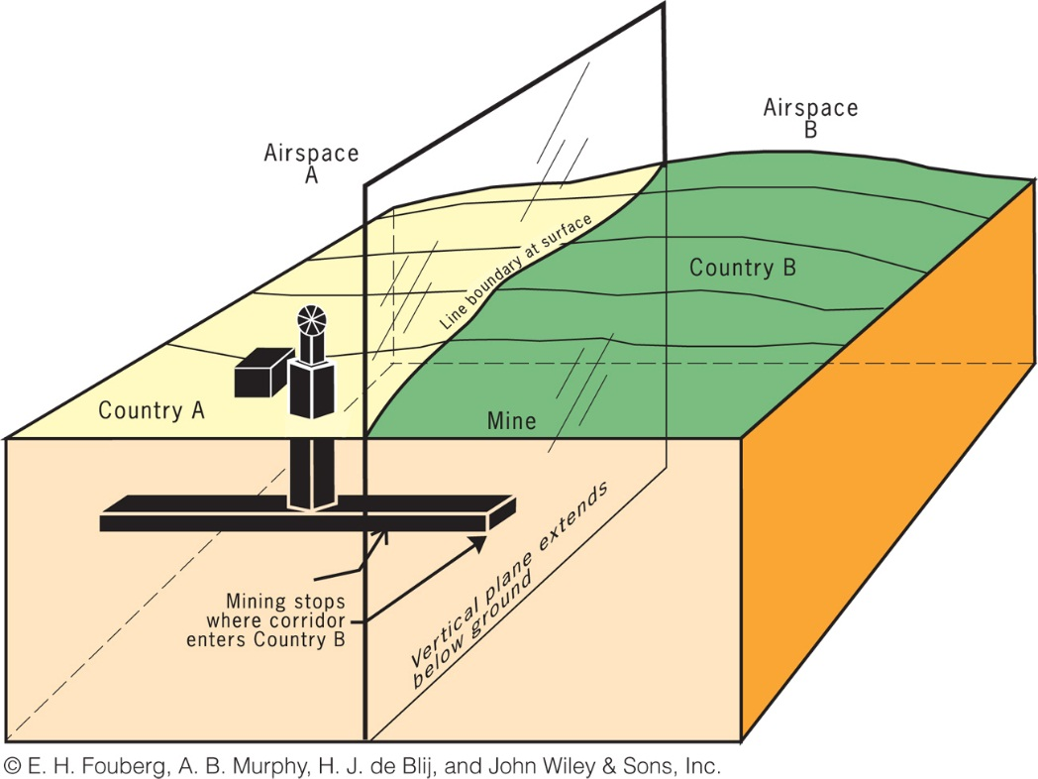
Key Question: How Are Boundaries Established, and Why Do Boundary Disputes Occur?
A boundary between states is actually a vertical plane that cuts through the rocks below (called the subsoil) and the airspace above, dividing one state from another (Fig. 8.18).
Only where the vertical plane intersects the Earth’s surface (on land or at sea) does it form the line we see on the ground.
The Vertical Plane of a Political Boundary

Slide 31
Establishing Boundaries
States typically define the boundary in a treaty-like legal document in which actual points in the landscape or points of latitude and longitude are described.
Cartographers delimit the boundary by drawing on a map.
If either or both of the states so desire, they can demarcate the boundary by using steel posts, concrete pillars, fences, walls, or some other visible means to mark the boundary on the ground.

Slide 32
Boundary Disputes
Geometric boundaries are drawn using grid systems such as latitude and longitude or township and range
Physical-political boundaries follow an agreed upon figure in the natural landscape
Ex.: The center point of a river or crest of a mountain range.

Slide 33
Types of Boundaries
Definitional boundary disputes focus on the legal language of the boundary agreement.
Locational boundary disputes center on the delimitation and possibly the demarcation of the boundary. The definition is not in dispute, but its interpretation is.
Operational boundary disputes involve neighbors who differ over the way their border should function.
Allocational boundary disputes are becoming more common as the search for resources intensifies.

Slide 34
People used to think physical-political boundaries were always more stable than geometric boundaries. Through studies of many places, political geographers have confirmed that this idea is false. Construct your own argument explaining why physical-political boundaries can create just as much instability as geometric boundaries.
Notes:
34

Slide 35
Key Question: How Does the Study of Geopolitics Help Us Understand the World?
Classical Geopolitics
Late 19th century/early 20th century geopoliticians were usually either part of the German school or the British/American school.
The German School
Tried to explain why certain states were powerful and how they became powerful.
Friedrick Ratzel: influenced by Darwin; the state resembles a biological organism whose life cycle extends from birth through maturity and, ultimately, decline and death.

Slide 36
The British/American School
Sir Halford J. Mackinder, “The Geographical Pivot of History” in the Royal Geographical Society’s Geographical Journal.
Land-based power, not sea power, would ultimately rule the world.
Influence of Geopoliticians on Politics
NATO
Geopolitics: term with negative connotations

Slide 37
Critical Geopolitics
Critical Geopolitics: intellectuals of statecraft construct ideas about geographical circumstances and places, these ideas influence and reinforce their political behaviors and policy choices, and then affect what happens and how most people interpret what happens.

Slide 38
Geopolitical World Order
Cold War: bipolar, with Soviet versus West alliances
Unilateralism: one country (e.g., United States) in position of dominance, with other countries following its lead
New World Order: Global cooperation to bring discipline to rogue states
Return with to Cold War split with Russian assertiveness?
Nuclear Weapons can invert the power structure (e.g.-North Korea scares people more than it would otherwise)

Slide 39
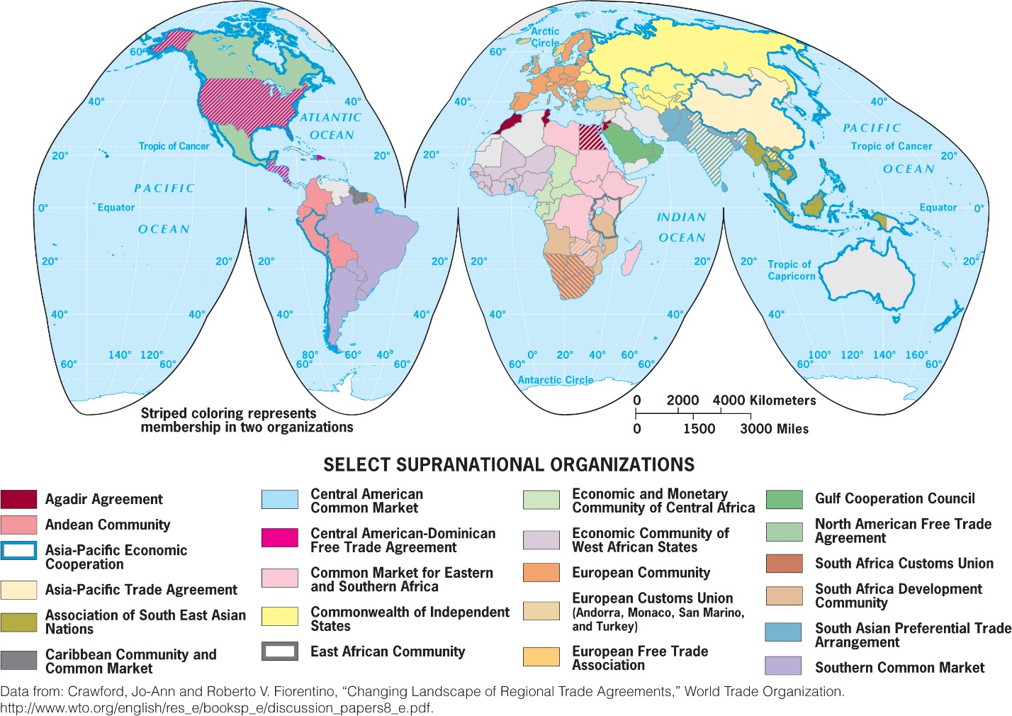
Key Question: What Are Supranational Organizations and What Are Their Implications for the State?
Supranational organization: three or more states that forge an association and form an administrative structure for mutual benefit and in pursuit of shared goals
Figure 8.21
Select Supranational Organizations. Data from: Crawford, Jo-Ann and Roberto V. Fiorentino, “Changing Landscape of Regional Trade Agreements,”
World Trade Organization. http://www.wto.org/english/res_e/booksp_e/discussion_papers8_e.pdf.

Slide 40
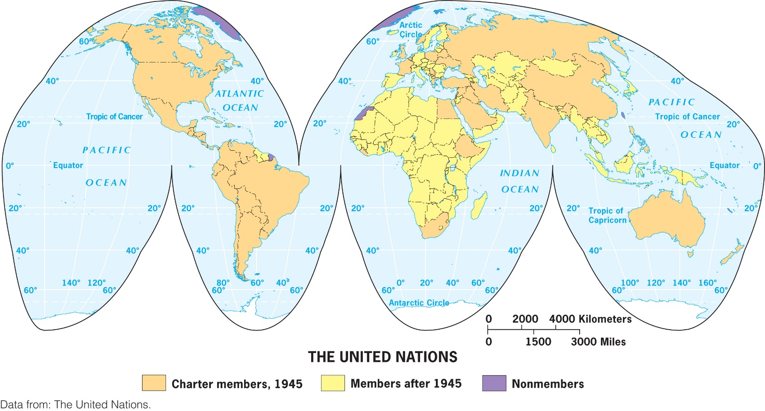
History of Global Supranationalism
Started with League of Nations in 1919
United Nations (UN), FAO, WTO, UNESCO
Regional Supranational Organizations
Benelux, Marshall Plan, EC, then EU
Figure 8.22
Member States of the United Nations. This map shows charter members, members after 1945 (with dates of entry), and nonmembers of the United Nations. Data from: the United Nations

Slide 41
European Union
After Marshall Plan, the Organization for European Economic Cooperation (OEEC) formed.
EU formed in 1993.
Not all EU member states are currently a part of the euro-zone, but the euro has emerged as a significant global currency.
Figure 8.25, Cortina, Italy. A market in northern Italy advertises the price of fruit in euros.© Alexander B. Murphy.

Slide 42
How Does Supranationalism Affect the State?
Economics associations: NAFTA, CIS, etc.
European Union: “taken on a life of its own”
Deterritorialization: globalization, networked communities, etc. undermine the state’s traditional territorial authority
Reterritorialization: the state is moving to solidify control over its territory

Slide 43
Additional Resources
On Geography Education:
Political, Devolution, Conflict, Gerrymandering, Supranationalism, Borders, Geopolitics, Territoriality.

