Slide 1
Human Geography: People, Place,
and Culture, 11th Edition

Slide 2
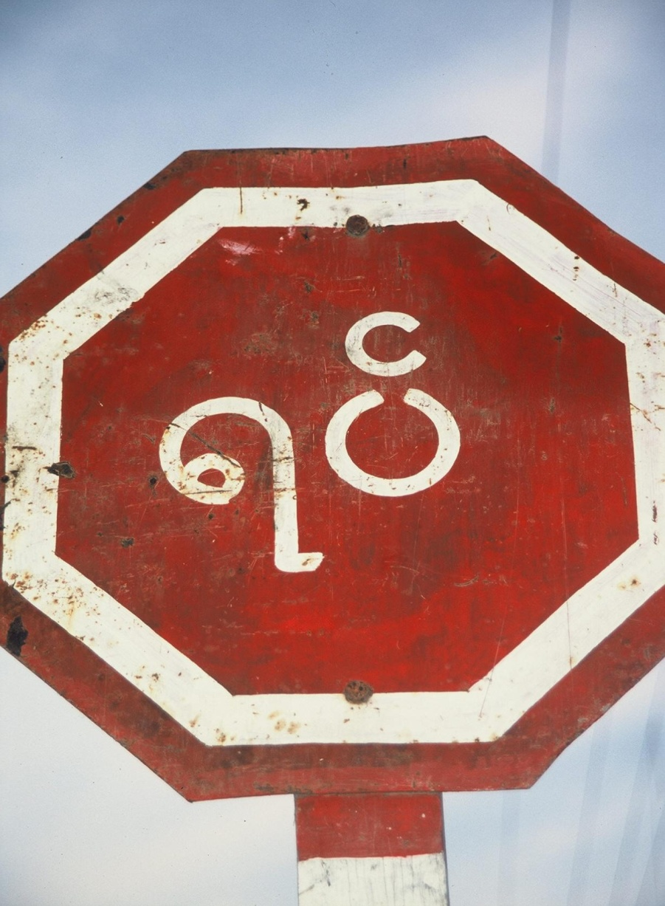
Chapter 6: Language
Concept Caching:
Burmese Script -Burma
© Barbara Weightman

Slide 3
Key Question: What Are Languages, and What Role Do Languages Play in Cultures?
Language
a set of sounds and symbols that is used for communication.
Language is an integral part of culture.
Language and Culture
Language reflects where a culture has been and what it values.
Language makes people in a culture visible to each other and to the world.

Slide 4
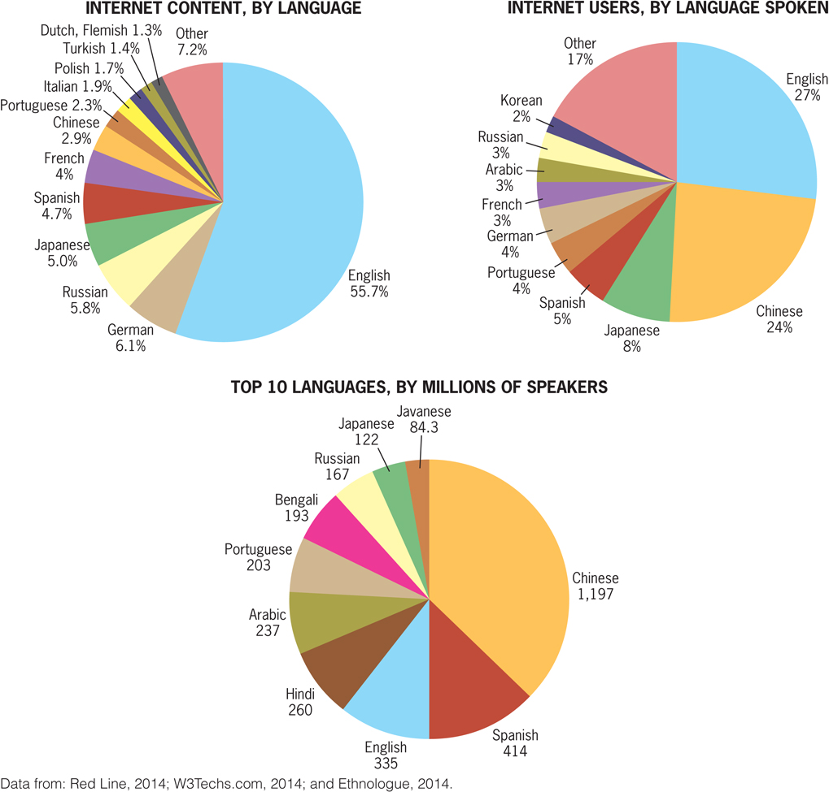

Slide 5
Language and Culture
American, Canadian, Australian, Russian, and New Zealand governments had policies of forced assimilation during the twentieth century, including not allowing indigenous peoples to speak native languages.
Language is so closely tied to culture that people use language as a weapon in cultural conflict and political strife.
Notes:
Figure 5.2
United States. Although biologically there is only one human
race, we are constantly asked to choose race “boxes” for ourselves.
This page of the 2010 United States Census asks the
individual, “What is your race?” and directs the individual to
“Mark one or more races to indicate what you consider yourself to be.” © U.S. Census Bureau

Slide 6
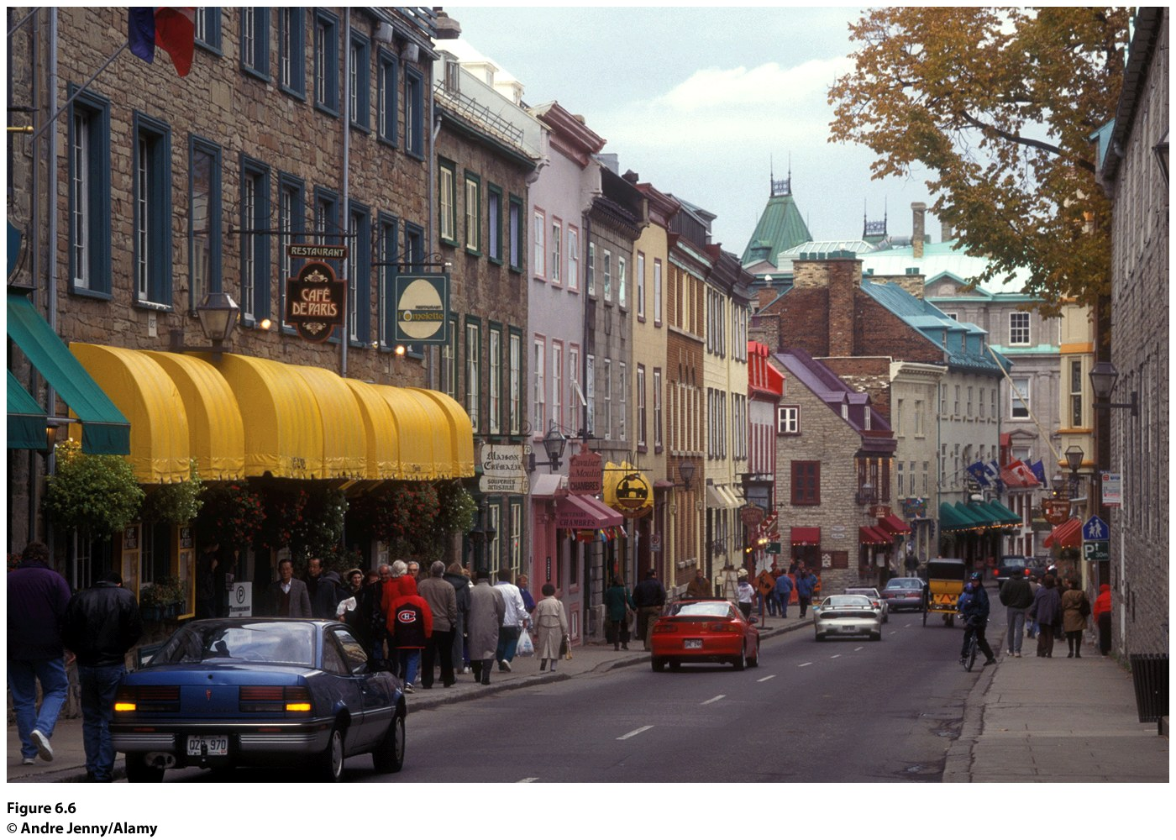
In 1993, the Quebec government passed a law requiring the use of French in advertising.
Notes:
Figure 6.6
Quebec Province, Quebec. The imprint
of the French Canadian culture is evident
in the cultural landscape of Rue Saint-Louis
in Quebec. Here, the architecture and
store signs confi rm that this region is not
simply Canadian; it is French Canadian.
© Andre Jenny/Alamy.

Slide 7
What Is a Language?
Mutual intelligibility:
Two people can understand each other when speaking.
Is almost impossible to measure.
Some languages are separate but are mutually intelligible.
Decision of what a standard language will be has to do with influence and power.

Slide 8
Dialects
Variants of a standard language along regional or ethnic lines
Differences in vocabulary, syntax, pronunciation, cadence, and pace of speech
Dialect chains across space
Dialects frequently marked by actual differences in vocabulary
Isogloss: geographic boundary within which a particular linguistic feature occurs

Slide 9
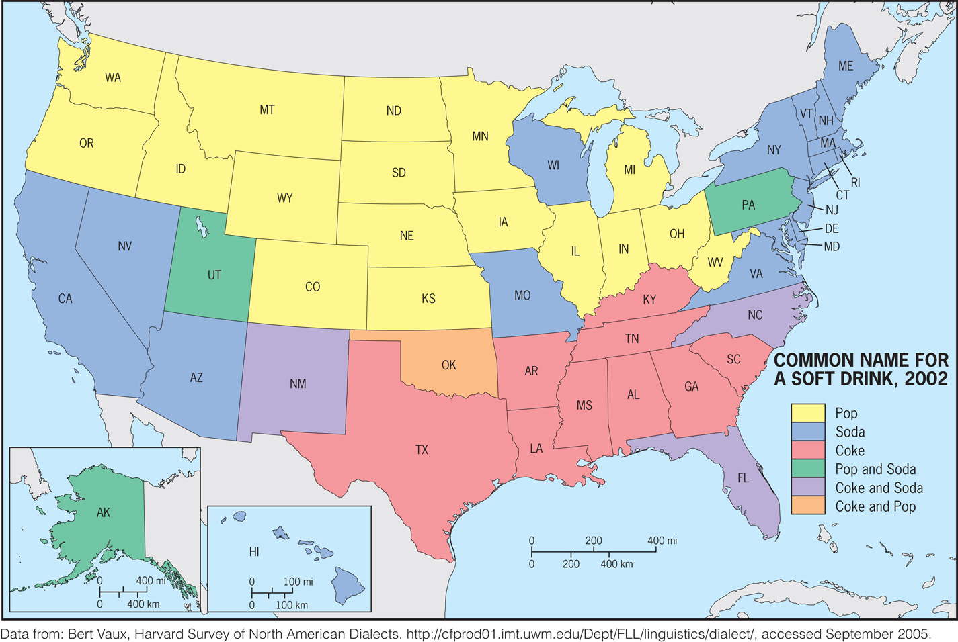

Slide 10
Linguist Bert Vaux’s study of dialects in American English points to the differences in words for common things such as soft drinks and sandwiches. Describe a time when you said something and a speaker of another dialect did not understand the word you used. Where did the person with whom you were speaking come from? Was the word a term
for a common thing? Why do you think dialects have different words for common things, things found across dialects, such as soft drinks and sandwiches?

Slide 11
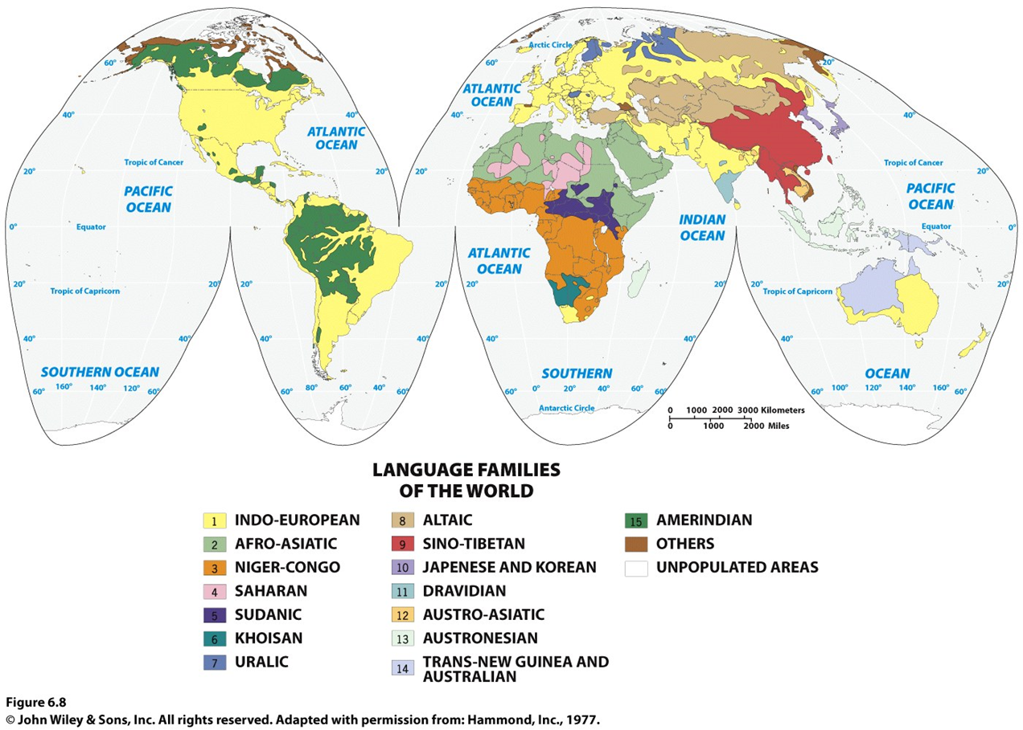
Key Question: Why are languages distributed the way they are?

Slide 12
Language Classification:
open to debate
Some linguists argue that there are not just a few but many dozens of language families.

Slide 13
Language Formation
Sound shift is a slight change in a word across languages within a subfamily or through a language family from the present backward toward its origin
Ex.: Italian, Spanish and French as members of the Romance language subfamily
Proto-Indo-European language: first major linguistic hypothesis; from studies of Jakob Grimm and William Jones

Slide 14
Proto-Indo-European
Backward reconstruction: to track sound shifts and hardening of consonants “backward” toward the original language
Extinct language, a language without any native speakers
Deep reconstruction: recreating the language that preceded it
Notes:
Vladislav Illich-Svitych and Aharon Dolgopolsky: Nostratic language

Slide 15
Locating the Hearth of
Proto-Indo-European
Language divergence, where new language forms from old one.
Language convergence: collapsing two languages into one.
Language extinction occurs when all descendants perish or they choose to use another language (typically occurs over several generations).
Linguists theorize that the hearth of the Proto-Indo-European language was somewhere in the vicinity of the Black Sea or east-central Europe.
Notes:
German linguist August Schleicher: language divergence,

Slide 16
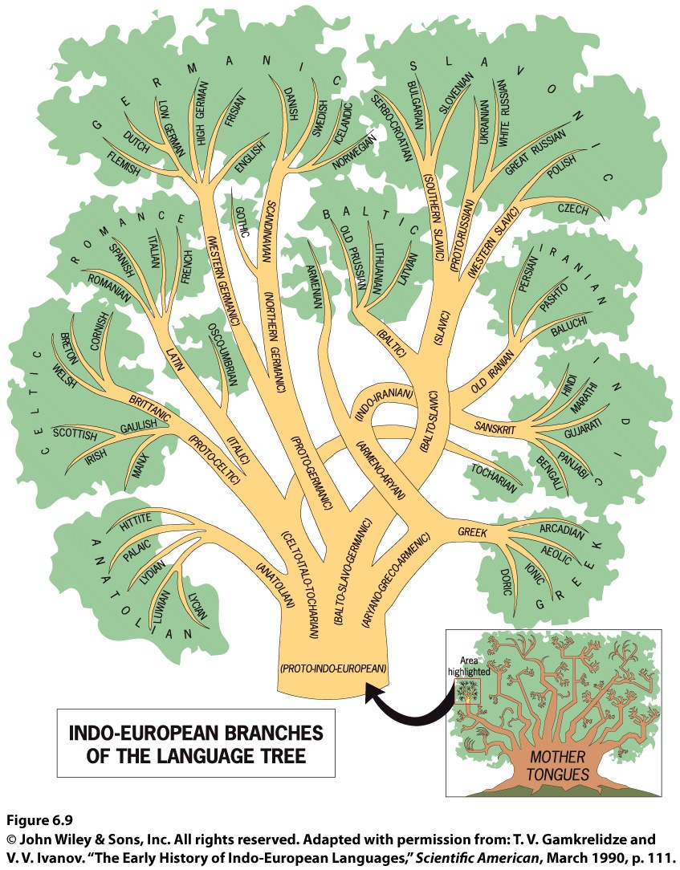

Slide 17
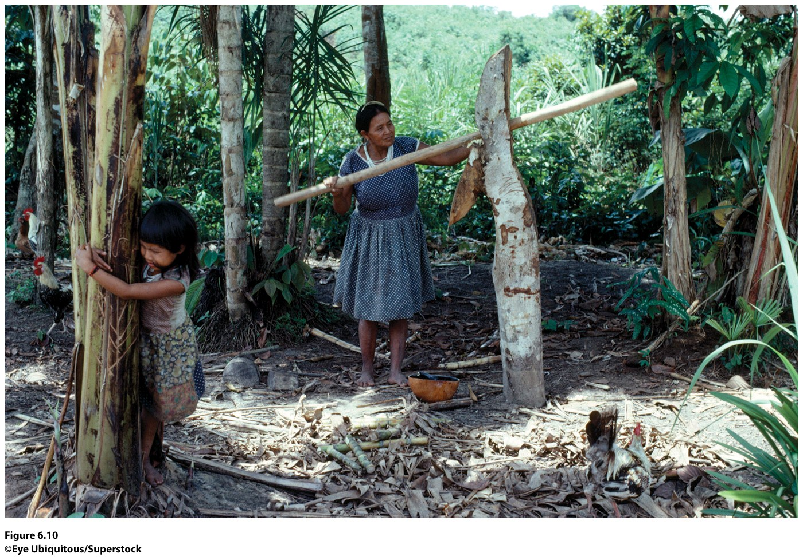
Figure 6.10
Northwest Amazon, Colombia.
The Barasana people, who live in the northwest Amazon in Colombia, have maintained their language and land-use systems despite external pressures. In 1991, the government of Colombia recognized the legal right of the Barasana to their land, which has aided the maintenance of their language. ©Eye Ubiquitous/Superstock

Slide 18
Proto-Indo-European Diffusion Routes
Commonality among language diffusion theories is a focus on Europe.
For Proto-Indo-European, it is clear that that the language diffused into Europe over time, and that a significant body of historical research and archaeology focuses on the early peopling of Europe.

Slide 19
Proto-Indo-European Diffusion Routes
Conquest theory: early speakers of Proto-Indo- European spread east to west on horseback, overpowering earlier inhabitants and beginning the diffusion/differentiation of Indo-European tongues.
An alternative agricultural theory proposes that Proto-Indo-European diffused westward through Europe with the diffusion of agriculture.
Dispersal hypothesis: the Indo-European languages that arose from Proto-Indo-European were first carried eastward into Southwest Asia, next around the Caspian Sea, and then across the Russian-Ukrainian plains and on into the Balkans.

Slide 20
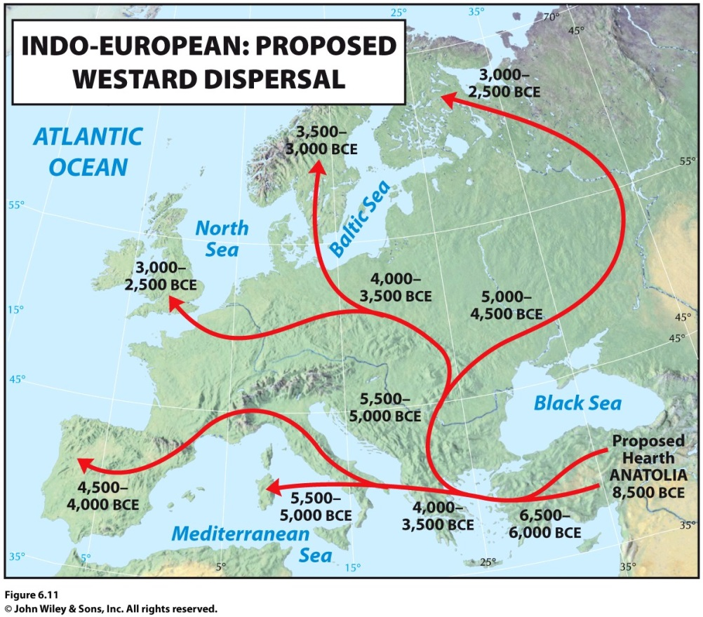
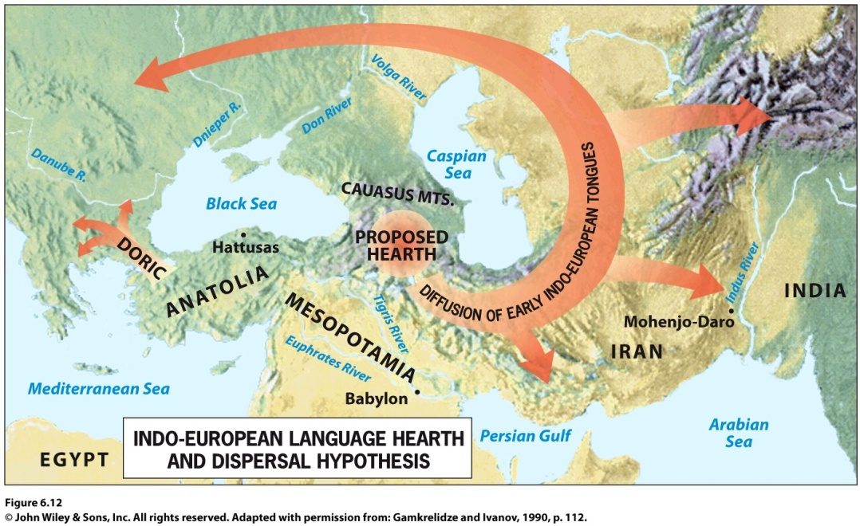
Figure 6.12
Indo-European Language Family: Proposed Hearth and Dispersal Hypothesis. This theory proposes that the Indo-European language family began in the Caucasus Mountain region and dispersed eastward before diffusing westward. Adapted with permission from: Gamkrelidze and Ivanov, 1990, p. 112.
Figure 6.11
Indo-European Language Family: Proposed Westward Dispersal. Approximate timings
and routes for the westward dispersal of the Indo-European languages.

Slide 21
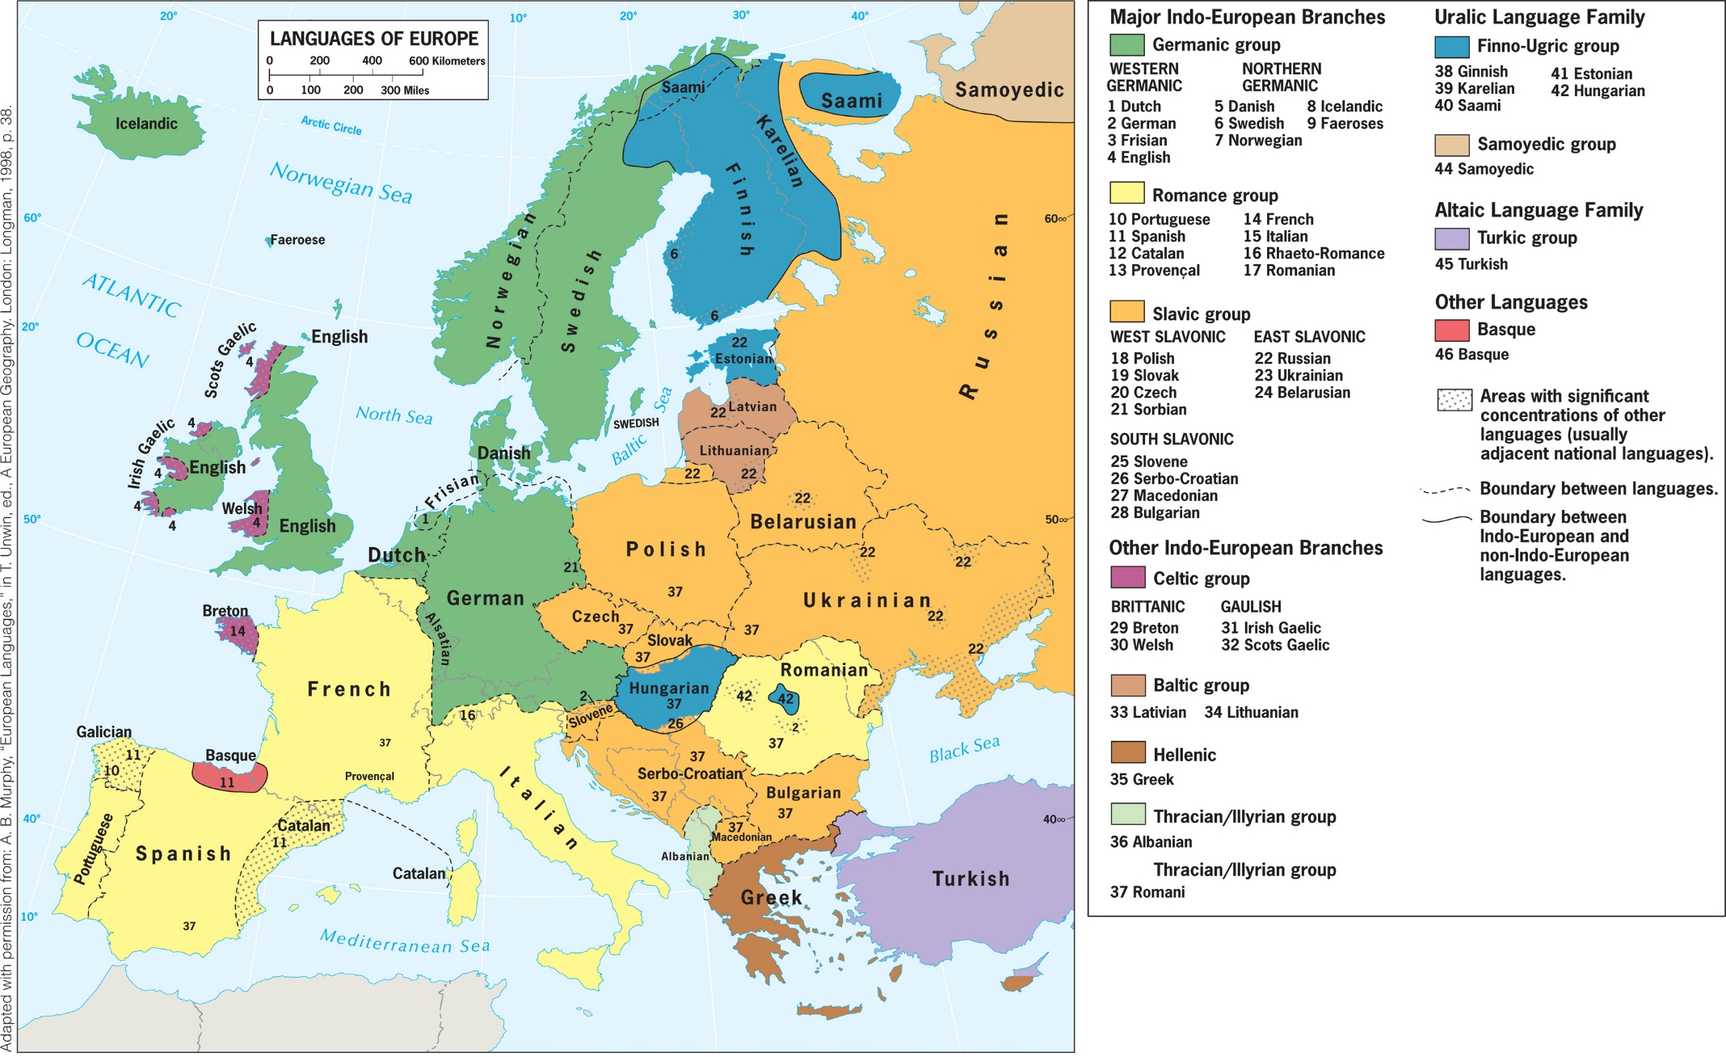
The Languages of Europe

Slide 22
Language Subfamilies in Europe
Romance languages:
French, Italian, Spanish, Romanian, and Portuguese
Have much in common because of their Latin connection, but are not mutually comprehensible
Germanic languages (English, German, Danish, Norwegian, and Swedish) reflect the expansion of peoples out of northern Europe west and south.
Slavic languages (Russian, Polish, Czech, Slovak, Ukrainian, Slovenian, Serbo-Croatian, & Bulgarian) developed as Slavic people migrated from a base in present-day Ukraine about 2,000 years ago.

Slide 23
Relationship to the Political Pattern
A comparison of Europe’s linguistic and political maps shows a high correlation between the languages spoken and the political organization of space.
A few important exceptions: French speakers in Belgium, Switzerland, and Italy; German speakers in Hungary; Hungarian speakers in Slovakia Romania and Yugoslavia; Romanian speakers in Moldavia and Greece; Turkish speakers in Bulgaria; Albanian speakers in Serbia.
The Basque language of Euskera covers a very small land area and is in no way related to any other language family in Europe.
Concept Caching:
Mount Vesuvius

Slide 24
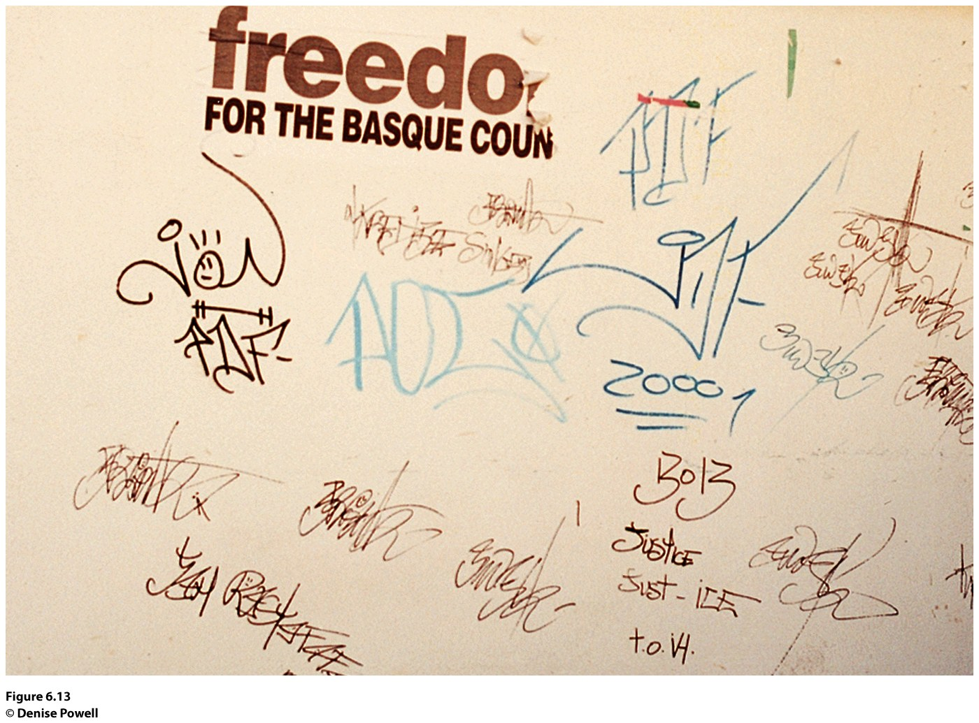
Figure 6.13
San Sebastián, Spain. Graffiti on the wall of this building uses
the English language, “Freedom for the Basque Country,” to show
support for the Basque separatist movement. © Denise Powell
Notes:
Figure 6.13
San Sebastián, Spain. Graffi ti on the wall of this building uses
the English language, “Freedom for the Basque Country,” to show
support for the Basque separatist movement. © Denise Powell

Slide 25
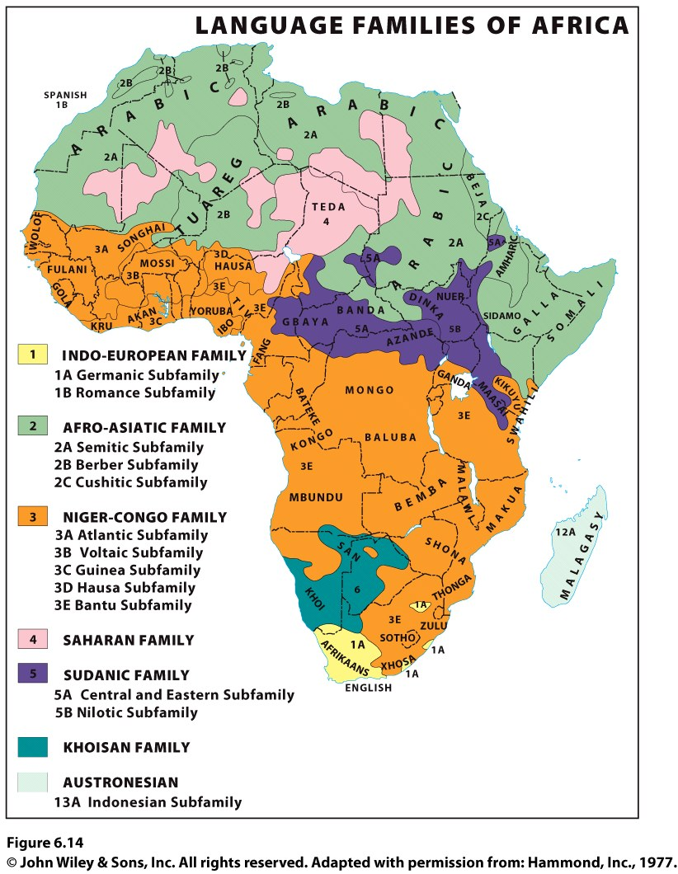
Languages of Subsaharan Africa
Niger-Congo language family dominates.
Oldest Subsaharan languages are the Khoisan languages, which include a “click” sound.

Slide 26
Languages of Subsaharan Africa
Nigeria’s 141 million people speak more than 500 different languages.
The three most prominent languages are distributed regionally:
Hausa in the north; 35 million people
Yoruba in the southwest; 25 million people
Ibo in the southeast; over 25 million people
When Nigeria gained independence in 1962, it adopted English as the “official” language, as the three major regional languages are too politically charged and thus unsuitable as national languages.

Slide 27
Education also affects the distribution of languages across the globe and within regions and countries. Thinking about different regions of the world, consider how education plays a role in the distribution of English speakers. Who learns English in each of these regions and why? What role does education play in the global distribution of English speakers?

Slide 28
Key Question: How Did Certain Languages Become Dominant?
By 2,000 years ago, languages such as Chinese and Latin had successfully diffused over large regions.
The Gutenberg printing press and rise of nation-states worked to spread literacy and stabilize certain languages through widely distributed written forms.
Political entities have a strong interest in promoting a common culture/language.
Globalization is shrinking the world’s linguistic heritage.

Slide 29
Linguistic Diffusion
A lingua franca is a language used among speakers of different languages for the purposes of trade and commerce.
Can be a single language or a mixture of two or more languages.
Pidgin language: When people speaking two or more languages are in contact and they combine parts of their languages in a simplified structure and vocabulary.
Creole language is a pidgin language with a more complex structure and vocabulary that has become the native language of a group of people.

Slide 30
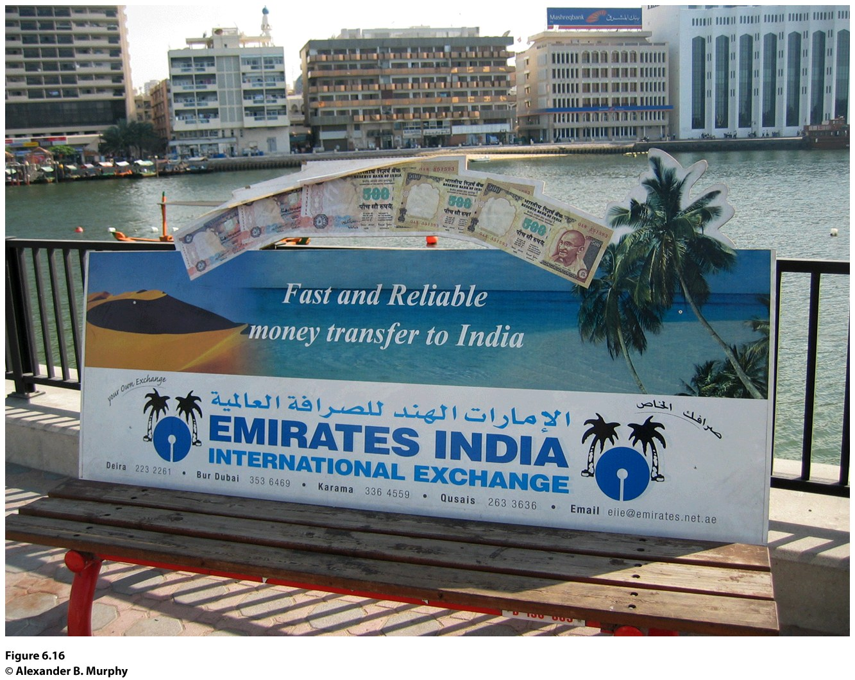
Figure 6.16 Dubai, United Arab Emirates. The message on the back of the bench is written in the lingua franca known to virtually all Indian migrants to the Arabian Peninsula. © Alexander B. Murphy.

Slide 31
Multilingualism
Monolingual states are countries where almost everyone speaks the same language.
Ex.: Japan, Uruguay, Iceland, Denmark, Portugal, Poland, Lesotho
Countries in which more than one language is in use are called multilingual states.

Slide 32
Official Languages
Countries with linguistic fragmentation often adopt an official language (or languages) to tie the people together.
A State adopts an official language in the hope of promoting communication and interaction among peoples who speak different local and regional languages.
The official languages in a country are a reflection of the country’s history.

Slide 33
How Did Certain Languages Become Dominant?
Global Languages
The principal language people use around the world in their day-to-day activities
A common language of trade and commerce used around the world

Slide 34
Choose a country in the world. Imagine you become a strong leader of a centralized government in the country. Pick a language used in the country other than the tongue spoken by the majority. Determine what policies you could put in place to make the minority language an official language of the country. What reactions would your initiative generate? Who would support it and who would not?

Slide 35
Key Question: What Role Does Language Play in Making Places?
Toponyms: Place names.
Language shapes of places.
Each place has a unique location and constitutes a reflection of human activities, ideas, and tangible, durable creations.
By naming a place, people call that place into being and give it a certain character.

Slide 36
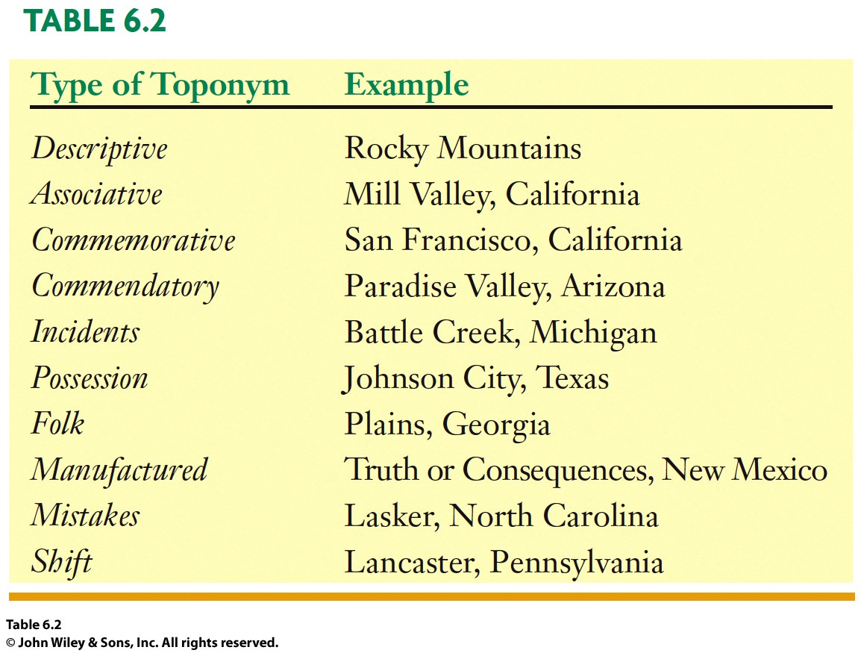
The Ten Toponyms
English Professor George Stewart

Slide 37
Toponyms and Globalization
The toponyms we see on a map depend in large part on who produced the map.
Some embattled locales have more than one name at the same time.
Ex.: Argentineans refer to a small cluster (archipelago) of islands off the southeast coast of South America as the Malvinas, but the British call the same cluster of islands the Falkland Islands.

Slide 38
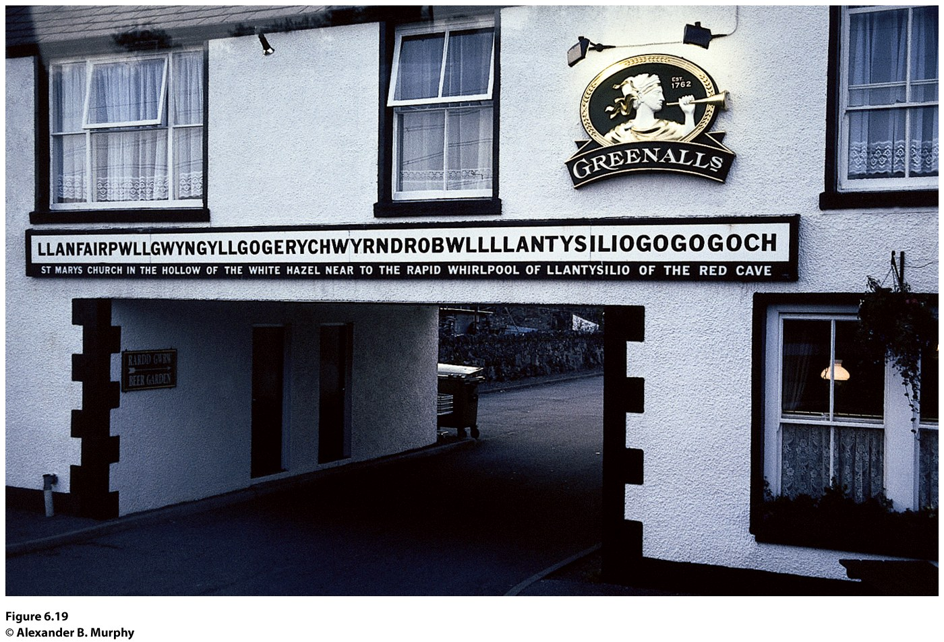
Changing Toponyms
When people change the toponym of a place, they have the power to “wipe out the past and call forth the new.”
Notes:
Figure 6.19
Llanfairpwllgwyngyllgogerychwyrndrobwllllantysiliogogogoch, Wales. The town with
the self-proclaimed longest name in the world attracts hordes of tourists each year to a place
whose claim to fame is largely its name. © Alexander B. Murphy.

Slide 39
Changing Toponyms
Postcolonial Toponyms: New governments renamed several countries and newly independent countries also changed the names of cities and towns to reflect their independence.
Postrevolution Toponyms: Changes in power through coups and revolutions prompt name changes.
Memorial Toponyms: People change a toponym to memorialize an important person or event.

Slide 40
This place was first named by Gabrielino Indians. In 1769, Spanish Franciscan priests renamed the place. In 1850, English speakers renamed the place. Do not use the Internet to help you. Use only maps in this book or in atlases to help you deduce what this place is. Maps of European exploration and colonialism will help you the most. Look at the end of the chapter summary for the answer.

Slide 41
Additional Resources
Bert Vaux’s Survey of American Dialects:
Learning Foreign Languages On-Line:
Resources on Geography Education:
Language, Diffusion, Toponyms,

