Slide 1

Human Geography: People, Place,
and Culture, 11th Edition

Slide 2

Chapter 4: Local Culture, Popular Culture, and Cultural Landscapes
Notes:
Figure 4.14
Beijing, China. RenRen, the Facebook of China, is a popular social network among college students. It now has over 165 million registered users. Wang Xing, who launched and sold Renren, has since launched Chinese versions of Twitter and Groupon. © Alamy Limited.

Slide 3
Key Question:
1. What are local and popular cultures?

Slide 4
Definitions of Culture
A culture is a group of belief systems, norms, and values practiced by a people.
A group of people who share common beliefs can be recognized as a culture in one of two ways:
  The people call themselves a culture.
  Other people (including academics) can label a certain group of people as a culture.

Slide 5
What Are Local & Popular Cultures?
Folk culture is small, incorporates a homogeneous population, is typically rural, and is cohesive in cultural traits.
Popular culture is large, incorporates heterogeneous populations, is typically urban, and experiences quickly changing cultural traits.

Slide 6
What Are Local & Popular Cultures?
A local culture is a group of people in a particular place who see themselves as a collective or a community, who share experiences, customs, and traits, and who work to preserve those traits and customs in order to claim uniqueness and to distinguish themselves from others.
Material culture of a group of people includes things they construct, such as art, houses, clothing, sports, dance, and food.
Nonmaterial culture includes beliefs, practices, aesthetics (what they see as attractive), and values of a group of people.

Slide 7

Hierarchical diffusion:
Can occur through a hierarchy of places
The hearth is the point of origin
Figure 4.2
London, United Kingdom. Catherine Middleton, Duchess of Cambridge, enters Westminster Abbey in a wedding gown reminiscent of Grace Kelly’s. Sarah Burton of the House of Alexander McQueen designed the gown. Members of the Royal School of Needlework hand cut and sewed the intricate lace. The sewers washed their hands every 30 minutes and replaced needles every 3 hours to keep the dress pristine and the work exact. © Samir Hussein/Wire Image.

Slide 8

Employing the concept of hierarchical diffusion, describe how you became a “knower” of your favorite kind of music—where is its hearth, and how did it reach you?

Slide 9
Key Question
2. How are local cultures sustained?

Slide 10
Cultural Assimilation
Assimilation: a policy of the U.S. government in the 1800s and into the 1900s to assimilate indigenous peoples into the dominant culture in order to make American Indians into “Americans” rather than “Indians.”
Canadians, Australians, Russians, and other colonial powers adopted similar policies toward indigenous peoples.
American Indians in the United States are working to push back assimilation and popular culture by reviving the customs of their local cultures.

Slide 11
Cultural Appropriation
Local cultures are sustained through customs, practices that a group of people routinely follow.
A local culture can also work to avoid cultural appropriation, the process by which other cultures adopt customs and knowledge and use them for their own benefit.
Local cultures desire to keep popular culture out, keep their culture intact, and maintain control over customs and knowledge.

Slide 12
Rural Local Cultures
Members of local cultures in rural areas often have an easier time maintaining their cultures because of their isolation.
When a local culture discontinues its major economic activity, it faces the challenge of maintaining the customs that depend on the economic activity and sustaining its culture.
Today, when a local culture decides to reengage in a traditional economic activity or other cultural custom, it can no longer decide in isolation.

Slide 13
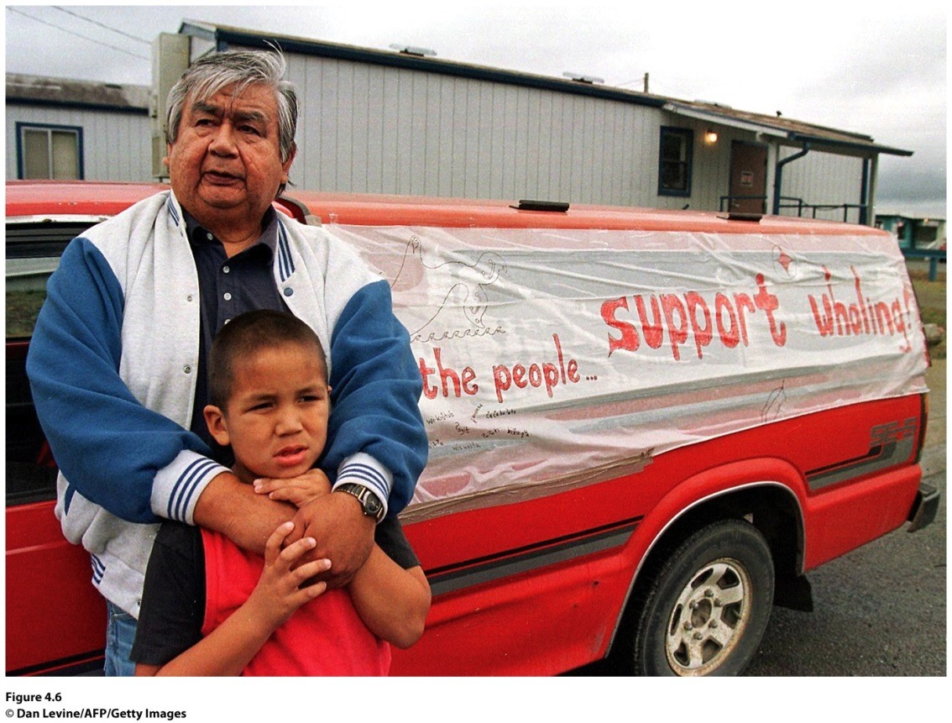
Case Study: The Makah American Indians
How Are Local Cultures Sustained?
Hunted whales for 1,500 years, but the U.S. government stopped them in the 1920s; the gray whale had become endangered.
1994, NOAA removed the eastern North Pacific gray whale from the endangered list.
Notes:
Figure 4.6
Neah Bay, Washington. Makah American Indians show their support for the return of the
whale hunt. ©

Slide 14
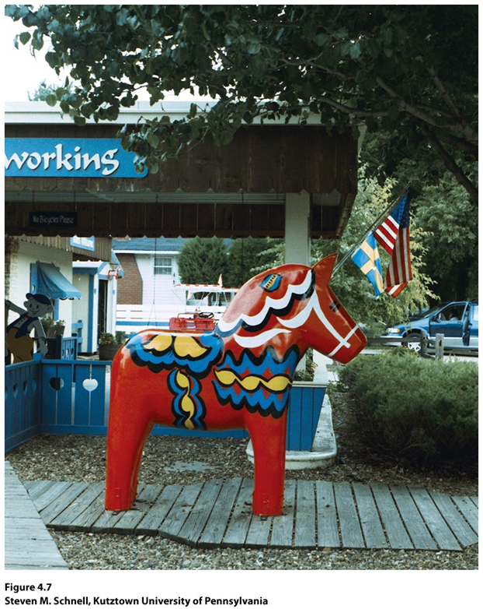
How Are Local Cultures Sustained?
Case Study: Little Sweden
Lindsborg, Kansas
In the 1950s, the townspeople began celebrating their Swedish heritage, the local culture of the Swedish immigrants.
Neolocalism seeking out the regional culture and reinvigorating it in response to the uncertainty of the modern world.

Slide 15
Cultural Commodification
the process where cultural elements become regarded as objects to be bought, sold or traded on the world market.
Ethnic Neighborhoods
Question of authenticity follows.

Slide 16
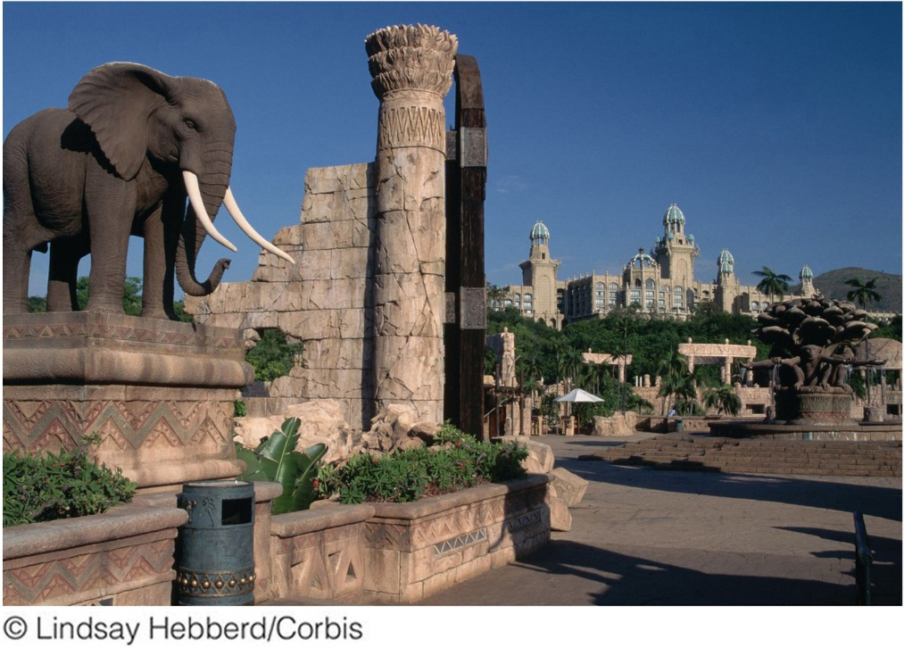
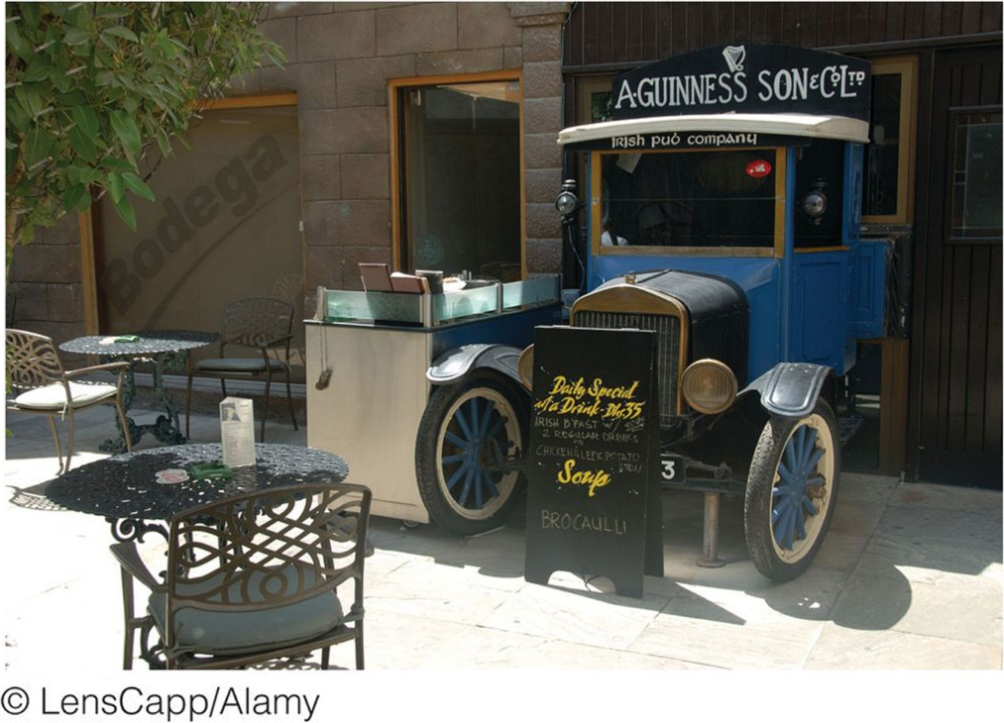
Authenticity of Places
How Are Local Cultures Sustained?
Guinness and the Irish Pub Company
The Lost City
Figure 4.9
Sun City, South Africa. The Lost City resort in Sun City evokes the mystical images of Africa described in a legend. © Lindsay Hebberd/Corbis.
Figure 4.10
Dubai, United Arab Emirates. An old Irish truck marks the entrance to an Irish Pub Company pub in Dubai. © Alamy.

Slide 17
What is the last place you went to or the last product you purchased that claimed to be “authentic?” What are the challenges of defending the authenticity of this place or product while refuting the authenticity of other similar places or products?

Slide 18
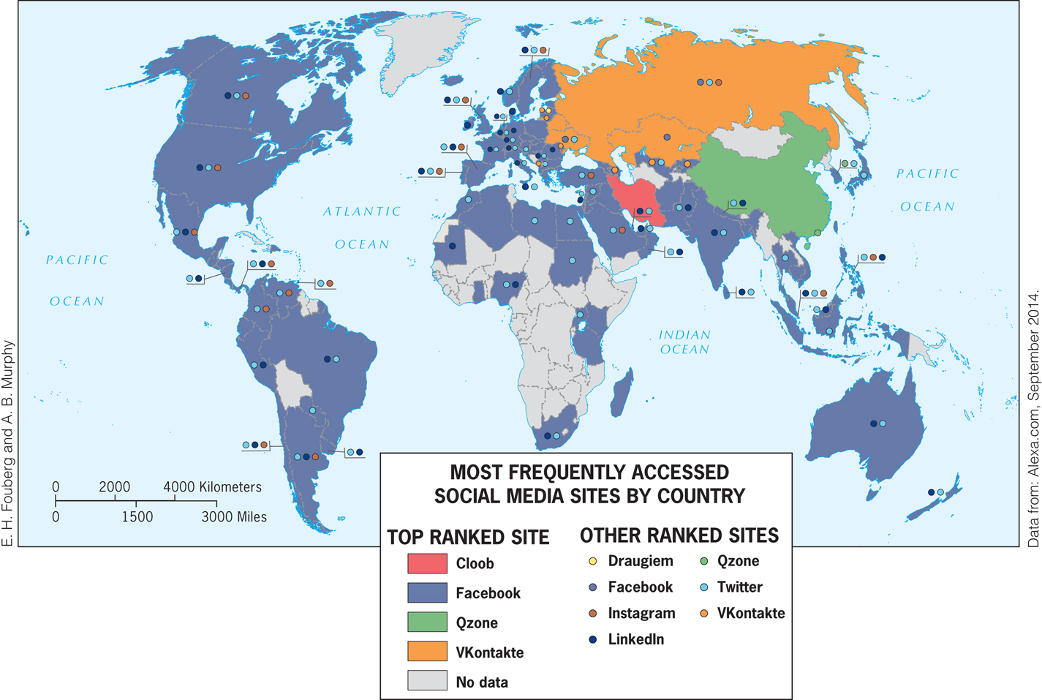
Key Question: 3
How is popular culture diffused?

Slide 19
Distance decay vs. time-space compression:
Distance decay, the likelihood of diffusion decreases as time and distance from the hearth increases.
Time–space compression, the likelihood of diffusion depends on the connectedness (in communications and transportation technologies) among places (geographer David Harvey).

Slide 20
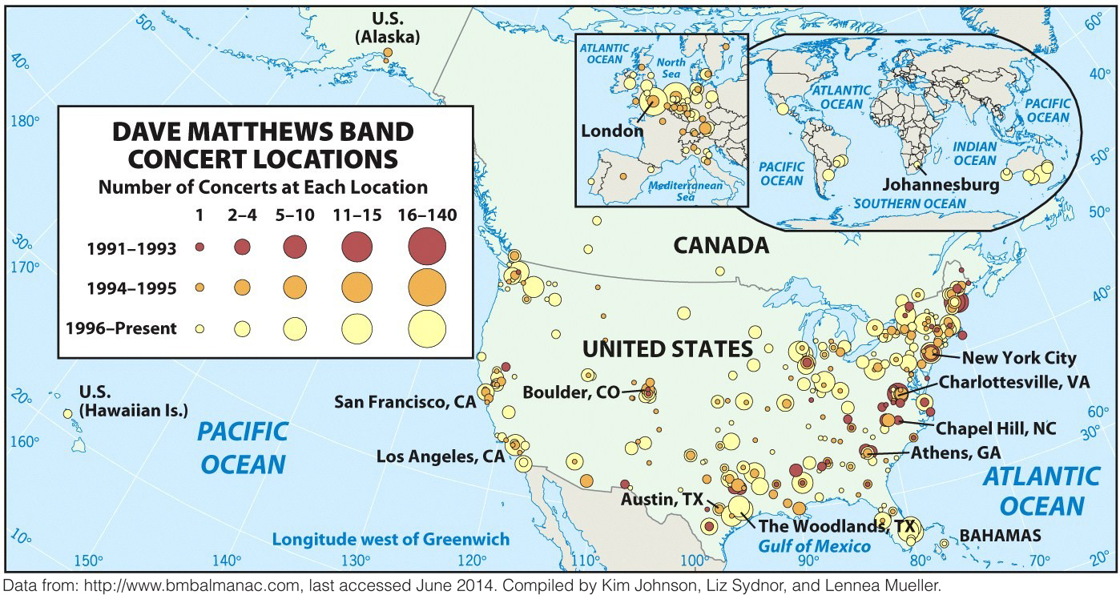
Hearths of Popular Culture
Establishing a Hearth
Contagious diffusion and hierarchical diffusion
Ex.: the Dave Matthews Band

Slide 21
Manufacturing a Hearth
Reterritorialization of popular culture: a term referring to a process in which people start to produce an aspect of popular culture themselves, doing so in the context of their local culture and place, and making it their own.
Ex.: reterritorialization of hip hop

Slide 22
Replacing Old Hearths with New: Beating out the Big 3 Sports
The Big 3: Football, Basketball, Baseball
Surfing (1960s)
Skateboarding (1970s)
Snowboarding (1980s)
Ultimate Fighting (1990s)
Corporations must create the “new” so that they have something to sell that is “socially desirable.”

Slide 23
Stemming the Tide of Popular Culture—Losing the Local?
At the global scale, North America, western Europe, Japan, India, and South Korea exert the greatest influence on popular culture at present
North America: movies, television, music, sports, and fast food
Japan: children’s television programs, electronic games, and new entertainment technologies
Western Europe: fashion, television, art, and philosophy
South Korea: television dramas, movies, and popular music
India: movies

Slide 24
Stemming the Tide of Popular Culture—Losing the Local?
The rapid diffusion of popular culture can cause consumers to lose track of the hearth of a good or idea.
When popular culture displaces or replaces local culture, it will usually be met with resistance.
Geographers realize that local cultures will interpret, choose, and reshape the influx of popular culture.

Slide 25
Think about your local community (your college campus, your neighborhood, or your town). Determine how your local community takes one aspect of popular culture and makes it your own.

Slide 26
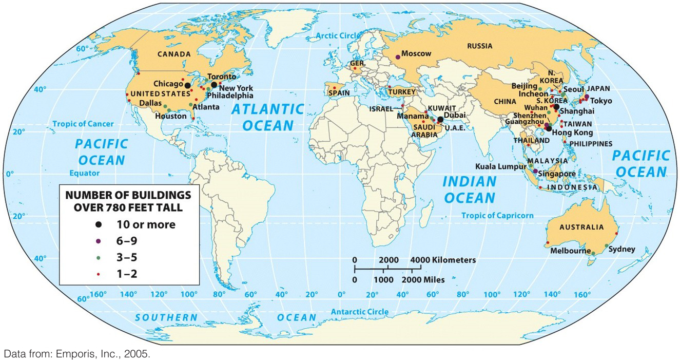
Key Question: 4
How can local & popular cultures be seen in the cultural landscape?

Slide 27
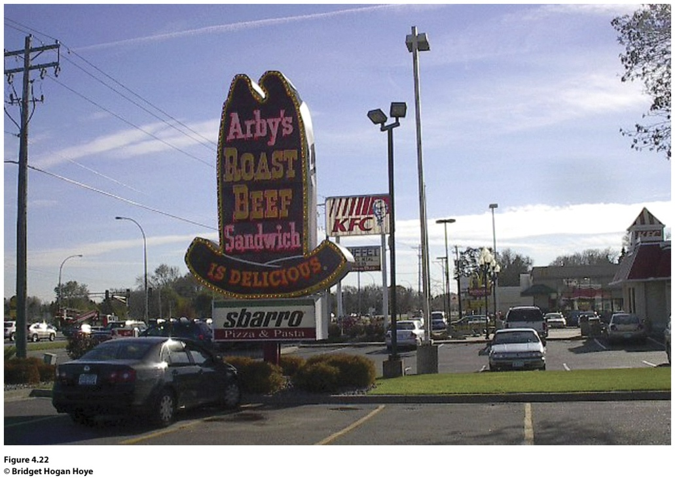
Cultural Landscape
The visible imprint of human activity on the landscape.
Placelessness: the loss of uniqueness of place in the cultural landscape to the point that one place looks like the next.
Figure 4.22
Roseville, MN

Slide 28
Cultural landscapes blend together in three dimensions
Particular architectural forms and planning ideas have diffused around the world.
Individual businesses and products have become so widespread that they now leave distinctive landscape stamp on far-flung places.
The wholesale borrowing of idealized landscape images promotes a blurring of place distinctiveness.

Slide 29
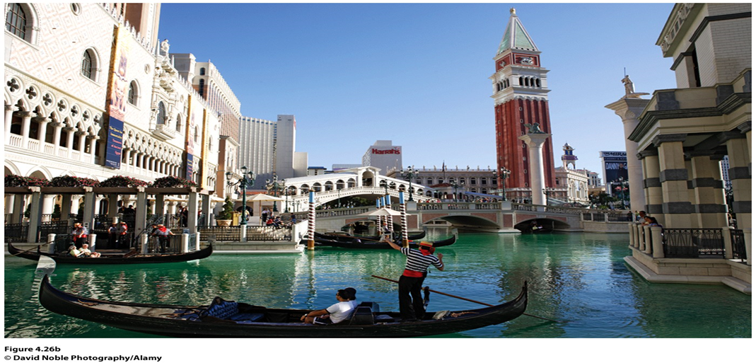
Global-local continuum concept:
emphasizes that what happens at one scale is not independent of what happens at other scales.
People in a local place mediate and alter regional, national, and global processes, in a process called glocalization.
Figure 4.26b
The Venetian Hotel Casino in Las Vegas, Nevada. © David Noble

Slide 30
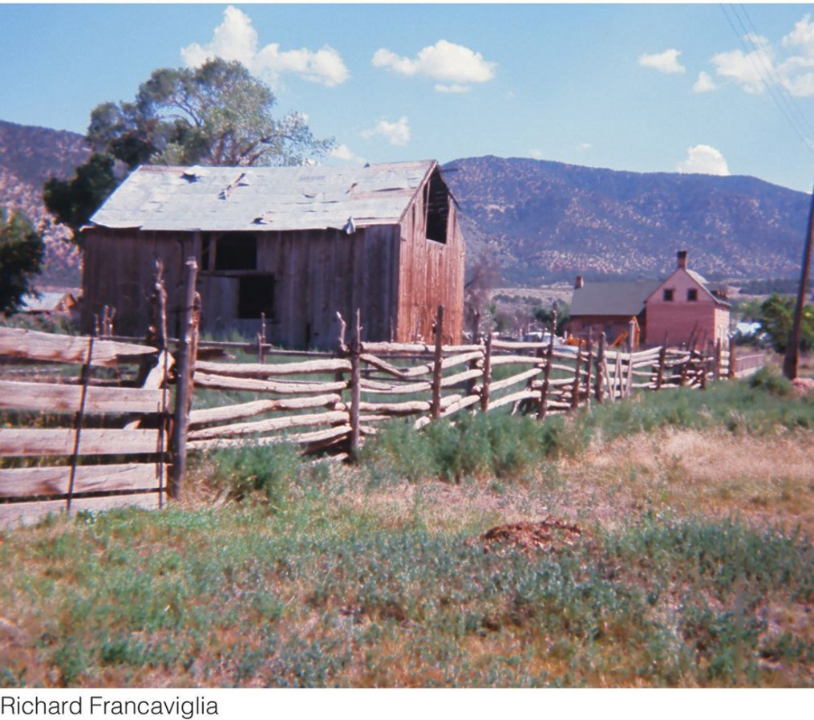

Cultural Landscapes of Local Cultures:
Case Study: The Mormon landscape of the American West:
  Early followers of LDS Church migrated westward under persecution.
  Early settlers established farming villages where houses clustered together and croplands surrounded the outskirts of the village.

Slide 31
Focus on the cultural landscape of your college campus. Think about the concept of placelessness. Determine whether your campus is a “placeless place” or whether the cultural landscape of your college reflects the unique identity of the place. Imagine you are hired to build a new student union on your campus. How could you design the building to reflect the uniqueness of your college?

Slide 32
Additional Resources
The Irish Pub Company www.irishpubcompany.com
The Makah Tribe www.makah.com
The City of Lindsborg www.lindsborg.org
The Hutterites www.hutterites.org
Related resources on Geography Education: Culture, Landscape, Folk Culture, Popular Culture

