Slide 1
Human Geography: People, Place,
and Culture, 11th Edition

Slide 2
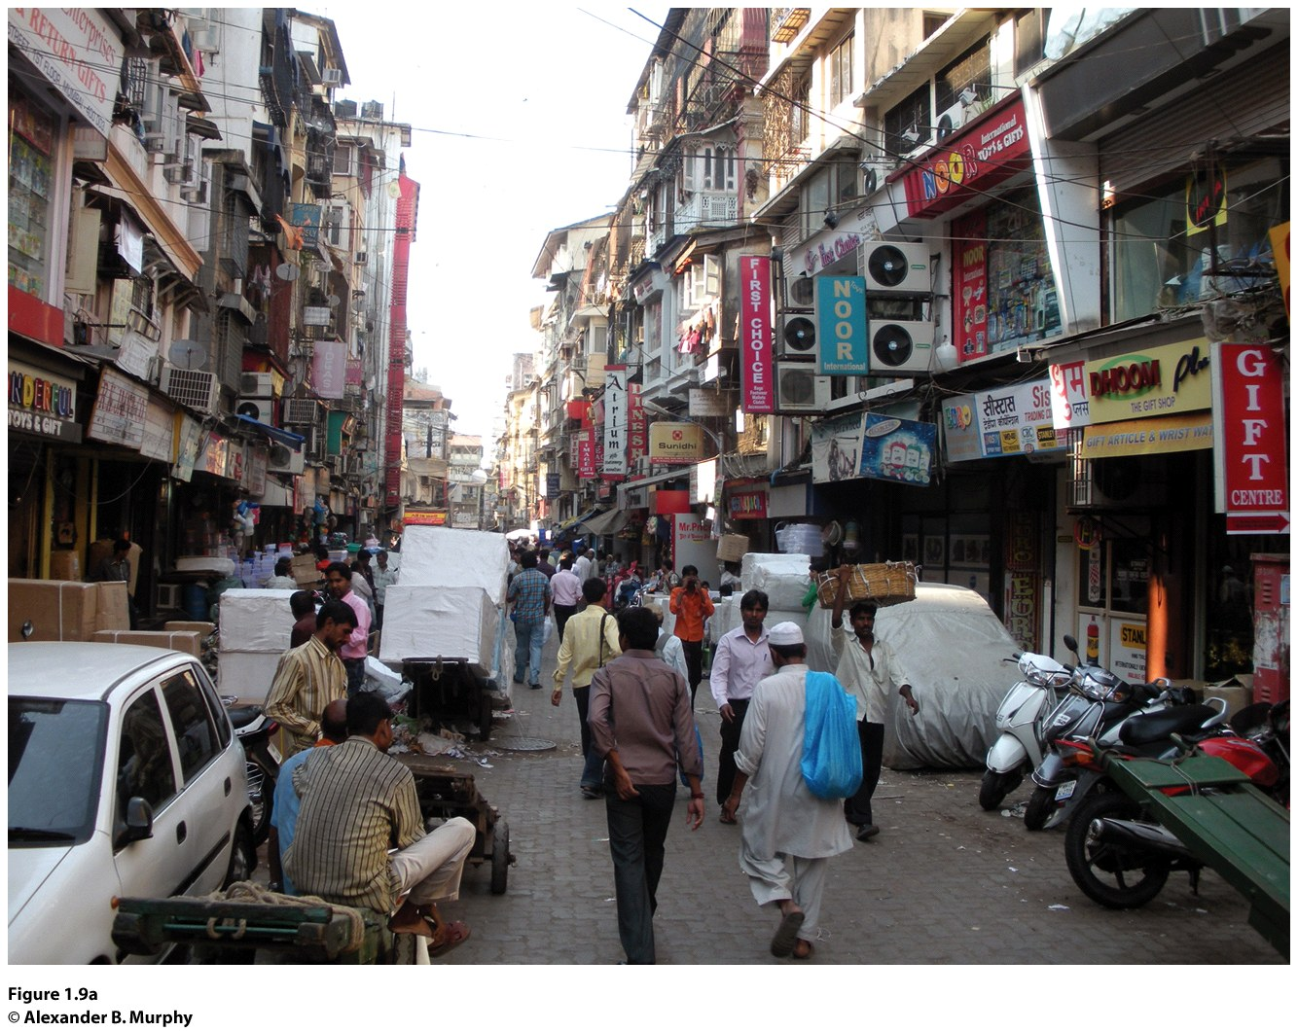
Chapter 1: Introduction to Human Geography
Mumbai, India

Slide 3
Key Question: What is Human Geography?
Human geography focuses on:
How people make places
How we organize space and society
How we interact with each other
How we make sense of ourselves and others

Slide 4
What Is Human Geography?
Advances in communication and transportation technologies are making places and people more interconnected.
Economic globalization and the rapid diffusion of elements of popular culture, such as fashion and architecture, are making many people and places look more alike.

Slide 5
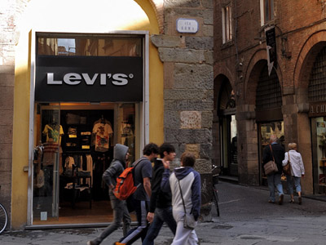
What Is Globalization?
Globalization: a set of processes that are increasing interactions, deepening relationships, and accelerating interdependence across national borders.
Concept Caching:
Levi’s in Lucca, Italy
© Jon Malinowski

Slide 6
What Is Human Geography?
Geographers employ the concept of scale to understand individual, local, regional, national, and global interrelationships.
What happens at the global scale affects the local, but it also affects the individual, regional, and national. Similarly, the processes at these scales influence the global.

Slide 7
Imagine and describe the most remote place on Earth you can think of 100 years ago. Now, describe how globalization has changed that place and how the people there continue to shape it and make it the place it is today.

Slide 8
Key Question: What are geographic questions?
Maps in the Time of Cholera-Pandemics
Medical geography: Mapping the distribution of a disease is the first step to finding its cause.
Dr. John Snow, a noted anesthesiologist in London, mapped cases of cholera in London’s Soho District in 1854 and found a link to contaminated water.

Slide 9
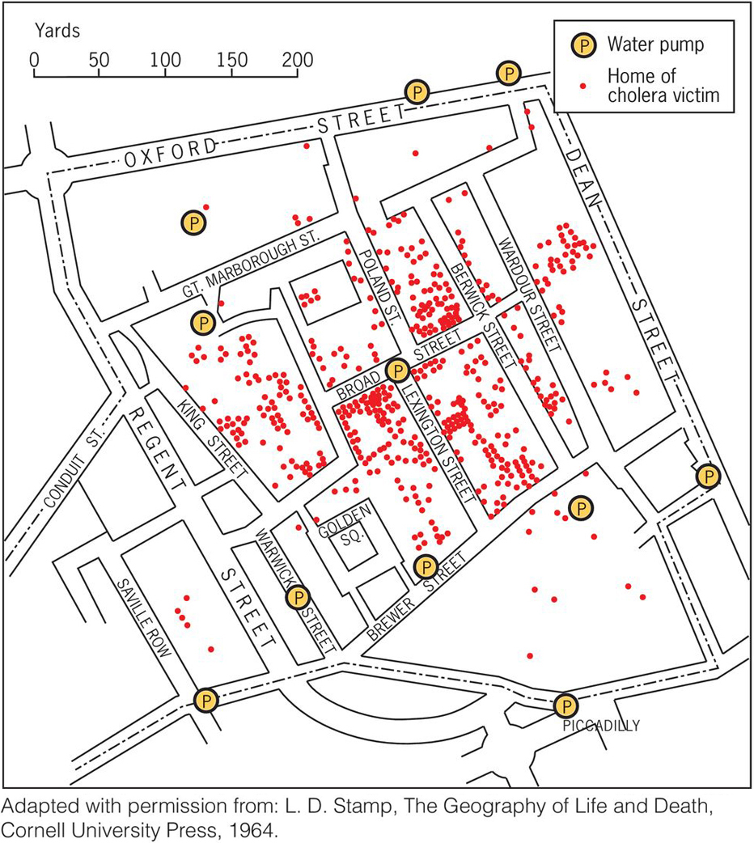
Colera
An ancient disease associated with diarrhea
and dehydration
Cholera has not been defeated completely.
We expect to find cholera in places that lack sanitary sewer systems and in places that are flood prone.

Slide 10
The Spatial Perspective
Immanuel Kant: We need disciplines focused not only on particular phenomena (such as economics and sociology) but also on the perspectives of time (history) and space (geography).
The five themes of geography
Cultural landscape

Slide 11
The Five Themes
The National Geographic Society introduced the five themes of geography in 1986.
The five themes were derived from geography’s spatial concerns.

Slide 12
First theme: Location
Highlights how the geographical position of people and things on Earth’s surface affects what happens and why
Helps to establish the context within which events and processes are situated

Slide 13
Second theme: Human-environment interactions
A spatial perspective invites consideration of the relationship between humans and the physical world.
Asking locational questions often means looking at the reciprocal relationship between humans and environments.

Slide 14
Third theme: Region
Features of the Earth’s surface tend to be concentrated in particular areas, which we call regions.
Understanding the regional geography of a place allows us to make sense of much of the information we have about places.

Slide 15
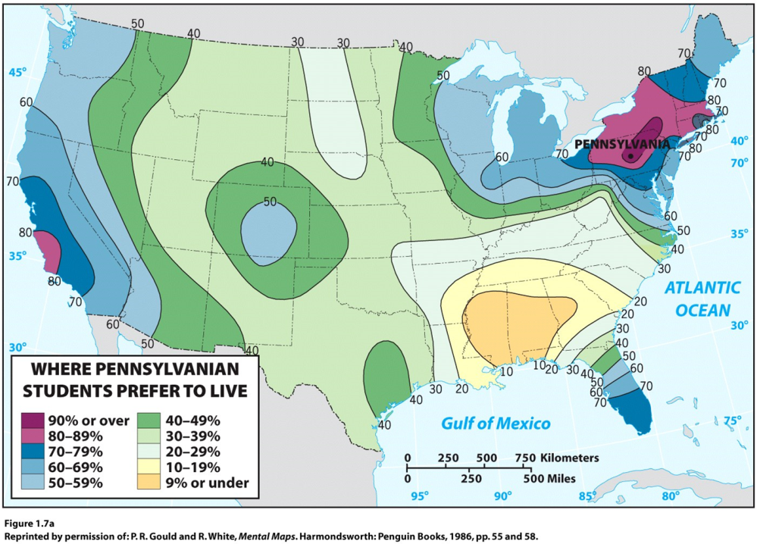
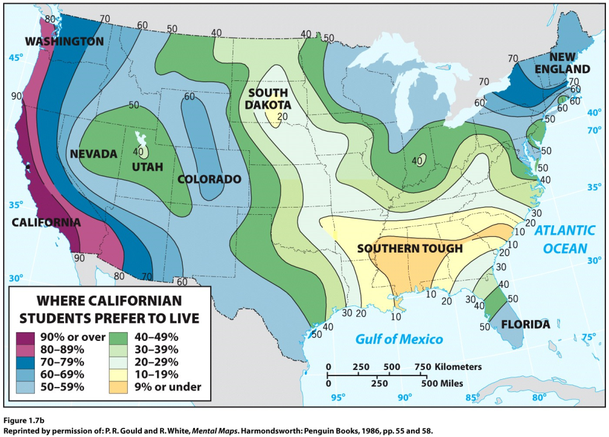
Fourth theme: Place
People develop a sense of place by infusing a place with meaning and emotion.
We also develop perceptions of places where we have never been through books, movies, stories, and pictures.

Slide 16
Fifth theme: Movement
Movement refers to the mobility of people, goods, and ideas across the surface of the planet.
Spatial interaction between places depends on:
The distances among places
The accessibility of places
The transportation and communication connectivity among places

Slide 17
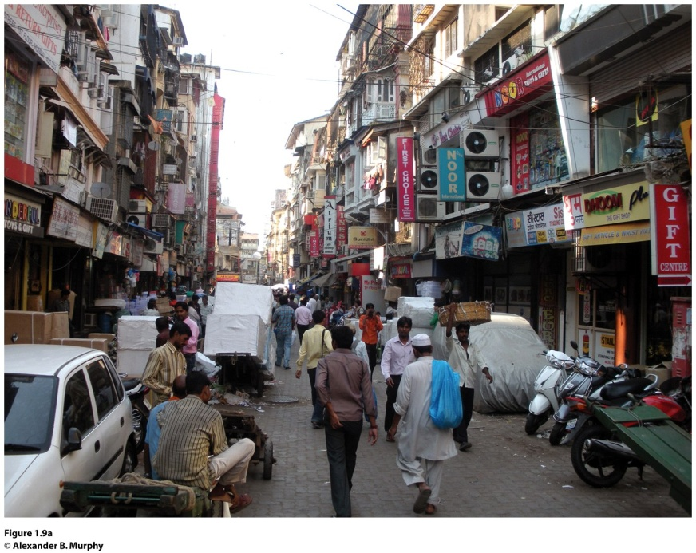
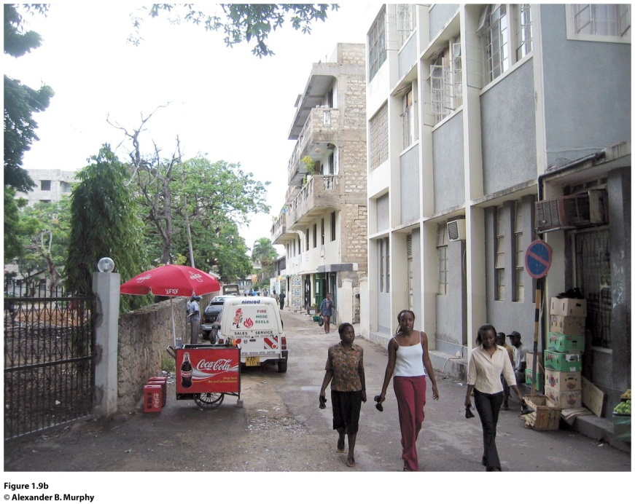
Sequent occupance refers to sequential imprints of occupants, whose impacts are layered one on top of the other, each layer having some impacts on the next.
Mumbai, India (left) and Dar-es-Salaam, Tanzania (right). Apartment buildings throughout Mumbai (formerly Bombay), India, are typically four stories with balconies. In Dar-es-Salaam, Tanzania, this four-story walkup with its laundry and other household items festooned on balconies and in doorways (right) stands where single-family African dwellings once stood, reflecting the sequential occupance of the city. © Alexander B. Murphy.
Notes:
Figure 1.9

Slide 18
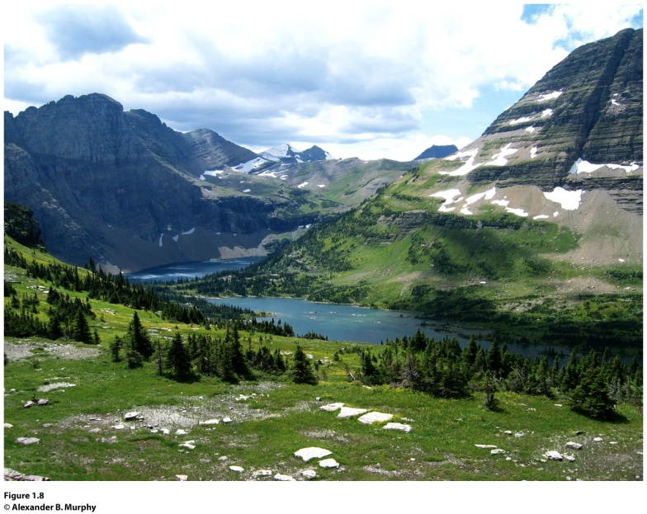
Field Note
“Hiking to the famed Grinnell Glacier in Glacier National Park brings one close to nature, but even in this remote part of the United States the work of humans is inscribed in the landscape. The parking lot at the start of the six-mile trail, the trail itself, and the small signs en route are only part of the human story. When I hiked around the turn in this valley and arrived at the foot of the glacier, I found myself looking at a sheet of ice and snow that was less than a third the size of what it had been in 1850. The likely reason for the shrinkage is human-induced climate change. If the melt continues at present rates, scientists predict that the glacier will be gone by 2030.”
Glacier National Park, United States
Notes:
*Could be an audio file.

Slide 19
Geographers who practice fieldwork keep their eyes open to the world around them and through practice become adept at reading cultural landscapes. Take a walk around your campus or town and try reading the cultural landscape. Choose one thing in the landscape and ask yourself, “What is that, and why is it there?” How might the existence of that thing influence the future development of the neighborhood? Take the time to find out the answers!

Slide 20
Key Question: Why do geographers use maps, and what do maps tell us?
Cartography: the art and science of making maps
Reference maps: show locations of places and geographic features
Thematic maps: tell stories, typically showing the degree of some attribute or the movement of a geographic phenomenon

Slide 21
Why Do Geographers Use Maps, and What Do Maps Tell Us?
Reference maps focus on accuracy in showing the absolute locations of places, using a coordinate system that allows for the precise plotting of where on Earth something is.
Satellite-based global positioning system (GPS) allows us to locate things on the surface of Earth with extraordinary accuracy.
Click here to view a description of NAVSTAR, the system of orbiting satellites designed for Global Positioning.

Slide 22
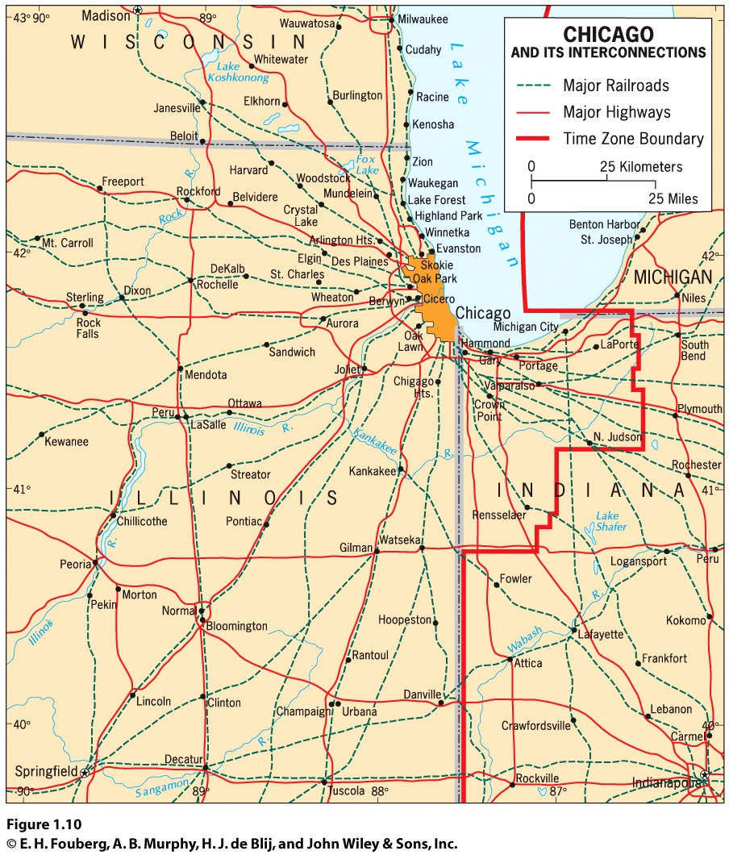
Why Do Geographers Use Maps, and What Do Maps Tell Us?
Thematic maps: tell stories showing the degree of some attribute or the movement of a geographic phenomenon.
Relative location: describes the location of a place in relation to other human and physical features

Slide 23
Why Do Geographers Use Maps, and What Do Maps Tell Us?
Absolute locations do not change.
Relative locations are constantly modified and change over time.

Slide 24
Mental Maps
Mental maps are maps in our minds of places we have been and places we have merely heard of.
Activity spaces are those places we travel to routinely in our rounds of daily activity.
Mental maps include terra incognita, unknown lands that are off limits.

Slide 25
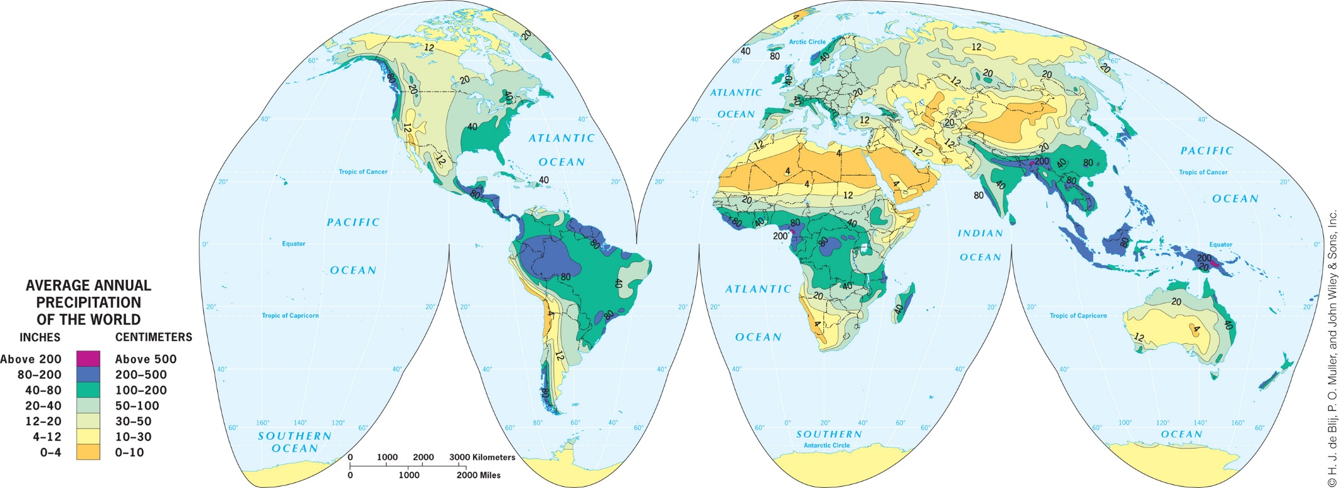
Why Do Geographers Use Maps, and What Do Maps Tell Us?
Generalization in Maps
Generalized maps help us see trends.

Slide 26
Remote Sensing and GIS
Geographers monitor Earth from a distance, using remote sensing technology that gathers data at a distance from Earth’s surface.
Remotely sensed images can be incorporated in a map, and absolute locations can be studied over time by plotting change in remotely sensed imagery over time.

Slide 27
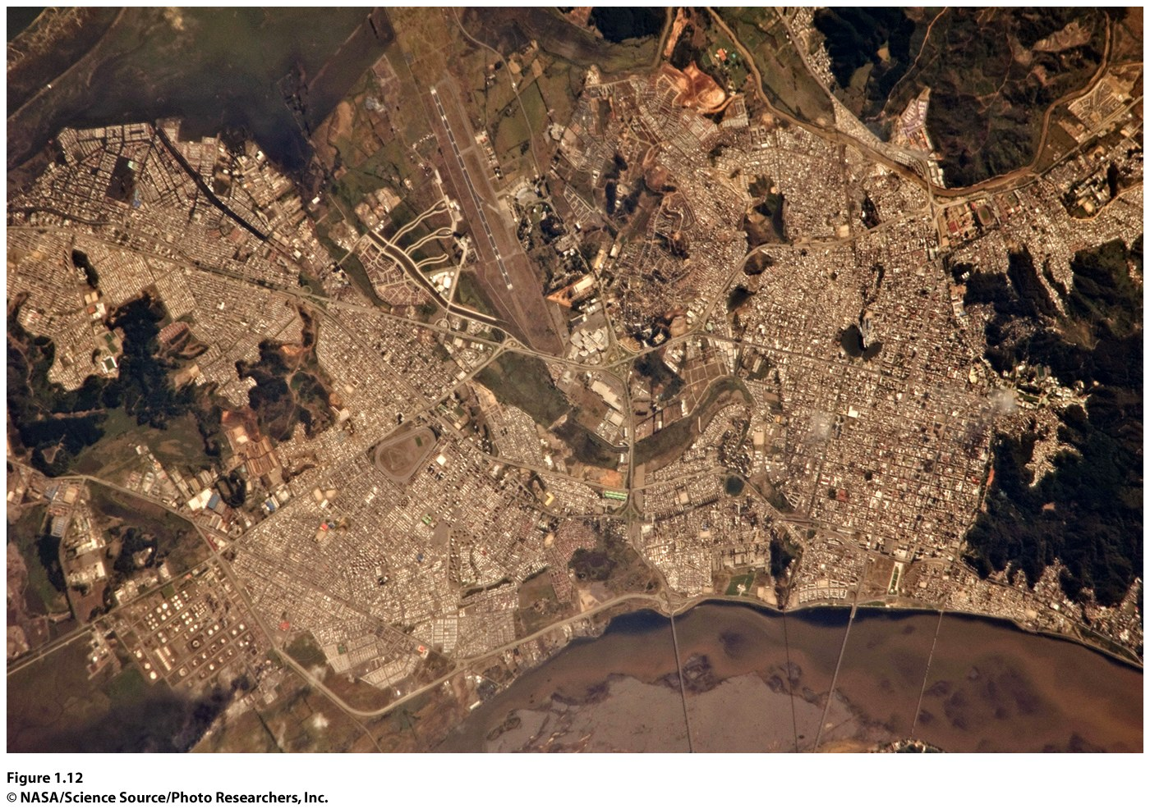
Figure 1.12 Concepcion, Chile.
Satellite image of the cities of Concepcion and Hualpen, Chile hours after an 8.8 magnitude earthquake occurred in 2010. The damage to the city is not noticeable in this satellite image except for the smoke plume from an oil refinery in the lower left corner.

Slide 28
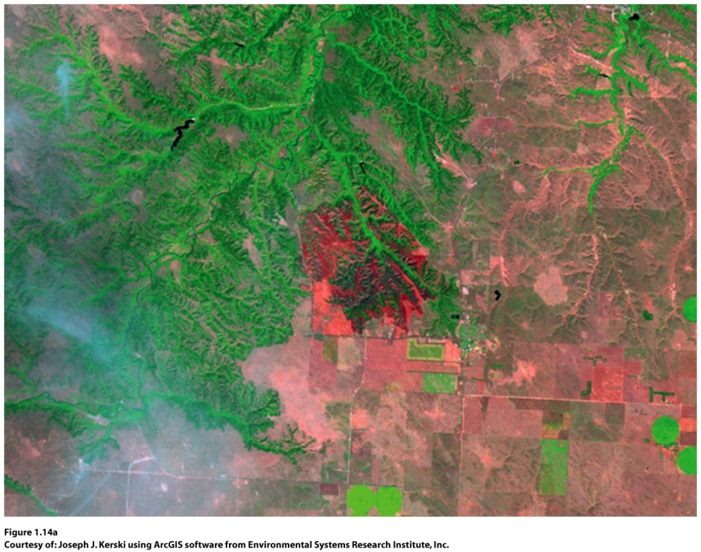
GIS (geographic information systems)
compare spatial data by creating digitized representations of the environment, combining layers of spatial data and creating maps in which patterns and processes are superimposed.
Notes:
Figure 1.14
Two Representations of St. Francis, South Dakota. (left) panchromatic raster satellite
image collected in 2002 at 10 m resolution during a grassland wildfi re; (right) vector data—
rivers, roads, cities, and land use/land cover digitalized from the image. Courtesy of: Joseph J.
Kerski using ArcGIS software from Environmental Systems Research Institute, Inc.

Slide 29
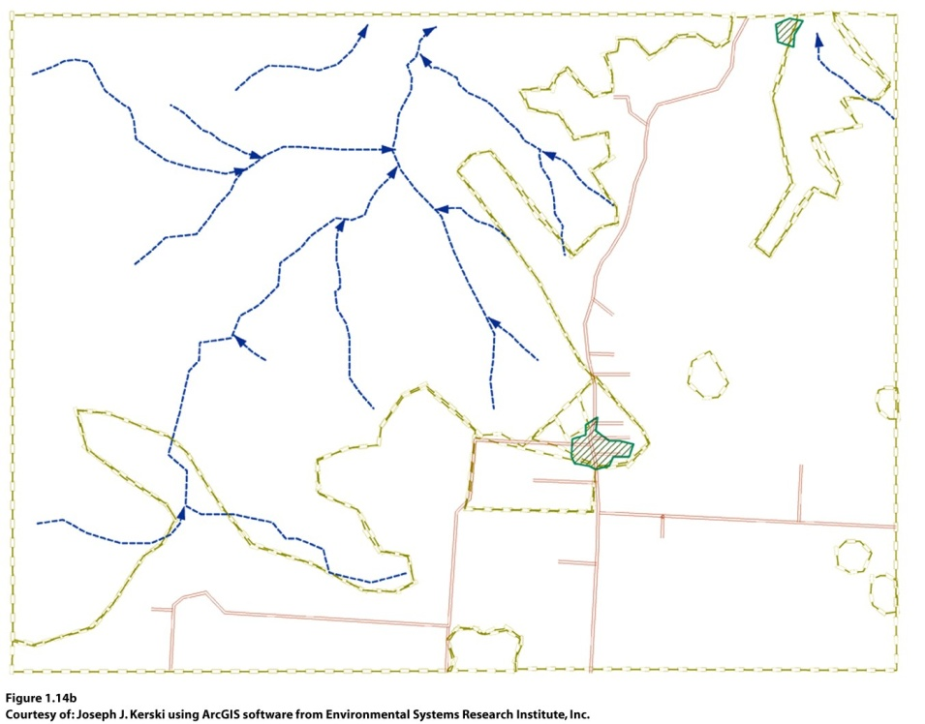
Remote Sensing and GIS
Geographers use GIS to analyze data.
Geographers use GIS in both human and physical geographic research.

Slide 30
Read the article on dengue fever in Brazil leading up to the 2014 World Cup. After reading the article, list and explain five layers of data you could add in ArcGIS Online to study the dengue outbreak in Brazil and predict where an outbreak will occur.

Slide 31
Remote Sensing and GIS
The amount of data digestible in a GIS, the power of the location analysis that can be undertaken on a computer platform, and the ease of analysis that is possible using GIS software applications allow geographers to answer complicated questions.
Geographic information science (GISci) is an emerging research field concerned with studying development and use of geospatial concepts and techniques to examine geographic patterns and processes.

Slide 32
Key Question: Why are geographers concerned with scale and connectedness?
Scale has two meanings in geography:
The distance on a map compared to the distance on the Earth
The spatial extent of something

Slide 33
Why Are Geographers Concerned with Scale and Connectedness?
Geographers’ interest in the scale involving the spatial extent of something derives from the fact that phenomena found at one scale are usually influenced by what is happening at other scales.
The scale of our research matters because we can make different observations at different scales.

Slide 34
Why Are Geographers Concerned with Scale and Connectedness?
The scale at which we study a geographic phenomenon tells us what level of detail we can expect to see.
Geographers’ concern with scale goes beyond an interest in the scale of individual phenomena to how processes operating at different scales influence one another.
Geographer Victoria Lawson: Jumping Scale: Politically rescaling activities

Slide 35
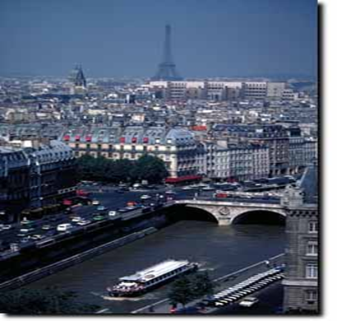
Regions
A formal region has a shared cultural or physical trait. Example: French-speaking region of Europe
In geography, a region constitutes an area that shares similar characteristics.
© Barbara Weightman

Slide 36
Other types of Regions
A functional region is defined by a particular set of activities or interactions that occur within it. Ex: the City of Chicago
Perceptual regions are intellectual constructs designed to help us understand the nature and distribution of phenomena in human geography.

Slide 37
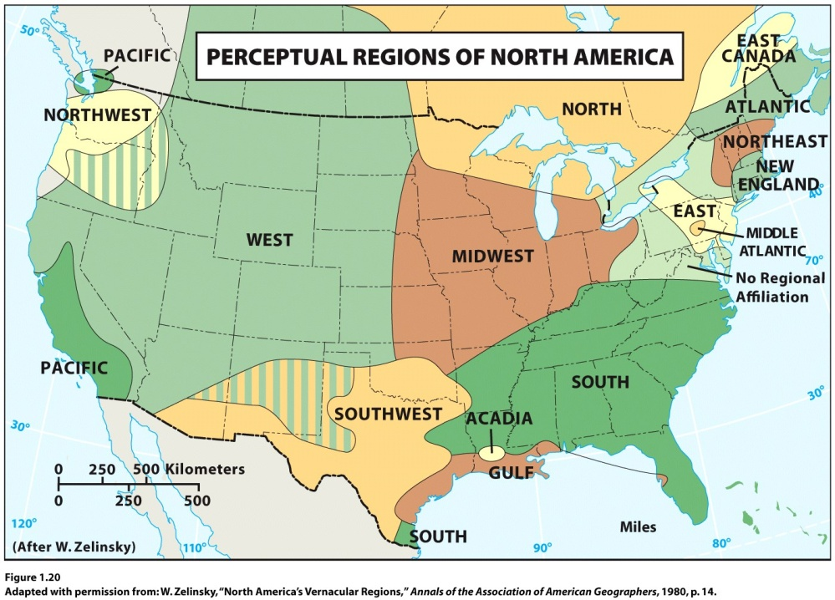
Other types of Regions
Perceptual Regions in the United States
Cultural geographer Wilbur Zelinsky identified 12 major perceptual regions on a series of maps in “North America’s Vernacular Regions.”
Concept Caching: Paris, France

Slide 38
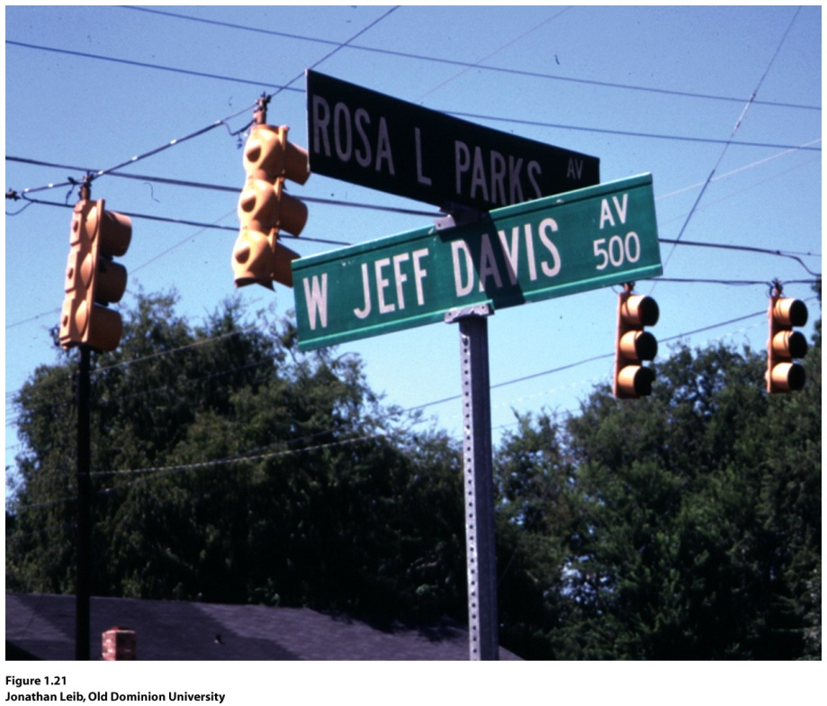
Guest Field Note
“Located in a predominately African American neighborhood in Montgomery, Alabama, the street intersection of Jeff Davis and Rosa Parks is symbolic of the debates and disputes in the American South over how the past is to be commemorated on the region’s landscape. The Civil War and civil rights movement are the two most important events in the history of the region.”
Montgomery, Alabama
Notes:
*Credit: Jonathan Leib, Old Dominion University

Slide 39
Culture
Culture is an all-encompassing term that identifies not only the whole tangible lifestyle of peoples but also their prevailing values and beliefs.
It is closely identified with the discipline of anthropology.
Cultural geographers identify a single attribute of a culture as a culture trait.

Slide 40
Culture
Culture complex: More than one culture may exhibit a particular culture trait, but each consists of a discrete combination of traits.
A cultural hearth is an area where cultural traits develop and from which cultural traits diffuse.
When a cultural trait develops in more than one hearth without being influenced by its development elsewhere, each hearth operates as a case of independent invention.

Slide 41
Connectedness through Diffusion
Expansion diffusion: when an innovation or idea develops in a hearth and remains strong there while also spreading outward.
Contagious diffusion: a form of expansion diffusion in which nearly all adjacent individuals and places are affected. Ex: Silly Bandz

Slide 42
Diffusion
Hierarchical diffusion is a pattern in which the main channel of diffusion is some segment of those who are susceptible to (or adopting) what is being diffused. Ex: Crocs footwear.
Stimulus diffusion: Not all ideas can be readily and directly adopted by a receiving population; yet, these ideas can still have an impact.

Slide 43
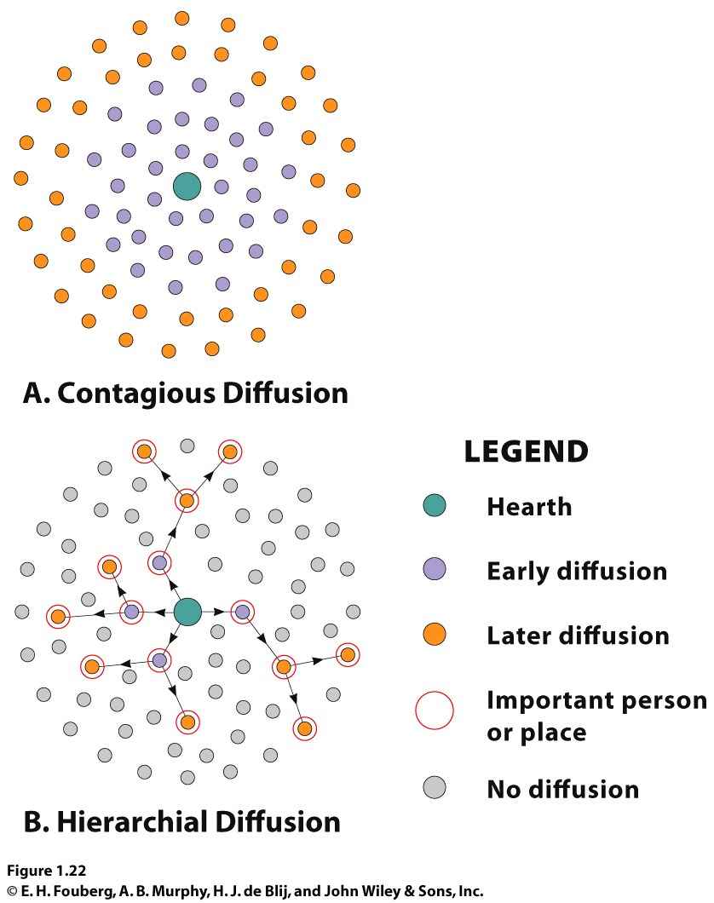

Slide 44
Relocation Diffusion
Occurs most frequently through migration
Involves the actual movement of individuals who have already adopted the idea or innovation, and who carry it to a new, perhaps distant, locale, where they proceed to disseminate it

Slide 45
Once you think about different types of diffusion, you will be tempted to figure out what kinds of diffusion are taking place for all sorts of goods, ideas, or diseases. Please remember that any good, idea, or disease can diffuse in more than one way. Choose a good, idea, or disease as an example and describe how it diffused from its hearth across the globe, referring to at least three different types of diffusion.

Slide 46
Key Question: What are geographic concepts, and how are they used in answering geographic questions?
Geographic concepts: Examples: place, relative location, mental map, perceptual region, diffusion, cultural landscape.
Geographers use fieldwork, remote sensing, GIS, GPS, and qualitative and quantitative techniques to explore linkages among people and places and to explain differences across people, places, scales, and times.

Slide 47
Rejection of Environmental Determinism
Environmental determinism holds that human behavior, individually and collectively, is strongly affected by, even controlled or determined by, the physical environment.
Geographers argued that the natural environment merely serves to limit the range of choices available to a culture.

Slide 48
Environmental Possibilism
Possibilism is the doctrine that the choices that a society makes depend on what its members need and on what technology is available to them.
Cultural ecology has been supplemented by interest in political ecology.

Slide 49
What Are Geographers Concepts, and How Are They Used in Answering Geographic Questions?
Possibilism
Cultural ecology: an area of inquiry concerned with culture as a system of adaptation to and alteration of environment
Political ecology: an area of inquiry concerned with the environmental consequences of dominant political economic arrangements and understandings

Slide 50
Today’s Human Geography
Encompasses many subdisciplines, including political geography, economic geography, population geography, and urban geography.
Human geography also encompasses cultural geography, which can be seen as a perspective on human geography as much as a component of it.

Slide 51
Choose a geographic concept introduced in this chapter. Think about something that is of personal interest to you (music, literature, politics, science, sports), and consider how whatever you have chosen could be studied from a geographical perspective. Think about space and location, landscape, and place. Write a geographic question that could be the foundation of a geographic study of the item you have chosen.

Slide 52
Additional Resources
Careers in Geography www.aag.org
http://www.bls.gov/opub/ooq/2005/spring/art01.pdf
Geocaching www.geocaching.org
Globalization and Geography www.lut.ac.uk/gawc/rb/rb40.html
John Snow and His Work on Cholera http://www.ph.ucla.edu/epi/snow.html
State of Food Insecurity in the World www.fao.org
World Hunger www.wfp.org
Google Earth www.googleearth.com
Related resources on Geography Education:
Location, Place, Mapping, GIS, Spatial, Diffusion, Regions

Slide 53
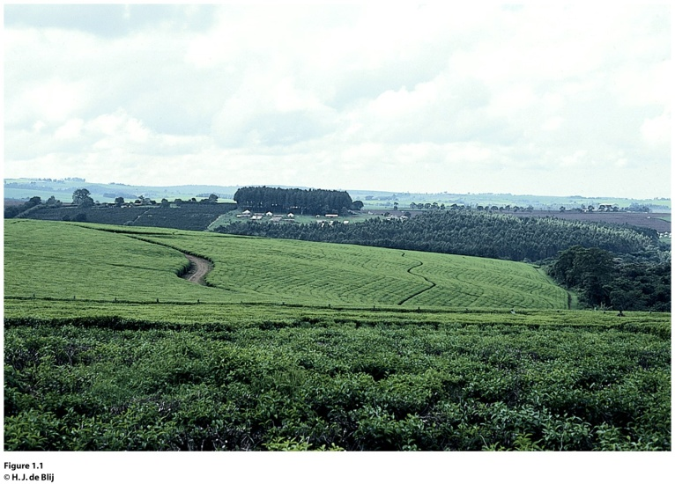
Field Note: Awakening to World Hunger
“Dragging myself out of bed for a 9:00 a.m. lecture, I decide I need to make a stop at Starbucks. “Grande coffee of the day, please, and leave room for cream.” I rub my eyes and look at the sign to see where my coffee was grown. Kenya. Ironically, I am about to lecture on Kenya’s coffee plantations. Just the wake-up call I need. When I visited Kenya in eastern Africa, I drove from Masai Mara to Kericho and I noticed nearly all of the agricultural fields I could see were planted with coffee or tea (Fig. 1.1). I also saw the poor of Kenya, clearly hungry, living in substandard housing. I questioned, “Why do farmers in Kenya grow coffee and tea when they could grow food to feed the hungry?” Trying to answer such a question sheds light on the complexities of globalization. In a globalized world, connections are many and simple answers are few.”
Concept Caching: Kericho, Kenya
Notes:
*Could be an audio file.

Slide 54
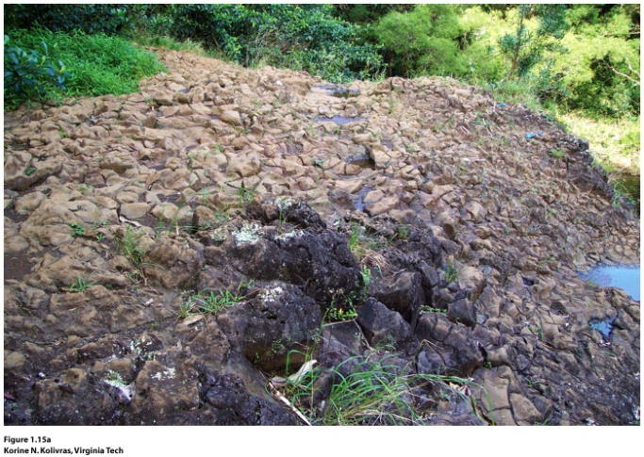
Guest Field Note
The diffusion of diseases carried by vectors, such as the Aedes mosquito that transmits dengue, is not solely a result of the environmental factors in a place. I use disease ecology to understand the ways in which environmental, social, and cultural factors interact to produce disease in a place.
Maui, Hawaii
Through a combination of fieldwork and geographic information systems (GIS) modeling, I studied the environmental habitat of the Aedes mosquito in Hawaii and the social and cultural factors that stimulated the outbreak of dengue in Hawaii. When I went into the field in Hawaii, I observed the diversity of the physical geography of Hawaii, from deserts to rainforests. I saw the specific local environments of the dengue outbreak area, and I examined the puddles in streams (Fig. 1.15A) in which the mosquitoes likely bred during the 2001–2002 dengue outbreak.
Notes:
Credit: Korine N. Kolivras, Virginia Tech

Slide 55
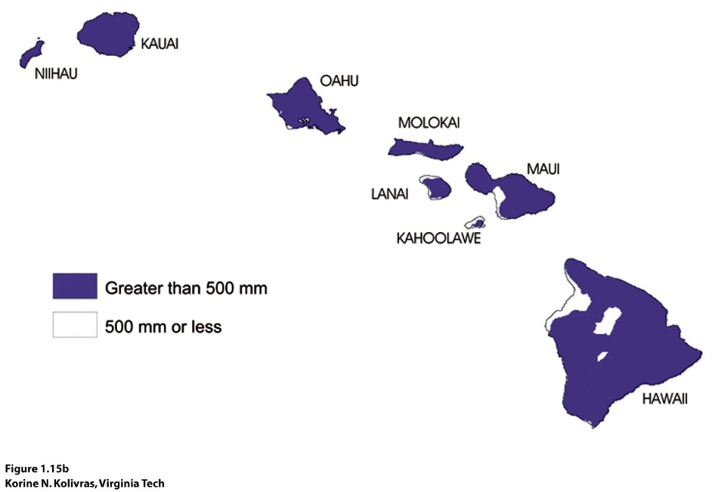
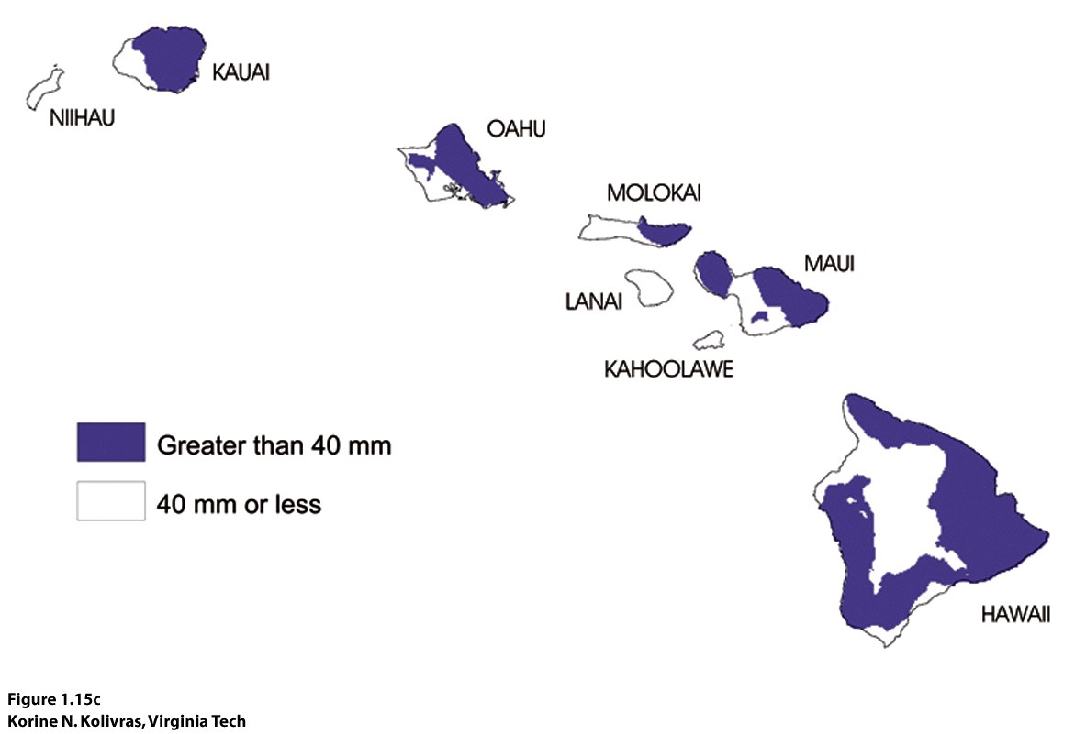
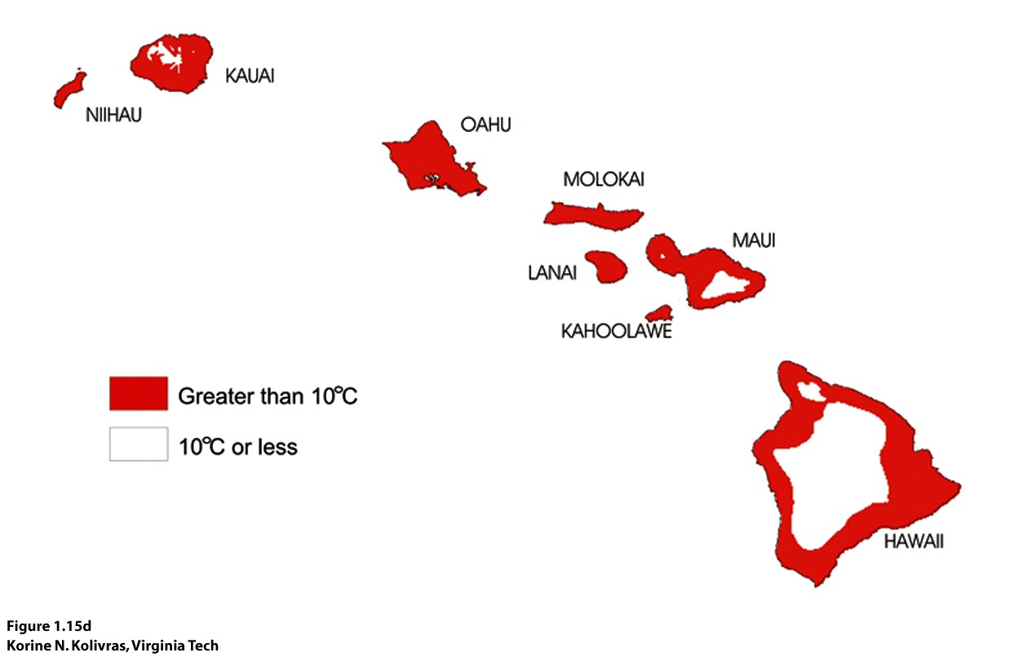
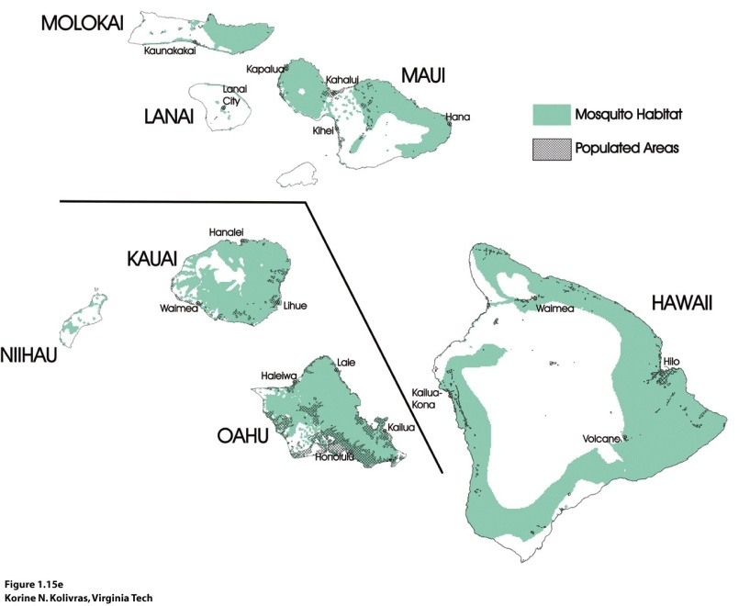
Figure 1.15B. Total annual precipitation
Figure 1.15C. Average June Precipitation
Figure 1.15D. Average February minimum temperature
Figure 1.15E. Dengue potential areas

